Slide 1

3D Object Recognition and Pose Estimation From Point Cloud Using Stably Observed Point Pair Feature
The presentation was prepared by students: Dubov Leonid,
Mansurov Roman.
Samara, 11.04.24

Slide 2


Goals
Project objectives:
- Collection and preparation of data
- Development of recognition algorithms
- Development of object observation algorithms
- Quality assessment
2

Slide 3

Content
1. Goals
2. Introduction
3. Methods of work
4. Results of experiments
5. Evaluation of criteria
6. Discussions
7. Conclusion
3

Slide 4

Introduction
3D object recognition is a popular topic in computer vision with numerous applications including robotics, biometrics.
4

Slide 5
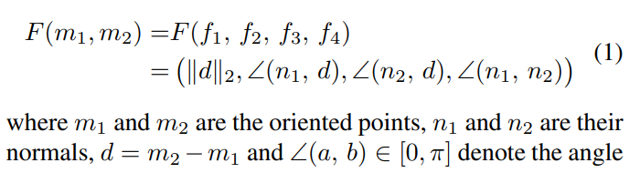
Methods of work
1. PPF METHOD
The PPF approach is a voting-based algorithm combining a hash table and efficient voting. In this section, we give a brief description of the PPF method. The point pair feature F(m1, m2) that describes the relative position and orientation of the oriented points is invariant to rigid motions. It’s defined as
5

Slide 6
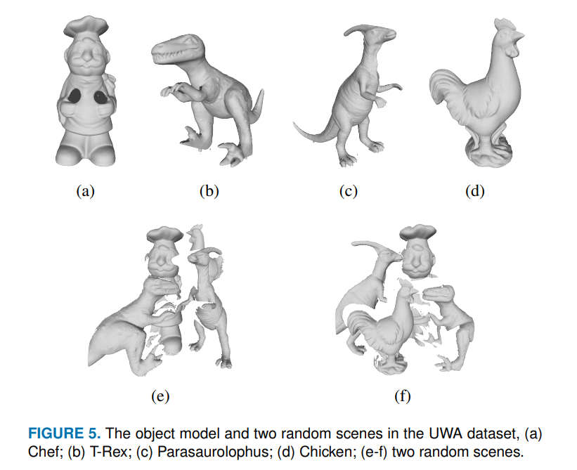
Methods of work
2. THE UWA DATASET
The UWA dataset contains five object models with full viewpoints and fifty scenes at specific viewpoints. The detected objects are depicted in Fig. 5.
6

Slide 7
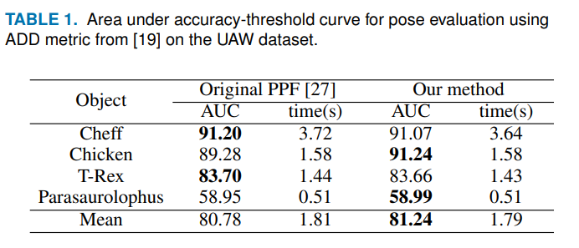
Results of experiments
In this section, we compare our proposed method with the original PPF method in the UWA dataset, the synthetic dataset and the real dataset.
7

Slide 8

Discussions
Advantages and disadvantages of using the function of a stably observed pair of points for recognizing and evaluating the position of 3D objects.
Comparative analysis with other methods of recognizing and estimating the position of 3D objects from a point cloud
Using the function of a stably observed pair of points for the task of navigation and localization in real time.
8

Slide 9

Conclusion
- We propose a novel strategy to build a global model description based on point pair features and Hough- like voting.
We analyze the observability of the model points according to the multiview rendering strategy and extract point pair features from stably observed points.
The experimental results on UWA, synthetic and real scene datasets demonstrate that the proposed method achieves a better trade-off between speed and recognition performance.
9

Slide 10

По желанию – личные контактные
данные автора,
телефон,
e-mail

