Slide 1
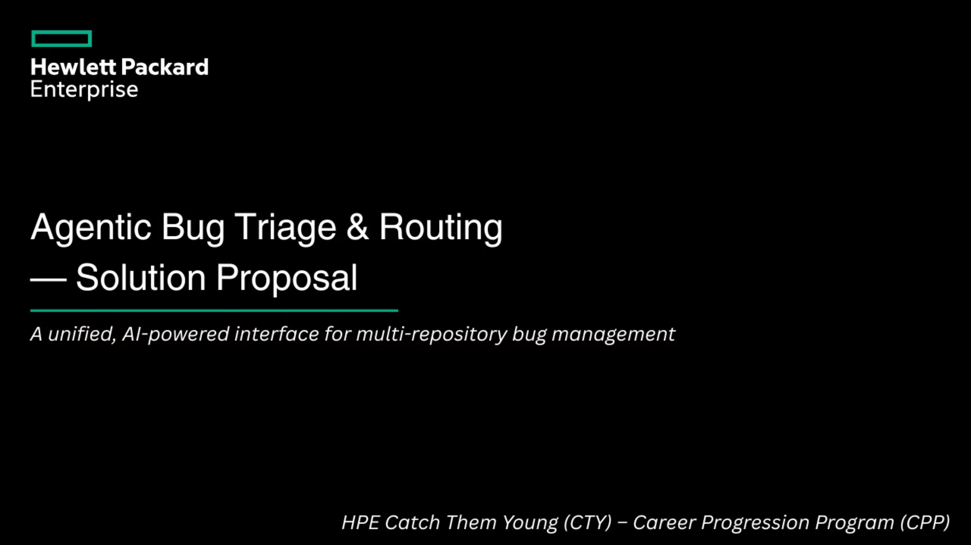

Slide 2
1. Problem Statement
Context: HPE manages hybrid cloud solutions across servers, storage, networking, and software. Each product area is owned by a different engineering team, each using a different bug tracking system.
1.1 The Core Problem
Read and interpret each bug report manually across disconnected systems
Identify which components are affected — with no AI assistance
Duplicate and copy-paste tickets between JIRA, Bugzilla, and GitHub — causing context loss
Track resolution across each team's separate tracker with no consolidated view
Manually piece together a status update for the customer from multiple systems
1.2 The Four Fragmentation Problems
Problem
Impact
Scattered data
Engineers must search across JIRA Cloud, JIRA On-Prem, and Bugzilla separately to understand the state of a single customer problem. There is no single pane of glass.
No Unified View
Customers and executives have no single status page. Each team gives separate, inconsistent updates.
Manual triage & routing
Incoming bugs often end up in the wrong repository. Engineers manually reclassify and re-file them. This wastes time and increases error rates.
Lost lineage & context
When a bug is copied or reclassified into another system, the relationship between the original and the new ticket is not maintained, leading to inconsistent tracking.
1.3 Example Scenario
"Customer reports: 'I cannot create a VM in our private cloud.' The failure could be caused by storage (disk quota), server (hypervisor timeout), or networking (vSwitch failure) — or all three simultaneously. Today: 3 separate engineers manually file 3 separate tickets with no linkage. Resolution time: 20-30 minutes per bug. With our system: fully automated in under 10 seconds."

Slide 3
2. Proposed Solution
2.1 The Core Idea
Build an agentic, multi-repository bug management system that acts as a single unified interface for all bug-related workflows — create, read, update, delete — irrespective of where the bug actually lives.
"One customer submission → AI identifies all affected components → tickets created in all relevant trackers simultaneously → one unified view shows every ticket's status across all systems."
2.2 What the System Does
Multi-repository write: One bug submission automatically creates tickets in JIRA Cloud, JIRA OnPrem, and Bugzilla simultaneously based on which components are affected.
Consolidated unified view: One screen shows the status of all tickets for one customer problem. The customer sees a plain-English ETA, not three separate ticket numbers.
Federated search: Engineers search from one place. Results come from all trackers merged and ranked. No context switching.
Automated classification and routing: The LLM reads the bug description, identifies which HPE components are affected, and routes to the correct teams automatically using a configurable routing table.
Lineage preservation: When a bug is copied or routed to multiple systems, the relationship is stored. Every ticket links back to the original customer case.

Slide 4
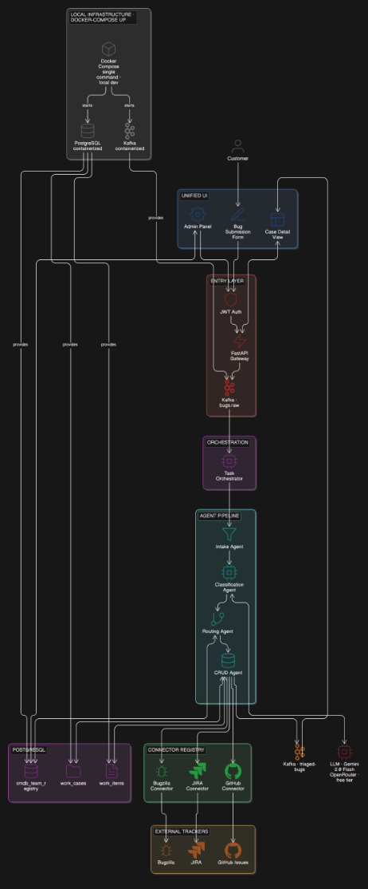
3. POC Architecture
Customer fills form → FastAPI receives → Kafka queues → Intake normalises → LLM classifies + identifies components → Routing looks up CMDBTeamRegistry → CRUD creates tickets in parallel (JIRA + Bugzilla) → Unified UI shows all tickets for one case → Engineer searches across all systems from one box

Slide 5
4. Future Scope — Post-POC / Production Grade
The POC proves the core loop. Everything below is designed, documented, and architecturally ready. Each item has a clear trigger for when it becomes necessary.
Component
When to add
What it enables
Redis cache
When monitoring tools fire the same alert 100+ times/day
Classification results cached 5 min. LLM cost drops 90%. Same bug, instant response.
Enrichment Agent
After core pipeline is stable
LLM receives KB articles alongside bug description. Classification accuracy improves.
Similarity / dedup Agent
After 4+ weeks of production data
Finds semantically similar past bugs. Monitoring alert deduplication — 500 alerts → 1 ticket.
Neo4j lineage graph
When multi-hop relationship traversal is needed
Complete forensic audit trail. Relationship based queries in milliseconds.
Elasticsearch
When semantic search across historical data is needed
Meaning-based search. 'Find bugs like this one' without shared keywords.
SLA Agent
Before going to production customer traffic
Automated deadline tracking.
Refinement Agent
After 2+ months of correction data
Pattern detection. Auto-updates routing rules when engineers correct the same mistake 5+ times.
OpenTelemetry + Grafana
When you have 5+ services to debug across
Distributed traces. Find any failure across all agents in under 30 seconds.
Kubernetes + HPA
When Docker Compose is the bottleneck
Orchestrator scales 1→10 pods under load. Zero-downtime deployments. HPA manifests ready now.
MCP protocol
When 10+ external systems connect dynamically
Runtime tool discovery. New trackers register without restarting orchestrator.

Slide 6
5. Execution Timeline — 6 Weeks
Week 1
Infrastructure + entry layer
Docker Compose: postgres + backend + frontend + kafka; PostgreSQL schema (all 4 tables + seed CMDB); FastAPI gateway: POST /bugs, GET /bugs/{id}, GET /search; JWT auth with 3 roles
POST /bugs returns 202. Row in DB.
Week 2
Orchestrator + Intake + Classification
Task orchestrator: state machine, retry, circuit breaker; Intake Agent: normalise, UUID, keywords; Classification Agent: LLM API + retry + fallback
Bug classified with severity + components in DB.
Week 3
Routing + CRUD + Connectors
Routing Agent: CMDB lookup, hard policies; CRUD Agent: Outbox idempotency; JIRA Cloud connector (real REST API); Bugzilla connector (real or mock)
Real JIRA ticket created. Outbox prevents duplicate on retry.
Week 4
Unified UI
Submit bug page with real-time classification result; Case detail page: all tickets, all statuses, persona views; Dashboard: list all cases, filter by severity/status
End-to-end: form to unified view works.
Week 5
Federated search + admin panel
Federated search: parallel calls to JIRA + Bugzilla, merged results; Admin panel: live CMDB edit (the routing change demo)
Search returns results from all systems. Live routing change works.
Week 6
Polish + demo prep
Edge cases: JIRA down, LLM slow, bad input handled; Docker Compose verified on clean machine; K8s manifests written and ready to show; Demo script rehearsed 3+ times
Full demo runs cleanly 3 times in a row.

Slide 7
6. POC Demo
The demo proves every architectural claim with live behaviour. Each moment corresponds to a specific design decision.
Moment
Action
What it proves
Multi-repo write
Submit 'VM creation fails'. Watch orchestrator logs run 4 agents. Show JIRA ticket STO-108 + Bugzilla BZ-302 created.
Core value: one submission → multiple trackers. No manual filing.
Unified view
Open case detail page. Show all tickets, all teams, all statuses in one screen. Switch persona views (customer vs engineer).
Single pane of glass. Customer sees ETA. Engineer sees ticket links + reasoning.
Live routing change
In admin panel: change NetworkTeam tracker from Bugzilla to JIRA. Submit network bug. Watch it go to JIRA instead.
Routing as configuration. One SQL update, zero code change, immediate effect.
Federated search
Search 'VM provisioning'. Results from JIRA + Bugzilla merged. Each result shows which system it came from.
Single search box across all systems. No context switching.

Slide 8
7. Comparison b/w POC & Future Scope
What the POC delivers
What is designed and ready for production
One bug submission creates tickets in all affected trackers simultaneously
AI identifies which teams own which components — no manual guessing
One unified view shows every ticket's status across all trackers
Federated search across all bug systems from one search box
Live routing configuration — change trackers without touching code
Full 10-agent pipeline with Neo4j lineage, Elasticsearch similarity, Refinement loop
Kubernetes + HPA autoscaling manifests written and demonstrable
Full security stack: Vault, HMAC, prompt injection defence, PII masking
Complete observability: OpenTelemetry, Grafana, Arize Phoenix
Multi-LLM backend support: Claude, GPT-4o, Bedrock, Ollama

