Slide 1

Agentic Bug Triage & Routing
Hewlett Packard Enterprise
— Mid Review
Architecture Design & Study Phase Learnings

Slide 2
Bug Triaging — The Problem Today
What is Bug Triaging?
Real Example at HPE
Customer reports: "I cannot create a VM in my private cloud." Root cause could be storage, compute, networking — or all three.
Today: 3 engineers, 3 systems, 3 tickets, zero connection. Resolution time: 20–30 minutes per bug.
Reading a bug report and deciding severity, ownership, and destination system
Done manually today by HPE engineers across multiple platforms
Works at small scale — breaks completely at enterprise scale
•
•
The 4 Core Pain Points
Scattered Data
Engineers open JIRA, Bugzilla, GitHub separately just to understand one bug. No single view exists.
Manual Mis-routing
Wrong team gets assigned. Days wasted before re-routing to the correct owner.
Lost Lineage
When a bug is copied across systems, the connection is lost. Teams work on same root cause in isolation.
No Unified View
Customers get fragmented, inconsistent updates. Executives have zero SLA visibility.

Slide 3
Proposed Solution
Engineer enters one Bug ID → AI agents query JIRA, Bugzilla, GitHub & Confluence simultaneously → AI correlates everything
→ Unified triage view in 6 seconds — data never leaves original systems.
5 System Capabilities
1. Cross-System Intelligence
Finds related bugs across JIRA, Bugzilla, GitHub & PRs automatically
2. AI-Powered Triage
LLM suggests severity, root cause & actions with confidence score
3. Knowledge Enrichment
Auto-searches Confluence for KB articles & runbooks — no manual search
4. Similarity Scoring
Every related issue shown with % match. 95%+ excellent, 90%+ good
5. Zero Data Duplication
All findings link to originals. Nothing permanently stored in our system

Slide 4
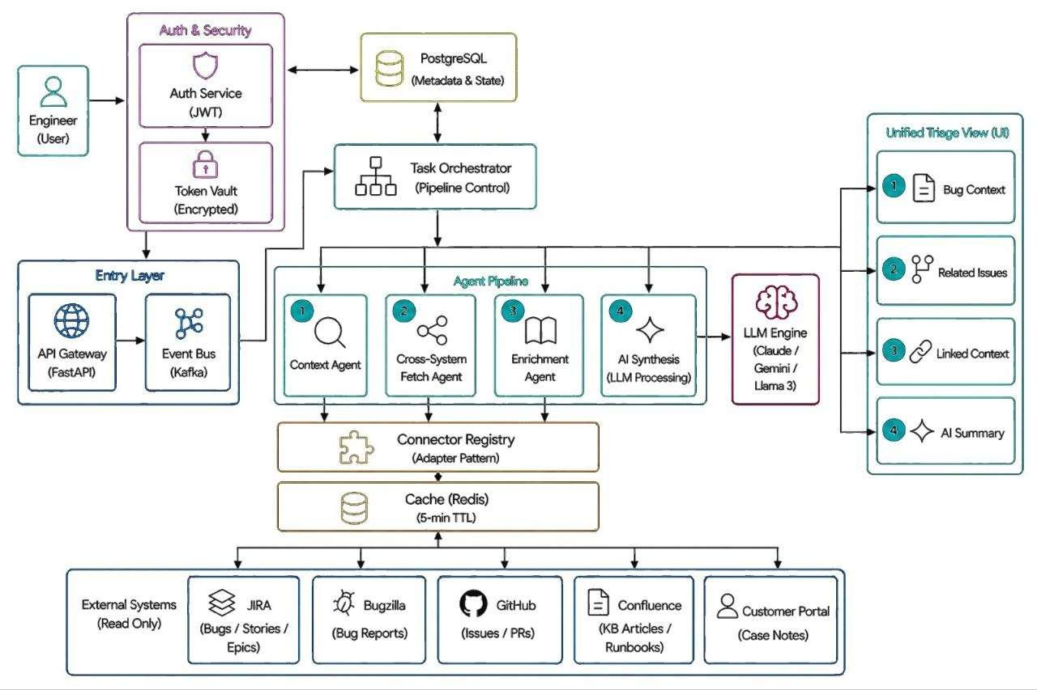
High-Level Design — Final Architecture
[Insert HLD Architecture Diagram Here]

Slide 5
Agent Pipeline — 4 Agents, 2 Phases
PHASE 1 — Runs First (sequential)
1 Context Agent
Why This Order Matters
Fetches full bug details from the source system (JIRA/Bugzilla/GitHub)
Retrieves linked customer case notes from Customer Portal
Extracts keywords — these drive all downstream agent searches
Must run alone. Its output is required by Agents 2 and 3
Agents 2 & 3 need keywords from Agent 1 — dependency forces sequential first step
Agents 2 & 3 are independent — running them in parallel saves 44% time vs sequential
Agent 4 cannot start until Agents 1, 2 & 3 complete — it needs all their data to build the LLM prompt
PHASE 2 — Runs in Parallel (after Phase 1)
2 Cross-System Fetch Agent
3 Enrichment Agent
4 AI Synthesis Agent
Searches Bugzilla for related bug reports
Searches GitHub for related issues & PRs
Similarity scores shown with % match
All results include direct links to originals
Searches Confluence via CQL — read- only
Returns top 5 KB articles, runbooks & past incident reports
Removes 15 min of manual Confluence search
Degrades gracefully if Confluence is down
Runs after Agents 1, 2, 3 — needs all their output
Combines all data into one LLM prompt
Claude/Gemini/Llama returns severity, root cause, recommended actions
Labeled as suggestion only — engineer decides
•
•
•
•
•
•

Slide 6

Unified Triage View — What the Engineer Sees
Results delivered via WebSocket — panels fill in real-time as each agent completes. All links open in original systems. Data never stored permanently.
1
Bug Context
From: Context Agent
2
Related Issues
From: Cross-System Fetch Agent
Title, priority, status, component, assignee
SLA warning if breach is imminent
Open in JIRA / Bugzilla — links to original
Customer case IDs linked to this bug
Similar bugs from JIRA, Bugzilla, GitHub
Similarity % score on every result
GitHub PR — may already contain the fix
Direct link to each issue in original system
3
Linked Context
From: Enrichment Agent
4
AI Summary
From: AI Synthesis Agent
Confluence KB articles and runbooks
Customer case notes from portal
Parent epic and user story links
Past incident reports for this component
Suggested severity with confidence score
Root cause hypothesis with source references
Recommended actions in priority order
Labeled as AI suggestion — engineer decides

Slide 7
Technology Stack
Backend
FastAPI (Python)
Async-first, Pydantic validation, auto OpenAPI docs
Event Bus
Apache Kafka
Fault-tolerant request buffering, at-least-once delivery
LLM Engine
Claude / Gemini / Llama 3
Pluggable — swap with one config change.
Database
PostgreSQL
State & metadata only — user roles, CMDB registry, pipeline recovery
Cache
Redis
Prevents redundant API calls, rate limiting.
Frontend
WebSocket
Auto-discover bug list, real-time progressive panel loading
Security
JWT + Token Vault
Zero hardcoded credentials. All API keys fetched at runtime only.
External
JIRA · Bugzilla · GitHub · Confluence · Customer Portal
Read-only via MCP. Data stays in source systems — always.
Containers
Docker + Docker Compose
Each agent runs independently. One command starts everything.

Slide 8
Next Steps — Moving to Implementation
01
02
Sequence Diagrams
UI Auto-Discovery
Create detailed sequence diagrams for two workflows — new bug triage and incremental change detection.
Redesign homepage — remove manual Bug ID entry. Auto-discover bugs from connected systems and display as a filterable list with dashboard.
03
04
LLM Similarity
Token Settings Page
Enhance matching to use LLM reasoning across bug title, description, logs, timestamps, crash dumps, and all engineer comments — not just keywords.
Build settings interface for engineers to configure base URLs, port numbers, and API tokens for each connected bug tracking system.

Slide 9
Thank You
Hewlett Packard Enterprise
Agentic Bug Triage & Routing System · Mid Review

