Slide 1
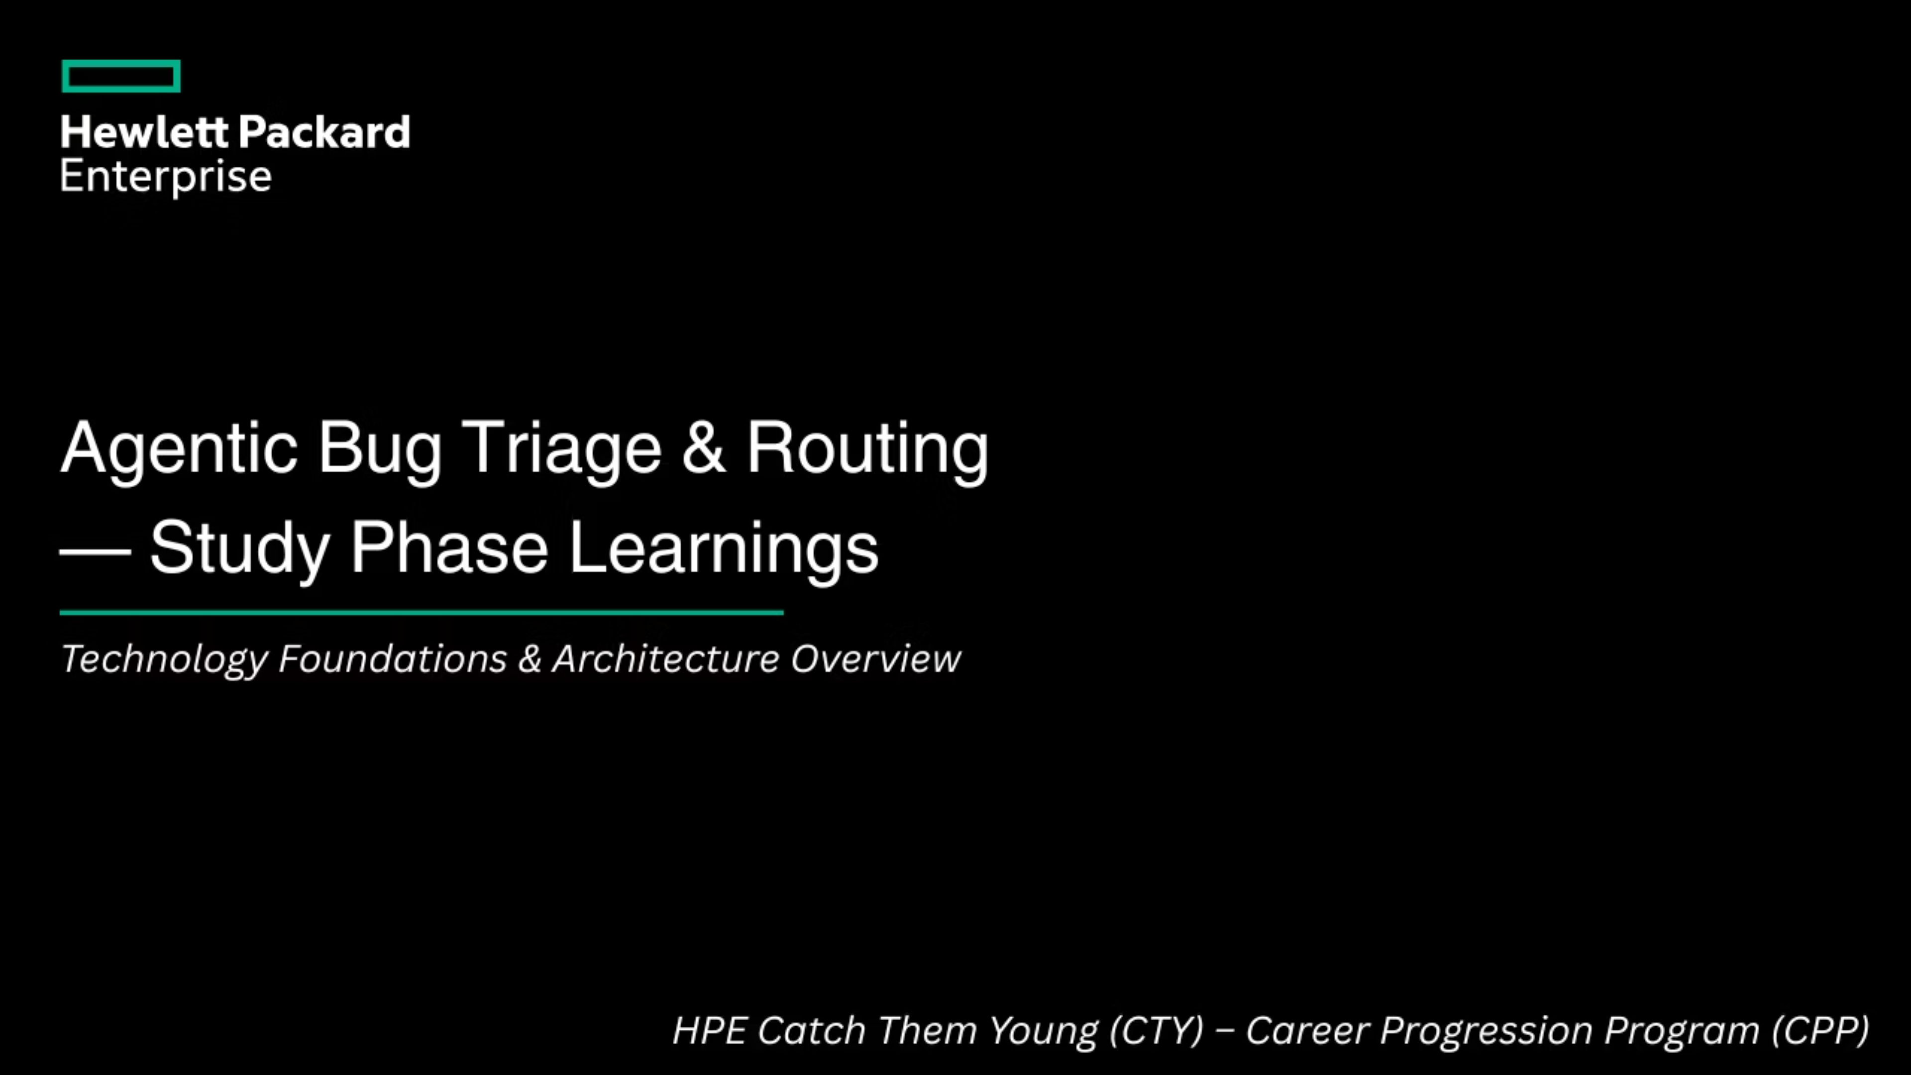

Slide 2

Bug Triaging — The Problem Today
What is Bug Triaging?
Process of reading an incoming bug report and deciding severity, ownership, destination repository
Done manually today by engineers
Works at small scale — breaks at enterprise scale
The Problems at Scale
Problem
Impact
Scattered data across JIRA, Bugzilla, custom repos
No single view, constant context switching
Manual misrouting
Wrong repo, rework, wasted engineer time
Lost lineage when bugs are copied/reclassified
Duplicate work, inconsistent tracking
Operational overhead
Slows remediation, degrades customer experience
The solution: an agentic system that automates triage, routing, and tracking across all repositories through a single interface.

Slide 3
AI/ML & Agentic Concepts
Foundations (how AI understands text)
LLMs — large models accessed via API, understand and generate language
Tokenization — text broken into chunks before processing
Embeddings — meaning represented as numbers, enables semantic similarity
Text Classification — assigning labels to text (severity, product area, type)
Agentic AI (how AI takes actions)
Agents — LLMs that can call tools and act in the world
Tool Calling — functions the LLM can invoke (search, create, notify)
Prompt Engineering — instructions that control agent behavior and output format
Multi-Agent Orchestration — specialized agents coordinated by a central orchestrator
ReAct Pattern — Reason → Act → Observe loop
"We use LLM APIs — no custom model training. Intelligence comes from prompt design and agent coordination."

Slide 4
Data Storage Fundamentals
🗄️Relational DB
🕸️ Graph DB
Postgres
Policy Store
Structured rules
ACID consistency
Neo4j / JanusGraph
Lineage Graph
Bug relationships across repos
⚡In-Memory Cache
📨Message Queue
Redis
Query Cache & Rate Control
Speed + throttling
Kafka / NATS
Event Bus
Async agent comms & audit logs
"Each storage technology is based on the shape of the data and its access pattern — not one database fits all needs."

Slide 5
Other Technologies
Development
Python — implementation language; key libraries are requests, asyncio (async workflows in Task Orchestrator), and Anthropic/OpenAI SDKs for agent calls.
Jupyter Lab / Google Colab — prototyping agents, testing prompts, experimenting with embeddings before system integration.
Deployment & Infrastructure
Containers (Docker) — each agent and connector runs as an independent container.
Container Orchestration (Kubernetes basics) — deploying and scaling agents to handle concurrent bug submissions.
Linux All containers and cloud servers run Linux.

Slide 6

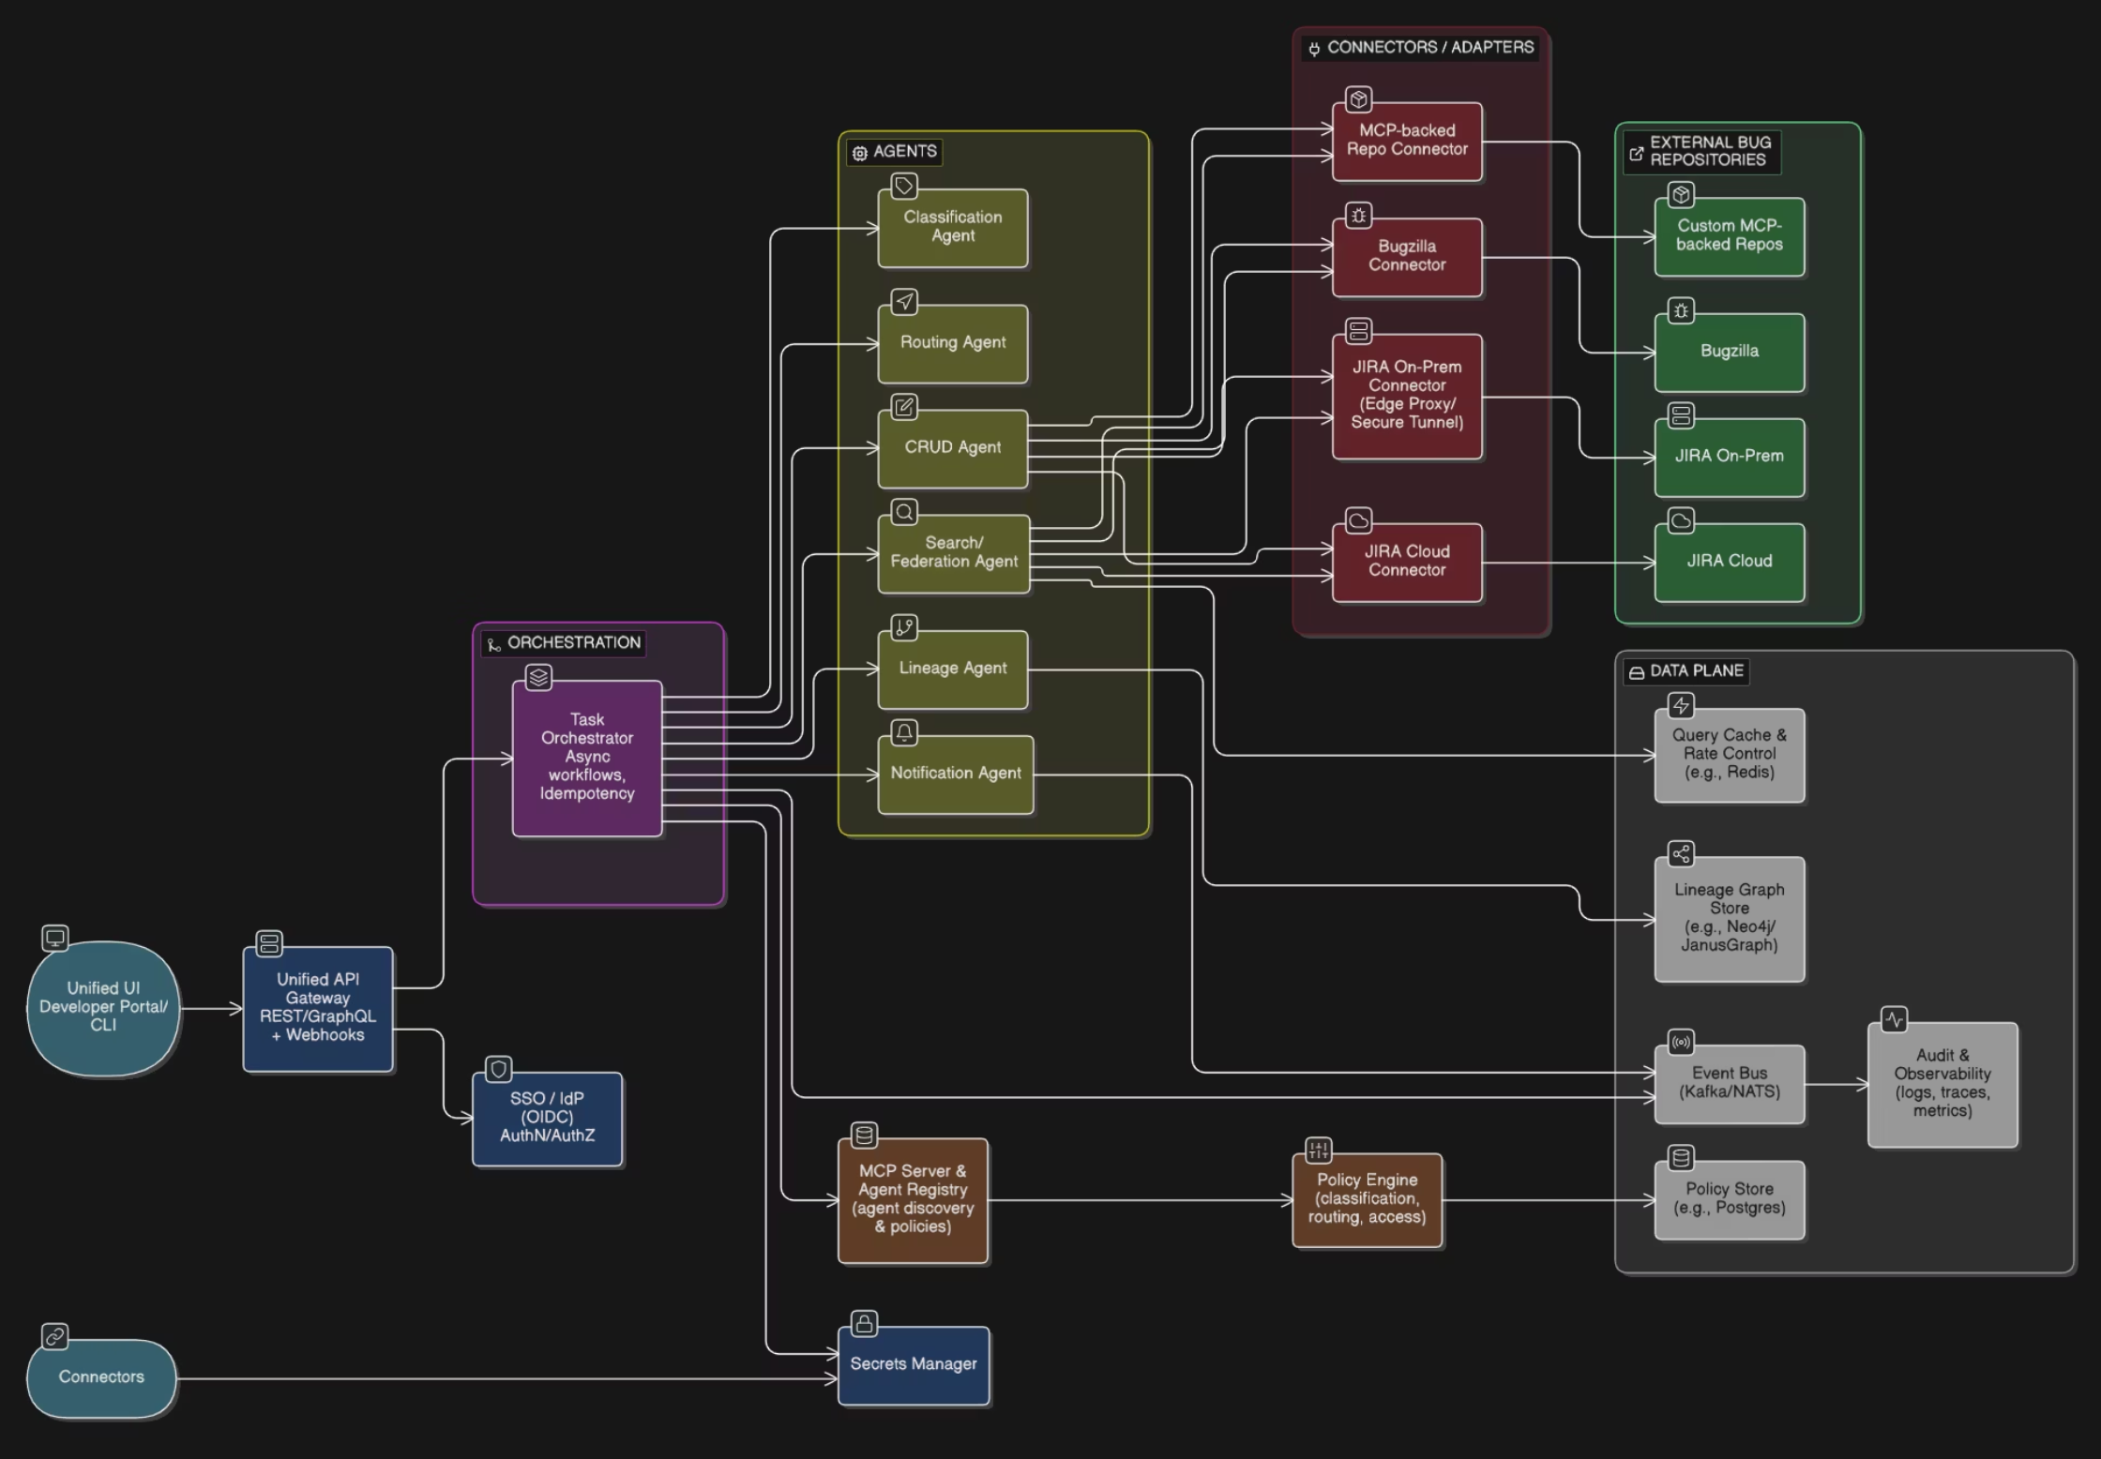
Next Steps & Architecture Discussion
"We're ready to move into design. Looking forward to your guidance on the above."

