Slide 1
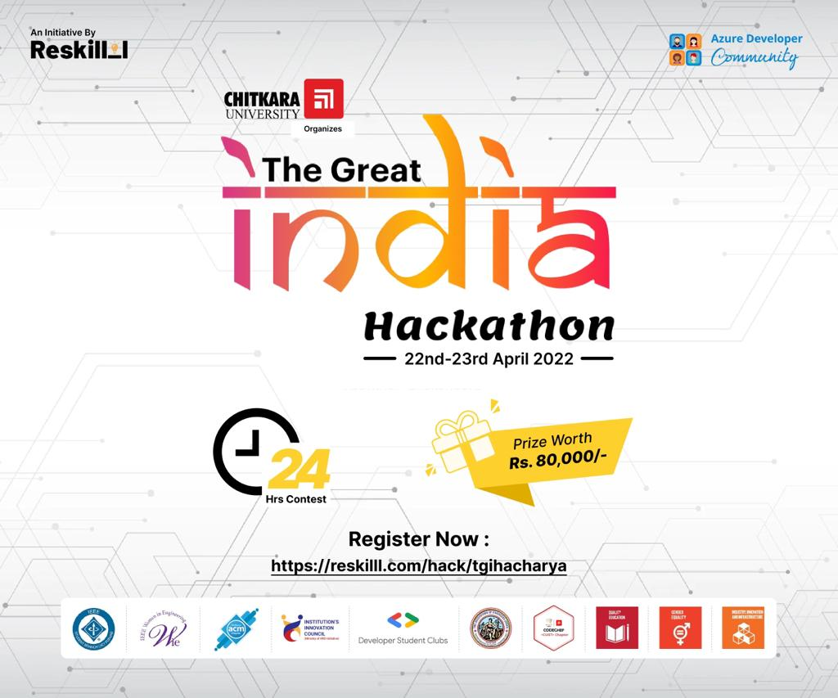

Slide 2

AcadConnect
Online Integrated platform for students
The Stellar’s

Slide 3
Problem Statement
01
To develop an online integrated platform for Competitive space and Collaborations for students. The information on this platform will help in the peer-to-peer learning and this will also help in cross functional research between various universities/colleges. The objective of our project is to develop an online integrated platform for academics taken up by the students of various universities/colleges.
Why is this a problem ?
We need to develop this platform because we do not have any specific app or website that is dedicated to students for showcasing their projects or researches.
We surely have other apps for professional use but they are not project or research specific and also not specifically for college or university students. This will also help in building a student community across India.
We do not have any specific platform where we can search for projects and researches done by the students (college specific).
No specific platform for students where they can showcase their project work or academic achievements.
No such collaborative platform for students

Slide 4
Idea & Prototype
Solution Statement
02
A common knowledge platform (with a facility for plagiarism) to bring all project works taken up at various levels by the students in Technical / Higher Educational Institutes and Universities throughout the country , it will be a great source of knowledge and also will help the student community to take up unique/innovative project works.
03
A platform for awareness and collaborations on academic works such as projects, research papers and more.
The application will enable students to interact, enact and research on their academic work.
It will create a space for combined progress and contrast knowledge.
The application will contain a user info page which will showcase the students account to other users of the application in which all your academic work will be showcased with the utmost professionalism.

Slide 5
Features
04
Can search projects and researches under one websites
Auto Recommendation Software
Project linker option (collaborative work)
Partial Plagiarism for idea and research.
HTML
CSS
JavaScript
Python
Tech Used

Slide 6
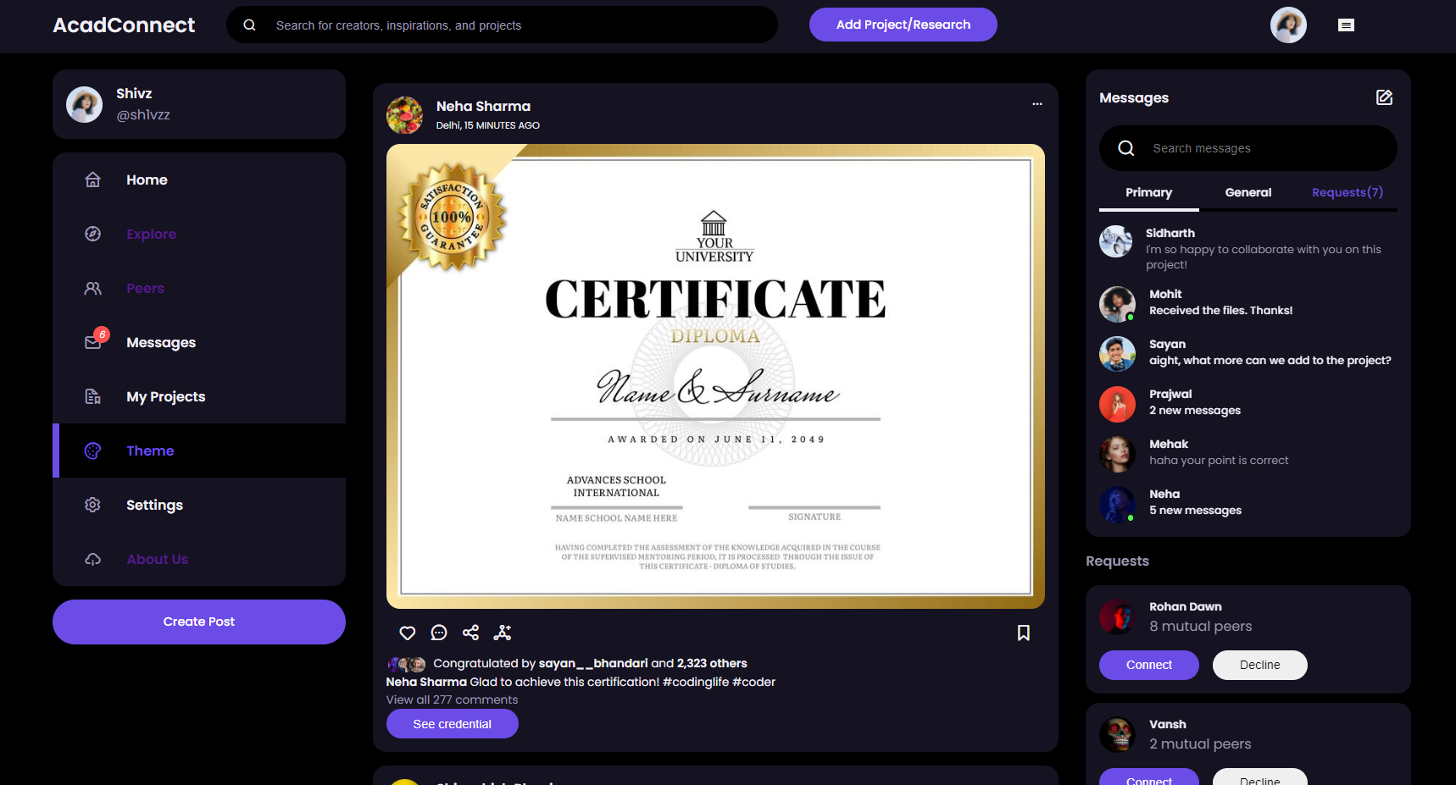
Feed Page of our Website

Slide 7
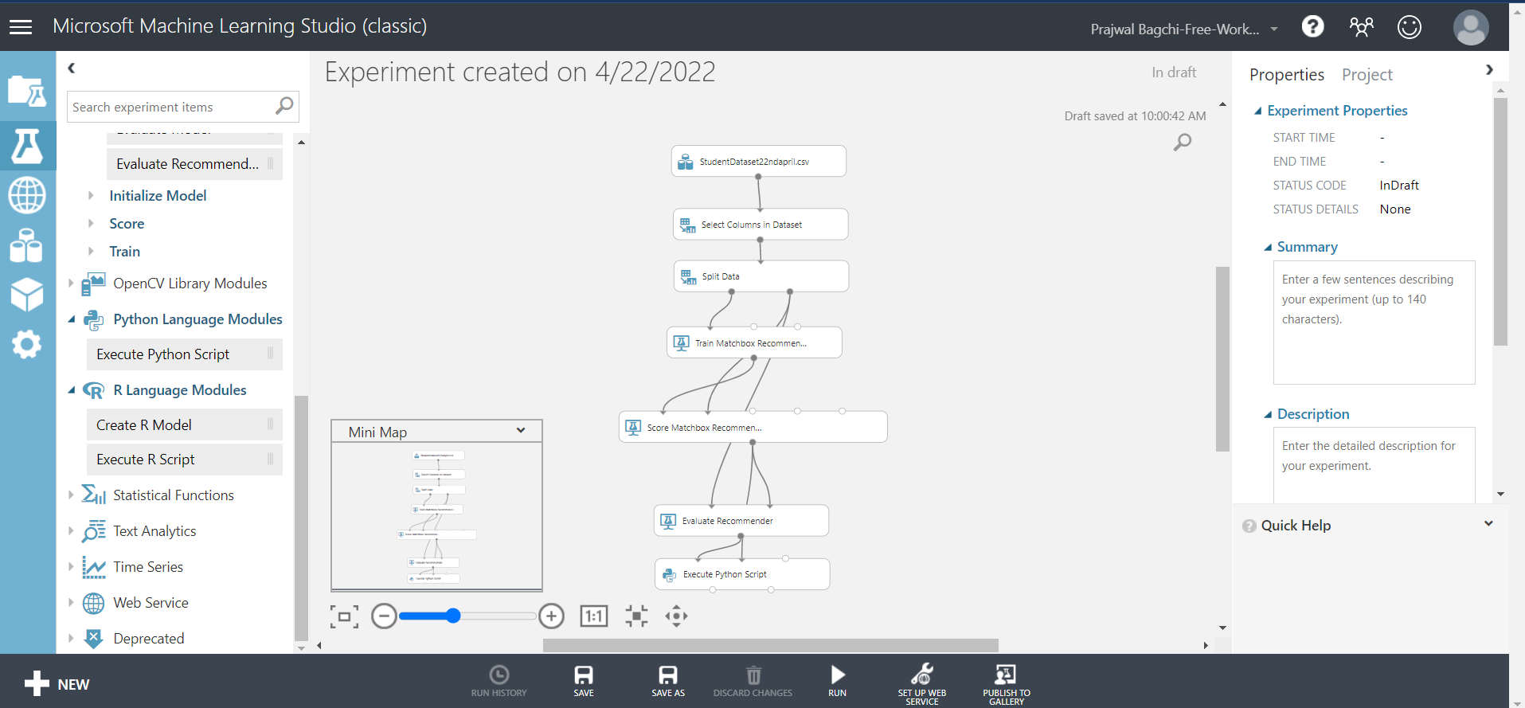
This is the Machine learning model we are creating using azure ml services, it will be implemented very soon.

Slide 8
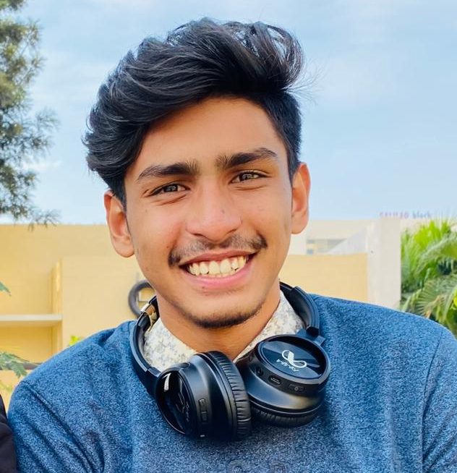
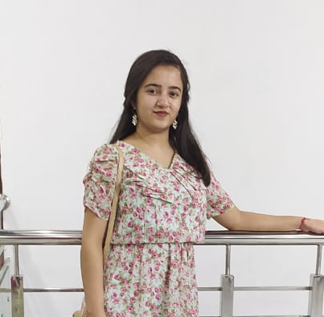
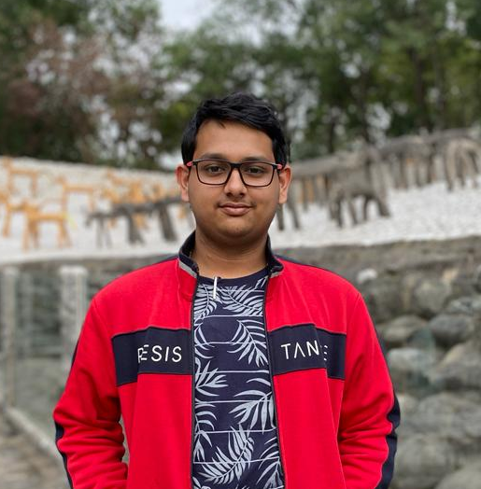
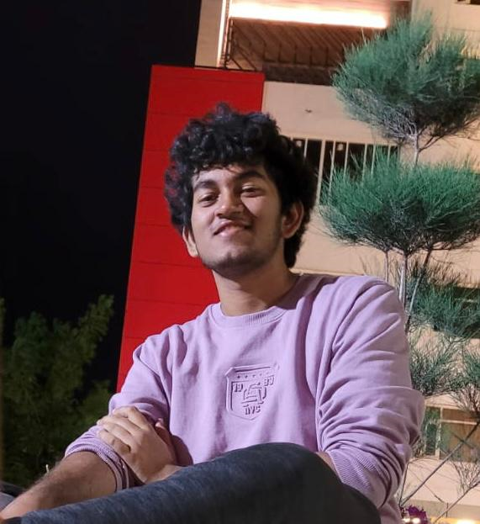
Our team
Sayan Bhandari
Mehak Walia
Shivashish Bhunia
05
Prajwal Bagchi
2110993831
2110990878
2110993833
2110993821

