Slide 1
Instructions for Visualization and Analysis Demos
You have 3 minutes to present – be ready to share your screen, practice first. We can only offer you one opportunity to present. Present your slides in “Slide Show” mode. Presentations will take place during the module Tutorial slots (see Canvas Announcements for links to join Tutorials via Teams).
The next few slides give you all the alternatives for how to present your Visualizations. You will select only one as fits your RQ. Before presenting DELETE all text (and instructions) that you do not use (including this slide). You can then enlarge your selection, so it is clearly visible on the slide.
Appointment slots will appear on Canvas soon (calendar-7com1079-24). Sign up early. When space runs out, we cannot issue any further slots for this week. If you do not turn up for your slot you will not be given another opportunity. Ideally, all the group members should attend but select one person to present. DO NOT SIGN UP unless one of your group can attend and present. You will not be graded on this.
We look forward to giving you feedback. If your group is not presenting, still attend the tutorial as the feedback will help you too.
¹At this point we assume you are using your allocated datasets (see group-dataset allocations on Slack Announcements). Any changes to the Kaggle/Data.world csv/xlxs file you make such as merges, grouping, or size reduction must be done via an R script, not manually, not in excel.

Slide 2
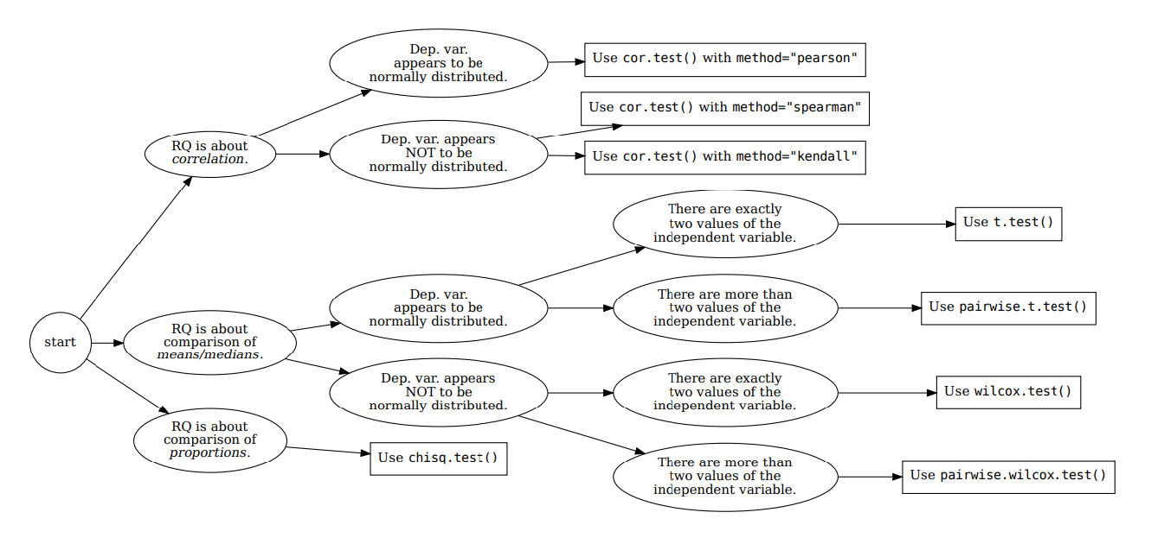







How your RQ + distribution of data (Histogram) leads to a statistical test. Visualization requirements highlighted in yellow.
Histogram & Scatterplots
Histogram and Boxplots
Stacked bar chart (no histogram)
Figure: Decision tree – how Research Questions relate to Visualizations and Statistical Test.

Slide 3

Visualization and Analysis –
Tutorial Presentation for Feedback
Date:
Group Id: A 80 Name of Student Presenting: Atik Patwary

Slide 4
If you have not defined your Research Question (RQ) yet, please do not attempt to present Visualizations and/or analyses of your data. Go to Canvas, announcements on RQ presentations, and use the PowerPoint template provided for you to present your RQ. You can use the time slot to present your RQ instead of the Visualisation.
Part 1: VISUALISATION

Slide 5
We are using the dataset (DS101) to answer our Research Question “Is there a correlation between the number of COVID-19 tests conducted in Ohio and the incidence of positive outcomes during the period 2020–2021?” ” ¹
The dataset has 756 rows and the variables we use are Confirmatory and Presumptive Lab Percent Positive (Daily)(dependent variable) and Confirmatory and Presumptive Lab Total Tested (Daily) (independent variable).
¹ Be sure you follow one of the three prescribed RQ Templates – identifying the type of statistical analysis you will be using. If you do not have the correct RQ, we will stop your presentation here.
² The variable name in your RQ may be different from the column name in cases where the column names are abbreviations.
^{3.4.}Be sure to identify which variable is your dependent variable and which one is your independent variable on this slide

Slide 6
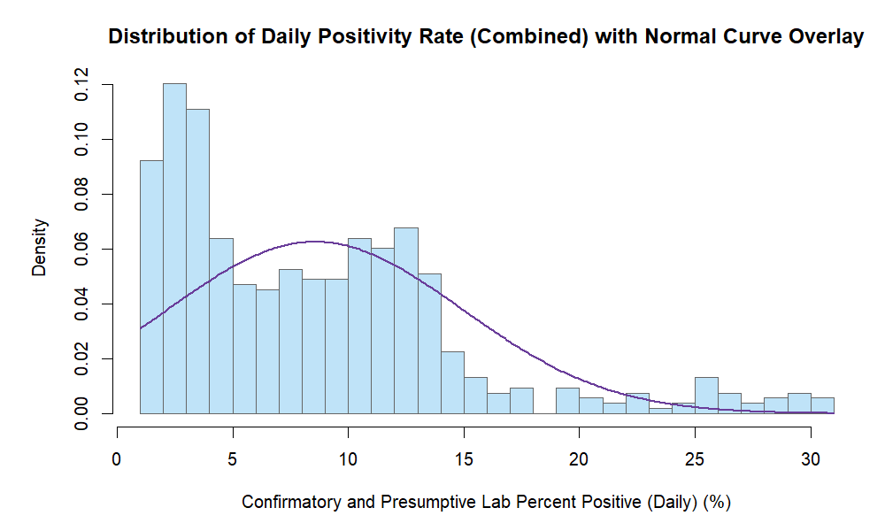
Visualization
Histogram

Slide 7
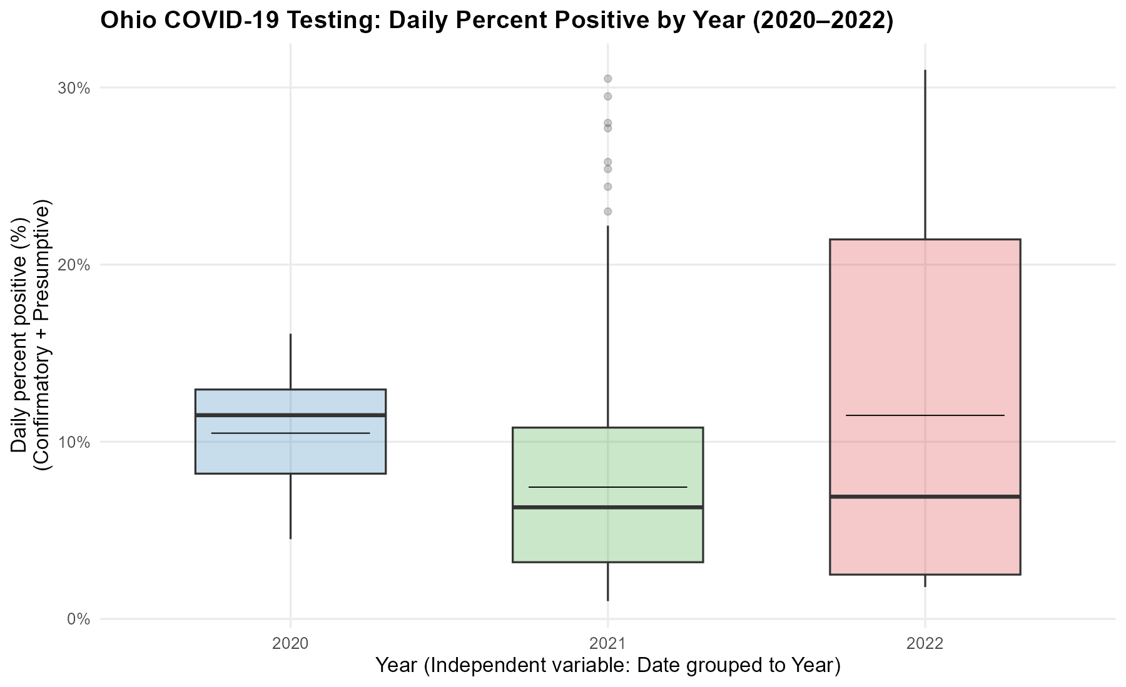
BOXPLOT

Slide 8
Only attempt this Analysis part of the demo if you have completed your Visualization(s). Otherwise end your demo after the Visualization for feedback.
Part 2: Analysis (building on your Visualizations)

Slide 9
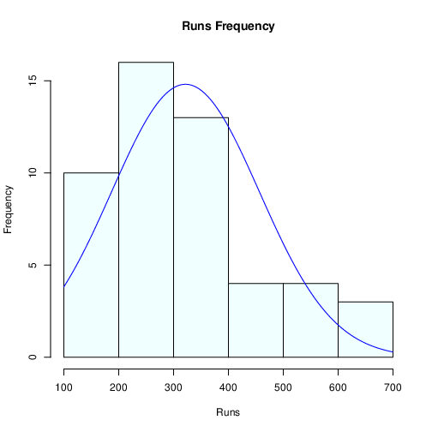
Here is a Histogram showing the frequencies of our dependent variable to include the normal curve overlay.
Our RQ asks about Correlation
For example:
Choose one:
1. The blue normal curve overlay follows the contours of the underlying data, so for our analysis we will use a parametric test for correlation: Pearson’s r
OR
The normal curve overlay does not follow the shape of the underlying data, so for our analysis we use the non-parametric test for correlation that does not assume normality: Spearman’s Rho or Kendal’s Tau
The example here is borderline, in terms of shape, so when in doubt choose the non-parametric equivalent.
9
Notes:
9

Slide 10
Here is a Histogram showing the frequencies of our dependent variable to include the normal curve overlay (shown in blue).
Our RQ asks about Differences in means/ medians
For example:
Choose one:
1. The normal curve overlay follows the contours of the underlying data, so we use the parametric test: t-test.
OR
2. The normal curve overlay does not follow the shape of the underlying data, so we use the non-parametric test that does not assume normality: Wilcoxon also known as the Mann Whitney U Test.
The example here is borderline, in terms of shape, so when in doubt choose the non-parametric equivalent.
10

Slide 11
Here is a contingency table (also known as table (matrix/cross tabulation) showing our dependent variable as rows, and our independent variable as columns. We have at least two values for both variables that are independent of each other (no overlap).
For example:
Our RQ is about Differences in proportions
Reason for absenteeism (Sample 16,550)
Age group | Operation | Stress | Physical Illness | Strike | Maternity / paternity | Holiday
16 -25 | 50 | 150 | 25 | 60 | 200 | 6000
26- 35 | 60 | 100 | 40 | 40 | 500 | 6000
36 -45 | 80 | 300 | 60 | 100 | 400 | 6000
46 -55 | 60 | 200 | 80 | 80 | 200 | 6000
56 - 65 | 100 | 250 | 100 | 120 | 100 | 6000
Over 65 | 90 | 80 | 80 | 55 | 0 | 6000
For comparison of proportions analysis, we will use a chi-square test to check for the likelihood that there is a relationship between the two nominal variables (reason for absenteeism and age group in example). This non-parametric test makes no assumptions about the shape of the data (which is nominal, not interval) so we do not include a histogram for this test.
11
Notes:
11

Slide 12
R Script and Results (For ALL types of test) – The Analysis
PRE 7COM1079-2022 Student Group No: ?????
12
Include a snippet of the R code you use to calculate your test statistic.
Give the value of the test statistic.
Tell us the p-value. Is the p-value > or < 0.05?
Is the result significant?
Do you ‘fail to reject the null hypothesis’ or ‘reject the null hypothesis’?
What does the result actually mean in the wider context of learning something useful / answering your RQ?
Notes:
12

