Slide 1


Slide 2

Cryptography

Slide 3

What is Cryptography? The word “cryptography” technically means the art of writing codes
Ever wondered how online banking transactions are so secure?
How websites, messaging applications claim to have secure connections and be end-to-end "encrypted"?
It's all cryptography. From visiting different websites, chatting with friends on WhatsApp to ordering our favorite stuff from amazon, Cryptography is used all over the internet to keep us safe.

Slide 4
Encoding & Encryption
What do you think of these two terms? Are they the same or different ?

Slide 5
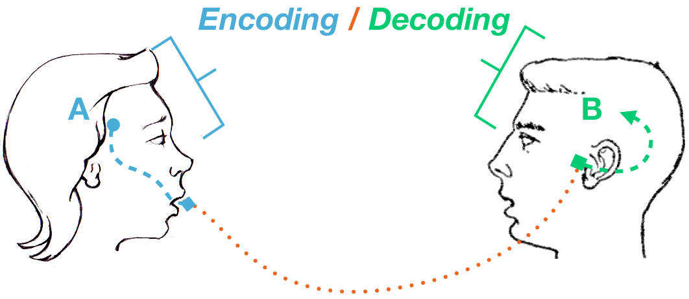
Encoding

Slide 6

Encoding
Encoding is the conversion of data into a specific format, for various reasons like making it easier to transfer, understand, store etc.
It is reversible in itself, unlike encryption.
Common encoding techniques:
ASCII
Base64
Hexadecimal, Octal, Binary etc
URL and HTML encoding and many more
Examples : https://gchq.github.io/CyberChef/

Slide 7
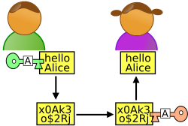
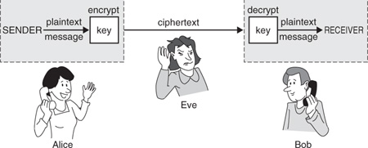
Encryption

Slide 8

Encryption
Encryption is the practice of scrambling information in a way that only someone authorized and with access can unscramble and read it.
There are various encryption algorithms using different operations, with a wide range of real-world applications.
This is obtained by a 'key', could be a string like a password, a random number or a file in some cases.
We take our info (let's call it plaintext), take our 'key' and apply the encryption algorithm. The result is – ciphertext. Cipher is sent to the receiver & is gibberish. So, our plaintext is hidden.
The receiver also needs a key to decrypt the cipher, and hence be able to read our message.

Slide 9
Types of Encryption
Symmetric Encryption
The same key is used to encrypt and decrypt, hence 'symmetric'.
They key needs to be hidden and only given to receiver.
Much faster, hence better for large data.
Ex: Caesar cipher, XOR, DES, AES
Asymmetric Encryption
Two keys – Public(to encrypt) and Private(to decrypt) key
The private key needs to be hidden and public key can be openly disclosed
Slower than symmetric, used to protect small but important data.
Ex: RSA, Diffie-Hellman key exchange, elliptical curve cryptography etc.

Slide 10
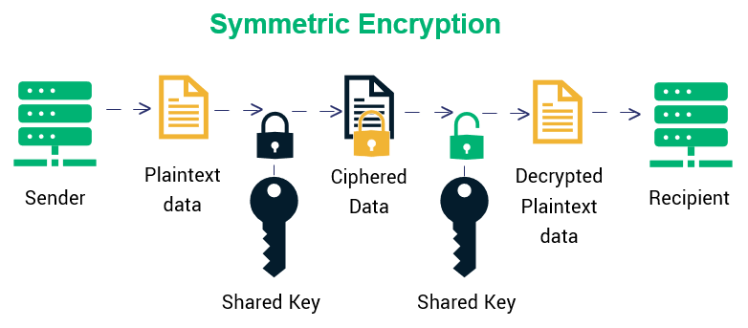
Symmetric encryption

Slide 11
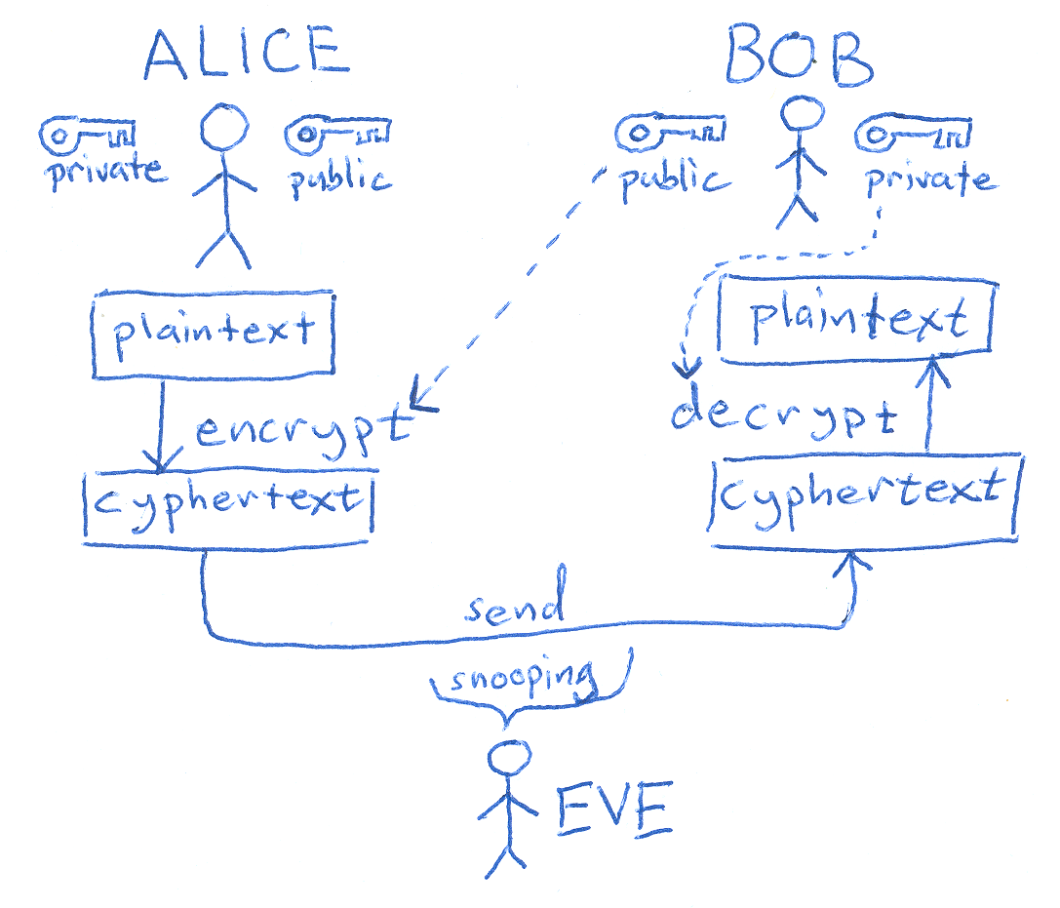
Asymmetric Encryption

Slide 12
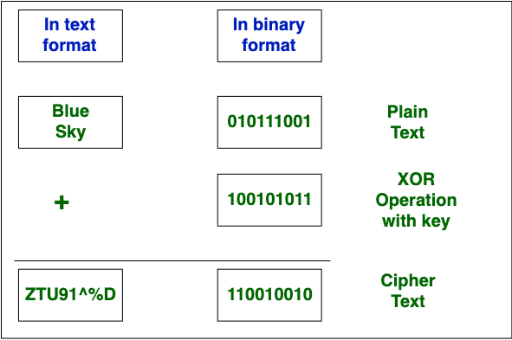
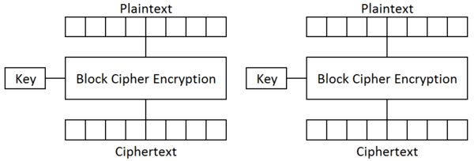
Encryption techniques
Stream Cipher
Stream Cipher Converts the plain text into cipher text by taking 1 char of plaintext.
Works on 1byte/8bits at a time.
Block Cipher
Block Cipher Converts the plain text into cipher text by taking plain text as blocks at a time.
Blocks of size 64, 128 and 256 bits
May have to use padding.

Slide 13
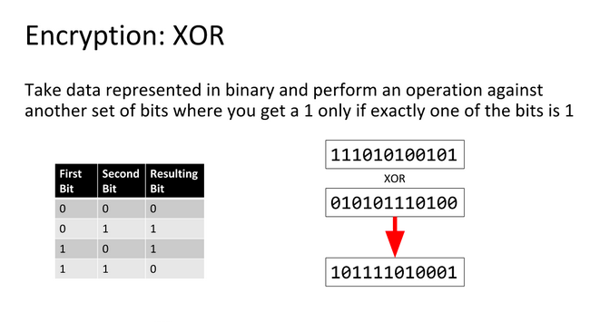
XOR (Ex-OR)
It’s a symmetric encryption.
https://ctf101.org/cryptography/what-is-xor/

Slide 14
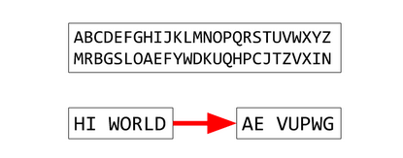
Substitution Cipher
In this type, the symbols of plaintext are replaced by some other symbol to make ciphertext.

Slide 15

Shift Cipher
Special type of substitution cipher.
The letters of plaintext are shifted to add some protection.
Let plaintext be - 'secret' now let there be an algorithm where, in ciphertext, I want to replace a with b, b with c, c with d and so on. In other words, I want the alphabets to "shift" rightward by 1.
So 's' -> 't', 'e'->'f', 'c'->'d', and so on, the cipher is 'tfdsfu'.
Let's try to decipher it in python.
Ex: Caesar cipher and Rot-13

Slide 16
Types of shift cipher
Caesar Cipher
It’s the shift cipher we saw, just the alphabets are shifted by 3
Rot-13
The same shift cipher, shifted by value '13'.
There are several Rot algorithms going from 1 to 25

Slide 17
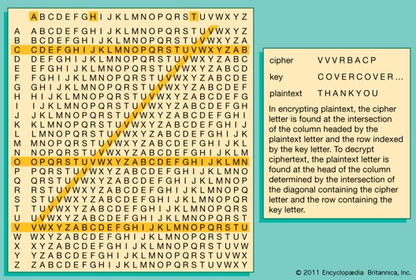
Vigenere Cipher
Extended case of shift cipher where the key is a word.
Ex: if plaintext='secret' and key='abc' (consider 'a' as 0,'b' as 1,'c' as 2..)
's' will be shifted zero times, 'e' 1 time and so on.
But notice that key is shorter than plaintext.
We append the key again, once run out
Like s e c r e t
+ a b c a b c
https://www.dcode.fr/vigenere-cipher

Slide 18
Hashes
Hashing is different from encoding and encryption, as it is irreversible.
Once we hash something, we can't retrieve it back just from the hash.
It is the transformation of data into fixed size strings called hashes. Data can be anything, just a string, a number or any files too.
Used for various purposes like indexing, and verification purposes. This is how passwords are stored and verified.
Examples – md5, sha-1, sha-256 etc.
Theoretically they provide a unique output of different inputs, but there have been some cases in old algs where different data gave the same hash. This is called a hash collision.

Slide 19
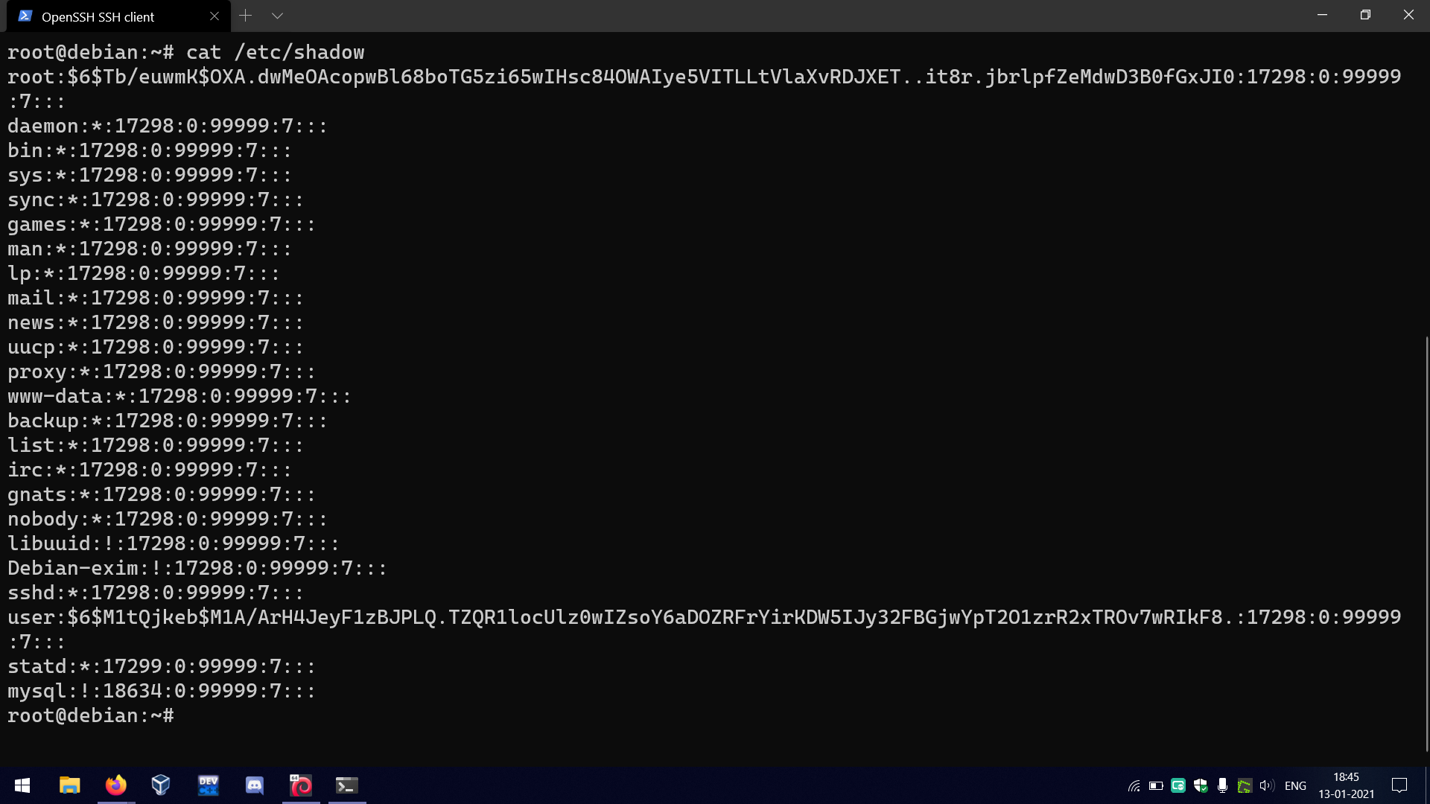
File in Linux storing password hashes(passwords themselves must never be stored) used for verification purposes.

Slide 20

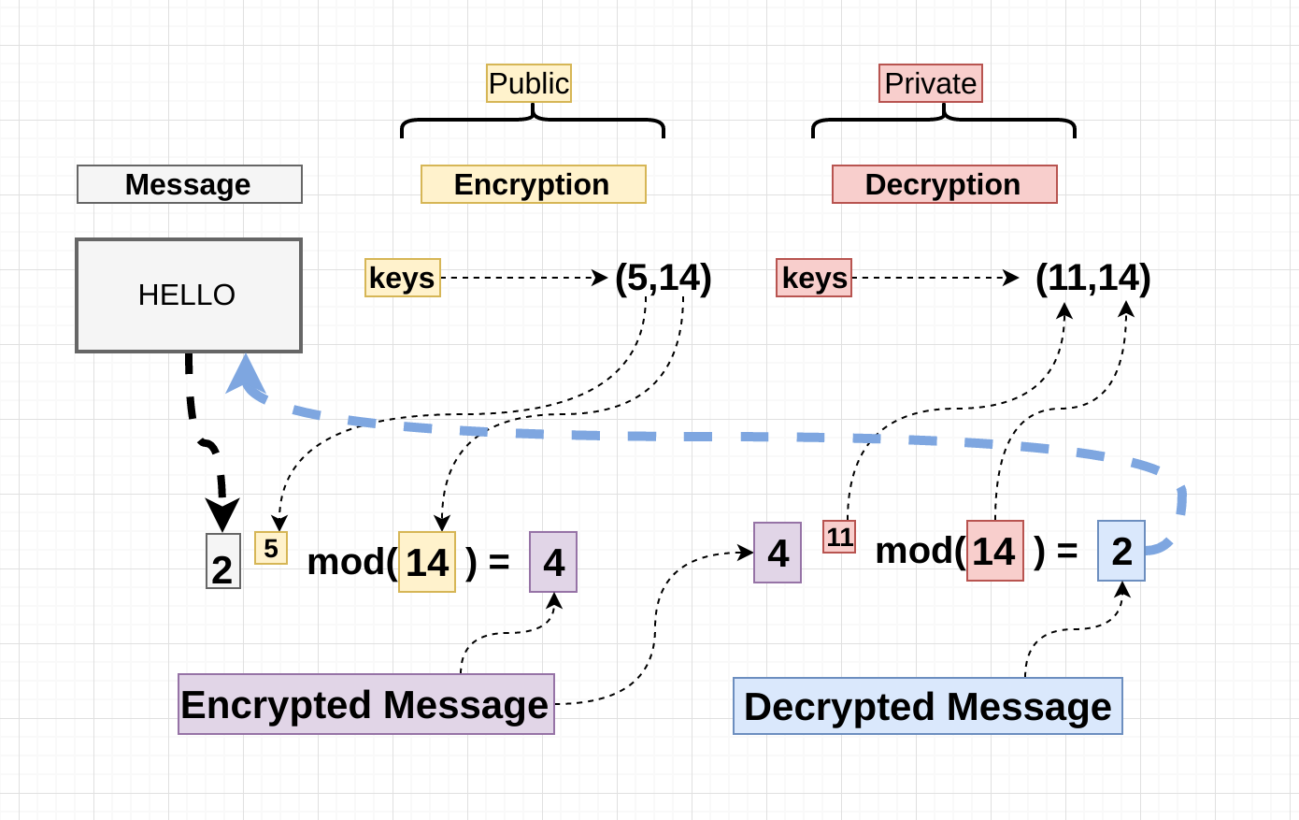
RSA algorithm
RSA (Rivest–Shamir–Adleman) is an algorithm used by modern computers to encrypt and decrypt messages. It is an asymmetric cryptographic algorithm.
What is the RSA algorithm? (educative.io)

Slide 21
AES algorithm
The AES(Advanced Encryption Standard) algorithm (also known as the Rijndael algorithm) is a symmetrical block cipher algorithm that takes plain text in blocks of 128 bits and converts them to ciphertext using keys of 128, 192, and 256 bits.
It is a worldwide standard used in a lot of places. Like wireless communication, file encryption etc.
What is the AES algorithm? (educative.io)

