Slide 1
Predict Home Energy Usage! 🏠⚡
*How much do weather parameters affect your home energy usage?
*How do the time parameters affect usage? 🏠⚡

Slide 2
Data
Data driven prediction models of energy use of appliances in a low-energy house. Luis M. Candanedo, Véronique Feldheim, Dominique Deramaix. Energy and Buildings, Volume 140, 1 April 2017, Pages 81-97, ISSN 0378-7788, http://dx.doi.org/10.1016/j.enbuild.2017.01.083.
Content :
The data set is at 10 min for about 4.5 months.
The house temperature and humidity conditions were monitored with a ZigBee wireless sensor network.
Weather conditions from airport weather station
Data points : (16808, 29)
Source : Kaggle

Slide 3
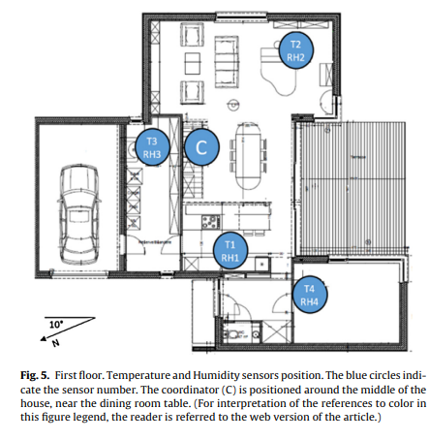
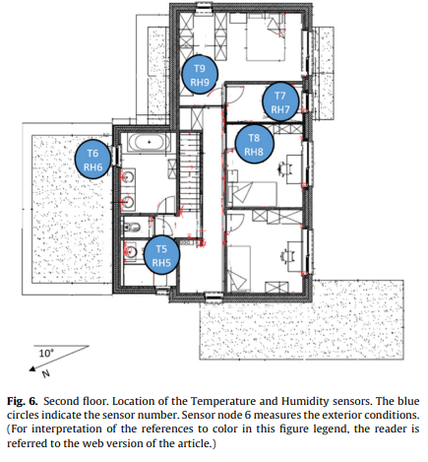
In house measures:
Insights
* Background : The low energy house was designed according to the passive house certification. ie, to have an annual heating load and cooling load of no morethan 15 kWh/m2 per year.
Humidity is the indication of the occupancy

Slide 4
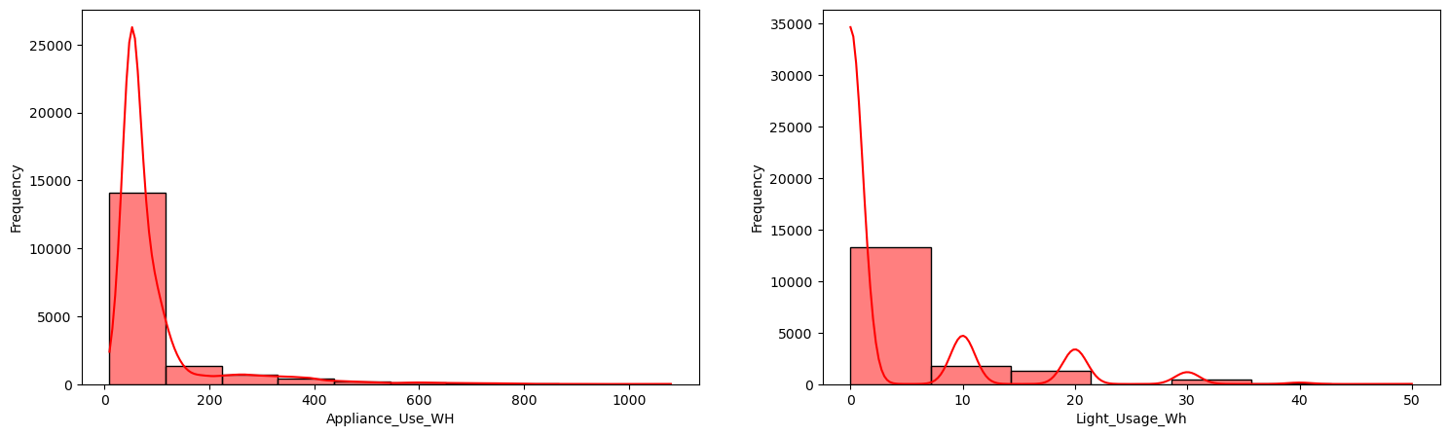
Appliances:
  Majority consumption is in the range of 0 ~ 200 kWh
Lights:
  77% of observations have ZERO Lights Energy Consumption

Slide 5
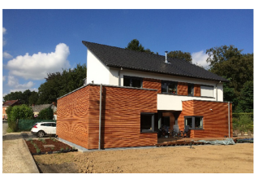
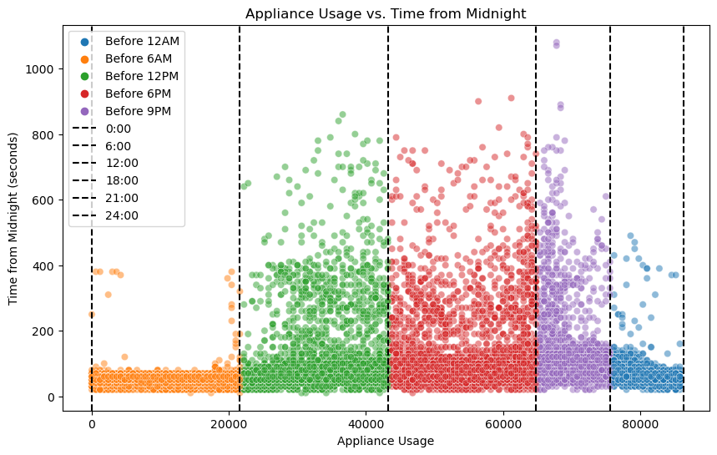
Time info:

Slide 6
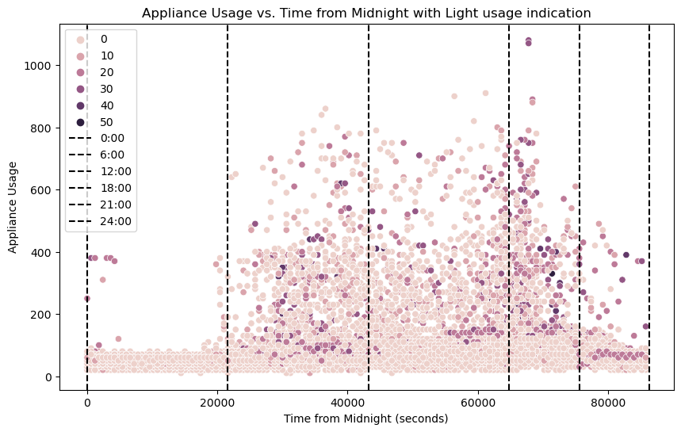
Peak Light usage:
  Increases after 6 am
  Also between 6 pm – 9pm

Slide 7
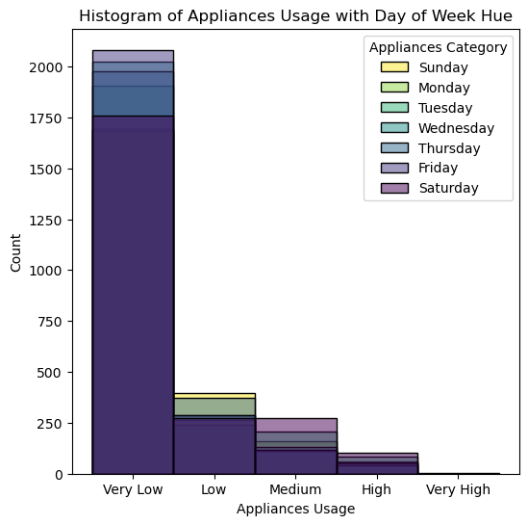
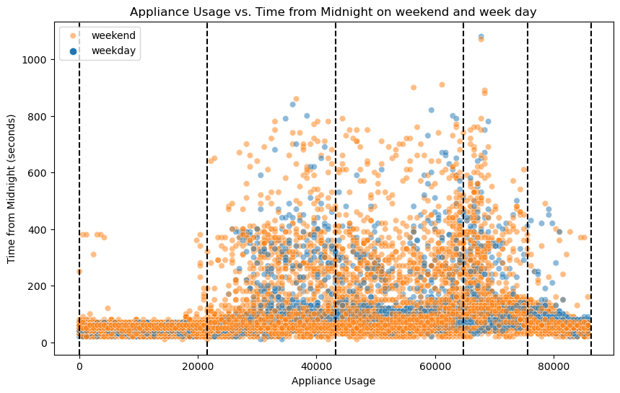
Day info:
bin_edges = [10, 100, 200, 400, 880, 2000]
bin_labels = ['Very Low', 'Low', 'Medium', 'High', 'Very High']
* Mean Appliance Usage on weekends from 4413 data points: 94.11, the weekend usage of power is more

Slide 8
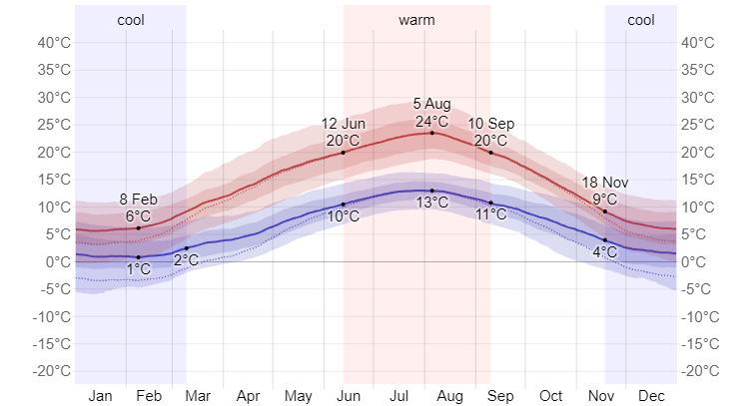
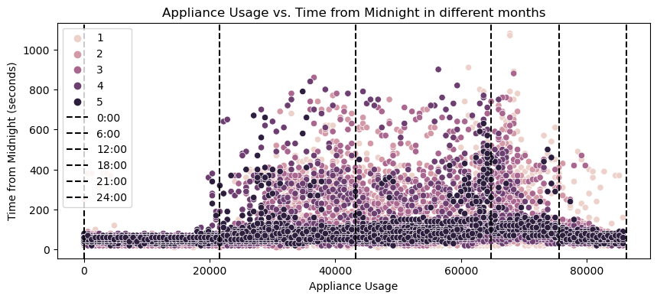
Seasonality info:
The cool season lasts for 3.7 months, from 18 November to 9 March, with an average daily high temperature below 9°C. The coldest month of the year in Chièvres is January, with an average low of 1°C and high of 6°C.https://weatherspark.com/y/49701/Average-Weather-in-Chi%C3%A8vres-Belgium-Year-Round
Peak Appliance usage is noticed in colder months
* For colder months (Feb) the max light usage is 30% more than warmer month(May)
* Beyond 6 pm appliance usage is more in colder months confirming heating loads.

Slide 9
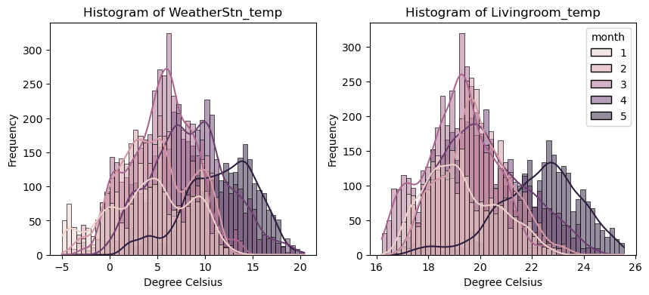
A minimum temp of 16 degree is maintained within the house. The mean living room temp is maintained (19 - 22) degree celsius

Slide 10
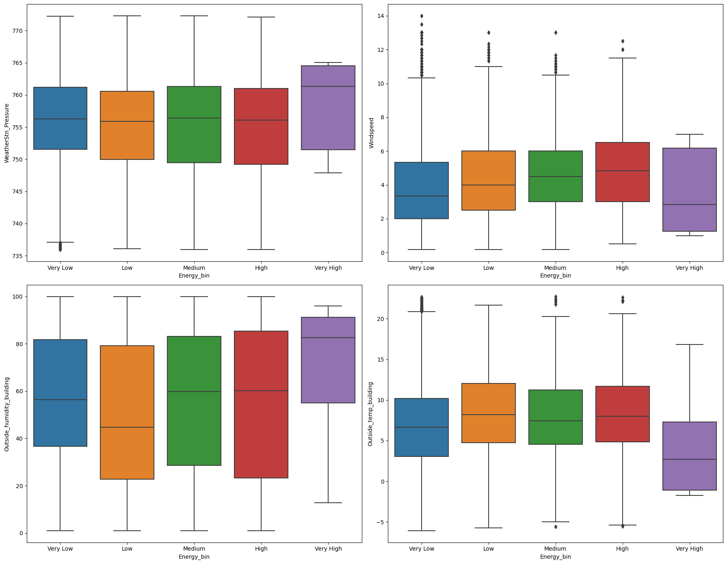
Weather parameters:
Correlation to energy usage
Outside_temp_building 0.095021
Outside humidity-0.061917
WeatherStn_Pressure -0.032367
Windspeed 0.103389

Slide 11
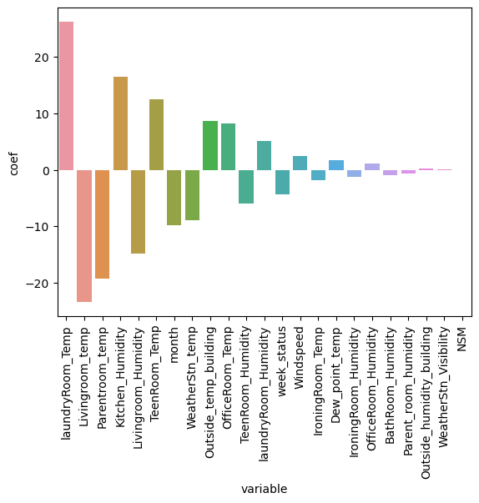
*How much do weather parameters affect your home energy usage?
*How do the time parameters affect usage? 🏠⚡
A Linear regression based machine learning model is explored to predict the energy consumption within the house.
Resulting features:
NSM,
Windspeed,
TeenRoom_Humidity,
Kitchen_Humidity,
Livingroom_Humidity,
IroningRoom_Humidity,
laundryRoom_Humidity,
laundryRoom_Temp,
Parentroom_temp,
Livingroom_temp,
TeenRoom_Temp,
BathRoom_Humidity,
month,
Outside_temp_building,
WeatherStn_temp,
OfficeRoom_Temp,
Outside_humidity_building, WeatherStn_Visibility,
week_status,
IroningRoom_Temp,
Parent_room_humidity,
OfficeRoom_Humidity,
Dew_point_temp

Slide 12
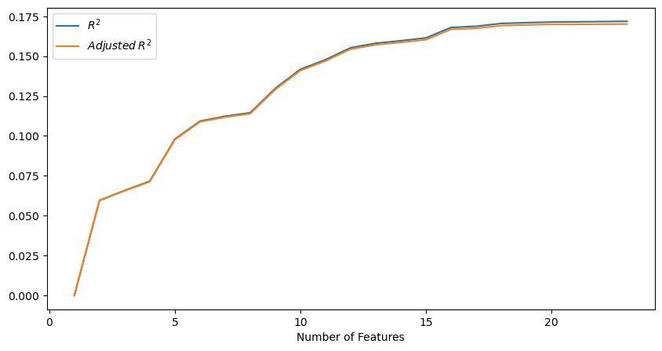
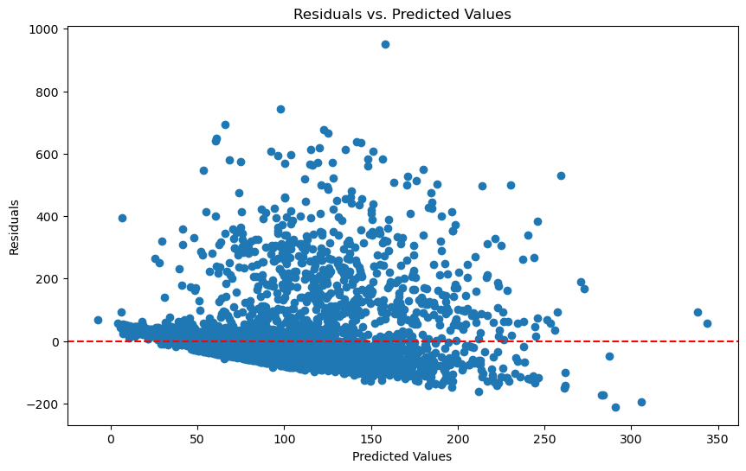
A Linear regression based machine learning model may not be the best solution to predict the energy usage.
RMSE: 93.26
With Feature selection R^2 value could be pulled up from 0.098 to 0.170

