Slide 1


nnAttention U-net for Brain Tumor Segmentation
Mattia Capparella
ID Number 1746513
Advisor
Maria de Marsico
External Advisors
Ilaria Gianoli Manuel Orlandi

Slide 2



Introduction
COMPUTER VISION
CLASSIFICATION
DETECTION
SEGMENTATION

Slide 3
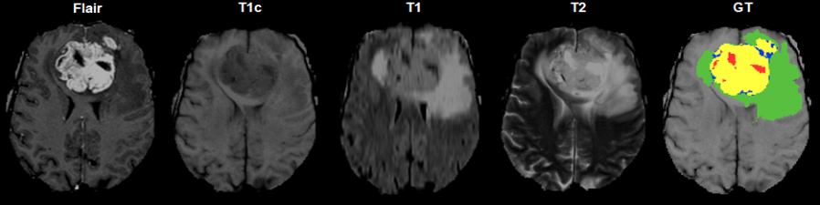
Introduction

Slide 4
Introduction
CSF is dark on T1 imaging
CSF is bright on T2 imaging
CSF is made dark and abnormalities remain bright in FLAIR

Slide 5
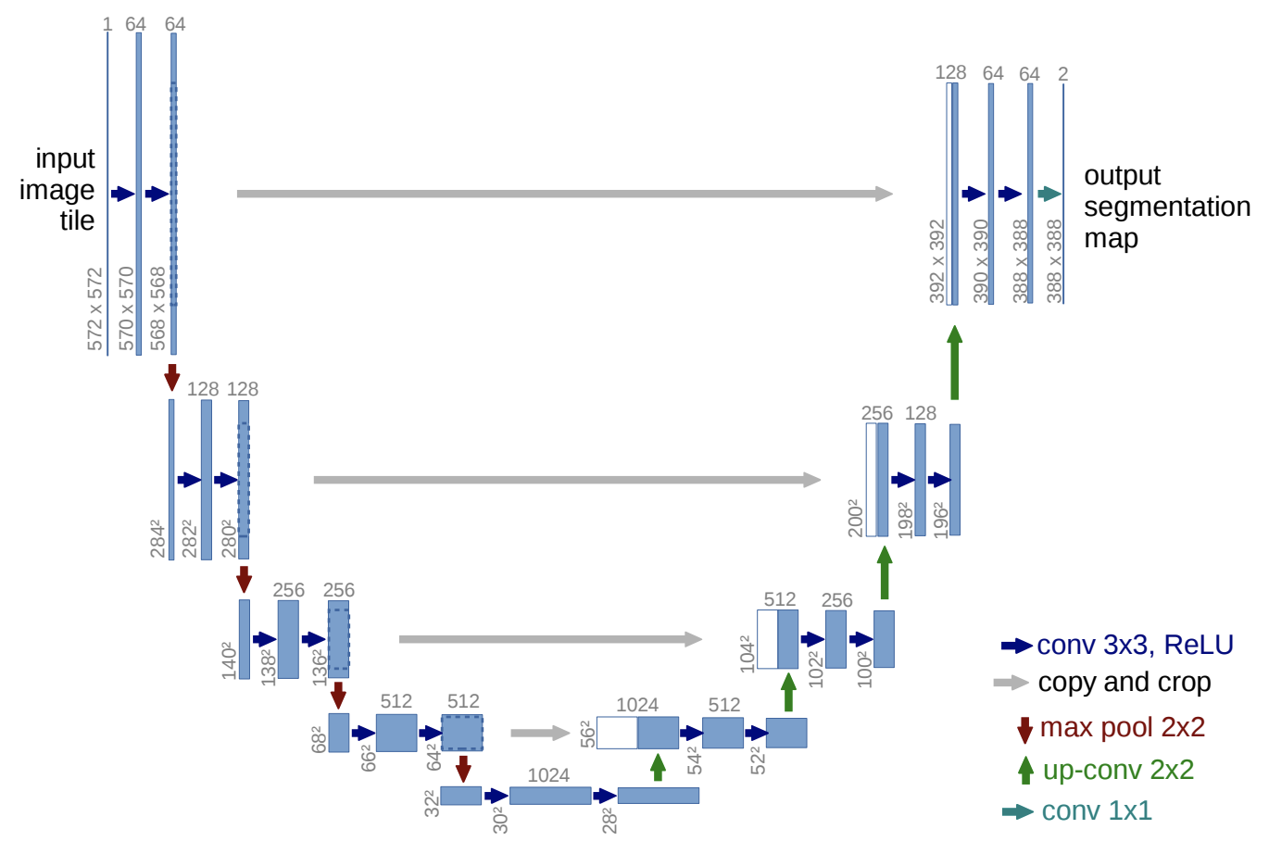
Literature Review

Slide 6
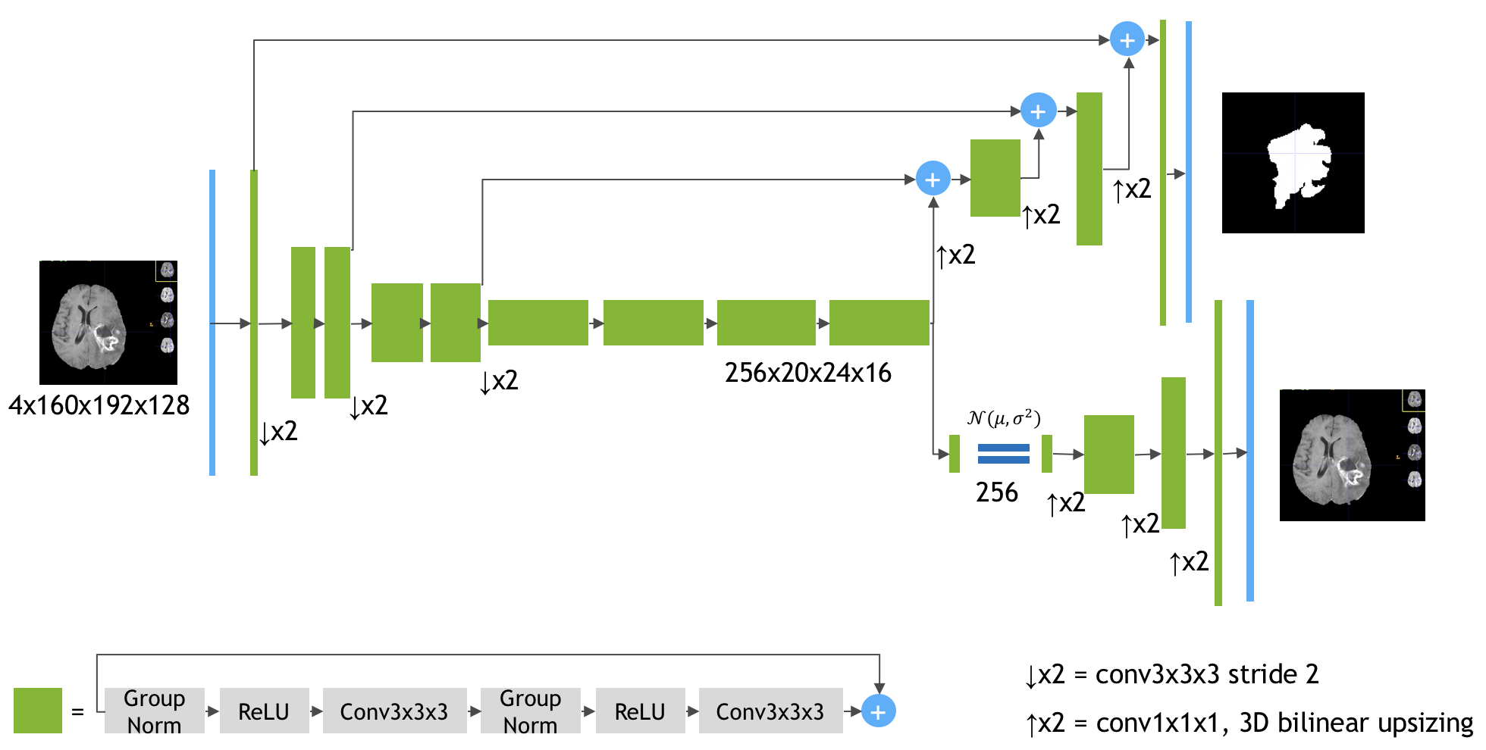
Literature Review
3x160x192x128
4x160x192x128

Slide 7
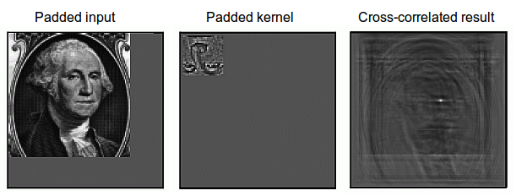
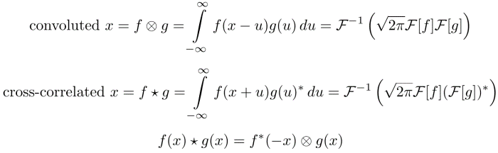
Literature Review
Notes:
https://developer.nvidia.com/discover/convolution
https://timdettmers.com/2015/03/26/convolution-deep-learning/
https://www.tutorialspoint.com/signals-and-systems-relation-between-convolution-and-correlation

Slide 8
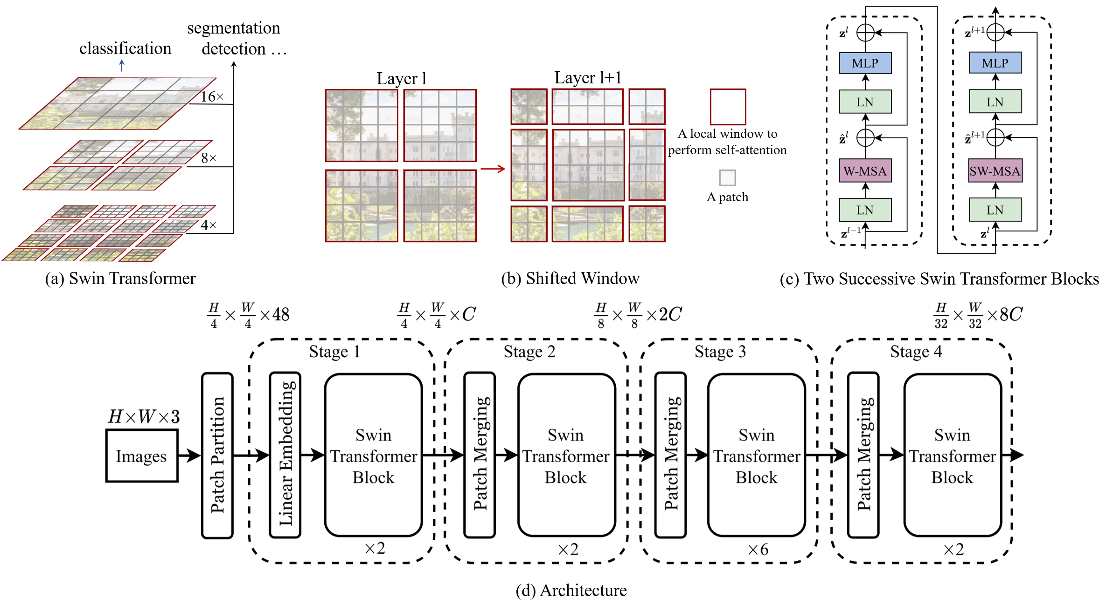
Literature Review

Slide 9
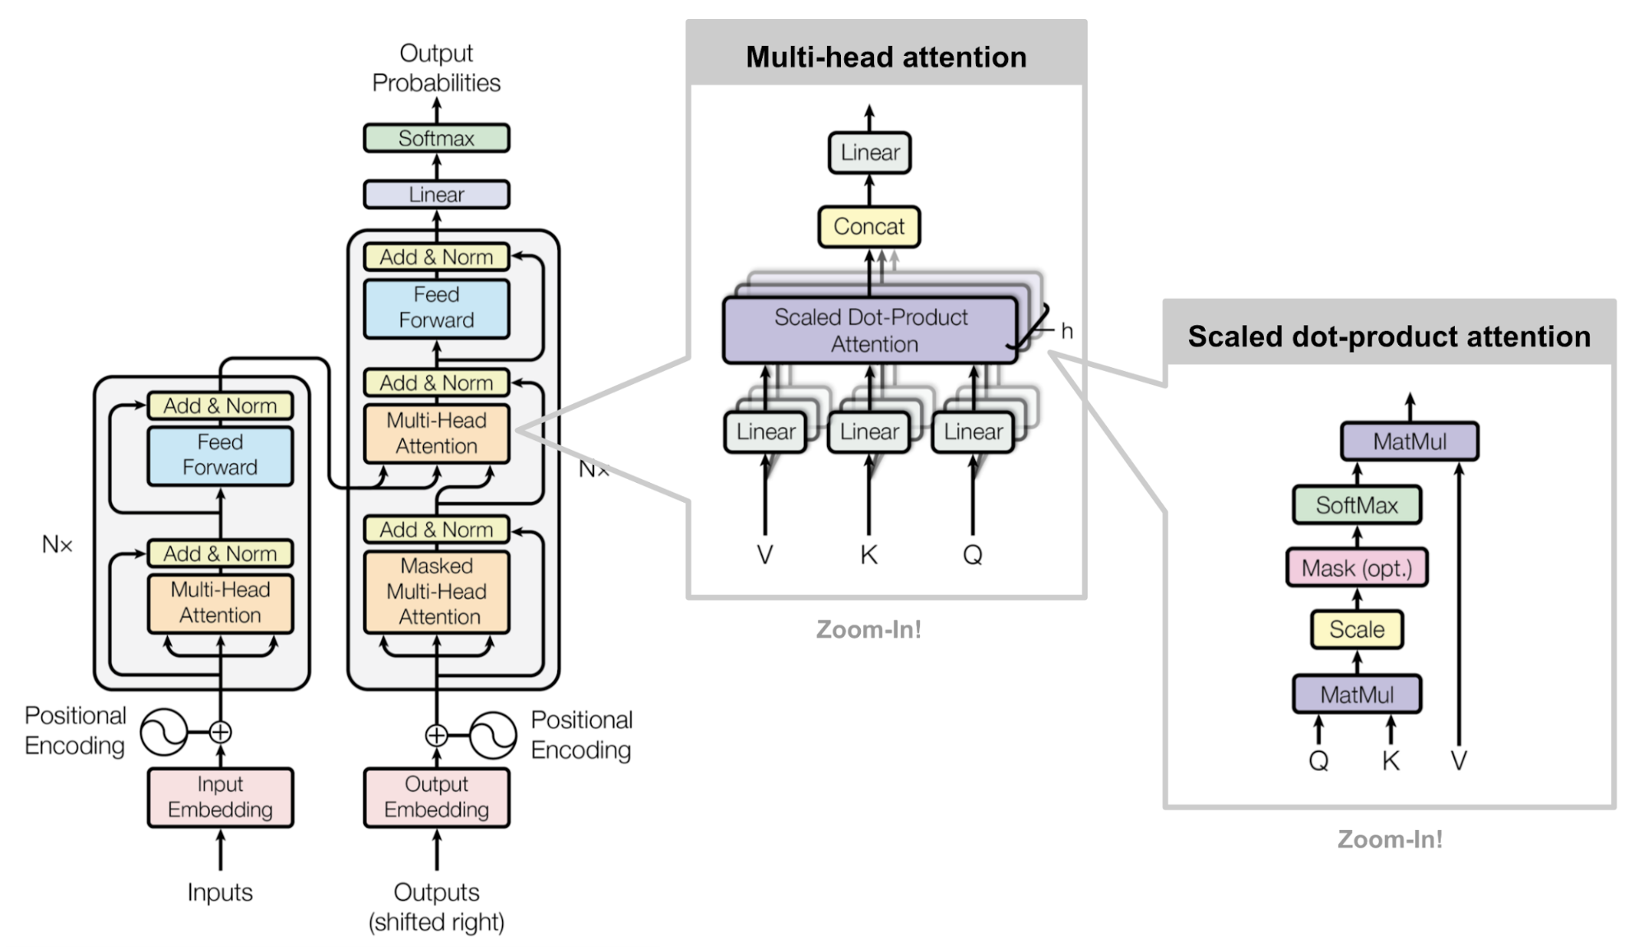
Literature Review
Notes:
https://lightning.ai/docs/pytorch/stable/notebooks/course_UvA-DL/05-transformers-and-MH-attention.html
https://uvadlc-notebooks.readthedocs.io/en/latest/tutorial_notebooks/tutorial6/Transformers_and_MHAttention.html
http://jalammar.github.io/illustrated-transformer/
https://lilianweng.github.io/posts/2020-04-07-the-transformer-family/
https://blogs.nvidia.com/blog/2022/03/25/what-is-a-transformer-model/
https://en.wikipedia.org/wiki/Vision_transformer
https://lightning.ai/docs/pytorch/stable/notebooks/course_UvA-DL/11-vision-transformer.html

Slide 10
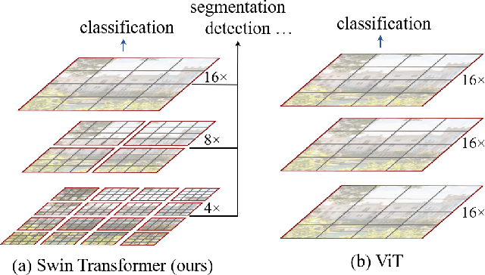
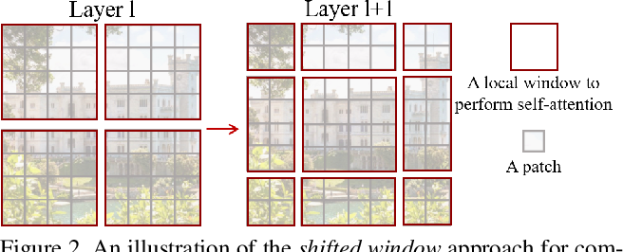
Literature Review
(a.1) Swin-Transformer
(a.2) ViT
(b) Shifted Window

Slide 11
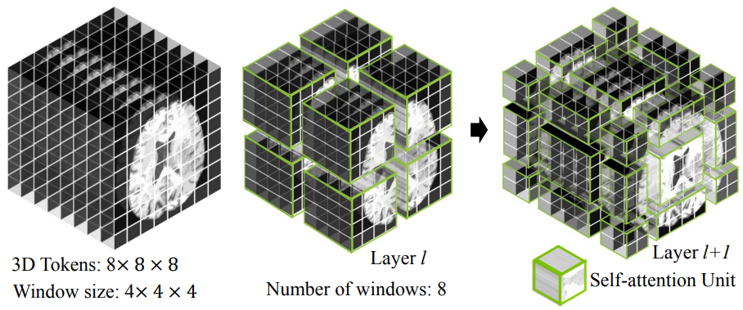
Literature Review

Slide 12
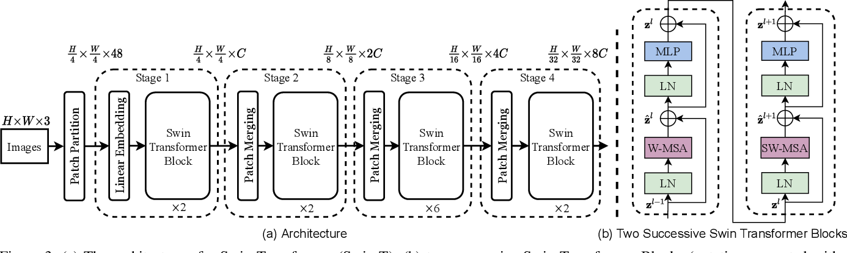
Literature Review

Slide 13
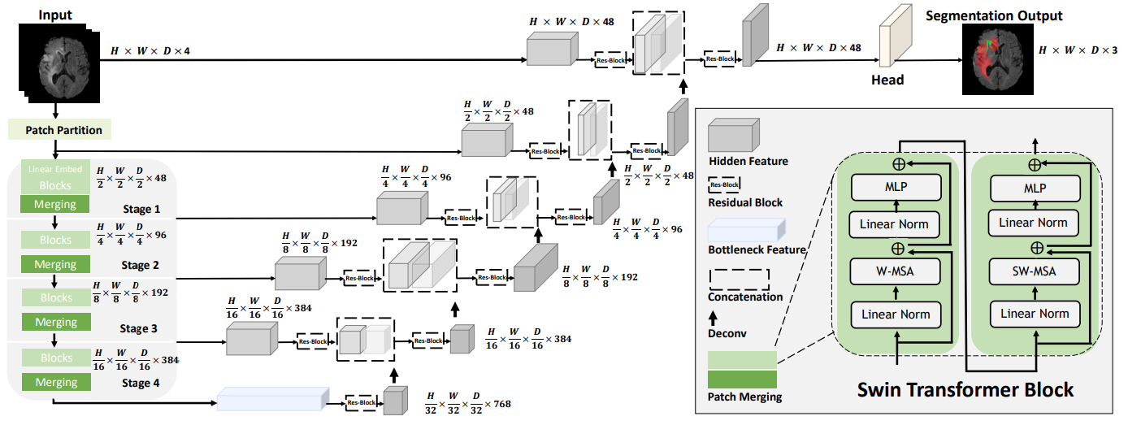
Literature Review

Slide 14
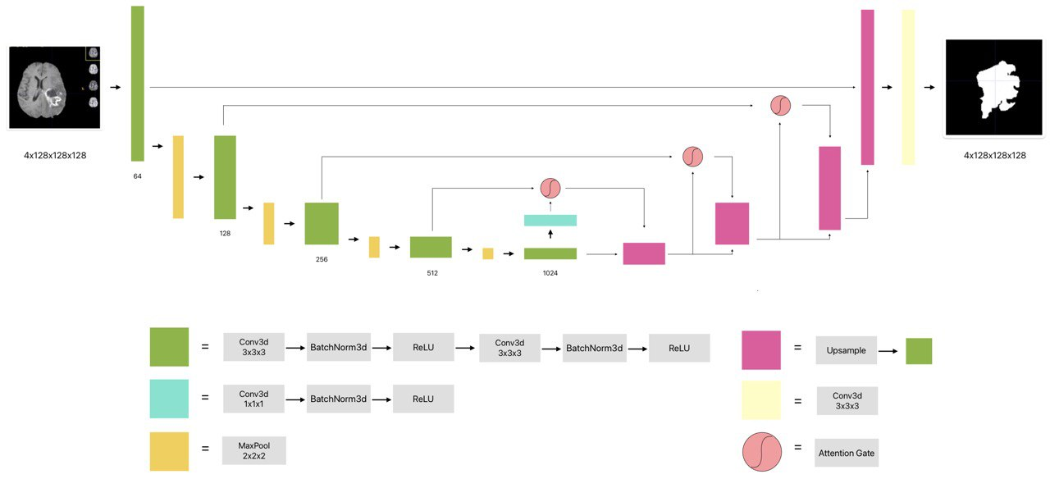
Literature Review

Slide 15
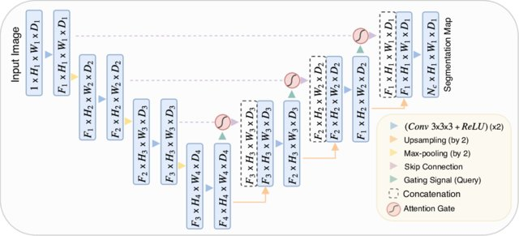
Literature Review

Slide 16
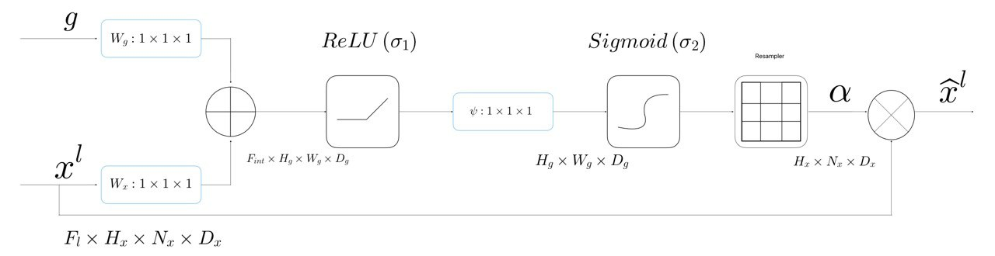
Literature Review

Slide 17
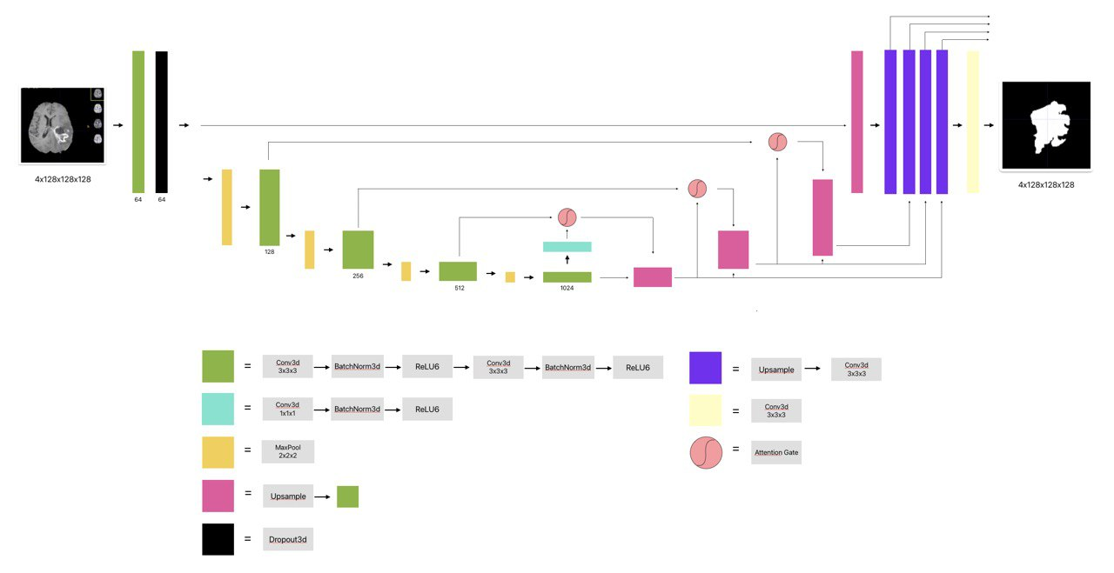
Literature Review

Slide 18




Methodology
Selezionare per scrivere o eliminare il sottotitolo

Slide 19
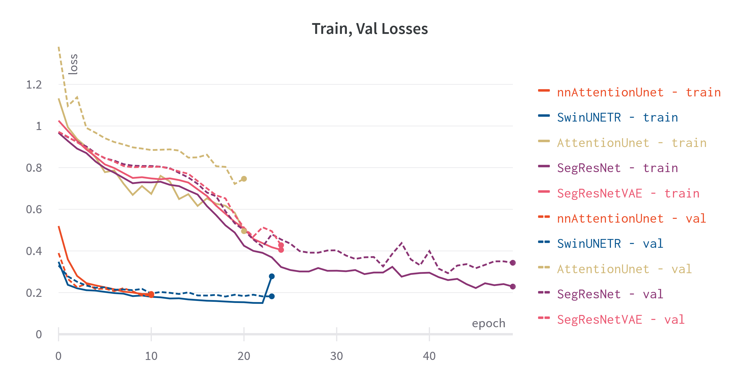
Results
Selezionare per scrivere o eliminare il sottotitolo

Slide 20
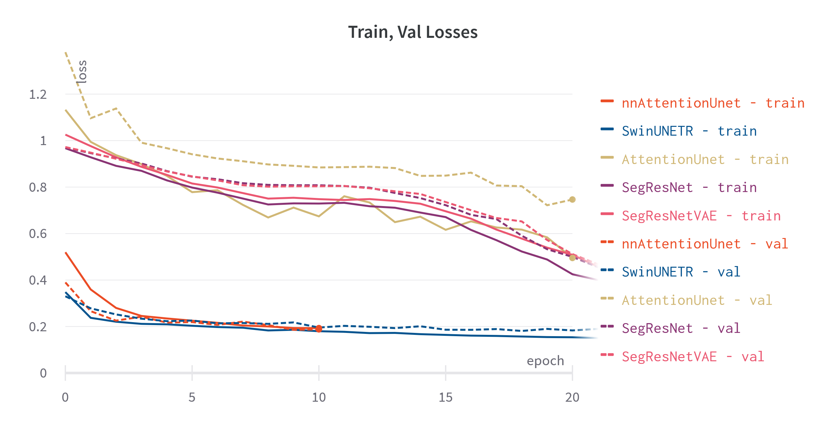
Results
Selezionare per scrivere o eliminare il sottotitolo

Slide 21
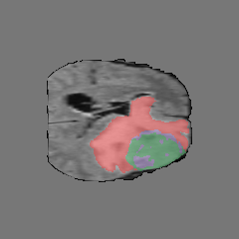
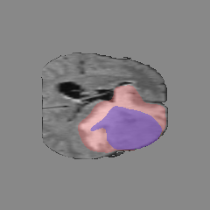
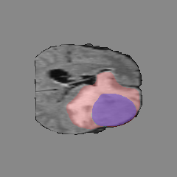
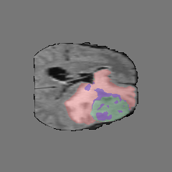
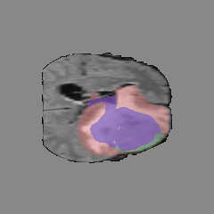
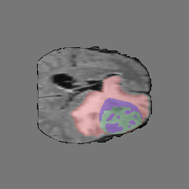
Results
Selezionare per scrivere o eliminare il sottotitolo
Ground truth
SegResNet
SegResNet-VAE
SwinUNETR
Attention UNet
nnAttention UNet

Slide 22
Review
Selezionare per scrivere o eliminare il sottotitolo

Slide 23
Thanks for the Attention

