Slide 1


nnAttention U-net for Brain Tumor Segmentation
Mattia Capparella
ID Number 1746513
Advisor
Maria de Marsico
External Advisors
Ilaria Gianoli Manuel Orlandi

Slide 2

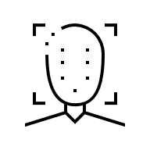

Introduction
COMPUTER VISION
CLASSIFICATION
DETECTION
SEGMENTATION

Slide 3
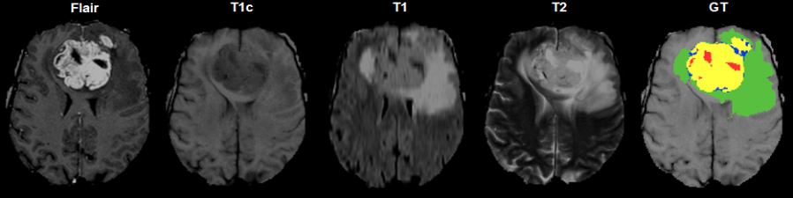
Introduction

Slide 4
Introduction
CSF is dark on T1 imaging
CSF is bright on T2 imaging
CSF is made dark and abnormalities remain bright in FLAIR

Slide 5
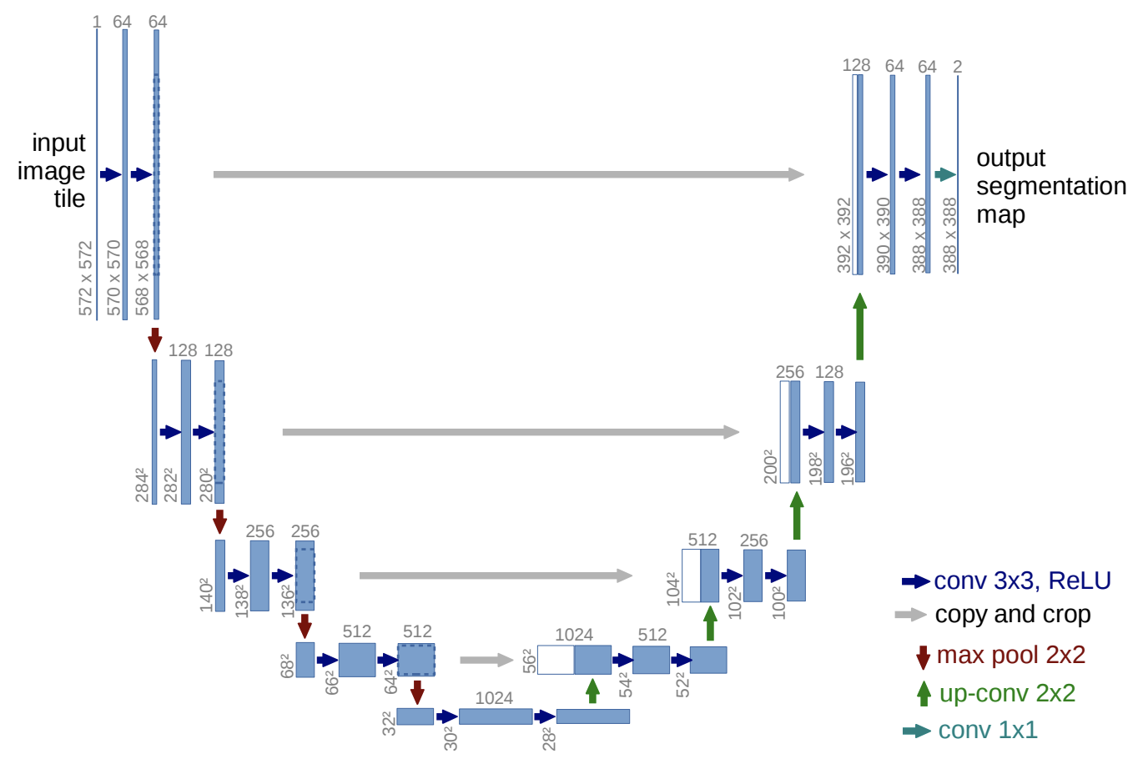
Literature Review

Slide 6
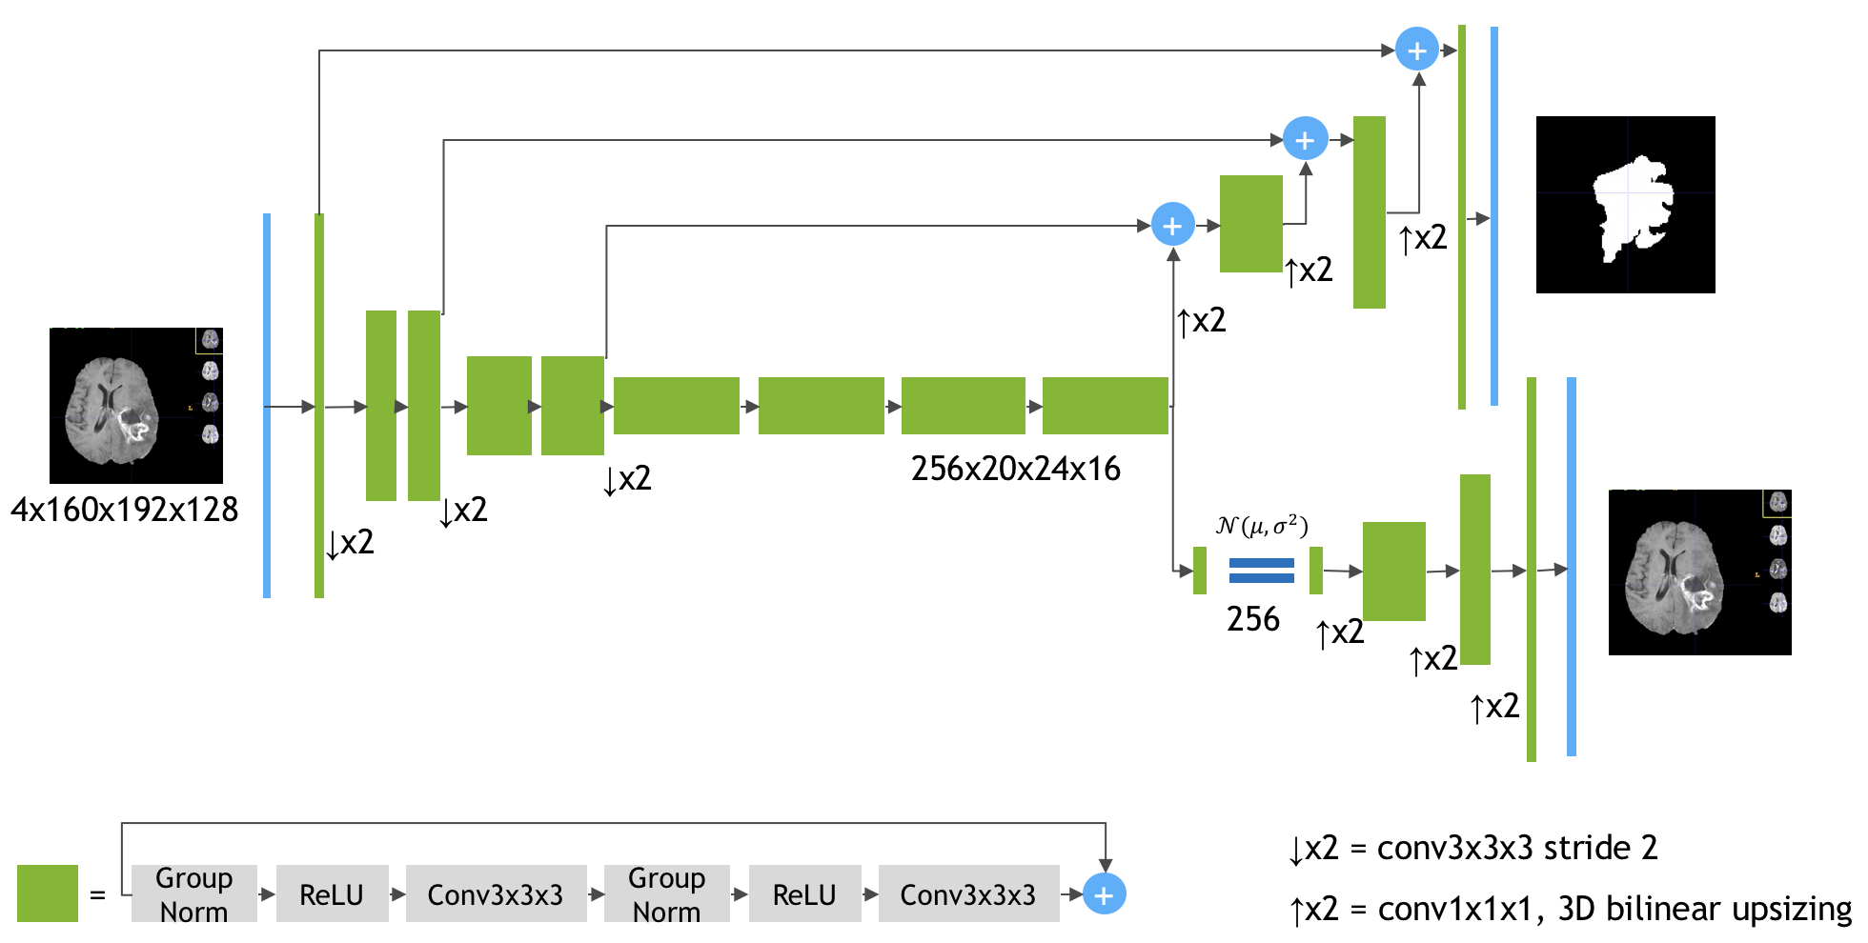
Literature Review
3x160x192x128
4x160x192x128

Slide 7
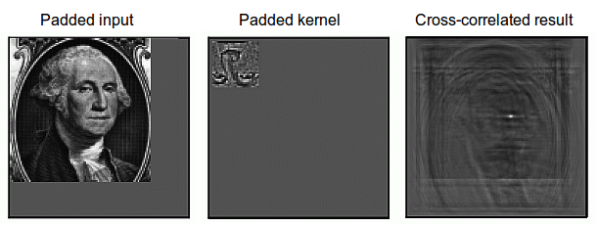
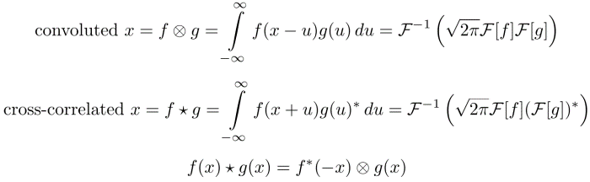
Literature Review
Notes:
https://developer.nvidia.com/discover/convolution
https://timdettmers.com/2015/03/26/convolution-deep-learning/
https://www.tutorialspoint.com/signals-and-systems-relation-between-convolution-and-correlation

Slide 8
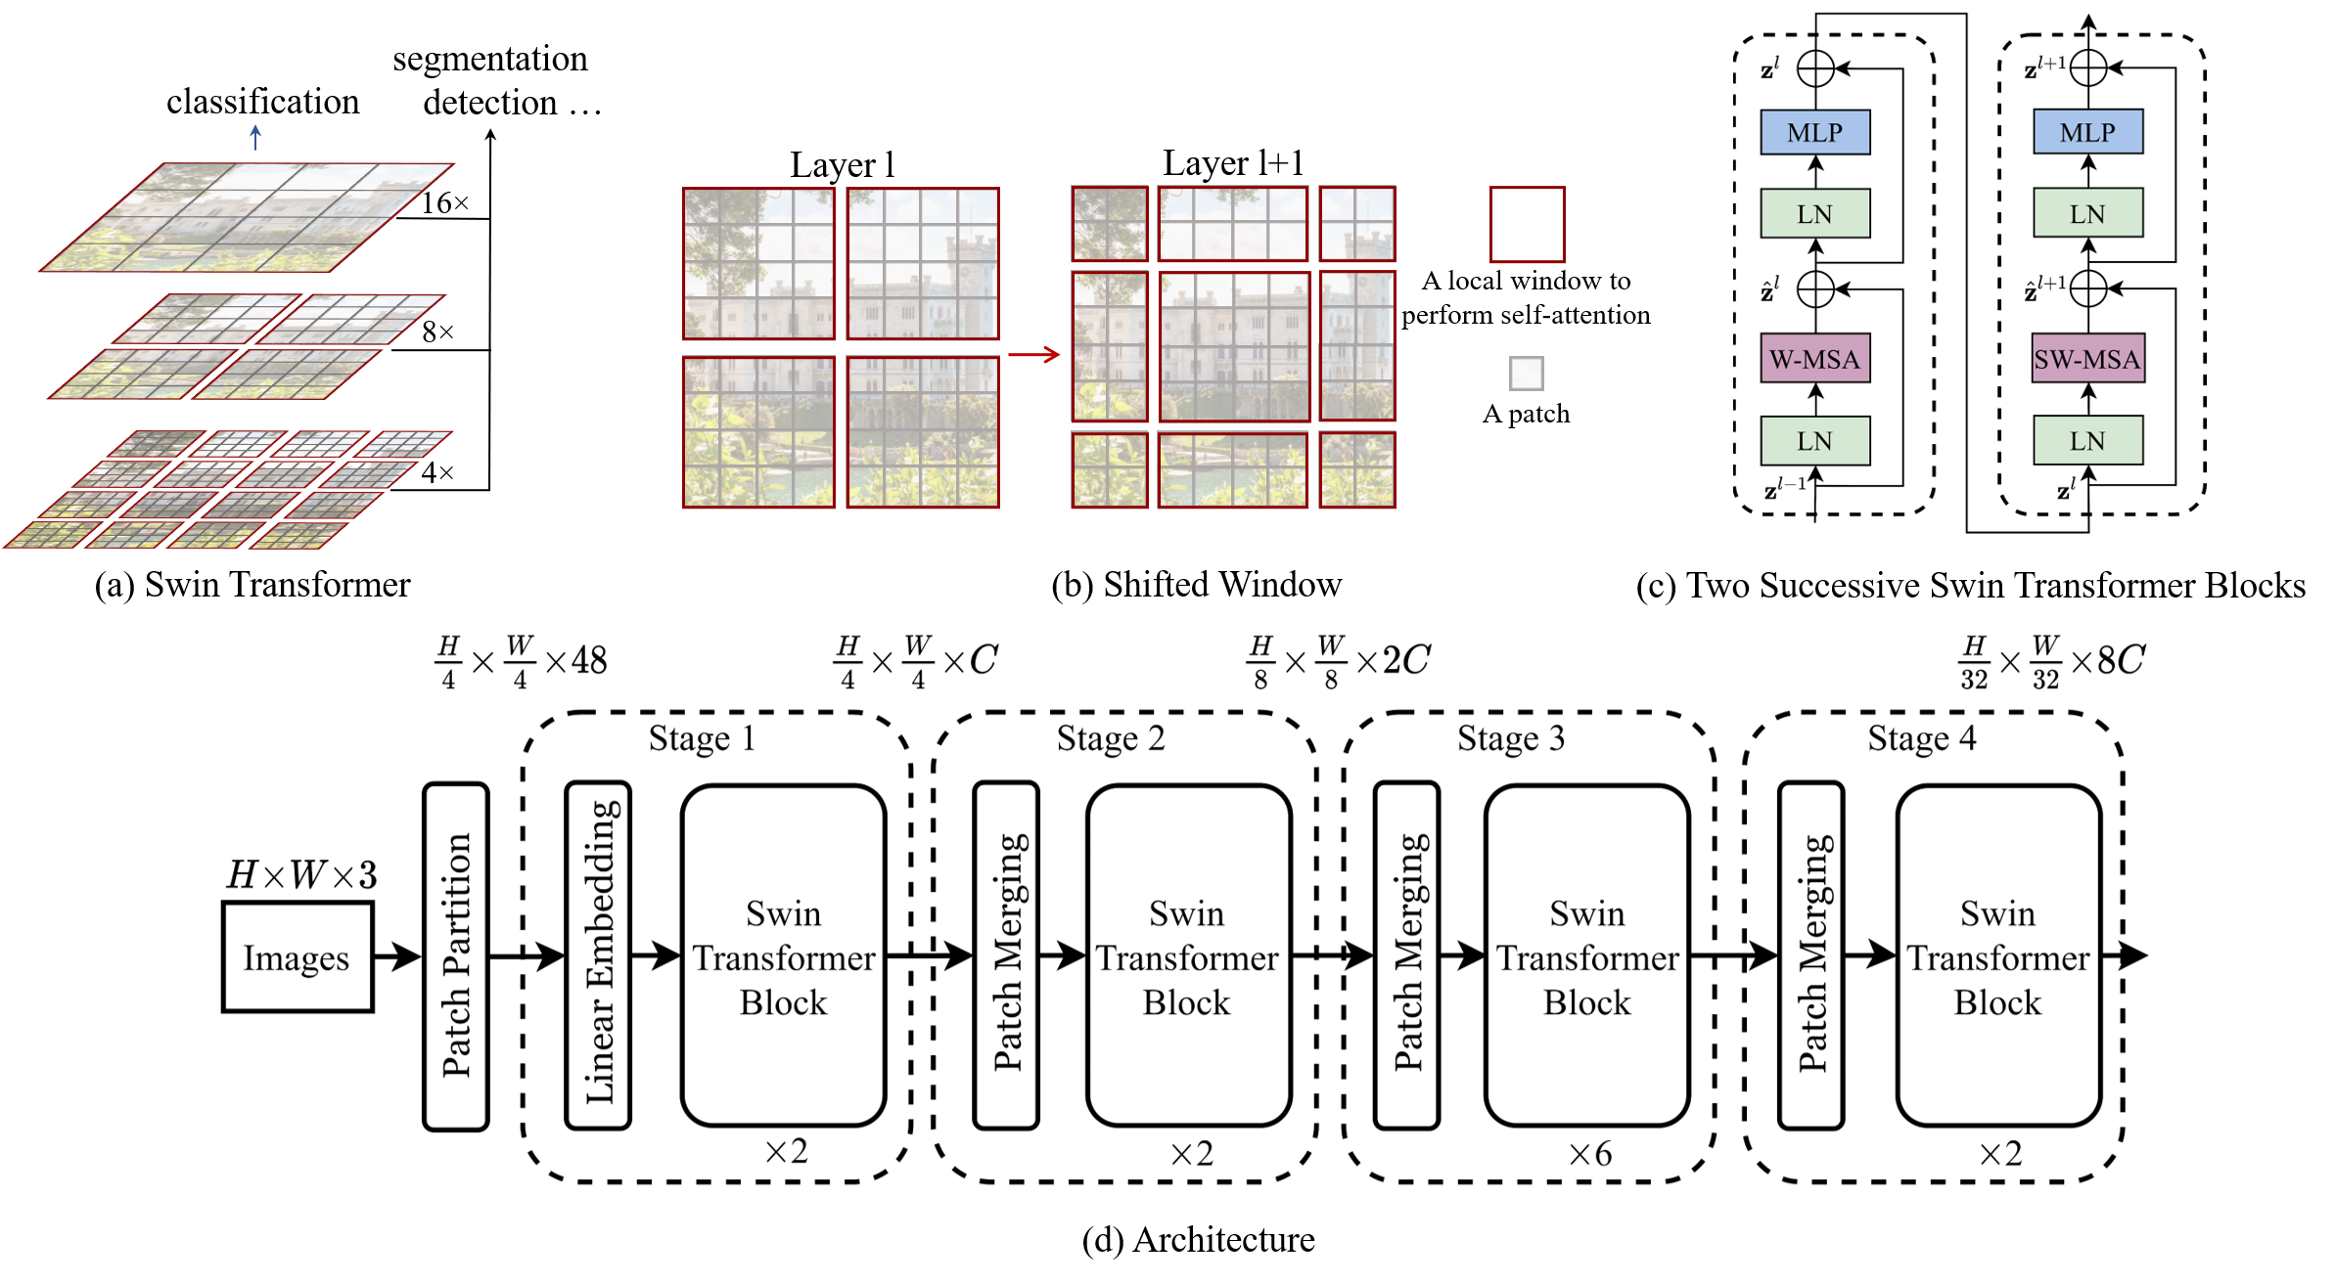
Literature Review

Slide 9
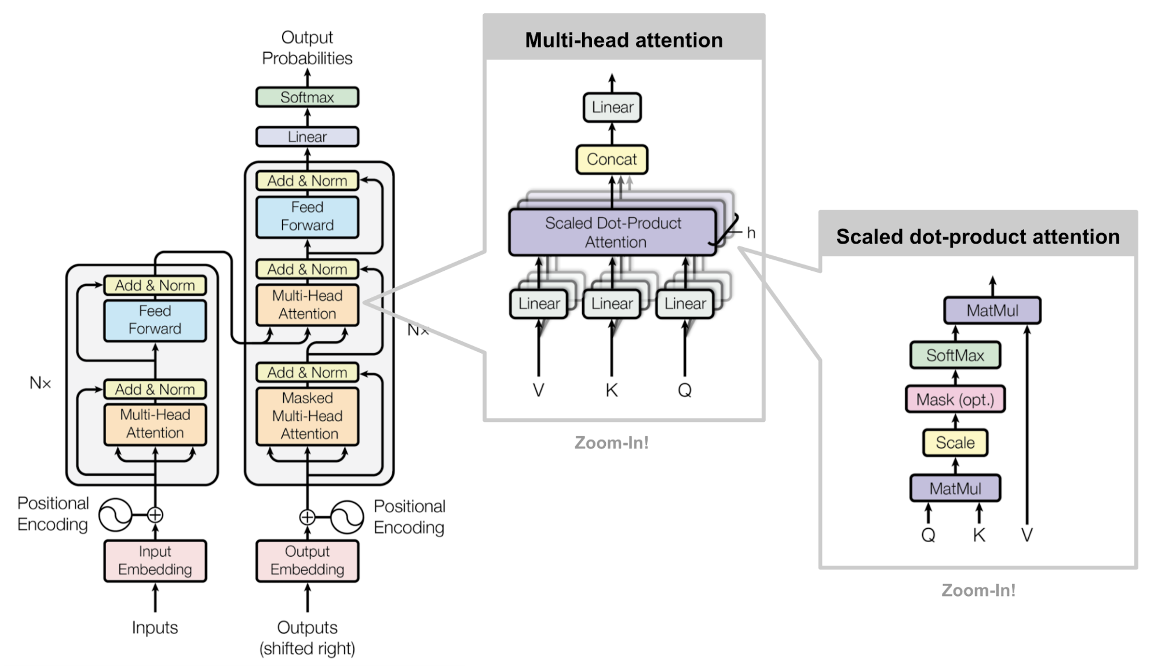
Literature Review
Notes:
https://lightning.ai/docs/pytorch/stable/notebooks/course_UvA-DL/05-transformers-and-MH-attention.html
https://uvadlc-notebooks.readthedocs.io/en/latest/tutorial_notebooks/tutorial6/Transformers_and_MHAttention.html
http://jalammar.github.io/illustrated-transformer/
https://lilianweng.github.io/posts/2020-04-07-the-transformer-family/
https://blogs.nvidia.com/blog/2022/03/25/what-is-a-transformer-model/
https://en.wikipedia.org/wiki/Vision_transformer
https://lightning.ai/docs/pytorch/stable/notebooks/course_UvA-DL/11-vision-transformer.html

Slide 10
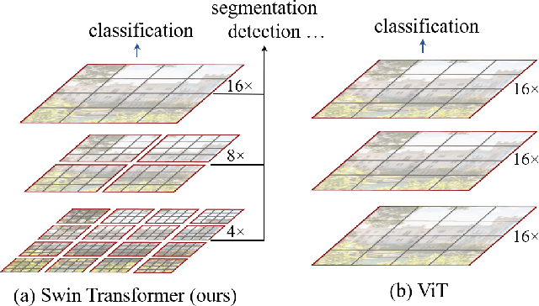
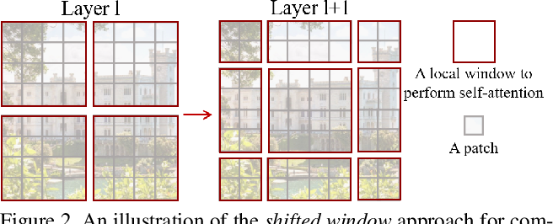
Literature Review
(a.1) Swin-Transformer
(a.2) ViT
(b) Shifted Window

Slide 11
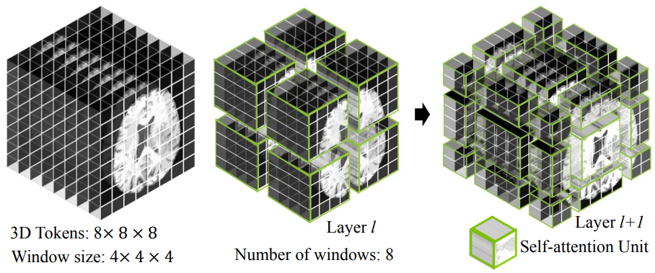
Literature Review

Slide 12
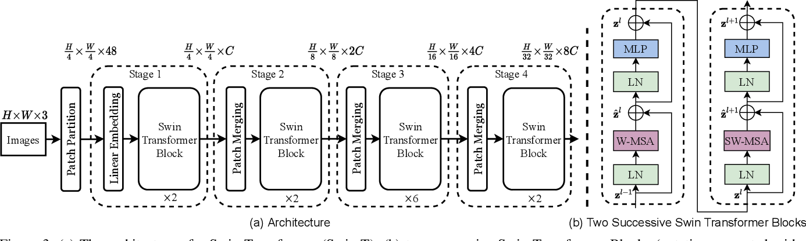
Literature Review

Slide 13
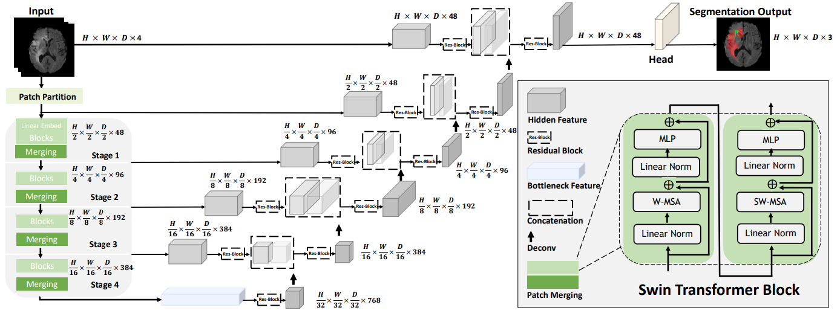
Literature Review

Slide 14
Literature Review

Slide 15
Methodology
Selezionare per scrivere o eliminare il sottotitolo

Slide 16
Results
Selezionare per scrivere o eliminare il sottotitolo

Slide 17
Review
Selezionare per scrivere o eliminare il sottotitolo

Slide 18
Thanks for the Attention

