Slide 1


nnAttention U-net for Brain Tumor Segmentation
Mattia Capparella
ID Number 1746513
Advisor
Maria de Marsico
External Advisors
Ilaria Gianoli Manuel Orlandi

Slide 2



Introduction
COMPUTER VISION
CLASSIFICATION
DETECTION
SEGMENTATION
nnAttention U-net for Brain Tumor Segmentation
Pagina <number>

Slide 3
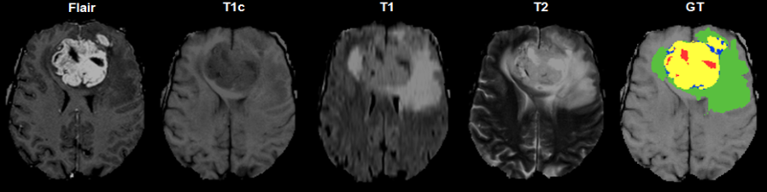
Introduction
nnAttention U-net for Brain Tumor Segmentation
Pagina <number>

Slide 4
Introduction
CSF is dark on T1 imaging
CSF is bright on T2 imaging
CSF is made dark and abnormalities remain bright in FLAIR
nnAttention U-net for Brain Tumor Segmentation
Pagina <number>

Slide 5
Literature Review
nnAttention U-net for Brain Tumor Segmentation
Pagina <number>

Slide 6
Methodology
Selezionare per scrivere o eliminare il sottotitolo
nnAttention U-net for Brain Tumor Segmentation
Pagina <number>

Slide 7
Results
Selezionare per scrivere o eliminare il sottotitolo
nnAttention U-net for Brain Tumor Segmentation
Pagina <number>

Slide 8
Review
Selezionare per scrivere o eliminare il sottotitolo
nnAttention U-net for Brain Tumor Segmentation
Pagina <number>

Slide 9
Thanks for the Attention
nnAttention U-net for Brain Tumor Segmentation
Pagina <number>

