Slide 1

Topic-Building a CGPA Predictor: Merging Probability and Data Visualization
Submitted By- Mohammad Sharique Arshad
Reg. No.- 12310194
Roll No.- 33
Section- E2301(G2)
Submitted To- Dr. Manoj Singh Adhikari
School of Electronics and Electrical Engineering
Lovely Professional University, Phagwara.

Slide 2
Index
Sr. No. | Content | Page No.
1 | Introduction | 3
2 | Understanding the CGPA Calculation | 4
3 | Implementing the Grade Input System | 5
4 | Designing the Probability Model | 6
5 | Implementing the Python Code | 7-9
6 | Putting It All Together | 10
7 | Output Obtained From The Code | 11
8 | Pie Chart Obtained From Output | 12
9 | Visualizing Grade Distribution | 13
10 | Enhancements | 14
11 | Future Uses | 15
12 | Conclusion | 16

Slide 3
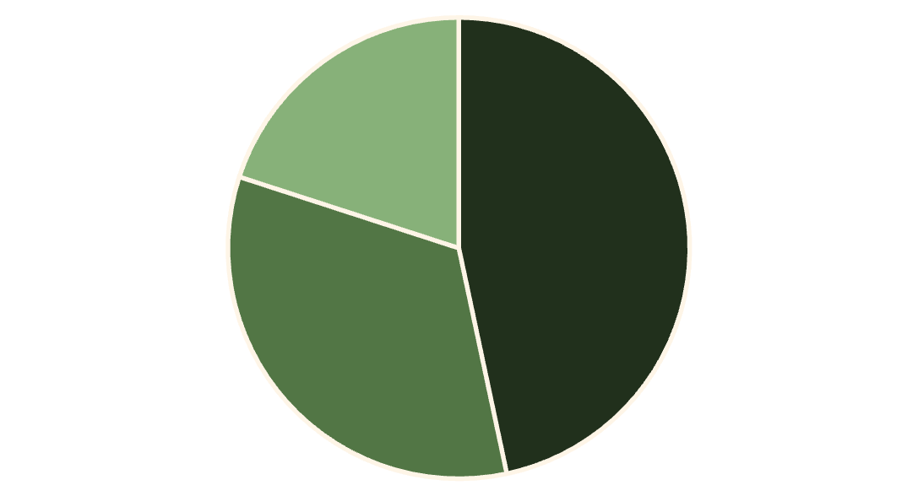
Building a CGPA Predictor: Merging Probability and Data Visualization
Welcome to an exciting journey into the world of academic performance prediction! In this project, I'll create a CGPA (Cumulative Grade Point Average) Predictor that combines probability modeling with data visualization. This tool will not only calculate a student's current CGPA but also forecast future academic performance, presenting the results through engaging pie charts.
As we dive into this project, we'll explore key concepts in Python programming, probability theory, and data visualization using matplotlib. Whether you're a budding data scientist or a curious student, this project will provide valuable insights into practical applications of these fields. Let's embark on this educational adventure and unlock the power of predictive analytics!

Slide 4
Understanding the CGPA Calculation
Before we delve into prediction, it's crucial to understand how CGPA is calculated. The Cumulative Grade Point Average is a measure of a student's overall academic performance, taking into account all courses taken so far. It's calculated by converting letter grades to numerical grade points, then averaging these points across all courses.
In our project, we'll use a standard grade to GPA conversion scale. For example, an 'A' is typically worth 10.0 points, while a 'B' might be 7.0 points. This conversion allows us to quantify performance across different courses and calculate an overall average.
1
Input Grades
3
Calculate Average
Collect letter grades for each course taken
Sum up all GPA points and divide by the number of courses
2
Convert to GPA
4
Display CGPA
Use the grade_to_gpa dictionary to convert
letter grades to numerical values
Present the final CGPA to two decimal places

Slide 5
Implementing the Grade Input System
Our CGPA Predictor begins with a robust grade input system. We'll create a function called get_grades() that prompts the user to enter their grades for multiple courses. This function will continue to accept inputs until the user indicates they're finished, allowing for flexibility in the number of courses.
To ensure data integrity, we'll implement error handling to validate each input. If a user enters an invalid grade, the system will prompt them to try again, maintaining the accuracy of our calculations.
1
User-Friendly Interface
2
Input Validation
Design an intuitive input system that guides users through the grade entry process
Implement checks to ensure only valid grades are accepted, improving data quality
3
Flexible Course Count
4
Error Handling
Allow users to input grades for any number of courses, accommodating various academic scenarios
Provide clear feedback for invalid inputs, guiding users towards correct data entry

Slide 6
Designing the Probability Model
At the heart of our CGPA Predictor lies a probability model that estimates the likelihood of achieving different CGPA ranges in the future. This model, while simplified for educational purposes, demonstrates how past performance can be used to predict future outcomes.
Our predict_cgpa_range() function takes the current CGPA as input and returns a list of probabilities for different CGPA ranges. These ranges are typically divided into high (8.5-10.0), medium-high (7.0-8.5), medium (5.0-7.0), and low (8.5-5.0) categories.
Current CGPA: 8.5+
Current CGPA: 7.0-8.49
Current CGPA: Below 7.0
High chance of maintaining excellence
Good chance of improvement
Higher chance of lower ranges
70% for 8.5-10.0
10% for 8.5-10.0
5% for 7.0-8.49
25% for 7.0-8.49
60% for 7.0-8.49
20% for 5.5-7.0
5% for 5.5-7.0
25% for 5.5-7.0
60% for 4.0-5.5
5% for 4.0-5.5
15% below 4.0

Slide 7
Implementing the Python Code:
import numpy as np
import matplotlib.pyplot as plt
# Grade to GPA conversion
grade_to_gpa = {
'A+': 10, 'A': 9, 'A-': 8,
'B+': 7, 'B': 6, 'B-': 5,
'C+': 4, 'C': 3, 'C-': 2,
'D+': 1, 'D': 0, 'F': 0
}
def get_grades():
grades = []
subjects = ['Probability and Statistics', 'Analog Electronics', 'Digital Electronics', 'PEL', 'Signals and Systems']
for subject in subjects:
while True:
grade = input(f"Enter grade for {subject} (A+, A, A-, B+, B, B-, C+, C, C-, D+, D, F): ").upper()
if grade in grade_to_gpa:
grades.append(grade)
break
else:
print("Invalid grade. Please try again.")
return grades

Slide 8
Implementing the Python Code:
def calculate_cgpa(grades):
total_points = sum(grade_to_gpa[grade] for grade in grades)
return total_points / len(grades)
def predict_cgpa_range(current_cgpa):
# Simple probability model
if current_cgpa >= 8:
return [0.7, 0.25, 0.05, 0]
elif current_cgpa >= 6:
return [0.1, 0.6, 0.25, 0.05]
elif current_cgpa >= 4:
return [0.05, 0.2, 0.6, 0.15]
else:
return [0, 0.1, 0.3, 0.6]
def plot_grade_distribution(grades):
grade_counts = {grade: grades.count(grade) for grade in set(grades)}
plt.figure(figsize=(10, 5))
plt.pie(grade_counts.values(), labels=grade_counts.keys(), autopct='%1.1f%%')
plt.title("Grade Distribution")
plt.axis('equal')
plt.show()

Slide 9
Implementing the Python Code:
def plot_cgpa_prediction(probabilities):
labels = ['8-10', '6-7.9', '4-5.9', '0-3.9']
plt.figure(figsize=(10, 5))
plt.pie(probabilities, labels=labels, autopct='%1.1f%%')
plt.title("CGPA Range Probability Prediction")
plt.axis('equal')
plt.show()
# Main program
grades = get_grades()
cgpa = calculate_cgpa(grades)
probabilities = predict_cgpa_range(cgpa)
print(f"\nCalculated CGPA: {cgpa:.2f}")
print("\nProbability of achieving CGPA ranges:")
for range, prob in zip(['8-10', '6-7.9', '4-5.9', '0-3.9'], probabilities):
print(f"{range}: {prob*100:.1f}%")
plot_grade_distribution(grades)
plot_cgpa_prediction(probabilities)

Slide 10
Putting It All Together: The Main Program
Now that we've built all the components of our CGPA Predictor, it's time to assemble them into a cohesive program. The main part of our script will orchestrate the flow of data through each function we've created, from input to calculation to visualization.
We'll start by calling get_grades() to collect user input, then use calculate_cgpa() to determine the current CGPA. Next, we'll feed this CGPA into predict_cgpa_range() to get our probability predictions. Finally, we'll display the results and call our visualization functions to create the pie charts.
Step
Function
Purpose
1
get_grades()
Collect grade inputs from user
2
calculate_cgpa()
Compute current CGPA
3
predict_cgpa_range()
Generate probability predictions
4
plot_grade_distribution()
Create grade distribution chart
5
plot_cgpa_prediction()
Create CGPA prediction chart

Slide 11
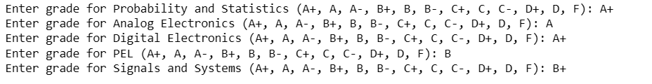
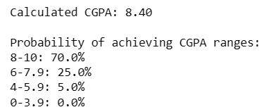
Output Obtained From The Code
Input:
Output:

Slide 12
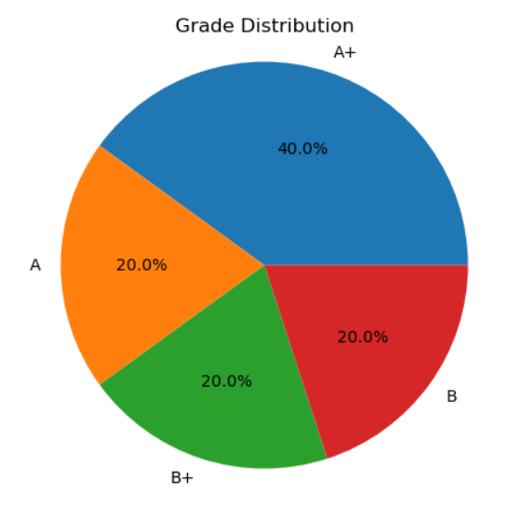
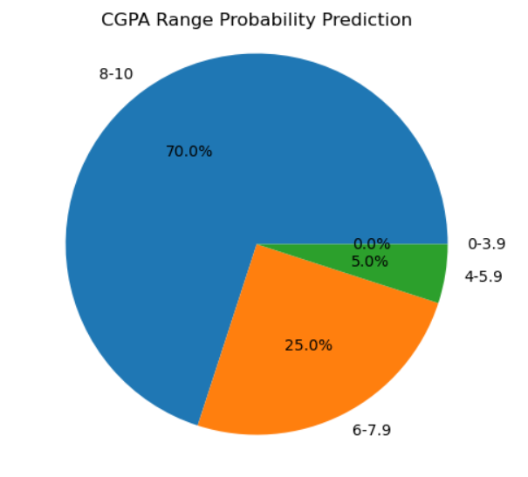
Pie Chart Obtained From Output

Slide 13
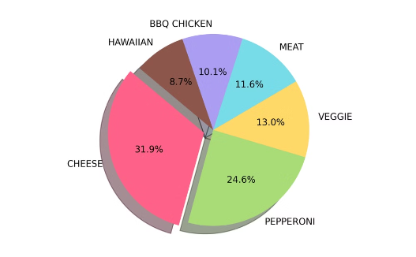
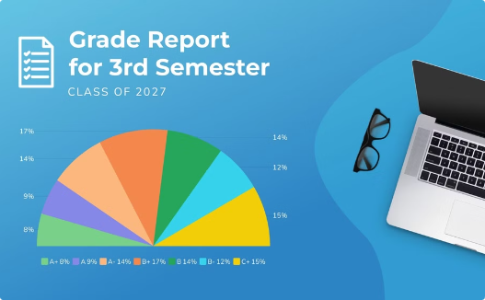
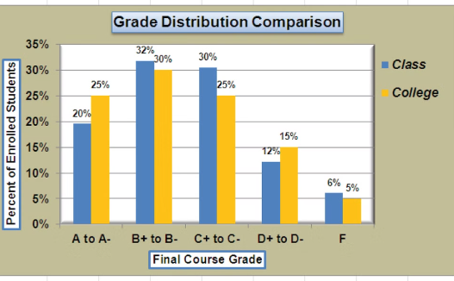
Visualizing Grade Distribution
Visualization is key to understanding data patterns. In our CGPA Predictor, we'll create a pie chart to display the distribution of grades entered by the user. This visual representation allows students to quickly grasp their overall performance across different courses.
We'll use matplotlib, a powerful plotting library in Python, to create this chart. The plot_grade_distribution() function will take the list of grades as input and generate a colorful pie chart showing the percentage of each grade received.
Matplotlib Code
Resulting Pie Chart
Data Analysis
The Python code snippet using matplotlib to create a pie chart of grade distribution
The colorful pie chart showing the percentage breakdown of different grades
A student examining their grade distribution to identify strengths and areas for improvement

Slide 14
Extending the Project: Future Enhancements
While our CGPA Predictor is already a powerful tool, there's always room for improvement and expansion. As you become more comfortable with the concepts and code, consider these potential enhancements to take your project to the next level:
You could implement a more sophisticated probability model that takes into account factors like course difficulty or historical grade trends. Another exciting addition would be a graphical user interface (GUI) using a library like Tkinter, making the application more user-friendly and visually appealing.
Advanced Probability Model
Graphical User Interface
Incorporate machine learning algorithms to improve prediction accuracy based on larger datasets and more variables
Develop a user-friendly GUI using Tkinter or PyQt to make the application more accessible to non-technical users
Broaden Subject and Course Offerings
Additional Visualizations
Expand the platform’s library to cover a wider variety of subjects and courses, catering to different fields of study and professional interests
Create more advanced charts and graphs, such as line plots showing grade trends or heatmaps of performance across different subjects

Slide 15
Future Uses of This Model
Academic Planning for Students
Career Counselling and Guidance
Course and Module Selection
Goal Setting and Progress Tracking
Career Path Exploration
Skills and Competency Development
Research and Data Analysis in Education
Personalized Learning and Academic Support
Understanding Performance Influencers
Educational Policy and Program Design
Customized Study Recommendations
Resource Allocation and Tutoring
Long-term Academic and Career Planning Tools
Institutional Performance and Curriculum Enhancement
Advanced Data for Academic Advisors
Predictive Analytics for Lifelong Learning
Faculty Development and Training
Curriculum Design and Improvement
With these varied applications, CGPA prediction tools have the potential to transform both individual learning experiences and broader educational systems, fostering a culture of personalized, data-informed education.

Slide 16
Conclusion: The Power of Predictive Analytics in Education
As we conclude our journey through the CGPA Predictor project, it's important to reflect on the broader implications of what we've created. This tool is more than just a grade calculator; it's a gateway into the world of predictive analytics and its potential applications in education.
By combining probability models with data visualization, we've created a powerful tool that can help students understand their academic standing and set realistic goals for improvement. Moreover, this project serves as an excellent introduction to key concepts in programming, statistics, and data science - skills that are increasingly valuable in today's data-driven world.
Present
Future
CGPA Predictor provides instant insights into academic performance
AI-powered systems provide personalized learning recommendations
1
2
3
4
Near Future
Far Future
Advanced models incorporate more variables for improved accuracy
Predictive analytics become integral to educational systems worldwide

