Slide 1
Yapp Router
Verification project

Slide 2
Router Spec

Slide 3
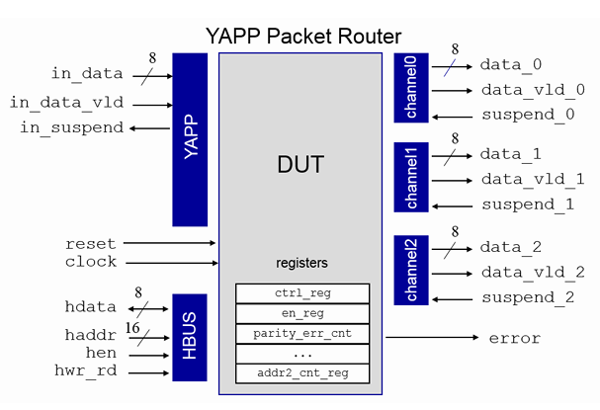
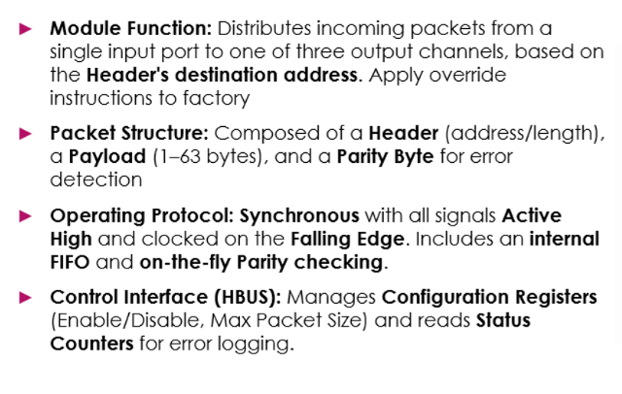
Router Spec

Slide 4
Verification Plan

Slide 5
Verification Plan
features
assumptions
·
configuration
sequences
environment
coverage

Slide 6
Creating a Simple UVC

Slide 7
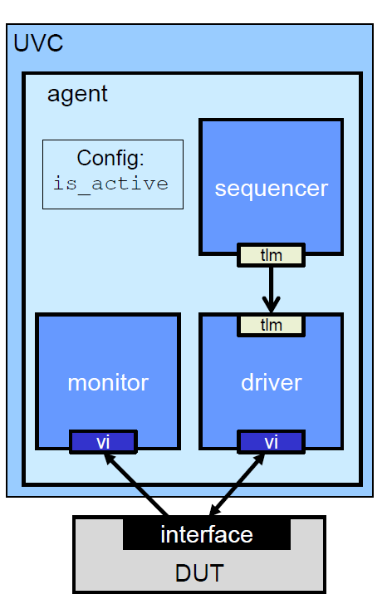
A Simple UVC-
uvm verification component

Slide 8
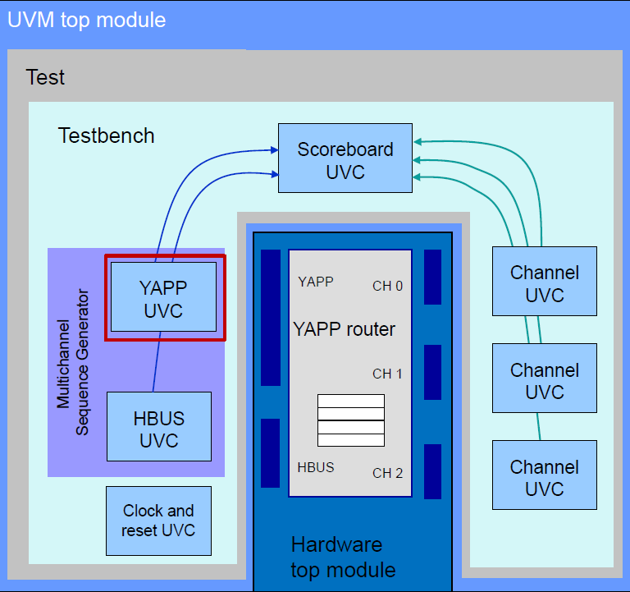
The agent’s kinds in our project
YAPP – active - injects the packets to DUT.
HBUS – active – Interface for the configuration of the DUT.
CHANNEL – active-slave - collect information from the DUT and forward it to the scoreboard.
its drive suspend signal to the DUT.

Slide 9
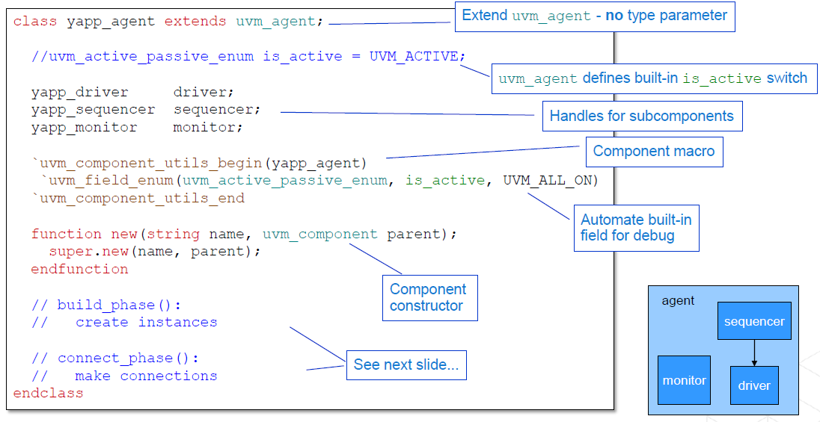
Creating the Agent : Declaration

Slide 10
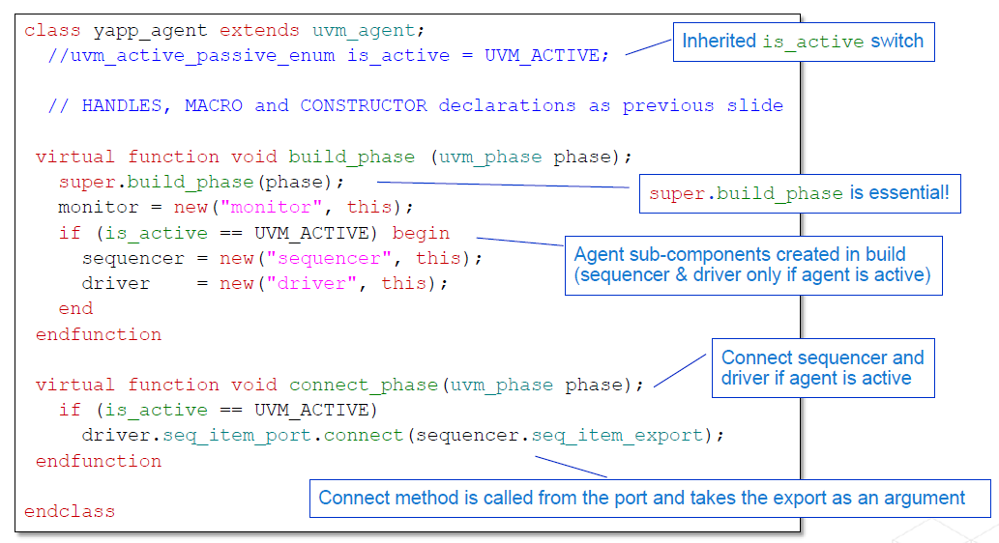
Creating the Agent : Build and Connect

Slide 11
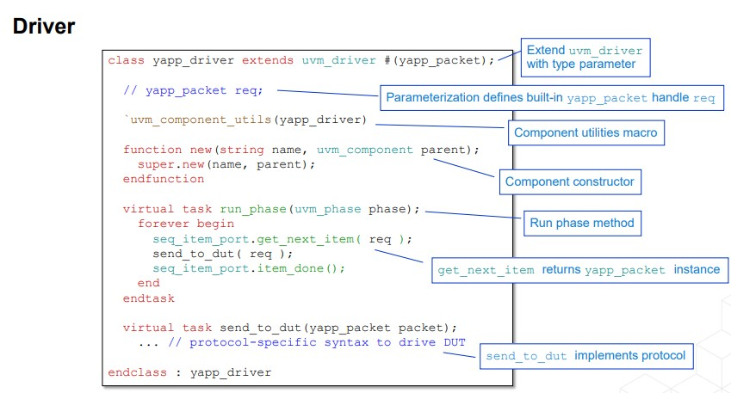
The Driver

Slide 12
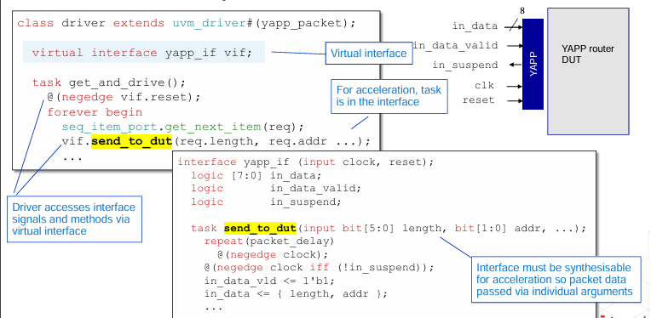
Send To DUT

Slide 13
Using Factory

Slide 14
Factory
Central location to create class instances
Each type is registered with factory
Instances created via factory call
Not via class constructor
Apply override instructions to factory
Make all yapp_packet instances short_packet instead
Factory returns class instance

Slide 15
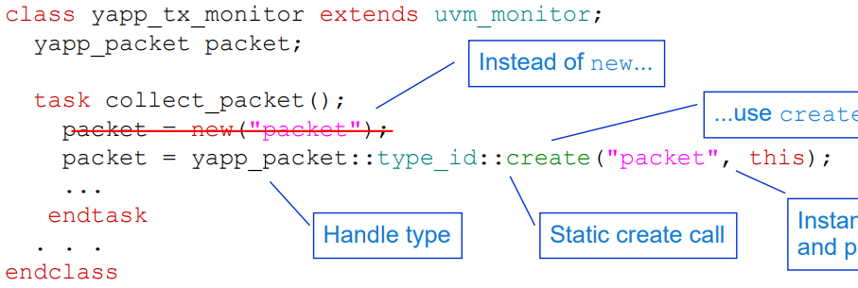
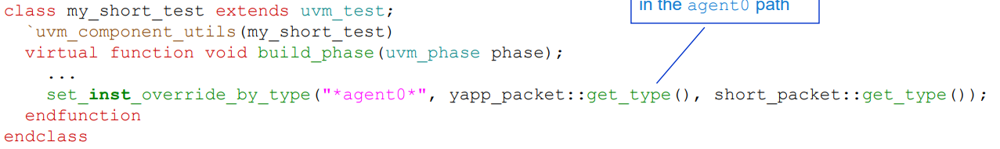
Example

Slide 16
configuration
uvm_config_db
Configuration allows for the customization
and control of system properties and behaviors.

Slide 17
Configuring Topology
Control topology during the build, for example:
Set UVC agent active or passive.
Set the number of UVC master and slave agents.
Properties must be set before components are created
The config database is searched
for a matching pathname and field name
Settings are applied only when match is found

Slide 18
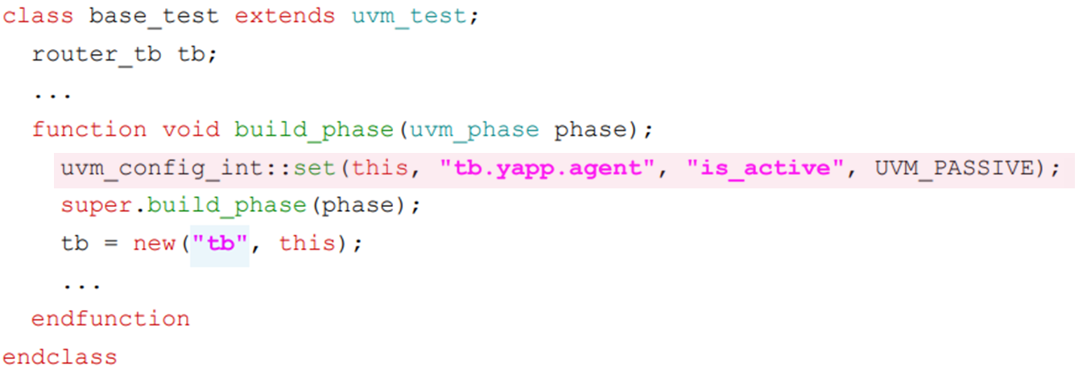
Example
UVM_ACTIVE
--------------------------------------------------

Slide 19
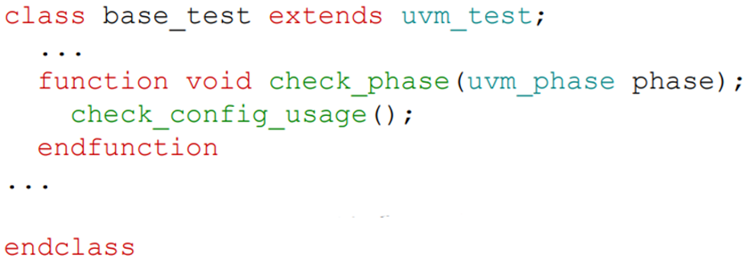
Checking
Configurations can be checked by calling check_config_usage();

Slide 20
Generating UVM Sequences

Slide 21
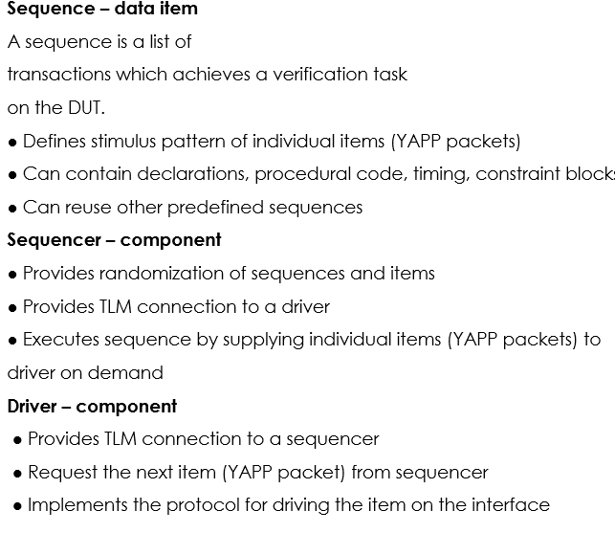
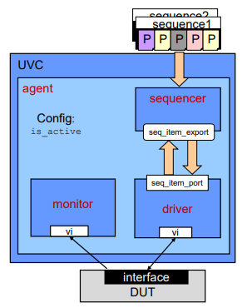
Sequences and UVCs Review

Slide 22
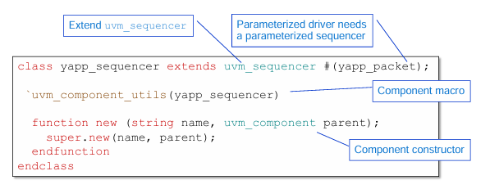
Sequencer
We created a yapp_tx_sequencer class that inherits from uvm_sequencer,A sequencer is an intermediary that creates a connection between a sequencer and a driver. After that, it passes transactions or sequence item to the driver so that they can be driven to the DUT. The sequencer accepts yapp_packet as a parameter.

Slide 23
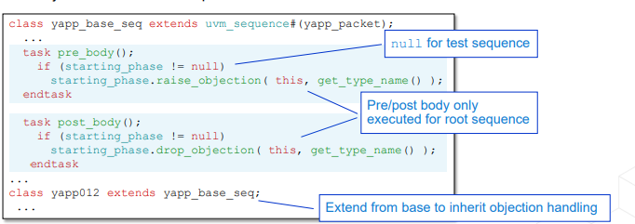
Objection Handling
UVM uses an objection mechanism, based on consensus, to end simulation.
As soon as UVM enters the run phase, it immediately tries to exit. A sequence needs to hold off the exit by raising an objection when it starts.
When the sequence ends, it must drop the objection to allow the phase to end.
We created a `class yapp_base_seq` that inherits uvm_sequence and extended it with classes that inherits it.
In the `yapp_base_seq` class, in the `pre_body()` ,we raised an objection to prevent the termination of the simulation, and in the `post_body()`, we dropped the objection.

Slide 24
Sequence
We created sequences to examine different cases , for example:
1. **yapp_rnd_seq**:
- Description: This sequence generates a random number of good packets and sends them to different addresses.
- Purpose: Testing the behavior of your design when it receives random good packets at various addresses.
2. **yapp_bad_addr_seq**:
- Description: This sequence produces packets with invalid addresses.
- Purpose: Testing how your design handles packets with invalid addresses, checking if it can detect and handle such packets appropriately.
3. **yapp_bad_parity_seq**:
- Description: This sequence produces bad parity packets.
- Purpose: Verifying how your design responds to packets with incorrect parity, ensuring that error detection mechanisms work as intended.
4. **yapp_repeat_addr_seq**:
- Description: This sequence sends several good packets to the same (random) address.
- Purpose: Evaluating your design performance and stability when receiving multiple packets addressed to the same destination.
5. **yapp_oversized_seq**:
- Description: This sequence produces oversized packets.
- Purpose: Assessing how your design handles packets that exceed the expected size, verifying that it correctly manages oversized data.

Slide 25
Router Verification Components

Slide 26
Router Verification Environment
The topmost component in a UVM environment is the test class. Its key roles are:
Instantiation of the router environment component
Configuration of UVC properties and policies
Selection of stimulus for interface UVCs
Controlling generation of data stimulus using type overrides
The router environment component:
Instantiates UVCs (both interface and module)
Instantiates other components such as multichannel sequencers, register models etc.
Configures the UVCs

Slide 27
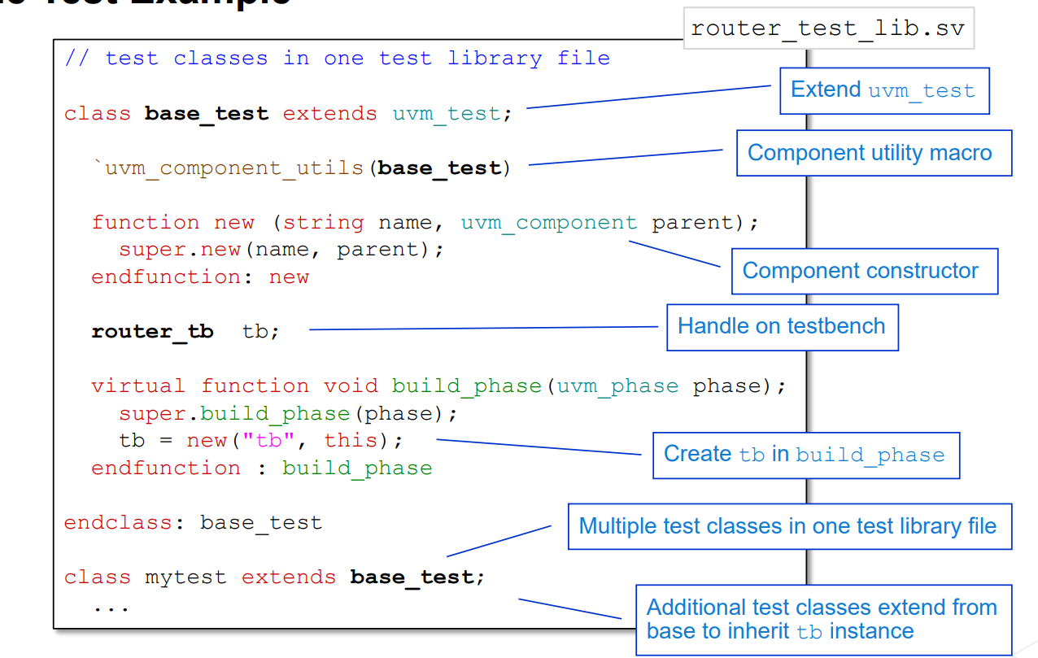
Test

Slide 28
Tests
simple_test
Description: Runs multiple sequences — yapp_012_seq for YAPP packets, clk10_rst5_seq for clock/reset, and channel_rx_resp_seq for the channel receivers.
Purpose: Verifies the full system integration — sending packets, receiving responses through the channels, and ensuring synchronization between all interfaces.
yapp_012_test
Description: Uses yapp_012_seq to send packets to addresses 0, 1, and 2.
Purpose: Tests routing functionality and packet delivery to all legal output channels.
reg_access_test
Description: Performs register-level operations (read, write, peek, poke) using the UVM register model.
Purpose: Validates accessibility and correctness of DUT registers via both frontdoor and backdoor paths.
reg_function_test
Description: Sends packets (yapp_012_seq) while monitoring the register counters that track packet activity.
Purpose: Confirms that register values correctly reflect the number of packets processed by the DUT and channels.
test_mc
Description: Runs the router_simple_mcseq sequence, which activates multiple channels and sends packets in parallel.
Purpose: Verifies that the router correctly handles multi-channel communication, ensuring data integrity and stability under concurrent traffic.
.

Slide 29
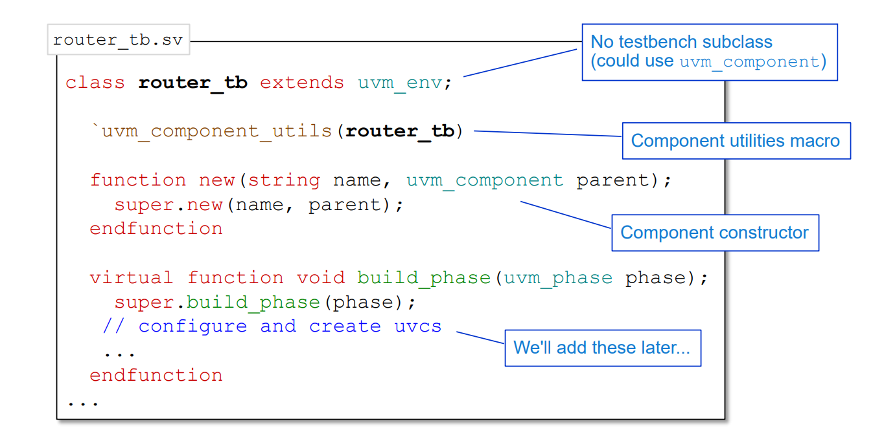
Router Environment
At this stage we created the basis for the environment without DUT integration

Slide 30
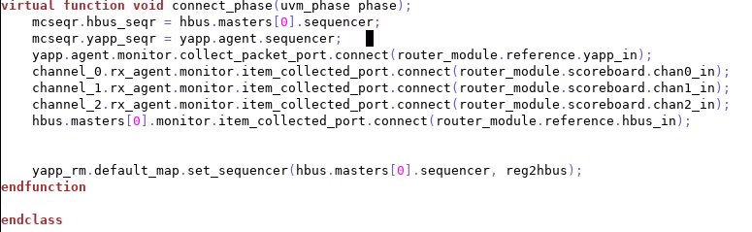
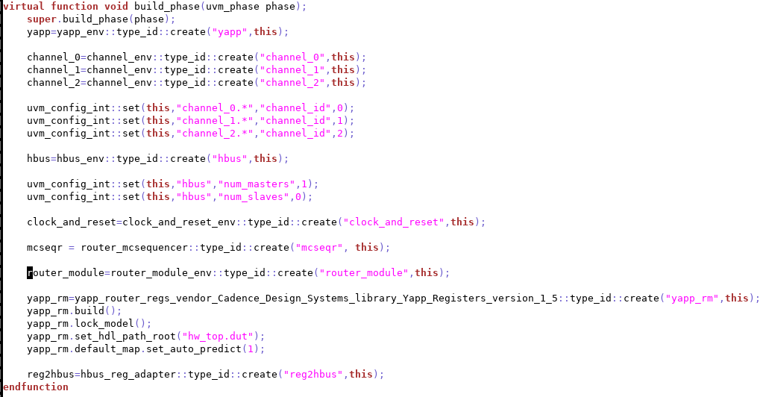
Build And Connect Phases

Slide 31

Connecting to Dut

Slide 32
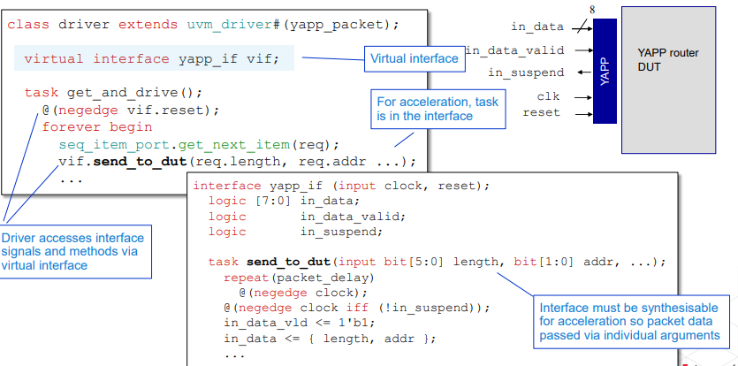


Connecting to a DUT

Slide 33
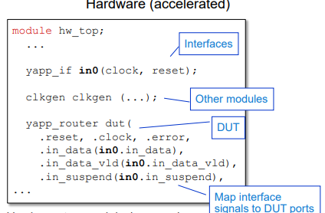

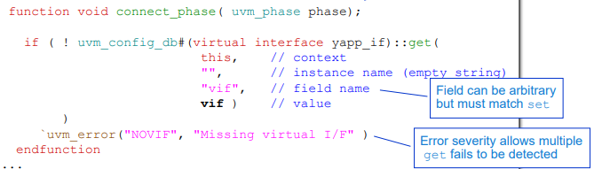
connect to virtual interface

Slide 34
Integrating Multiple UVCs

Slide 35
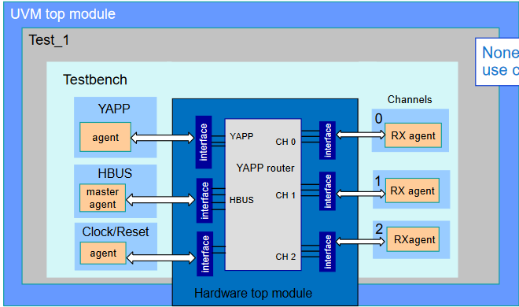
Integrating Multiple UVCs

Slide 36
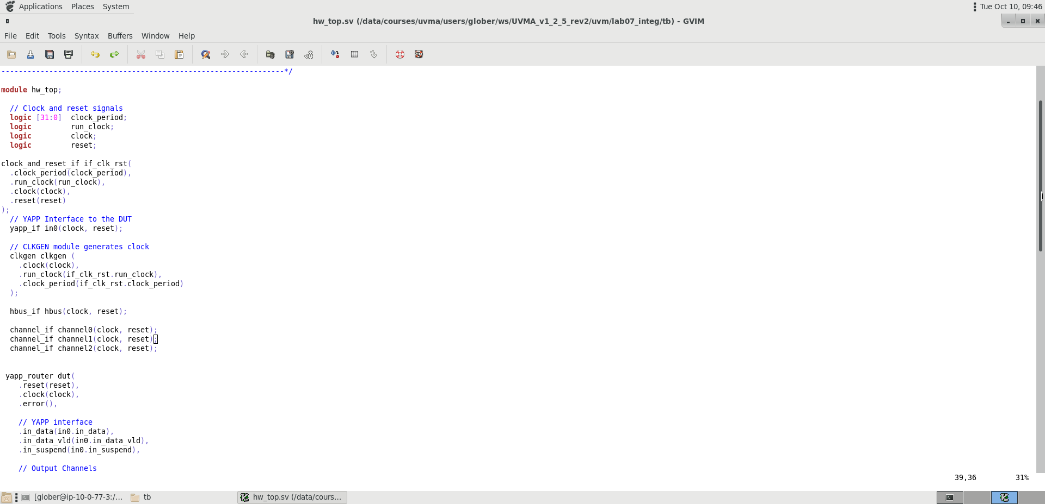
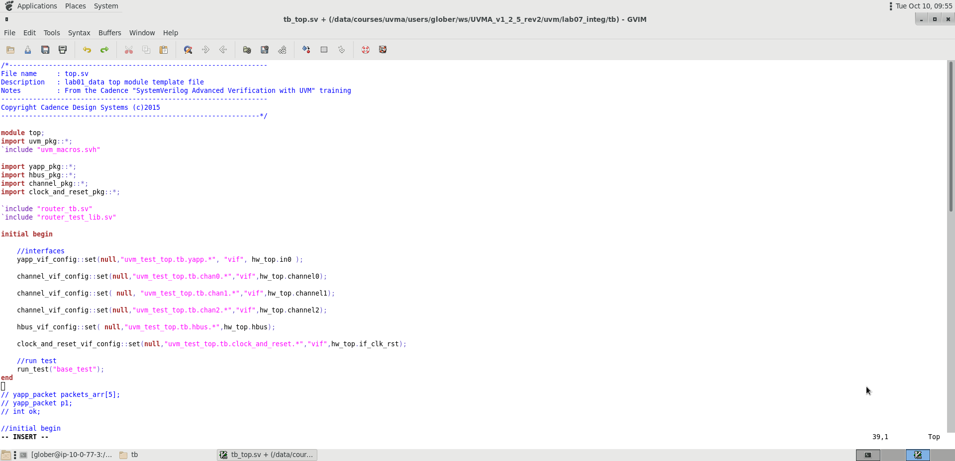
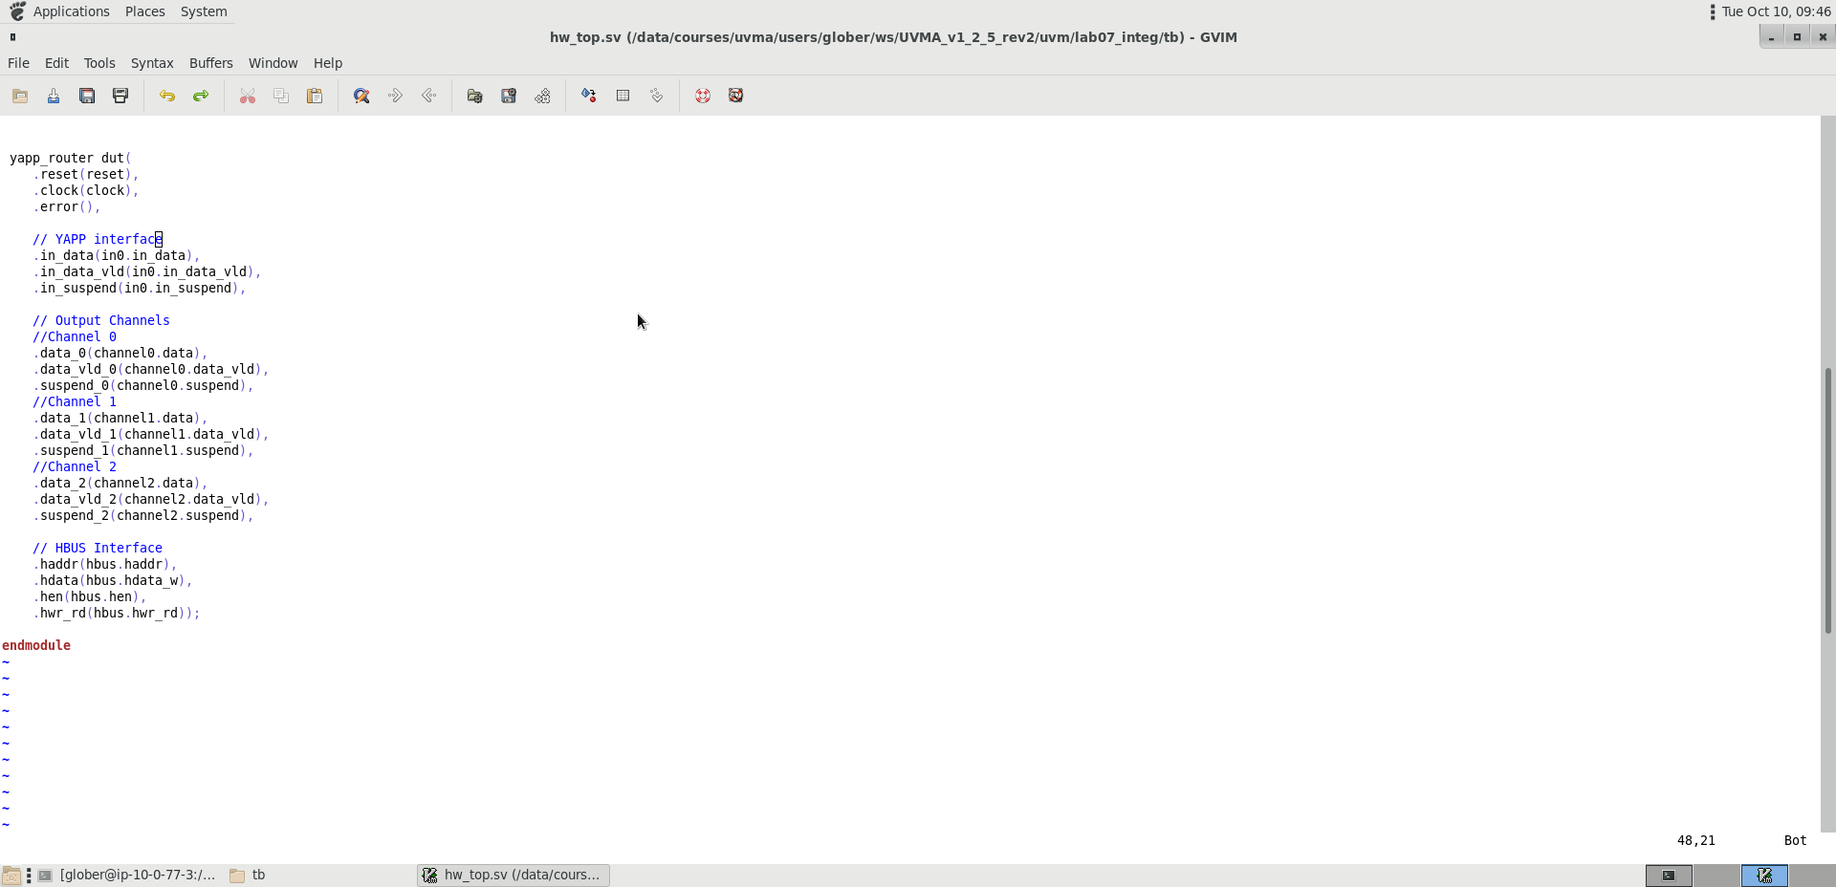
Integrating Multiple UVCs : Import and Interface
In the hardware top module hw_top:
1. Instantiate the interface and connect to the
DUT
module tb_top:
1. Import the UVC package before the testbench
2. Add a configuration set to connect the interface
Tb_top.sv

Slide 37
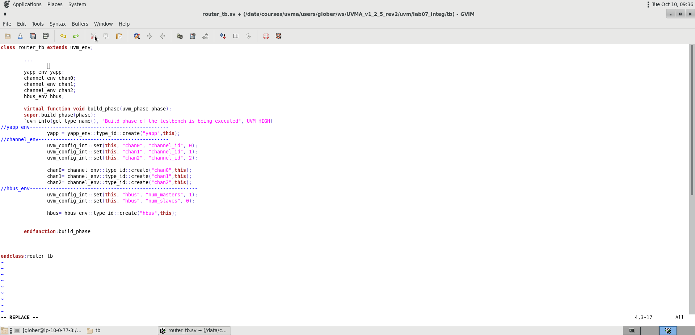
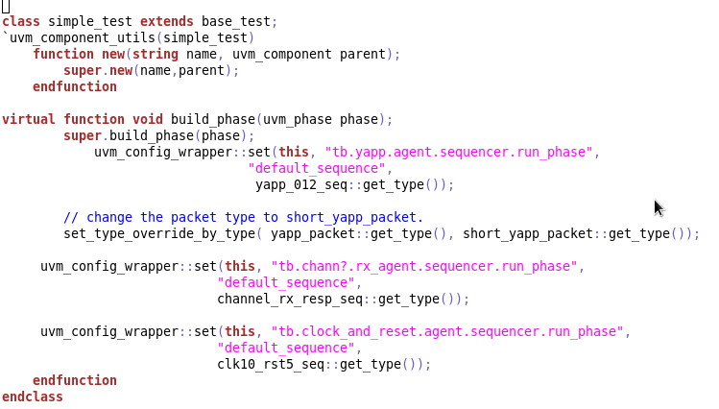
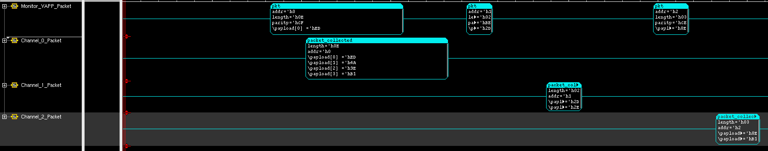
Integrating Multiple UVCs : Configuration and Instantiation
Router_test_lib.sv

Slide 38
Multichannel (virtual) Sequencer

Slide 39
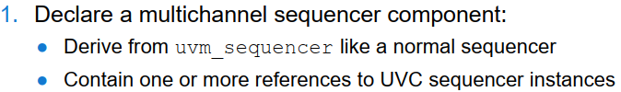
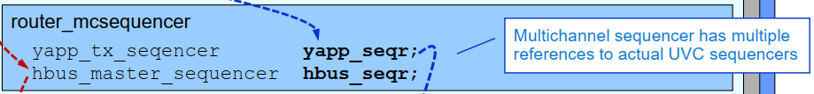
Procedure for Adding a Multichannel Sequencer
For our router, we need to coordinate the stimulus from the YAPP and the HBUS UVCs. The Channel UVCs and the Clock and Reset UVCs always run a single sequence,
so do not need to be controlled via the multichannel sequencer.

Slide 40
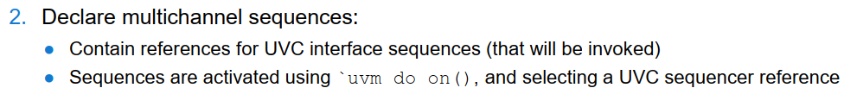
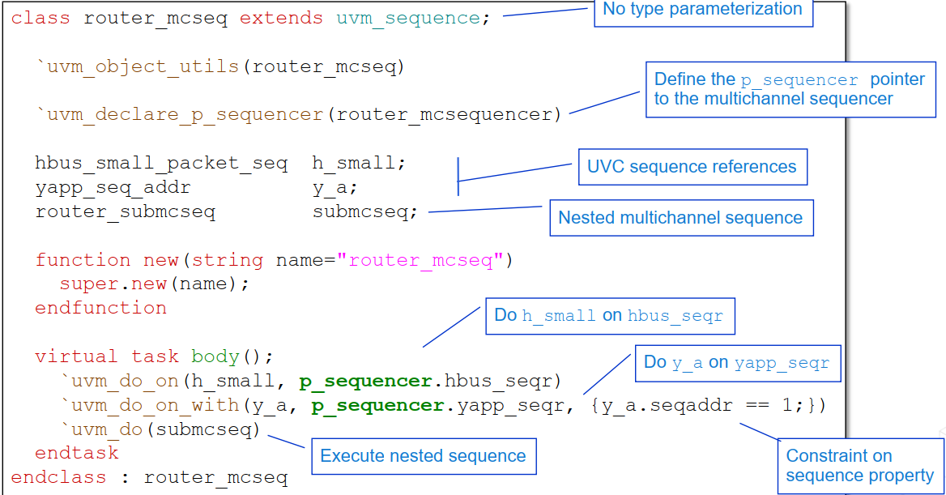

Slide 41
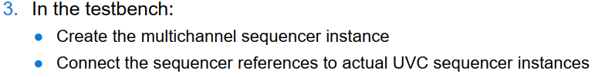
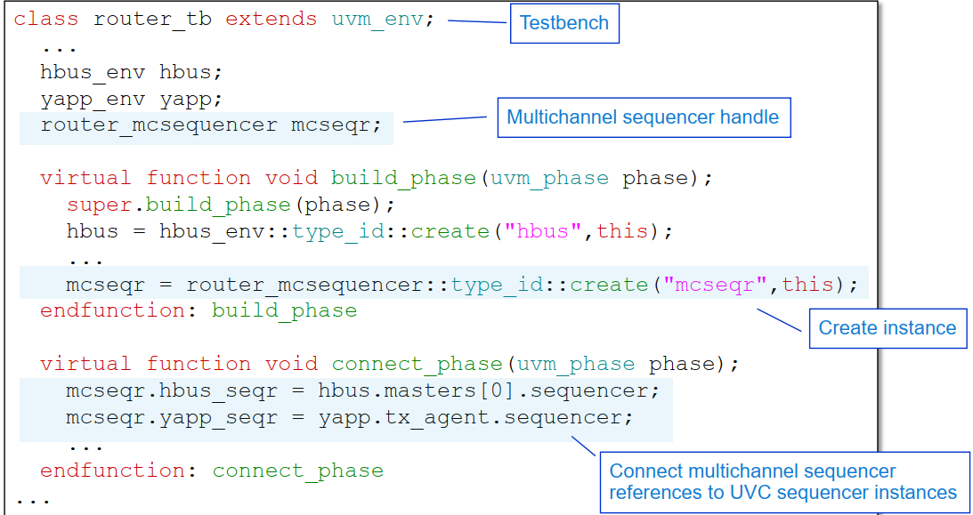

Slide 42
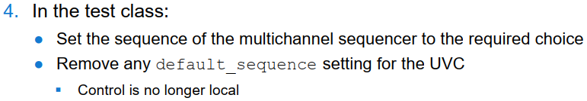
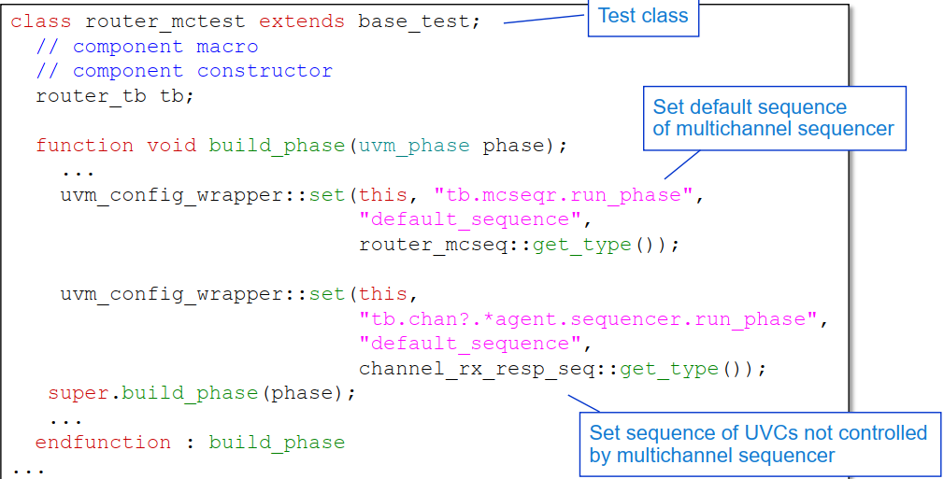
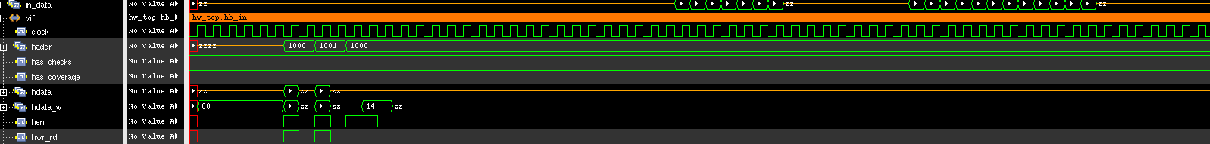

Slide 43
REF Model & Scoreboard
IMPLEMENTATION AND CONNECTIONS

Slide 44
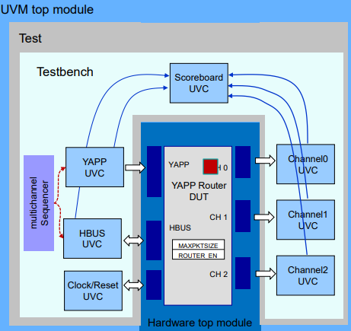
Scoreboard Building

Slide 45
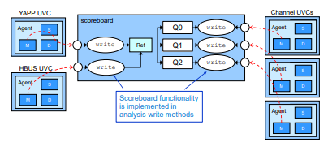
YAPP Scoreboard Structure
The YAPP Scoreboard component contains a reference model and a scoreboard classes which has the following logic:
The reference model accepts all of the packets that were sent to the DUT and send only the legal packets to the scoreboard.
On the scoreboard we instantiate packet queues and every packet that is received from the reference model being pushed to the correct queue and will be compared to the actual data from channels.

Slide 46
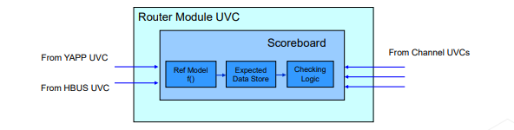
Reference Model
The reference model accepts the packets that were sent to the DUT and send only the legal packets to the scoreboard. Valid packets are:
Packets with legal address(between 0 to 2)
Legal size according to the max_size register.
Router is enabled when packet is sent, according to the router_en register.

Slide 47
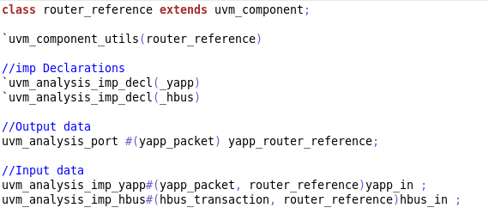
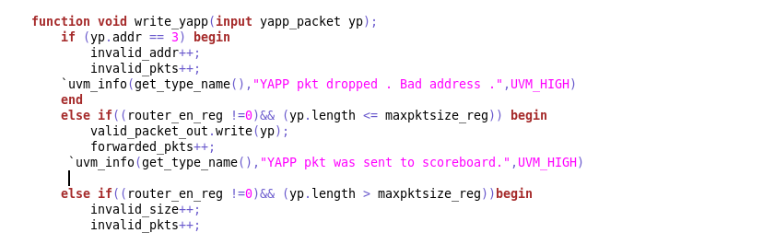
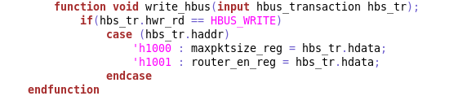
Reference Model
Reference:
Instantiates an uvm_analysis_port object, parameterized for data type
Initiates transfer by calling write method. port objects imp and port are connected together in higher hierarchical level (testbench)
…
…

Slide 48
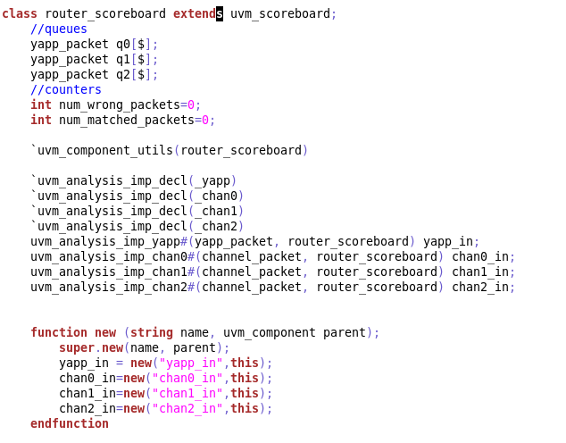
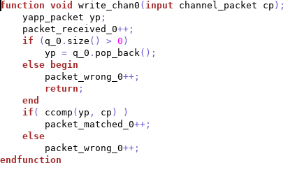
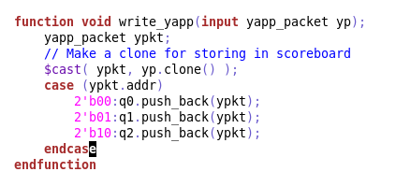
Scoreboard
Scoreboard :
Instantiates an uvm_analysis_imp objects, parameterized for data type
Defines implementations of the write functions to process the data

Slide 49
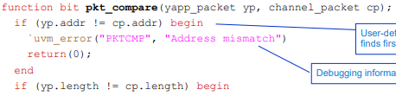
Scoreboard Comparison
The scoreboard must compare the output packets of the router, as received from the Channel UVC, against the appropriate input packets as received from the YAPP UVC (and stored in the router queues). The best place is to do this in the Channel write methods.
Therefore we had to declare our own user-defined comparison, to take two input packets of type yapp_packet and channel packet; compare their corresponding fields (omitting control fields like packet_delay) and then return 1 if all appropriate fields match
…

Slide 50
Register Abstract Layer

Slide 51

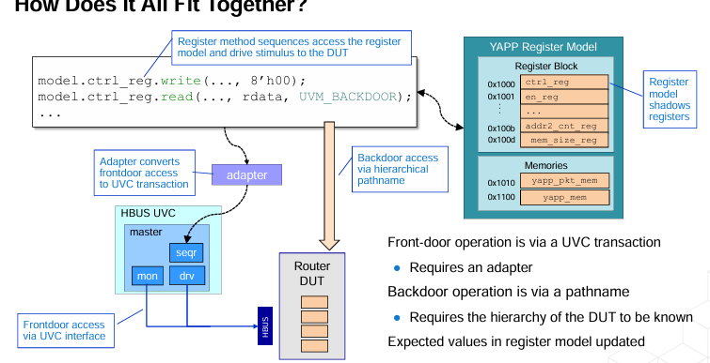
RAL
RAL – Register Abstraction Layer
The RAL model represents the DUT’s registers and memories, allowing read/write access through the HBUS UVC. It provides both frontdoor access (via UVC transactions) and backdoor access (via hierarchical paths).
We used the RAL for:
Verifying register functionality through sequences like uvm_reset_test, uvm_mem_walk_test, and reg_access_test.
Checking that register values match expected states after transactions.
Simplifying register operations using built-in UVM sequences (e.g., uvm_reg_hw_reset_seq).

Slide 52

Registers Table

Slide 53

RAL Implementation

Slide 54


Register Test

Slide 55

Coverage plan + results
Verify that all destination addresses (0–3) are exercised during simulation.
Verify that the size of packets were min, max, small, medium and large.
Verify that send packet where router_en 0 and also it's 1(by cross).
Verify that the parity bit will be 0 will be and 1.
Verify that all address get all size packet in 2 modes of parity
Verify that haddr will be legal and illegal
Verify that hwr_rd will be 0 and 1.
Verify that in_data_vld will be 0 and 1.
Verify that suspend_x will be 0 and 1.
Verify that error will be 0 and 1.
Cover different reset scenarios — including reset during idle and during packet transmission.
Cover that en_reg enable bits assertion/deassertion for all counters.

Slide 56
The end
…

