Slide 1

A Proposal On: Delta Arm Waste Classifier
Presented By:
Prateek Paudel [PAS076BEI024]
Samman Shrestha [PAS076BEI029]
Shiva Shrestha [PAS076BEI038]
Sudarshan Gurung [PAS076BEI044]
2080/11/21

Slide 2
Outline
Introduction
Problem Statement
Objective
Requirements
Literature Review
Methodology
Result
Challenges
Conclusion
References

Slide 3
Introduction
In today’s world, waste management and recycling have become critical issues for sustainable development.
The “Delta Arm Waste Classifier” project aims to revolutionize waste management by developing an automated system capable of intelligently categorizing and sorting different types of waste.

Slide 4
Introduction
The Delta arm, renowned for its precision and speed, provides a versatile and agile robotic solution for waste manipulation and placement.
To identify and classify waste items, the project employs state-of-the-art deep learning algorithms such as YOLO.

Slide 5
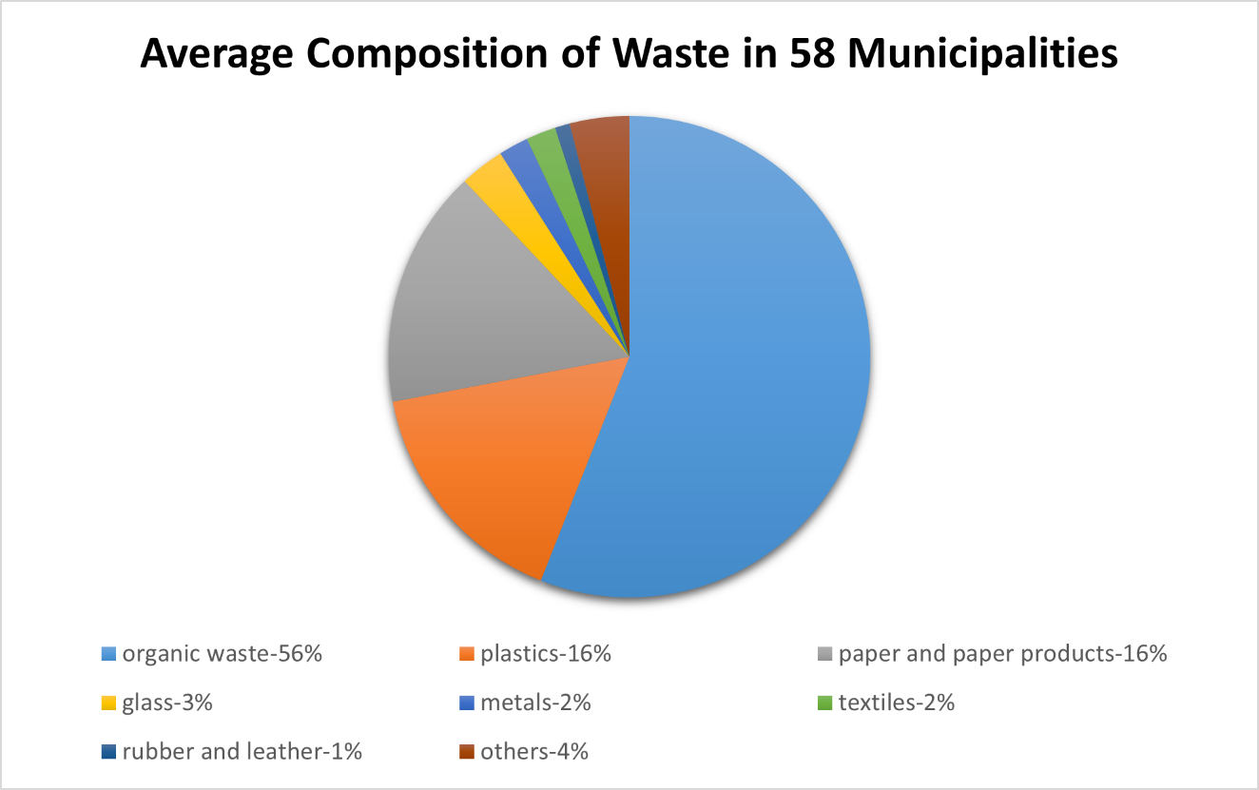
Problem Statement
Diverse solid waste composition: Municipal solid waste distribution
(Solid Waste Management in Nepal: Current Status and Policy Recommendations, 2017)

Slide 6
Problem Statement
Limited waste segregation at source: Notable gap in waste segregation practices at the source, with only 30% of households surveyed engaging in this practice. Consequently, the waste generated by approximately 70% of households ends up in the collection stream as mixed waste [1].
Low recycling rate: Only 4.1% of the total waste generated in Nepal undergoes proper recycling processes. The major causes being improper separation of waste materials [2].

Slide 7
Objective
To build and utilize a Delta arm to pick up waste items and place them in their respective place.

Slide 8
Requirements
Hardware Components
Arduino Uno
Stepper motor
Air suction Pump
Stepper motor driver A4988
Power Supply-12V 10A
CNC Shield V3
Software Components
Python
TensorFlow
OpenCV
Pyserial
Ultralytics YOLOv8
Streamlit
Arduino IDE
RoboFlow

Slide 9
Literature Review
SN | TITLE | AUTHOR | YEAR | FINDINGS
1 | A state-of-the-art review on robotics in waste sorting: scope and challenges | A. G. Satav , S. Kubade , C. Amrutkar ,G. Arya, and A. Pawar | 2023 | Implantation of robotics and AI in sorting of materials (wastes) and suggested further researches and innovation to improve the system efficiency.
2 | Recyclable waste image recognition based on deep learning | Q. Zhang, X. Zhang, X. Mu, Z. Wang, R. Tian, X. Wang, and X. Liu | 2021 | Explores the application of deep learning algorithms for waste classification and suggested further research to optimized the model performance along with implementing the model on smart devices.
3 | A waste management technique to detect and separate non-biodegradable waste using machine learning and yolo algorithm | A. Aishwarya, P. Wadhwa, O. Owais, and V. Vashisht | 2021 | Implementation of The YOLO algorithm for waste classification , achieving high accuracy and efficiency and suggested future work is to design a robot for this this implementing this algorithm.

Slide 10
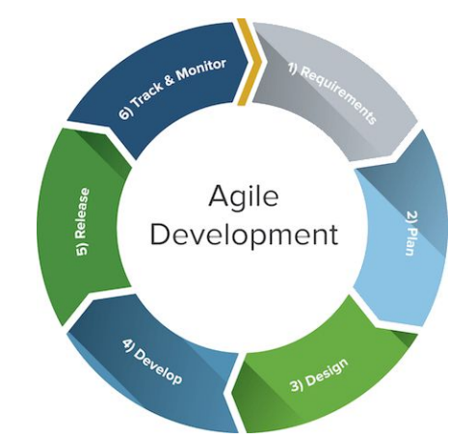
Methodology
1. Product development lifecycle
Fig: Agile development model

Slide 11
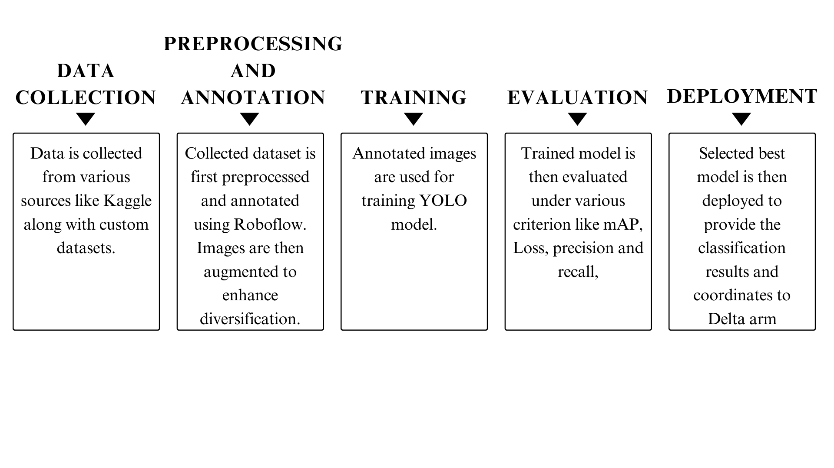
Methodology
2. Model training

Slide 12
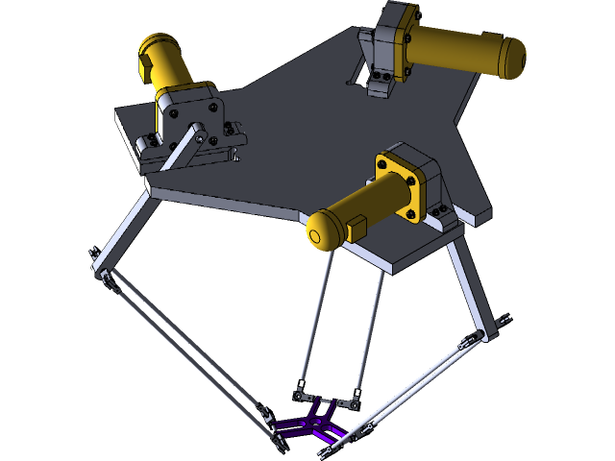
Methodology
3. Hardware Integration 3.1 Delta Arm Design and Development 3.2 Arduino Integration 3.3 Control Unit Implementation
Fig: Delta Arm

Slide 13
Methodology
4. User Interface Development
A Streamlit web application is developed to allow manual control of the Delta arm and real-time object detection.
It includes a user-friendly interface for controlling the Delta arm’s movement and monitoring the object detection process in real time.

Slide 14
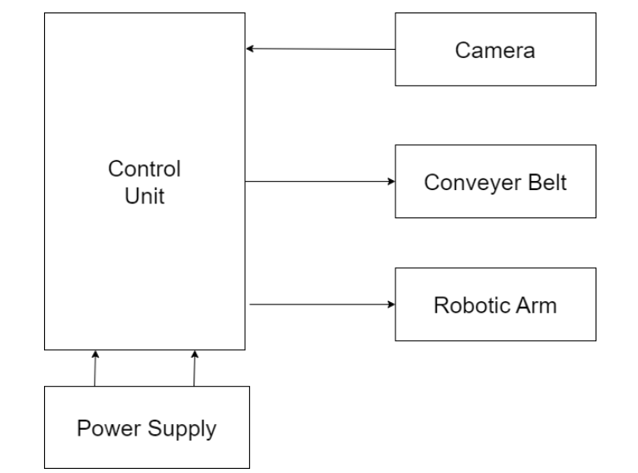
Methodology
5. System Block Diagram

Slide 15
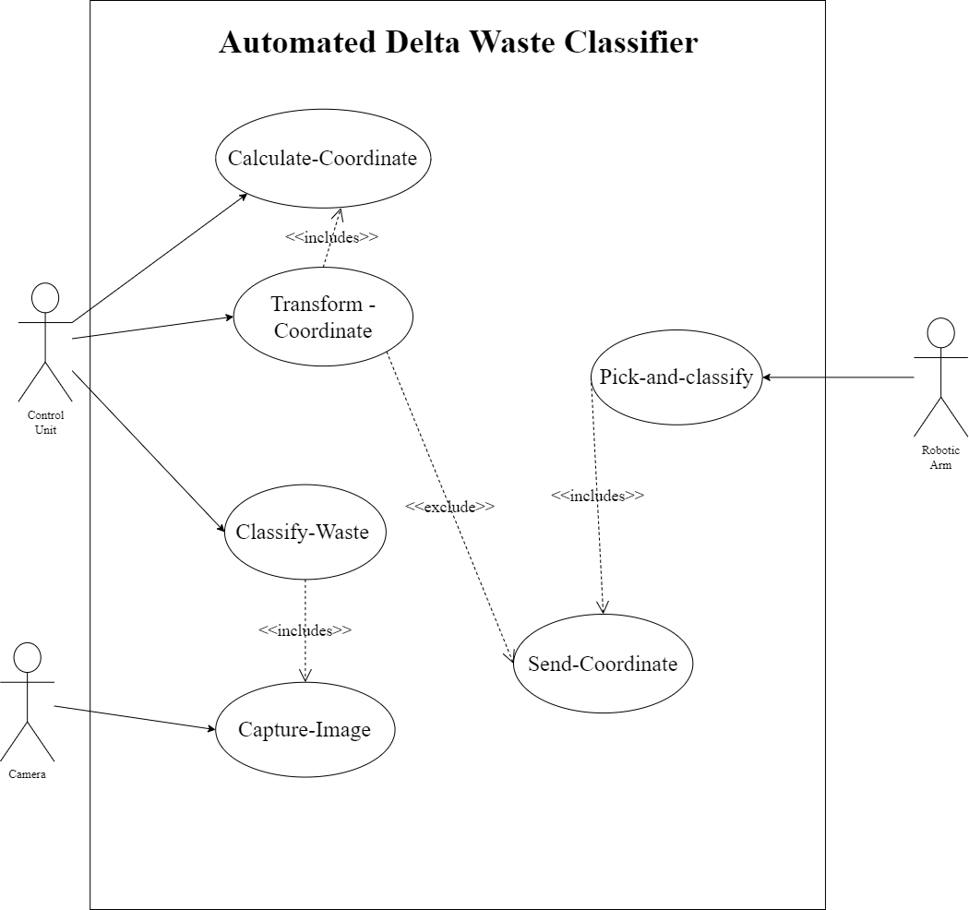
Methodology
6. Use Case Diagram

Slide 16
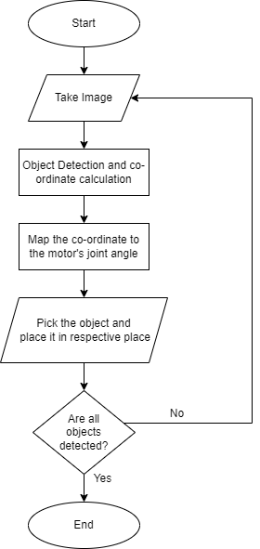
Methodology
7. Flow Chart of system

Slide 17
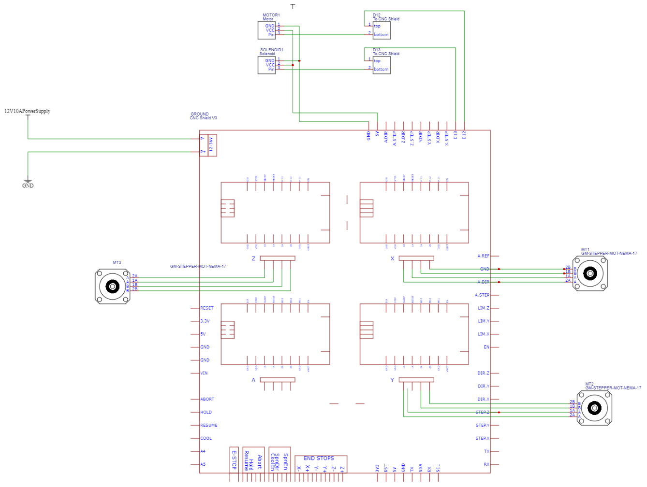
Methodology
8. System Schematic Diagram

Slide 18
Result
The YOLOv8 model was trained for 70 epochs with a batch size of 32. Following are the results obtained:
Box loss | 0.30762
Classification loss | 0.23631
Distribution focal loss | 0.92997
Table 1 : Training losses
Box loss | 0.34798
Classification loss | 0.27666
Distribution focal loss | 0.97204
Table 2 : Validation losses

Slide 19
Result
Precision | 0.94188
Recall | 0.96622
mAP@50 | 0.98252
mAP@50-95 | 0.92723
Fig: Box loss over epochs

Slide 20
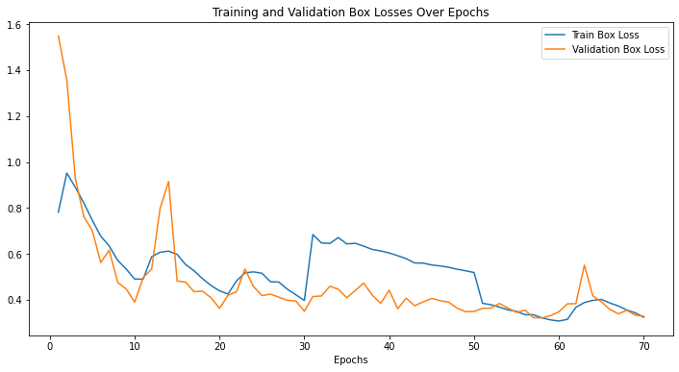
Result
Fig: Box loss over epochs

Slide 21
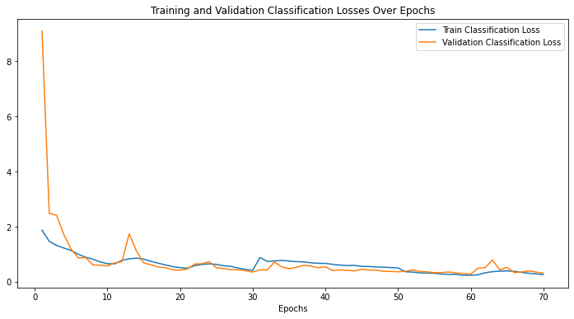
Result
Fig: Classification loss over epochs

Slide 22
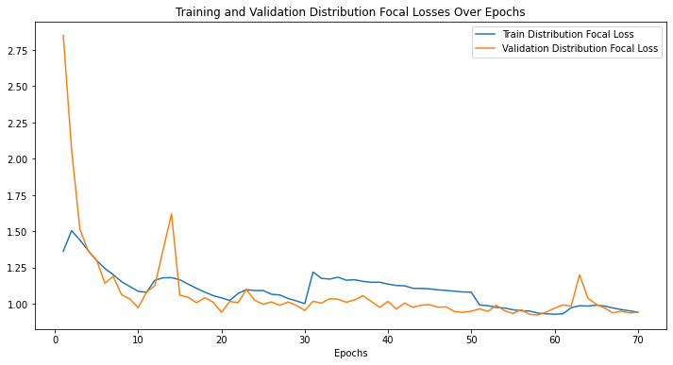
Result
Fig: Distribution focal loss

Slide 23
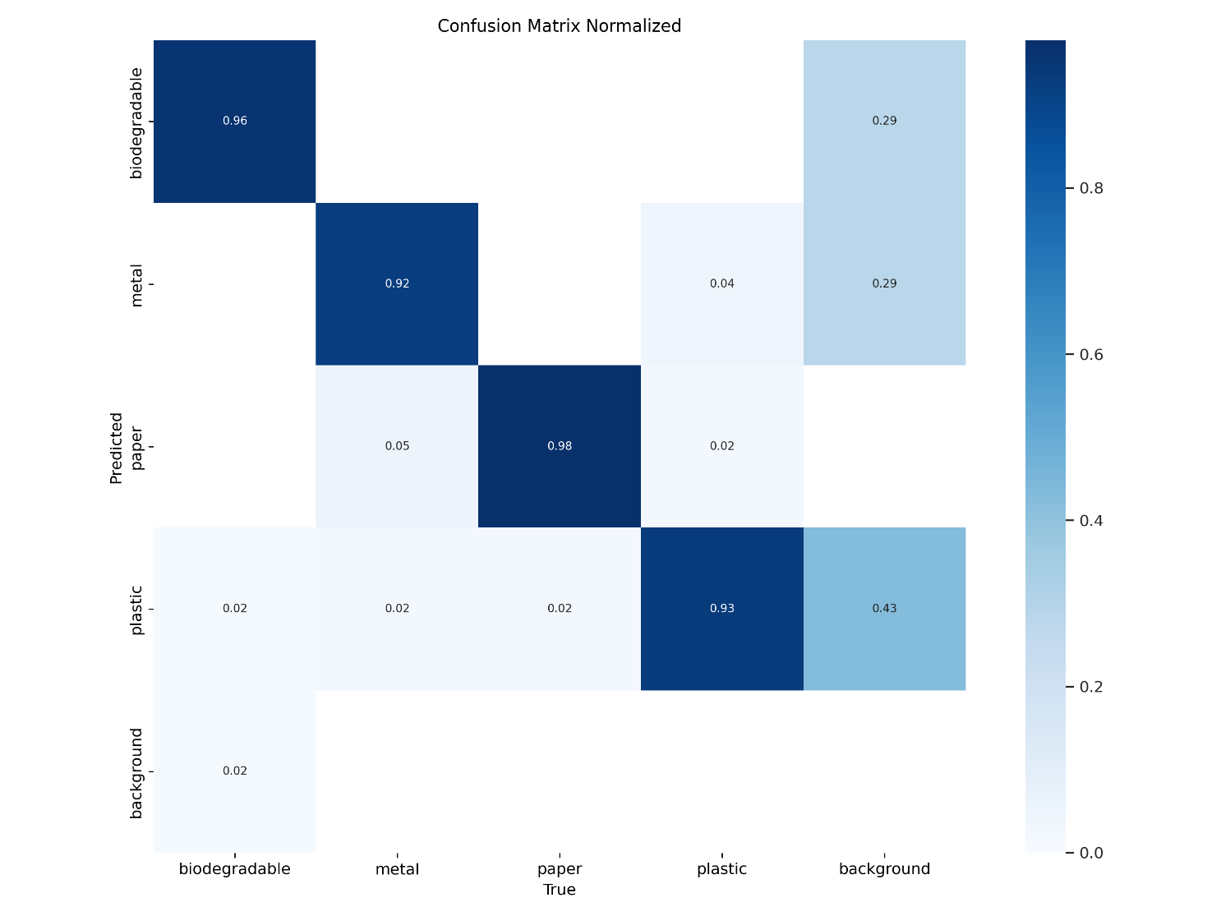
Result
Fig: Normalized confusion matrix

Slide 24
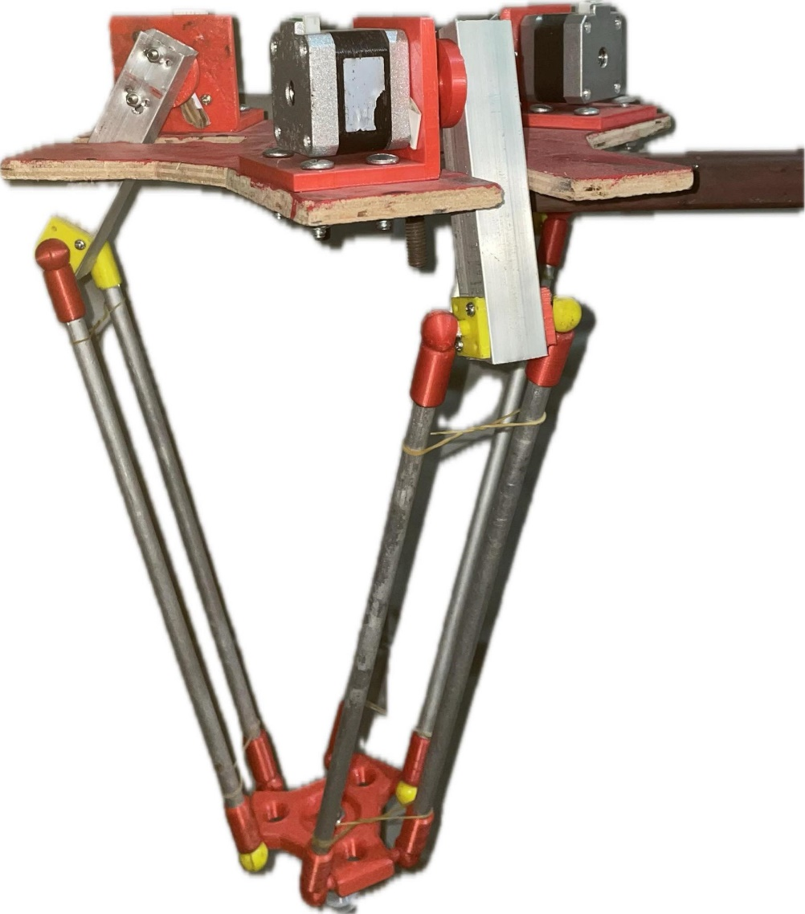
Result
Fig: Delta arm

Slide 25
Challenges
Torque inadequacy in the stepper motors
Time consumption associated with 3D printing
Insufficient and limited budget.

Slide 26
Conclusion
The delta arm waste classifier presents a promising solution for enhancing waste sorting and recycling efforts.
With its precise sorting capabilities, the delta arm waste is able streamline operations, reduce waste contamination, and promote recycling initiatives.

Slide 27
References
Solid waste management in Nepal: Current status and policy recommendations. (2017, November 15). Asian Development Bank. https://www.adb.org/publications/solid-waste-management-nepal-current-status-and-policy-recommendations
Solid Waste Policies and Strategies: Issues, challenges and case studies. (2020). https://doi.org/10.1007/978-981-15-1543-9
A. G. Satav, S. Kubade, C. Amrutkar, G. Arya, and A. Pawar, “A state-of-the-art review on robotics in waste sorting: scope and challenges,” International Journal on Interactive Design and Manufacturing (IJIDeM), pp. 1–18, 2023.

Slide 28
References
A. Aishwarya, P. Wadhwa, O. Owais, and V. Vashisht, “A waste management technique to detect and separate non-biodegradable waste using machine learning and yolo algorithm,” in 2021 11th International Conference on Cloud Computing, Data Science & Engineering (Confluence). IEEE, 2021, pp. 443–447.
Q. Zhang, X. Zhang, X. Mu, Z. Wang, R. Tian, X. Wang, and X. Liu, “Recyclable waste image recognition based on deep learning,” Resources, Conservation and Recycling, vol. 171, p. 105636, 2021.

Slide 29
Thank You !

