Slide 1


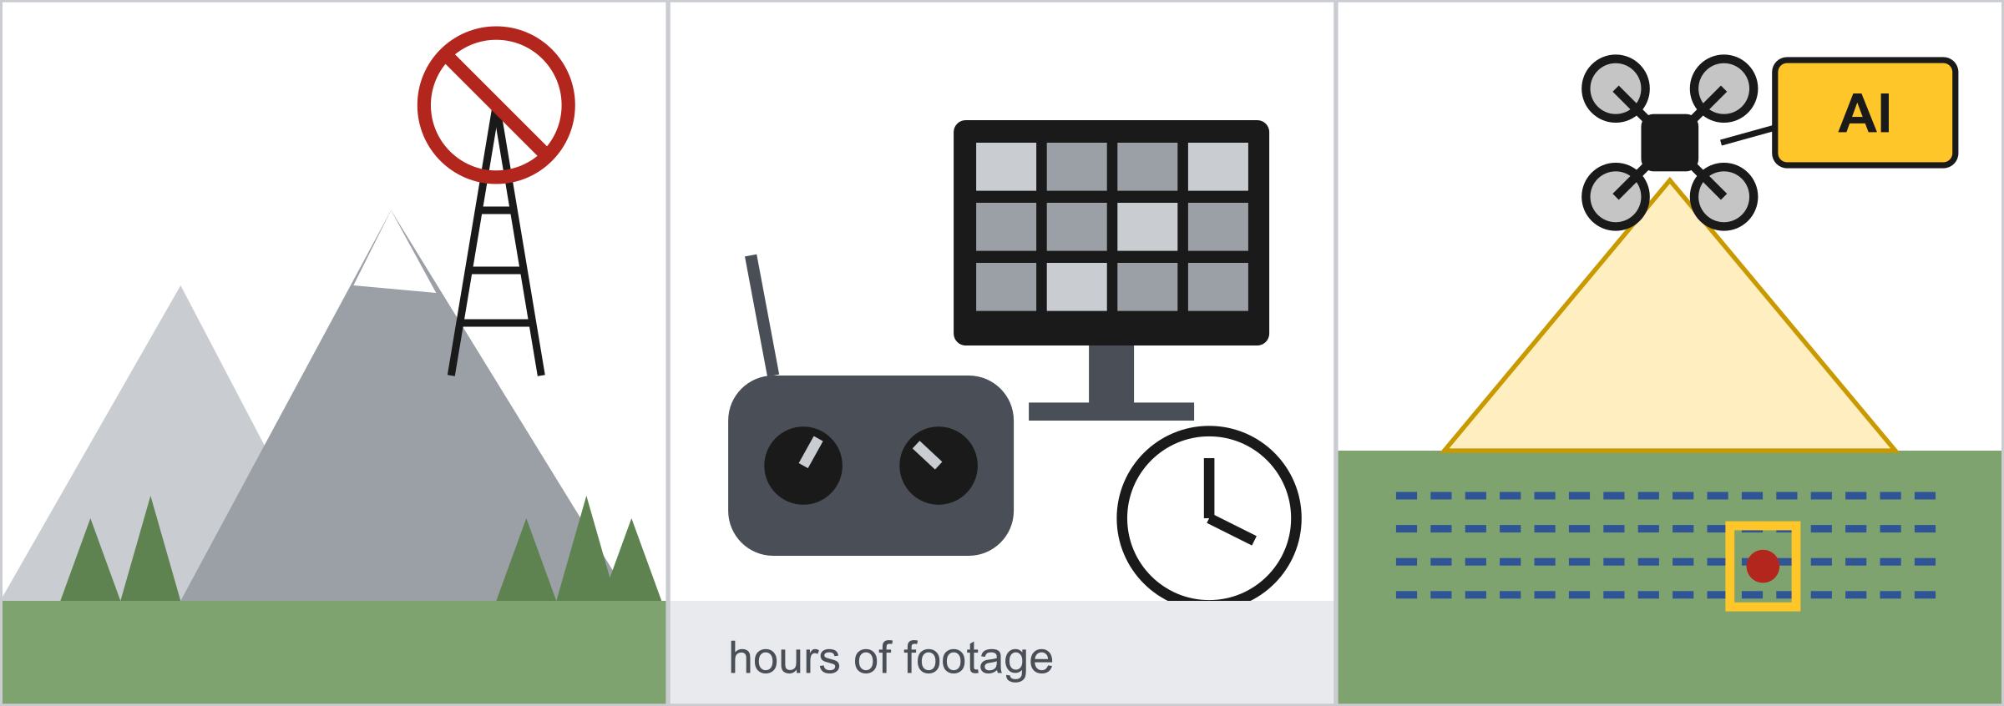
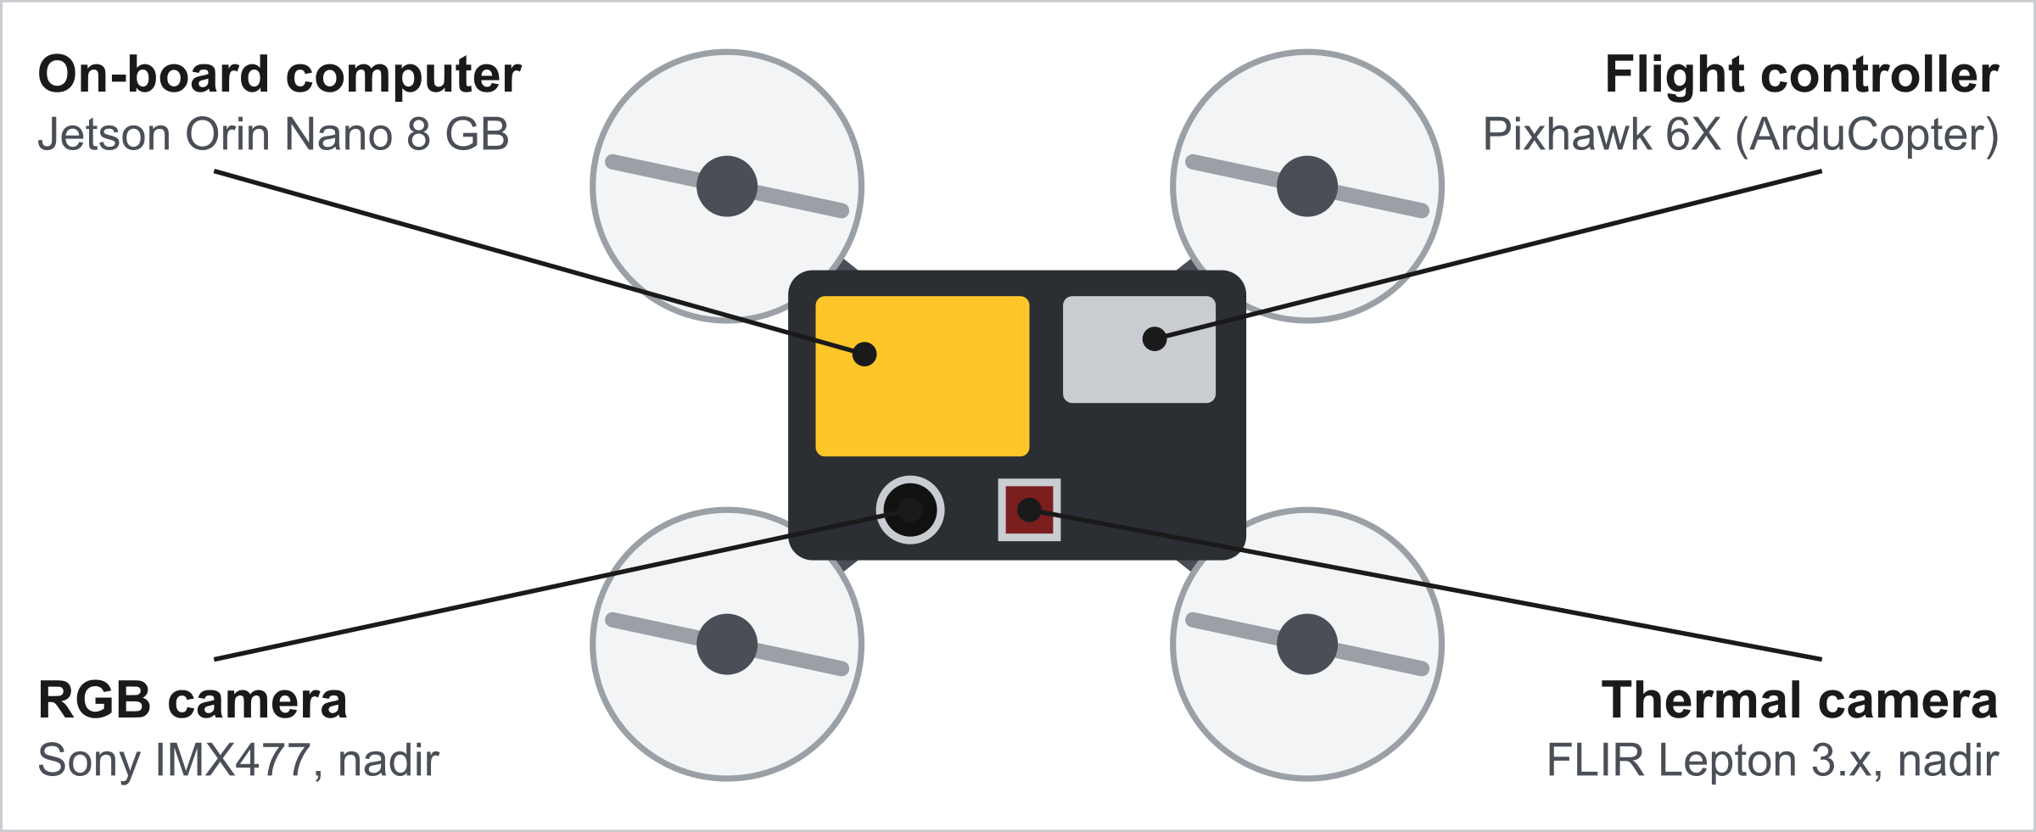
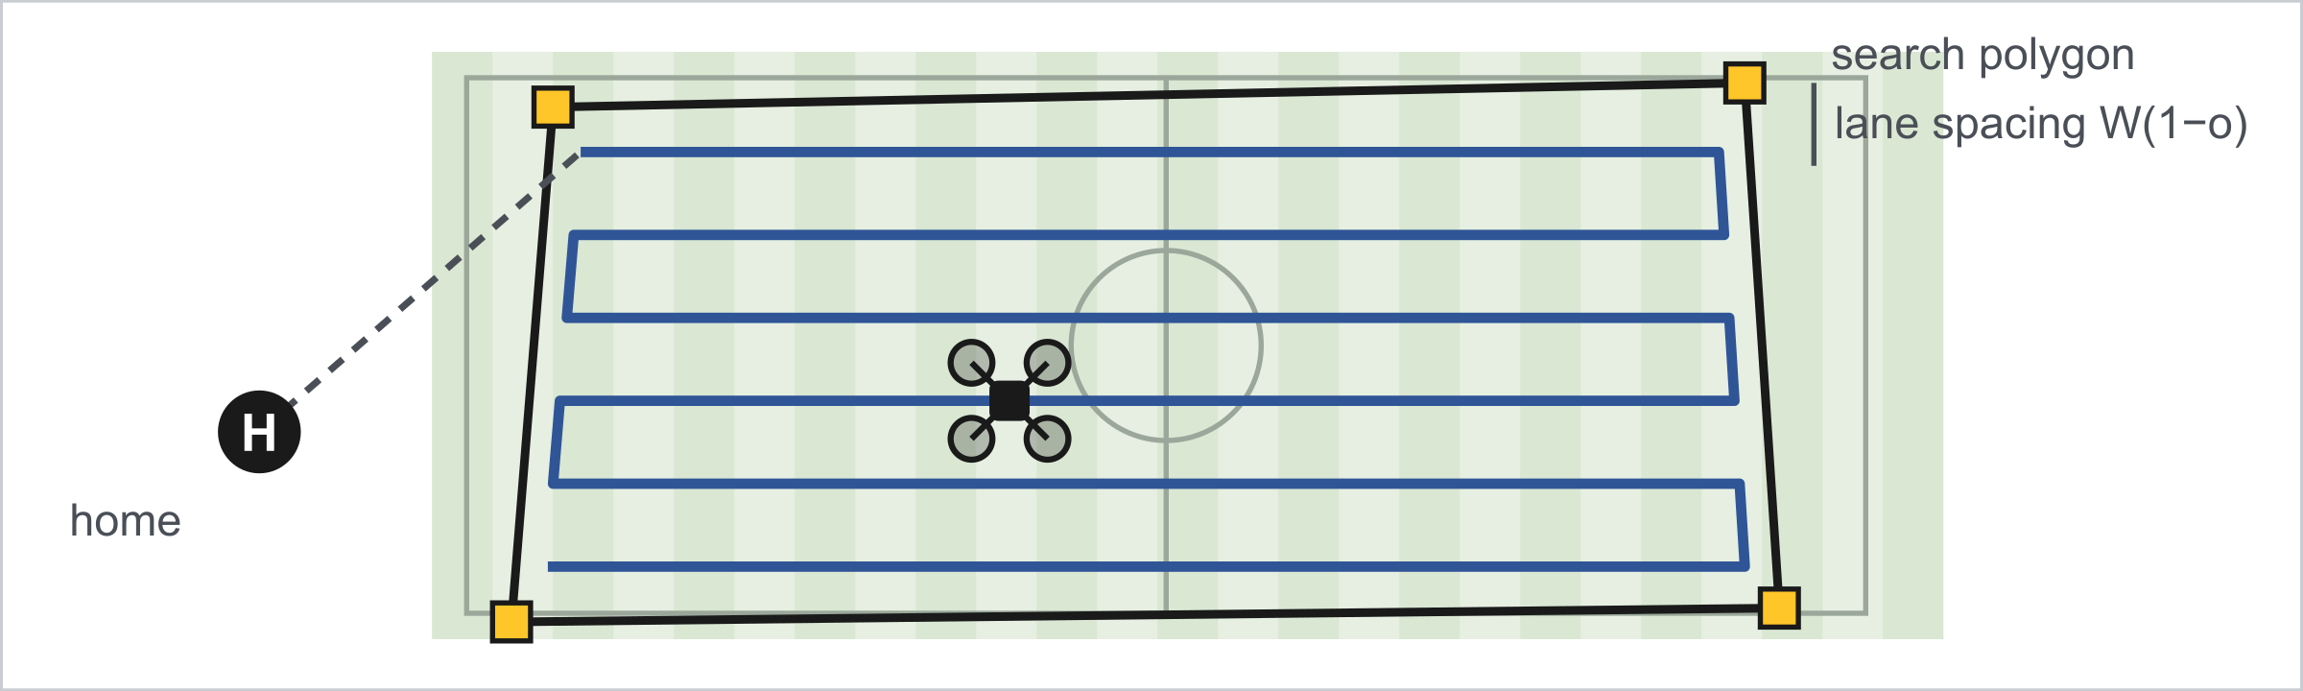
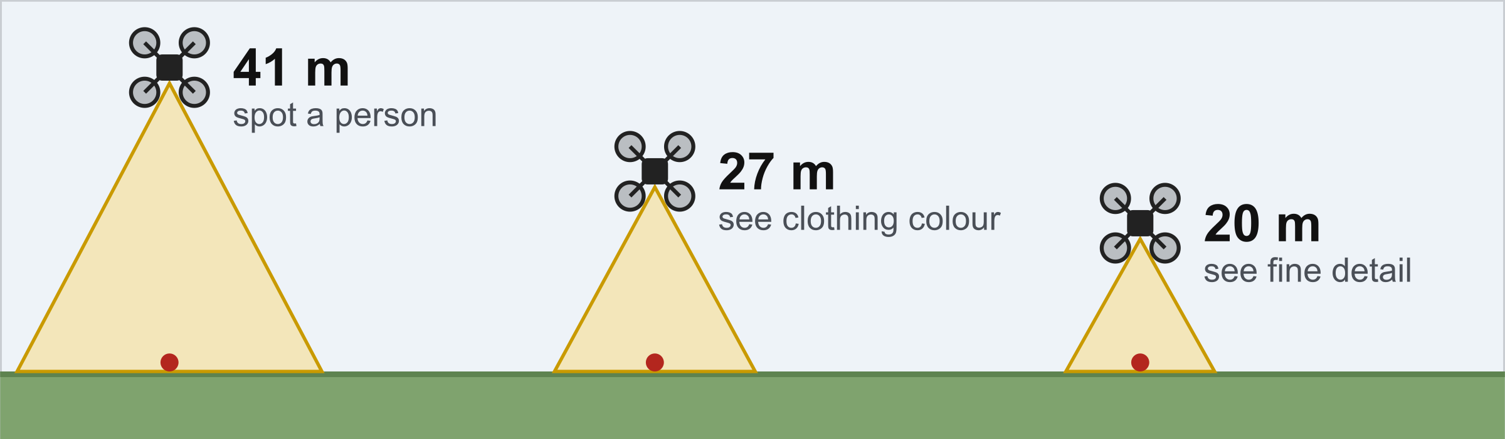
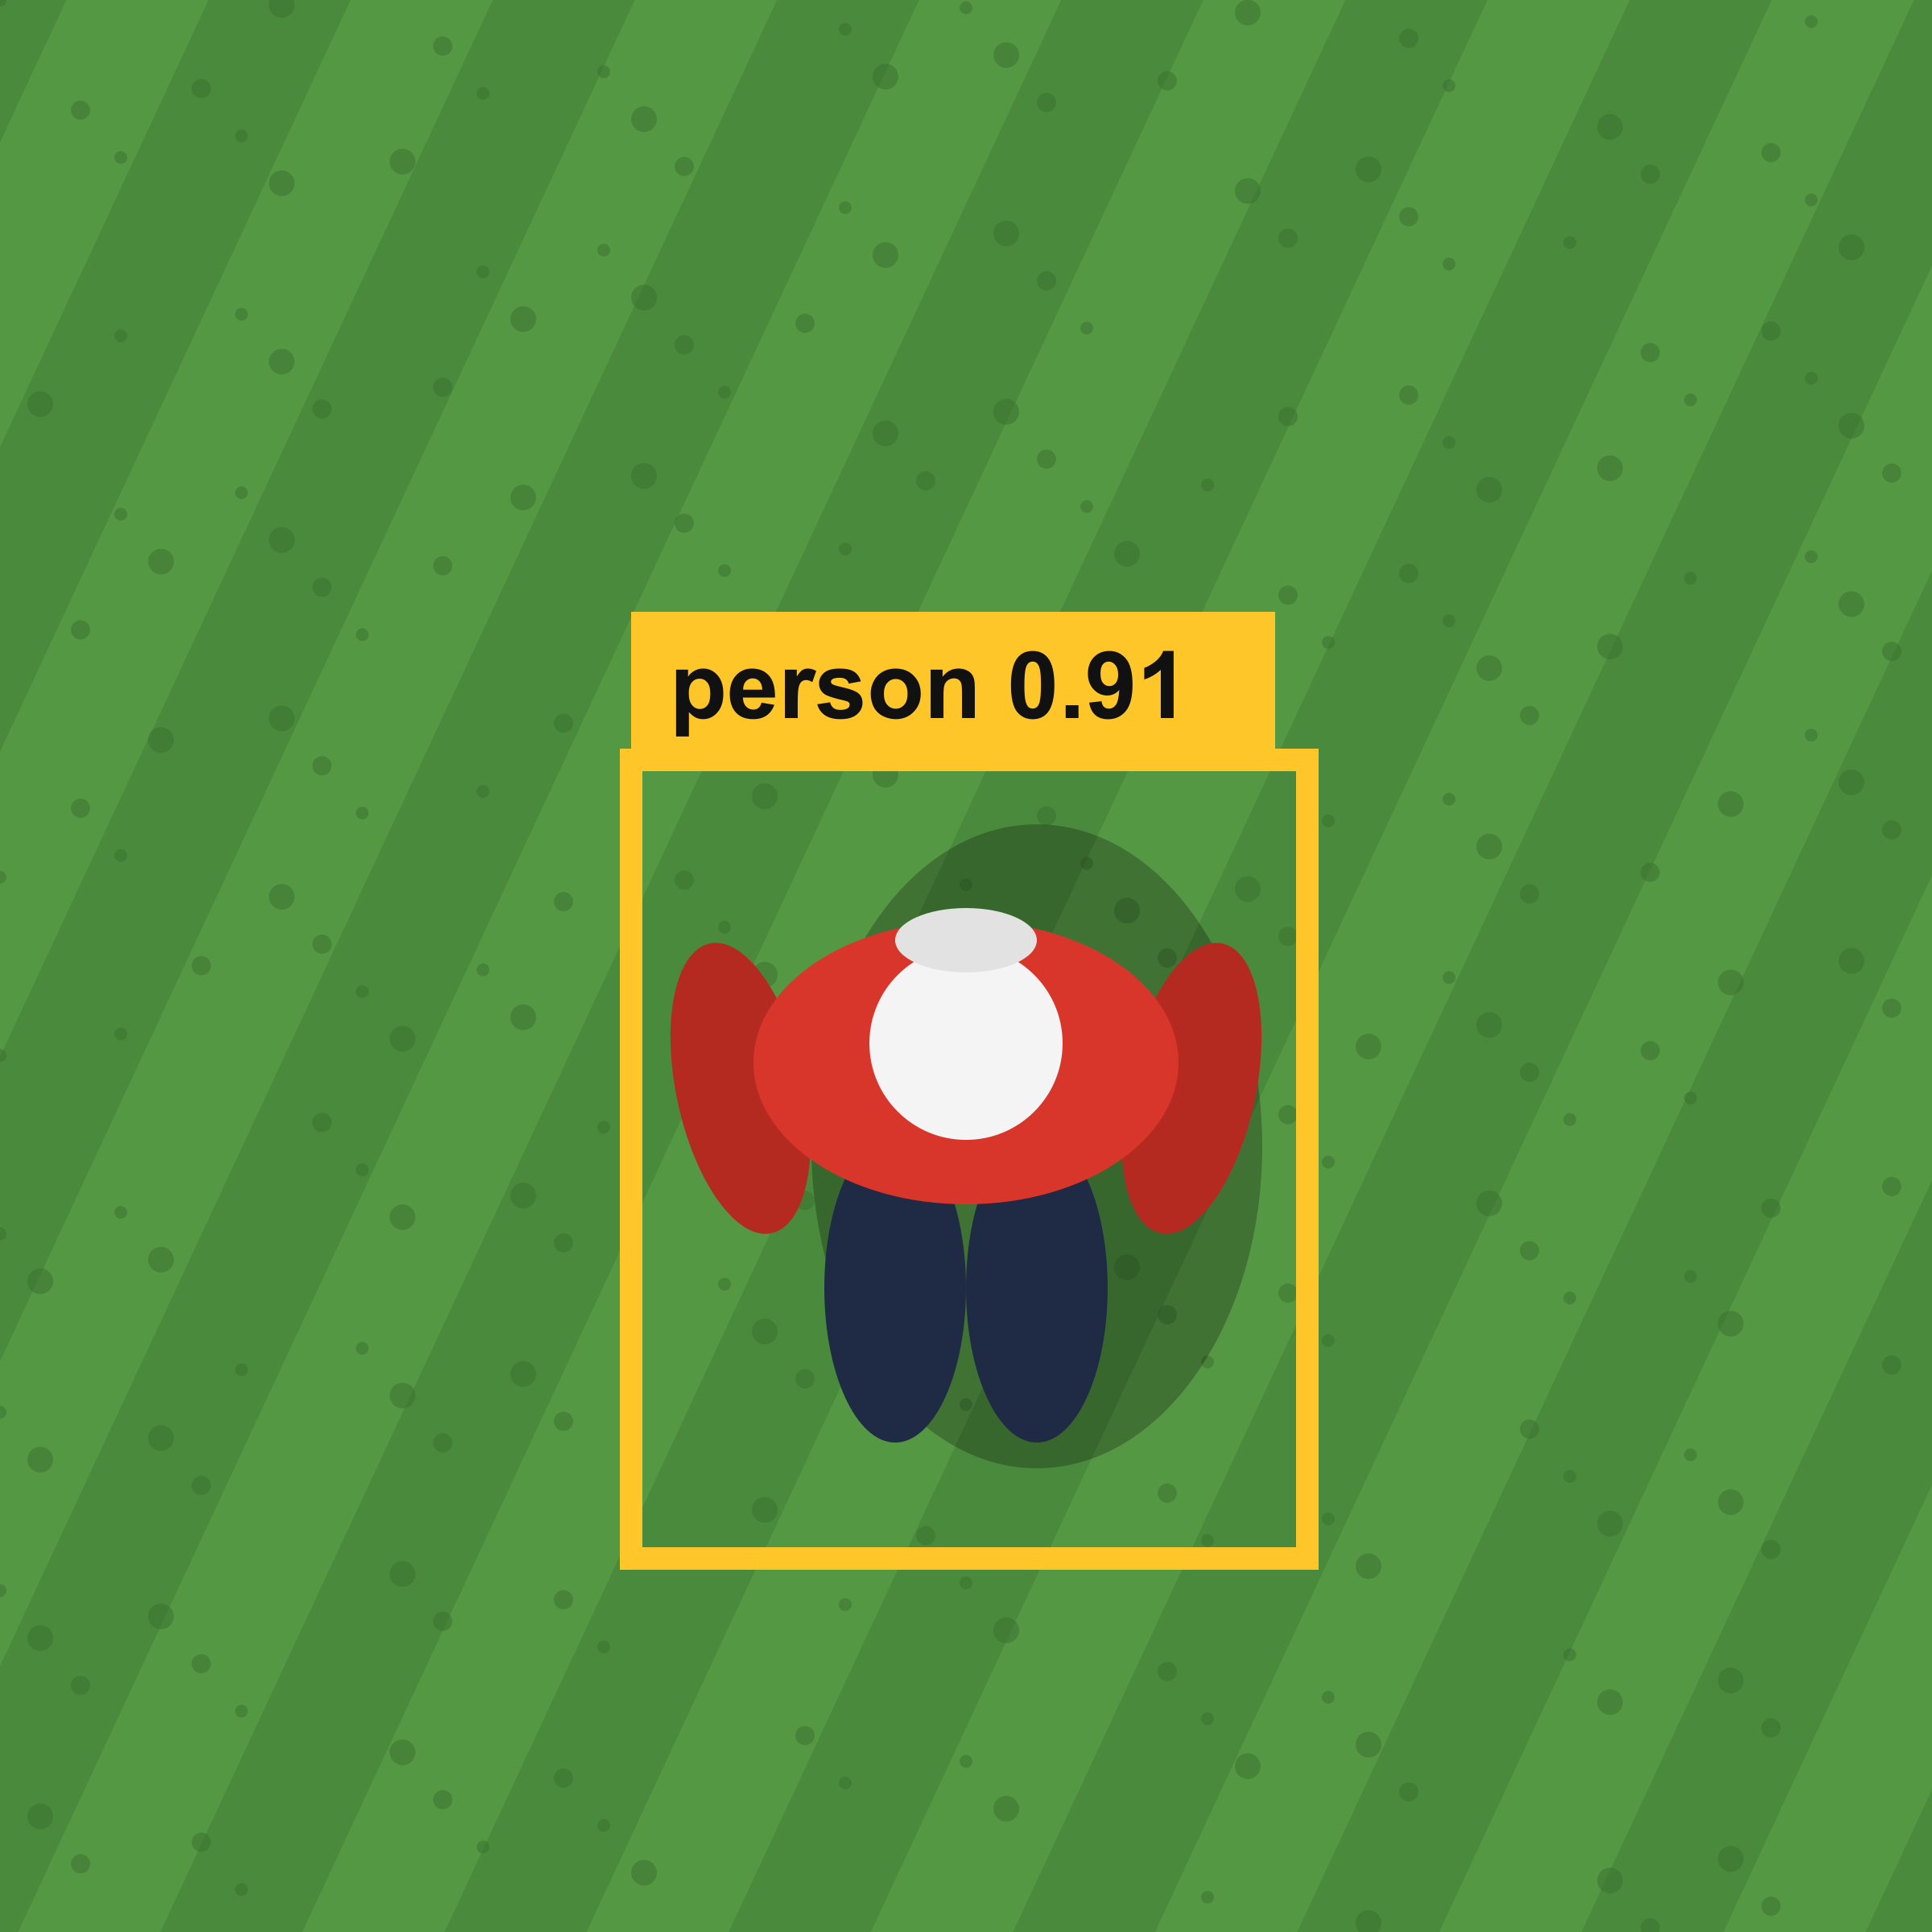
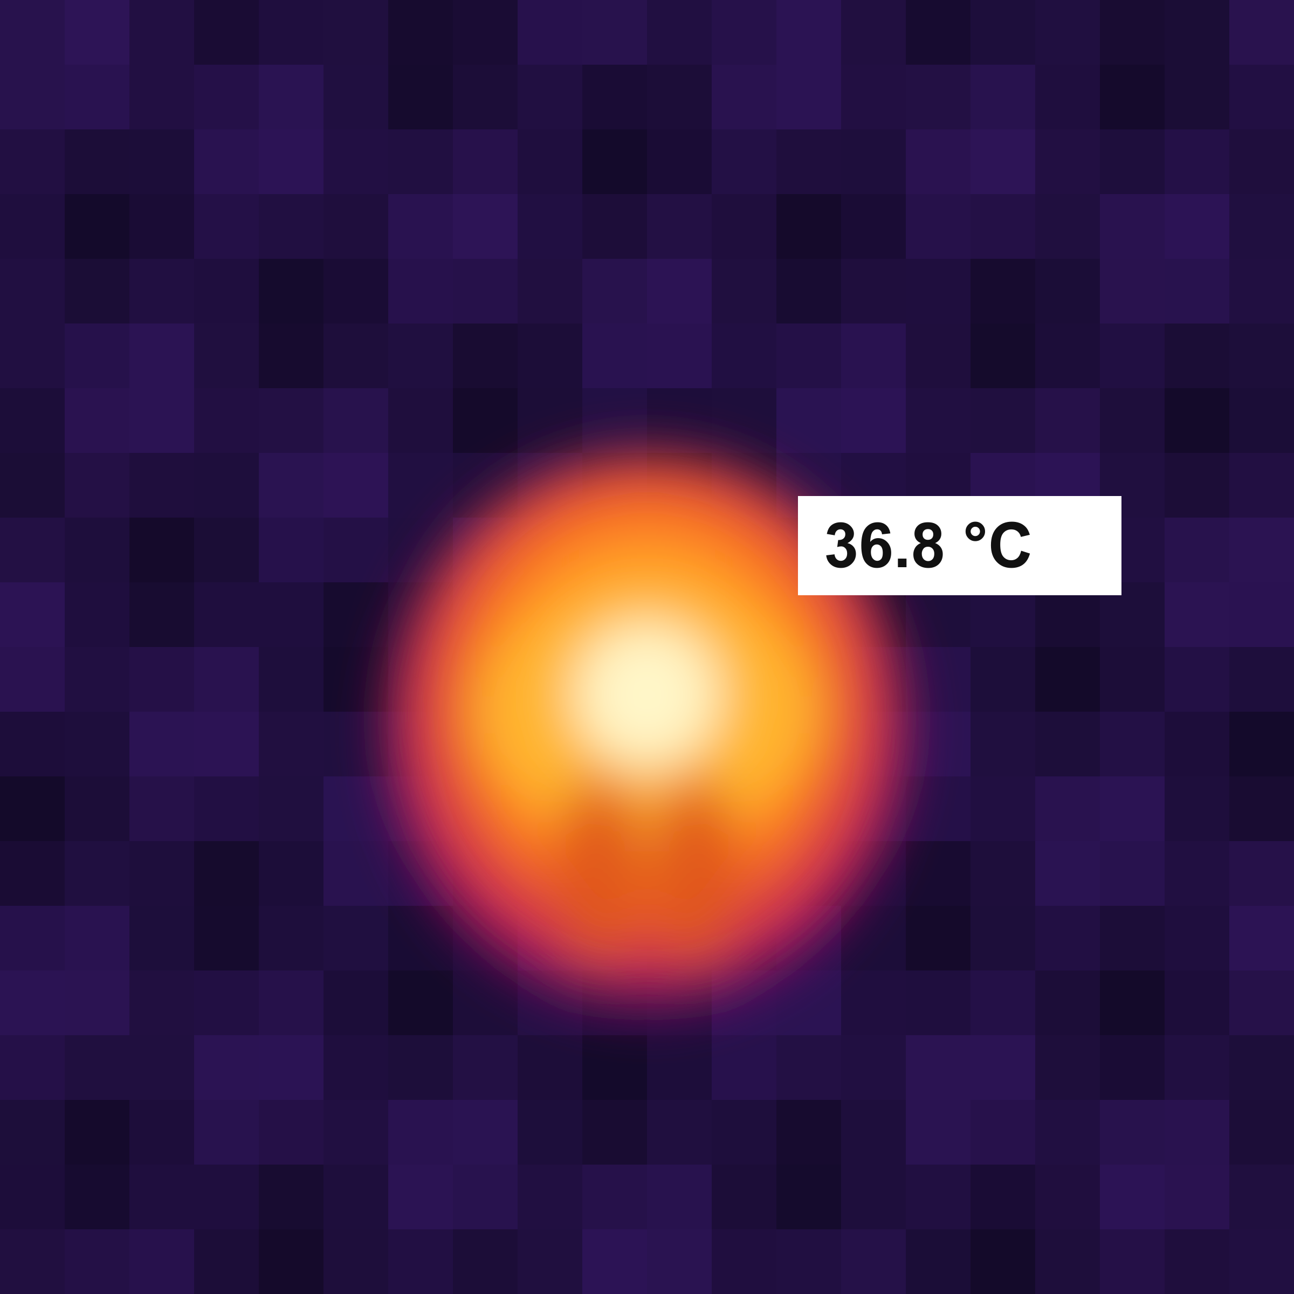
KESTREL: An Offline, On-Board AI System
for Autonomous Aerial Search and Rescue
Team KESTREL
Kennesaw State University, Marietta, Georgia
Source code
1. Motivation
3. Methods
4. Safety and Regulatory Compliance
3.1 Mission planning by conversation
✓
GPS fix and home
✓
Battery level
KESTREL
Operator request
(plain English)
✓
Geofence and failsafes
✓
400 ft / 120 m ceiling
Search 100 × 50 m north of home
LLM → structured JSON intent
✓
LAANC altitude limit
✓
RC link to pilot
Who should I look for?
✓
Autopilot pre-arm
✓
Mission read-back
A man in a red jacket
Code: units, geometry,
altitude, speed
✓
Cameras and AI ready
✓
Legal checklist
No cell or internet coverage
Manual piloting and video review
KESTREL: autonomous, on-board AI
Plan ready
Target: man, red jacket
Altitude: 27 m
Safety: passed
Figure 9. Automated checks run at upload and again at GO; any failure blocks launch.
Figure 1. Search and rescue challenges and the proposed approach (schematic).
Safety validation
Part 107. Flown by a certified Remote Pilot in Command with RC override; the operator needs no piloting skills.
2. System Overview
Review plan
5. Results
Operator review, then GO
Figure 5. The operator chats in plain English. The LLM only interprets the words; code computes every number and never lets the model produce coordinates.
3.2 Coverage path and altitude
Figure 10. Measured latency; the full loop uses about 14 % of its 1 s cycle.
Figure 2. Airframe layout (top view, schematic).
Operator smartphone: chat and map web app
Figure 6. Lawn-mower lanes cover the search area; each point is seen in at least 3 frames.
Wi-Fi hotspot (no internet)
RGB camera
Jetson Orin Nano (on-board computer)
LLM mission
planner
YOLO person
detector
Thermal camera
CLIP description
matcher
Thermal
fusion
Figure 11. Left: LLM choice on 16 live planning tests. Right: CLIP threshold tuning trades recall for precision.
Survey planner and
safety validator
Offline
maps
Figure 7. Altitude is chosen automatically from the detail the description needs (80 / 120 / 160 px on target).
631
0
8 GB
RC (pilot override)
MAVLink
3.3 Perception and target matching
automated tests
network connections
total on-board memory
Pixhawk 6X flight controller
Thermal fusion
C_{person} = 1 − (1 − C_{yolo})(1 − w·C_{heat})
CLIP description match
C_{final} = C_{person} · C_{match}
Alert
mean of last 5 C_{final} ≥ 0.7
Figure 3. System architecture. All inference runs on the aircraft.
6. Conclusions
Describe
Plan
Validate
Confirm
GO
Search
Report
The full search workflow runs offline on an 8 GB embedded computer.
The LLM interprets language; code makes every safety-critical decision.
Next: aerial validation and supervised field trials at KSU Marietta.
Figure 4. Operational workflow. Gold steps require a human; grey steps are automated.
(a)
(b)
Figure 8. (a) RGB person detection and (b) radiometric thermal view (schematic), fused and matched to the description.
References. Ultralytics YOLO; OpenCLIP (Cherti et al., CVPR 2023); llama.cpp; ArduPilot; FAA 14 CFR Part 107.

