Slide 1
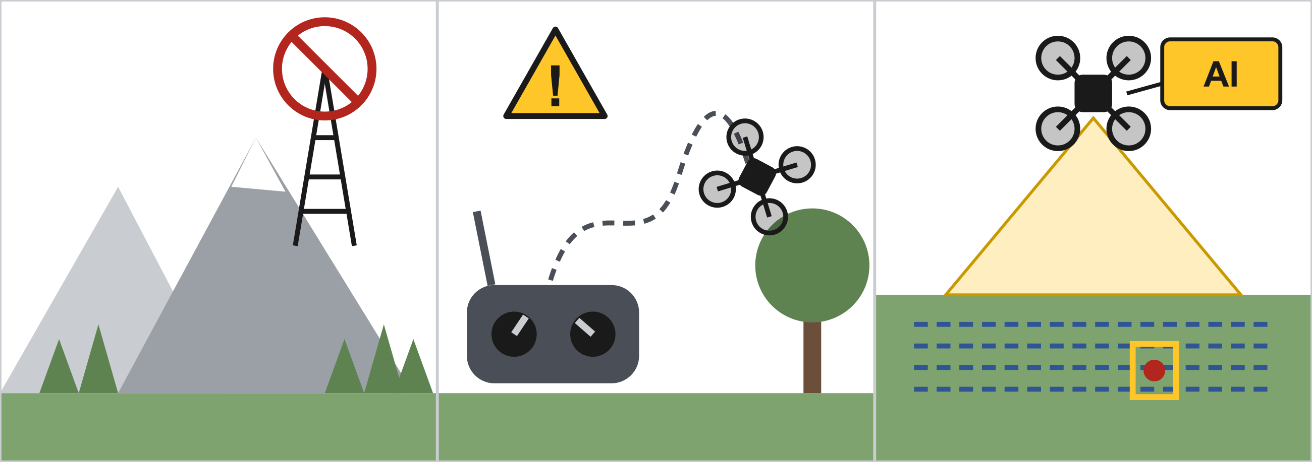
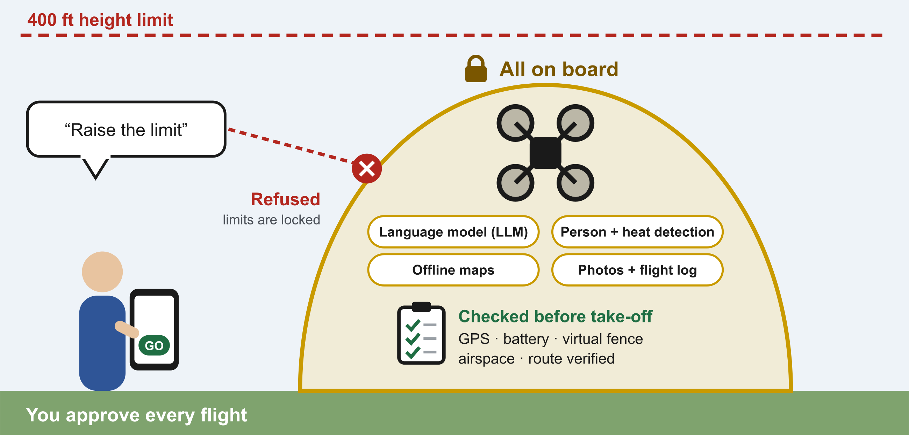
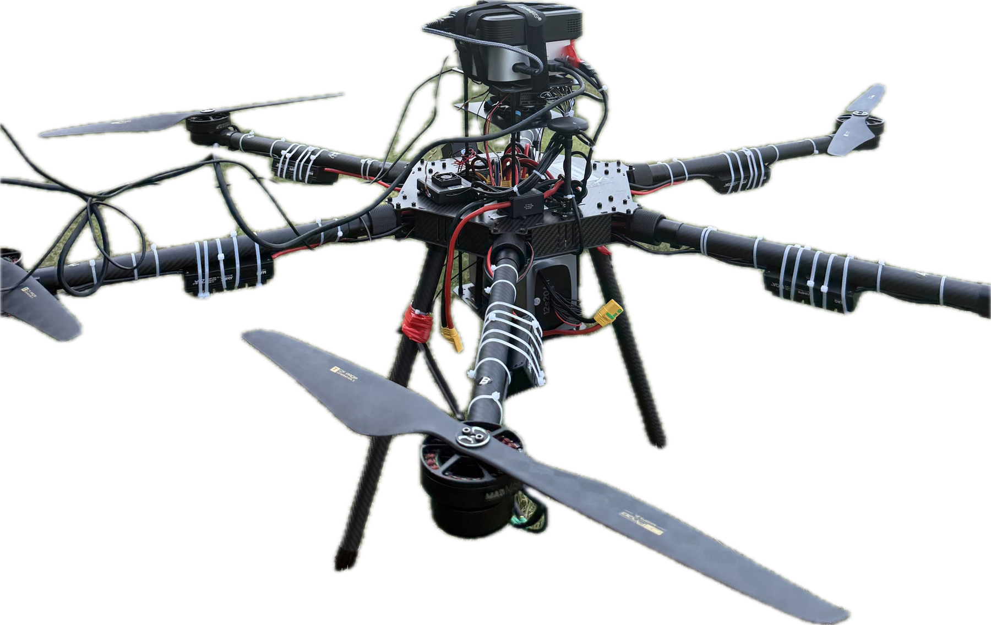
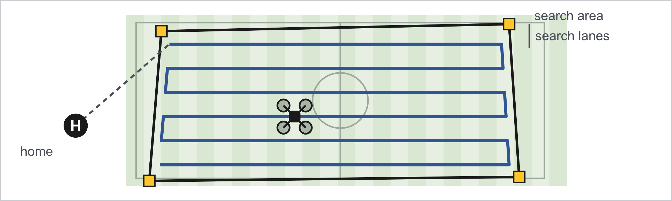
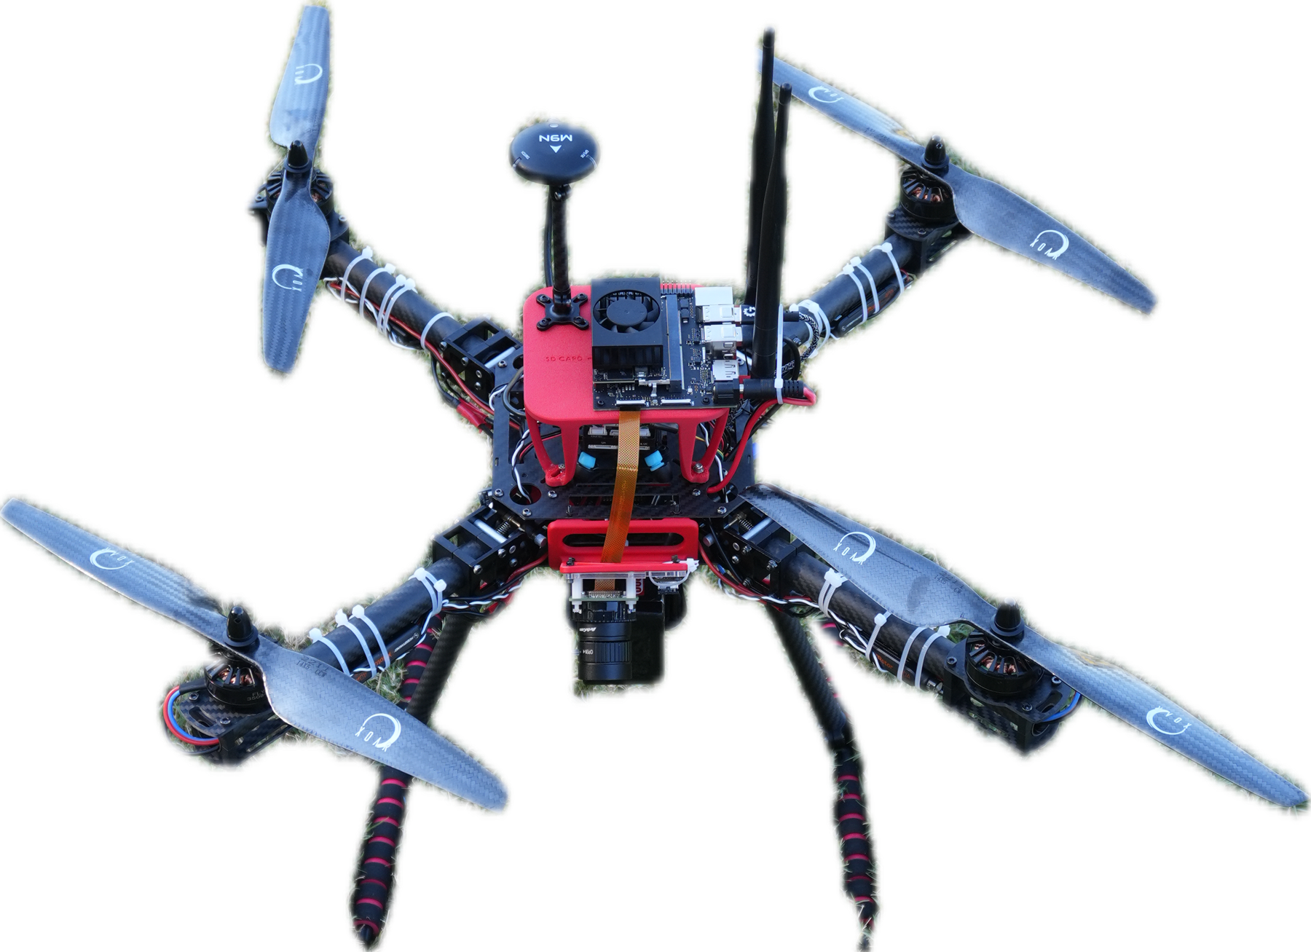
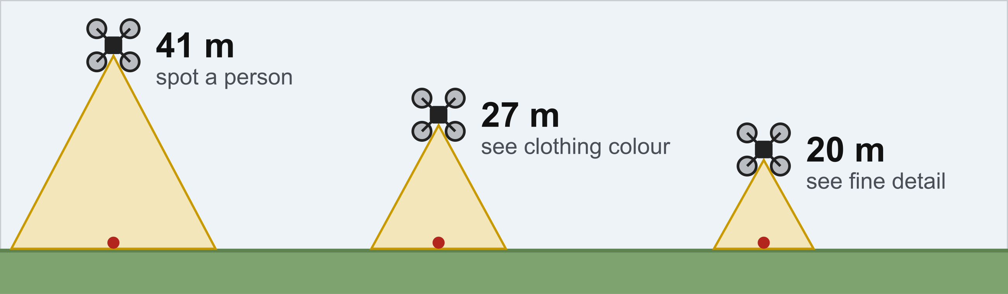
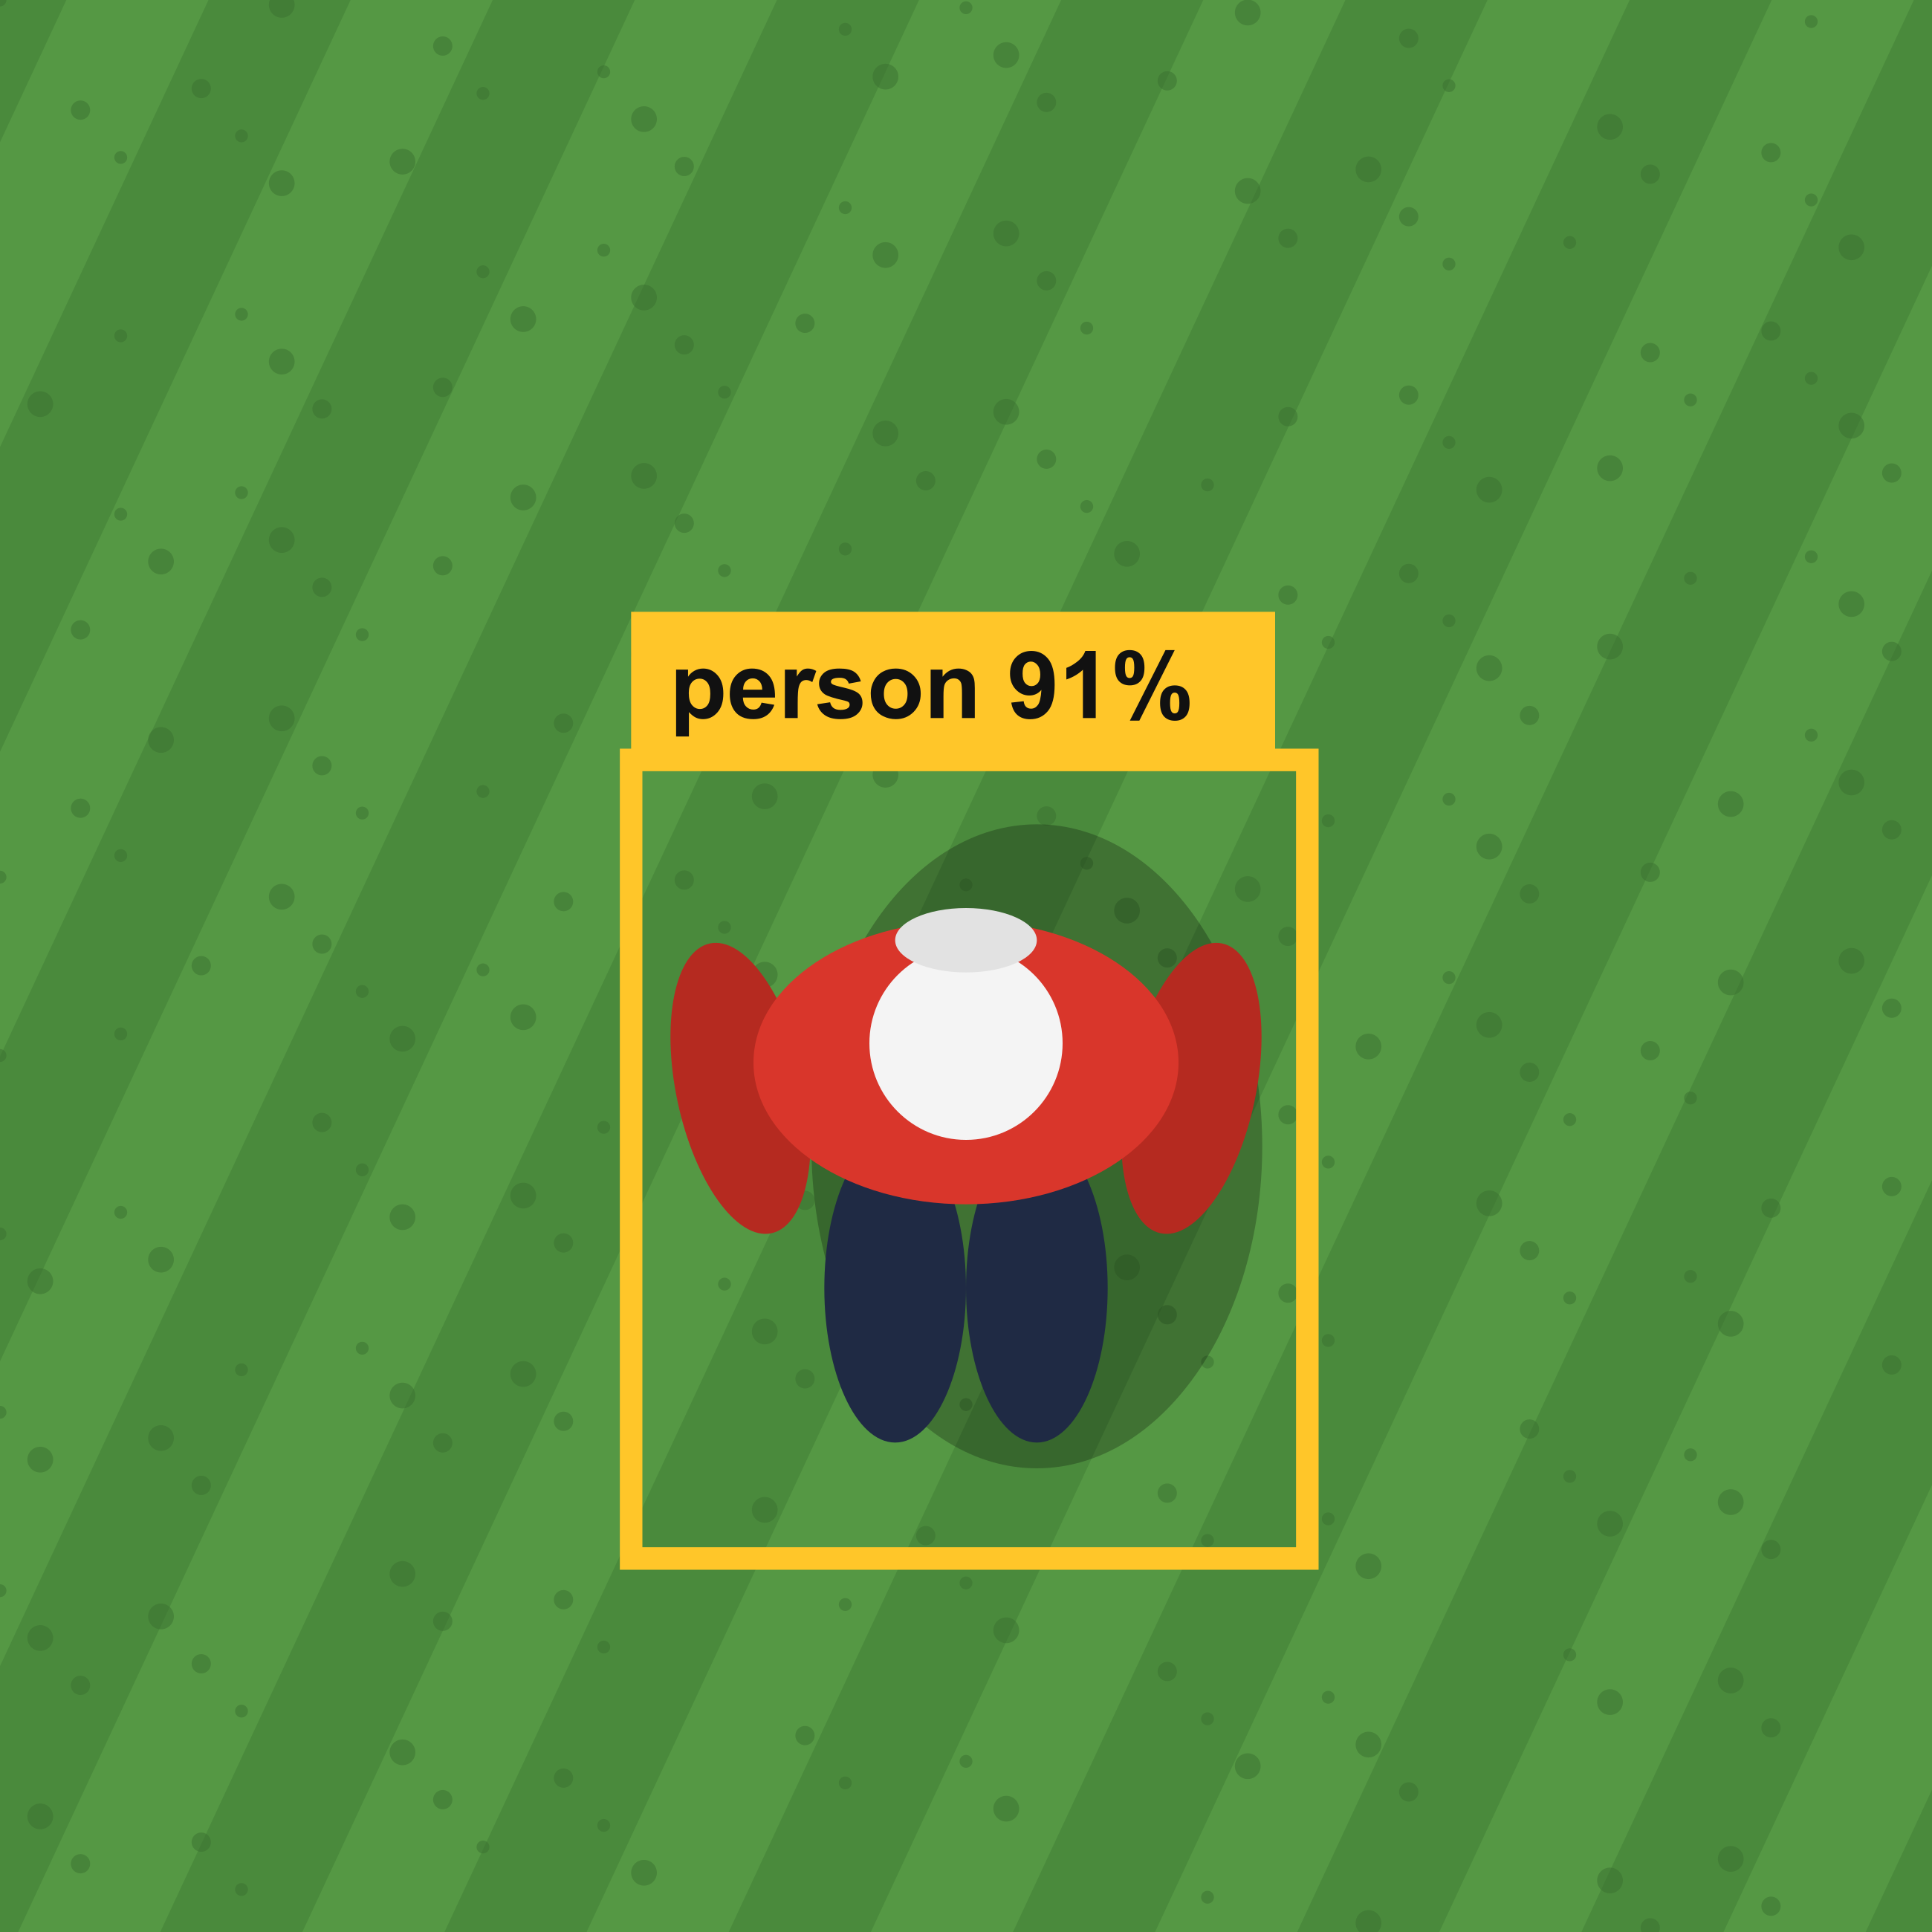
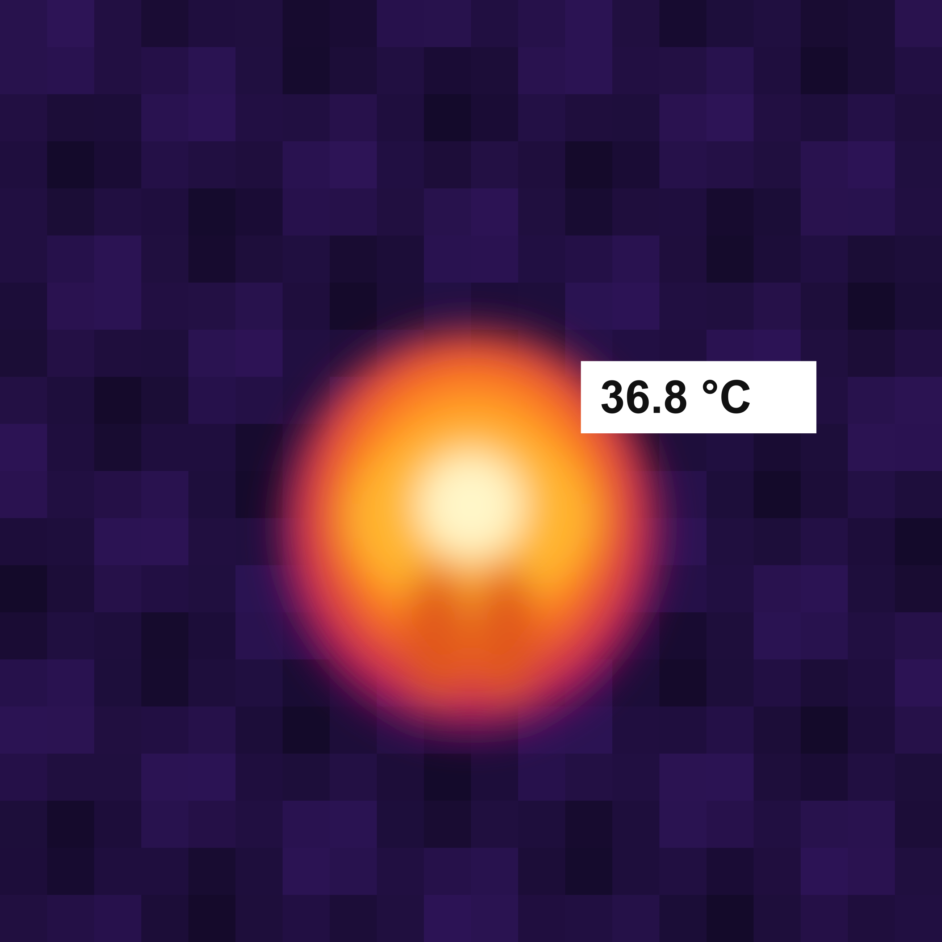
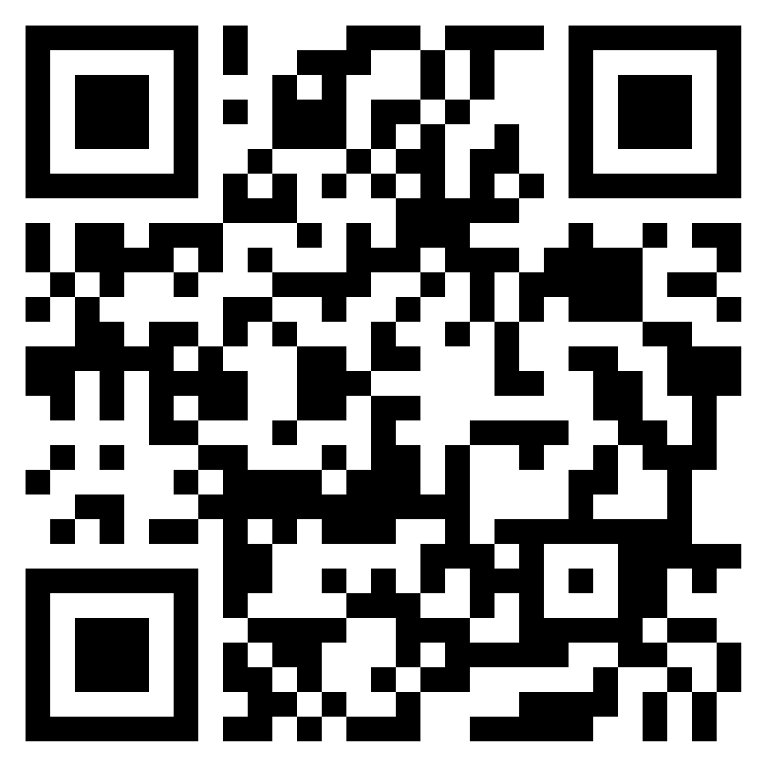

KESTREL: Just Say What to Search
XX-000
Shiva Shrestha
The problem
Planning a search by chat
Secure and trustworthy
KESTREL
You type a request
Search 100 × 50 m north of home
Large language model (LLM) understands it
Who should I look for?
A man in a red jacket
Software builds the route
Plan ready
Target: man, red jacket
Flying height: 27 m
Safety: passed
Automatic safety check
No signal
Hard to fly
KESTREL flies itself
Review plan
You press GO
Two drones
Covering the search area
Results
Compact X-quad, 550 mm
Jetson · Gemma 4 E2B
Large hexacopter, 1.2 m
Mac mini · Qwen3.6-35B-A3B
How it is built
Spotting the person
Phone, tablet or laptop
Wi-Fi, no internet
Colour camera
On-board computer
LLM
Person spotter
Description checker
Heat + image
Shiva Shrestha
PhD CS, Kennesaw State University
sshres16@students.kennesaw.edu
shivashrestha7.com.np
Thermal camera
Route + safety
Offline maps
Colour camera
Thermal camera
Pilot’s remote
Autopilot
Possible match
Man, red jacket. Photo and map pin sent to your device
Open map

