Slide 1
MAN 7916
Session 1: Introduction to Content Analysis and Tools
Aaron McKenny
10/13/2026

Slide 2
Agenda
About this course
This week’s readings
Resources
Homework discussion
The job application process

Slide 3
About this course
Content/Text Analysis Methods
  Manual
  Computer
Methodological rolodex
  What they are
  How they’re used
  Key considerations
  Get your feet wet
Limitations

Slide 4
Course grading

Slide 5
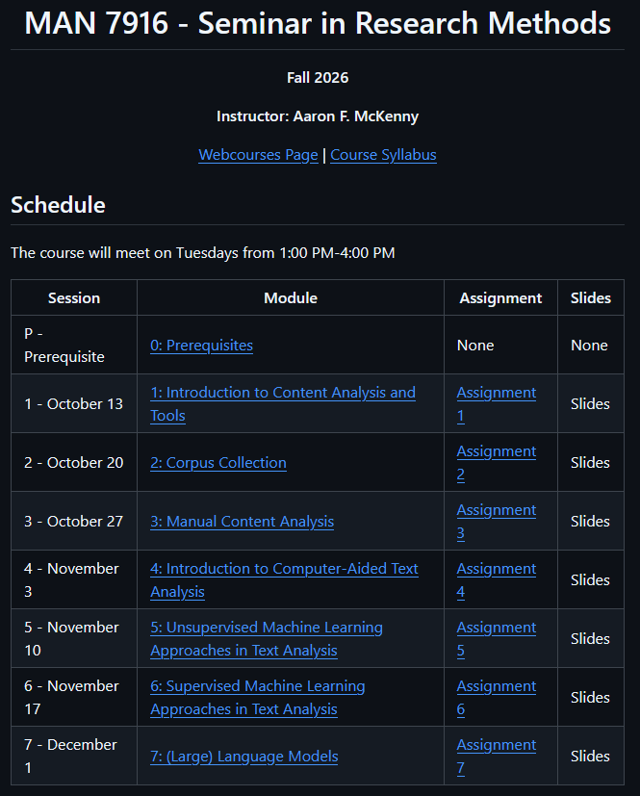
Components: Weekly assignments
40% Contribution
Individual Work*
Due
  On GitHub
  Before class
  Not accepted late
Grades
  Posted to Webcourses

Slide 6
Components: Participation and discussion leadership
20% Contribution
How to make this course really boring:
  100% Instructor lecture
  Uneven involvement/preparedness
  Keep everything at a conceptual level
Participation
  Assessed:
    Routine, active, verbal participation in class discussion
    Content of participation indicates adequate preparation and reflection
  Having an “off-day” is okay on occasion

Slide 7
Components: Participation and discussion leadership
Most classes will have a student “discussion leader”
  2 times per semester
  Co-leads the class with me
Co-lead discussion of method/readings
  Prepare discussion questions
  Stepped-up preparedness/participation
Let’s select weeks!

Slide 8
Week selection
Introduction (10/13) – Aaron
Corpus Collection (10/20**) – Aaron
Manual Content Analysis (10/27) - __
Intro to CATA - __
Unsupervised ML - __
Supervised ML - __
(Large) Language Models - __

Slide 9
Components: Research paper
Research Paper Excerpt
  Hypotheses/Research Questions
  Extended Methods Section
  Extended Analysis+Results Section
Guidelines:
  Must work with a faculty coauthor
  May work with other students
  May double-count existing papers/papers from other courses
  May use someone else’s texts
  ‘Methods’ papers are inappropriate for this course

Slide 10
Preparing for class
Weekly readings
  Required readings
  Choose your own adventure
Assignments
  We will go through in class
Ideally, bring your laptop
  Avoid over-reliance during discussion

Slide 11



Technology

Slide 12
Generative AI (e.g., Claude, GPT, Gemini)
Outside of class: OK w/ disclosure
  As a content analysis tool
  Sanity checking your work
  Writing improvement
  Coding assistance*
Outside of class: Not OK
  Substitute for reading
  Writing for you
  Assist with analysis/interpretation
In class: OK…
  Code debugging on the fly during activities
  With permission
In class: Not OK…
  Everything else

Slide 13
Agenda
About this course
This week’s readings
Resources
Homework discussion
The job application process

Slide 14
Neuendorf Chapters 1 & 2

Slide 15
What is content analysis?
“…a research technique for the objective, systematic, and quantitative description of the manifest content of communication” (Berelson, 1952)
“…any research technique for making inferences by systematically and objectively identifying specified characteristics within text” (Stone et al., 1966)
“…a research technique for making replicable and valid inferences from texts [broadly conceived] to the contexts of their use.” (Krippendorff, 2004)
“…a research method that uses a set of procedures to make valid inferences from text” (Weber, 1990)
“…the systematic, objective, quantitative analysis of message characteristics.” (Neuendorf, 2016)

Slide 16
Common threads?
Systematic
  Not ad hoc/purely subjective
  Same reliability and validity concerns as other techniques
Based in text (though text here is broader than just the written word)
  Organizational communication generates our data
  Context (medium, communicator, recipient, intent) matters
Role of Inference
  Often using text to infer something about reality

Slide 17

Not everyone agrees
Qualitative vs Quantitative… both?
Inductive vs Deductive… both?
Manifest vs Latent content.. Both?
What do the readings suggest?
  What do you think?

Slide 18
What content is being analyzed and how?
Inductive theory building
Narrative analysis
Discourse analysis
Semantic analysis
Rhetorical analysis
Critical analysis
Quantitative content analysis
How do these differ? How are they similar?

Slide 19
Assumption: Words have meaning…
“I love you”
“Dammit Janet”
“We are an innovative company”
“I like you”
“Gosh Janet”
“We are a software company”

Slide 20
Assumption: Words have meaning…
Language is important in…
  Human psychology (Sapir, 1944; Whorf, 1956)
  Sociological processes (Fishman, 1967)
  Economic processes (Rubinstein, 2000)
They tell us something about reality
  How we think
  What we value
  Where our attention is

Slide 21
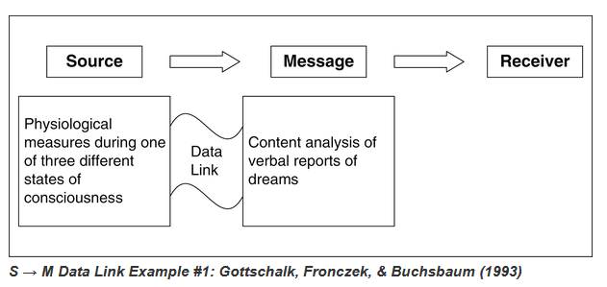
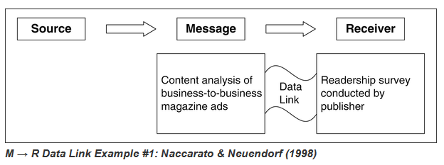
Integrative Process of Content Analysis
Process flowchart (Pages 40-41)
  How is this similar to other deductive research processes?
    Survey
    Database
    Etc.
  How is it different?
What are some research ideas using these links in your area?
  S→M
  M→R

Slide 22
Psychological aspects of natural language use
What do our words tell us about ourselves?
How are our ‘selves’ reflected in the words we use?
What can we glean from the analysis of words?
  Manifest content?
  Latent content?

Slide 23
A content analysis of the content analysis literature
How is content analysis being applied to organizational research?
What kinds of research questions are being answered?
What are some of the:
  Advantages?
  Disadvantages?

Slide 24
Curating Research Assets: Git
Why should we care about version control?
  Is it just for our own sanity/organization?
  How might this help with collaboration with coauthors?
How does this fit with:
  The open science movement?
  The replication crisis?
What are some strengths limitations of Git/version control tools?

Slide 25
Let’s explore Git/GitHub!
https://www.github.com/amckenny
https://github.com/stanfordnlp/stanza
https://github.com/arsena-k/Word2Vec-bias-extraction

Slide 26
Agenda
About this course
This week’s readings
Resources
Homework discussion
The job application process

Slide 27
Keeping your repository up-to-date
Commit and sync your local work
Open your fork on GitHub
Your username should appear in the repository URL
Select the ‘main’ branch and click “Sync Fork”
Review the incoming updates
Click “Update branch” to add my changes to your fork.
Fetch/pull your fork to your local machine

Slide 28
Other Resources
ARCC – https://arcc.ist.ucf.edu/
Google Colaboratory – https://colab.research.google.com/
https://www.terry.uga.edu/contentanalysis/
Textbook
  https://ucf-flvc.primo.exlibrisgroup.com/permalink/01FALSC_UCF/1r87uf/alma99384180312506596

Slide 29
Agenda
About this course
This week’s readings
Resources
Homework discussion
The job application process

Slide 30
Agenda
About this course
This week’s readings
Resources
Homework discussion
The job application process

Slide 31
Your first job market: Application materials
Get this out of the way: Research Schools
  Priorities
    Publications and conditional acceptances at top-tier outlets
    R&Rs at top tier outlets
    Publications, conditional acceptances, R&Rs at other good outlets
    Dissertation and research pipeline with solid co-authors
    Application materials
  Application materials
    Tie-breaker
    Deal-breaker
    Get to know you more holistically

Slide 32
Application materials: Research statement
What do I care about and why?
Where have I been and where do I envision myself going?
Goals: Help them envision…
  your publication record 6 years from now
  fit with their current faculty/needs
  your initial thinking on a “systematic program of research”
Suggestions:
  1… maybe 2 pages maximum
  Get examples from scholars in your area

Slide 33
Application materials: Teaching statement
What do I care about and why?
Where have I been and where do I envision myself going?
Goals: Help them envision…
  what you’re like in the classroom
  fit with their current teaching needs
  whether they can put you in front of MBA students
Suggestions… again:
  1… maybe 2 pages maximum
  https://citl.indiana.edu/teaching-resources/documenting-teaching/teaching-statements-philosophies/index.html
  Get examples from scholars in your area

Slide 34
Application materials: Letters of recommendation
3-4 per school
Who writes them matters
  Who knows you best as a scholar?
  Who can speak best to your promise?
  Who does the selection committee trust?
  Famous scholars
    Only to the extent they meet points 1-3
Who doesn’t write them can matter
  Dissertation chair not writing one? (first job market)
    Better be a good reason that is evident to the selection committee

Slide 35
Application materials: Letters of recommendation
You don’t have to use the same recommenders for all applications
  Social networks
  Research themes
Give your recommenders
  Lots of time (at least a month before first letter is needed)
  The list of schools and your initial thoughts on each
    Why that school
    Where it sits in your “wish list”
  Your up-to-date CV and research status
  Additional points you think may be relevant

Slide 36
Application materials: Cover letter
In roughly this order
  What position you are applying to
  Why you are applying to that position and why you are a good fit
    Why this school (ties to the area, research complementarities, etc)
    How your research (and teaching for teaching schools) complements what is being done at that school, if possible
    Who you could envision working with on research, not just famous scholars
  Call to action
Highlight but don’t regurgitate points from other materials
You should cater this document to each position you apply to
1 page maximum
Get examples from scholars in your area

