Slide 1




International Conference on Electrical Electronics and Computing Technologies (ICEECT 2024)
Lane Detection using the concept of Deep Learning and Digital Image Processing
Paper ID: 698
PRESENTER NAME
Shashi Kant Ojha (SET, CSE Department Sharda University)
Abhishek Kumar (SET, CSE Department Sharda University)
Sandeep Kumar (SET, CSE Department Sharda University)

Slide 2
Contents
Introduction
Problem statement
Objective
Literature review
Dataset Description
Methodology
Working
Advantages
Conclusion
References

Slide 3
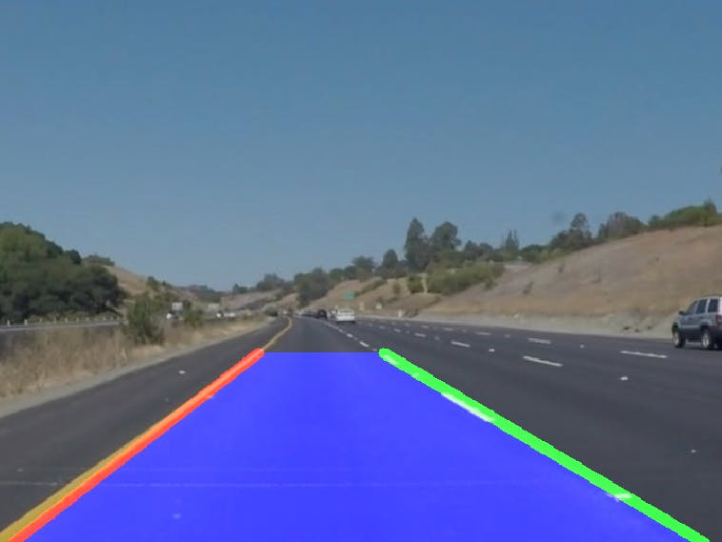
Introduction
Problem: Accurate lane detection is crucial for autonomous vehicles and advanced driver assistance systems.
Traditional methods: Edge detection, Hough Transform and Kalman filtering have limitations in complex scenarios.
Deep Learning: Offers a powerful solution by learning complex patterns from large datasets.
Approach: Through this system we are able to discuss the application of deep learning techniques for lane detection, focusing on Semantic Convolutional Neural Network (CNN).
Fig: Lane detected image overview
https://www.hackster.io/kemfic/simple-lane-detection-c3db2f

Slide 4
Introduction (contd.)
What is lane detection and why is it important?
Lane detection is the process of identifying the lanes on a roadway from camera images and videos.
Applications
Autonomous driving.
Advanced Driving Assistance Systems (ADAS)
Traffic Management.
Importance
Enhances safety by preventing lane departure.
Assists in navigation and path planning.
Reduces driver fatigue in semi-autonomous vehicles.

Slide 5

Problem Statement
Why is lane detection a challenging problem?
Varying Lighting Conditions: Lane markings can be obscured in low light or under glare.
Occlusions: Objects (e.g., vehicles, pedestrians) can obstruct lane markings.
Road Markings: Variations in lane marking types, colors, and quality.
Complex Environments: Urban environments with multiple lanes, intersections, and construction zones.
Fig: Biggest Question
https://www.freepik.com/premium-vector/question-mark-symbol-vector-illustration_29889744.htm

Slide 6
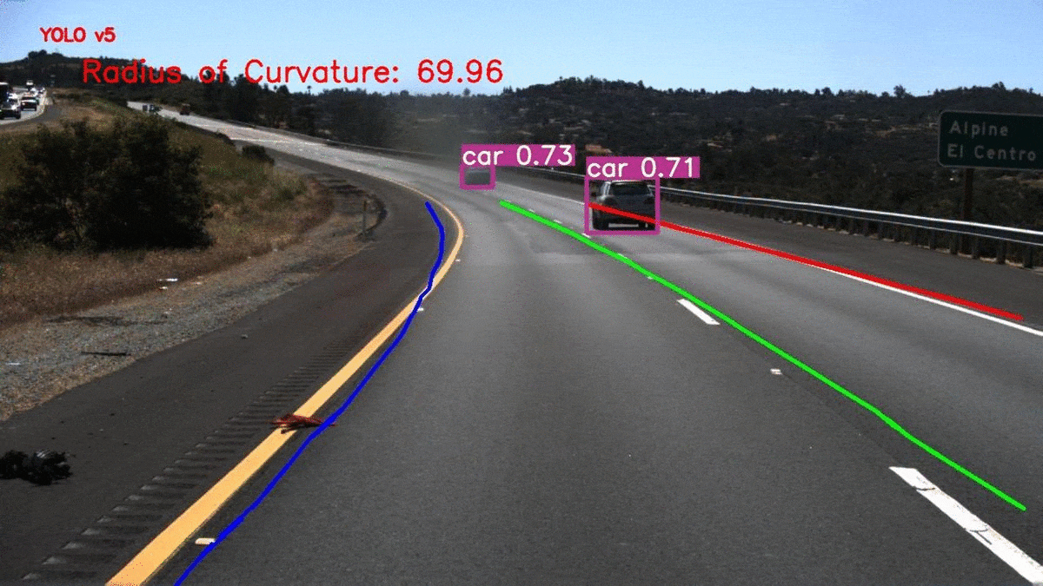
Problem Statement (contd.)
The need of Deep Learning
Complex Patterns: Deep learning models can learn complex patterns and relationships in images, making them suitable for handling challenging lane detection scenarios.
Robustness: Deep learning models can be trained on large datasets to improve their robustness to different lighting conditions, occlusions, and road variations.
Real-time Performance: Deep learning models can be optimized for real-time inference, enabling their application in autonomous driving systems.
Fig: Real time lane detection and alerts for autonomous driving
https://towardsdatascience.com/real-time-lane-detection-and-alerts-for-autonomous-driving-1f0a021390ee

Slide 7
Objectives
Accurate lane detection:
Ensure precise identification of the lane boundaries under various conditions.
Real time- processing:
Develop algorithms capable of processing images/videos in real-time to meet the needs of autonomous driving.
Robustness:
Maintain performance across different road conditions, lighting, and weather scenarios.
Scalability:
Design a system that can be easily integrated into a range of vehicles and scaled to different deployment scenarios.
Low-computational cost:
Optimize the system to run efficiently on available hardware without compromising performance.

Slide 8
No. | Title | Authors | Year | Methodology | Drawbacks | Datasets Used
1 | Self-Supervised Learning for Lane Detection | Neven, Davy et al. | 2022 | Utilizes self-supervised learning techniques to improve lane detection without requiring extensive labeled data. | Performance may degrade in complex scenarios with multiple lanes. | CULane, TuSimple
2 | End-to-End Lane Detection through Differentiable Least-Squares Fitting | Qin, Zequn et al. | 2022 | Proposes an end-to-end learning framework using differentiable least-squares fitting for lane detection. | Computationally intensive, may struggle with lane occlusions. | TuSimple, CULane
3 | CurveLane-NAS: Unifying Lane-Sensitive Architecture Search and Adaptive Point Blending | Liu, Wenyuan et al. | 2023 | Uses neural architecture search (NAS) to design a lane-sensitive model and adaptive point blending for better accuracy. | High computational resources required for NAS. | CurveLanes
4 | Lane Detection via Deep Reinforcement Learning | Xu, Yang et al. | 2021 | Introduces deep reinforcement learning for adaptive lane detection in diverse environments. | Reinforcement learning models require significant training time. | ApolloScape
5 | Multi-Lane Detection and Recognition Using Attention Mechanism | Tan, Wei et al. | 2021 | Applies attention mechanisms to improve multi-lane detection and recognition accuracy. | High computational cost, especially for real-time applications. | TuSimple, CULane

Slide 9
Dataset Description
Tu Simple Lane Detection dataset
Key Points:
Size: Contains a large number of high-resolution images (e.g., 1280x720 pixels) collected from various driving scenarios.
Annotation: Each image is accompanied by detailed lane annotations, including lane markings, lane boundaries, and lane types.
Diversity: Covers a wide range of driving conditions, such as urban roads, highways, and rural areas.
Challenges: Includes challenging scenarios like occlusions, varying lighting conditions, and complex road structures.
Format: Images are typically in JPEG format, while annotations are in JSON format.

Slide 10
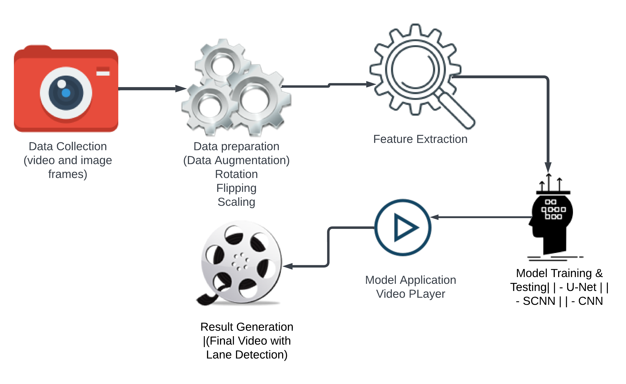
Methodology (Flow diagram of model)

Slide 11
Methodology (contd.)
Complete methodology and architecture of the whole model:
Data Preparation: Collect and preprocess the TU Simple Lane Detection dataset.
Feature Extraction:
SCNN: Extract high-level semantic features (e.g., road, lane markings).
CNN: Learn low-level features (e.g., edges, corners).
Segmentation:
U-Net: Perform pixel-wise segmentation to predict lane boundaries.
Post-processing: Refine the segmentation results using techniques like morphological operations.

Slide 12
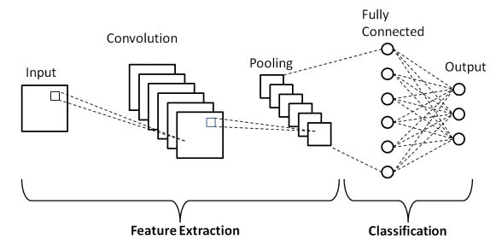
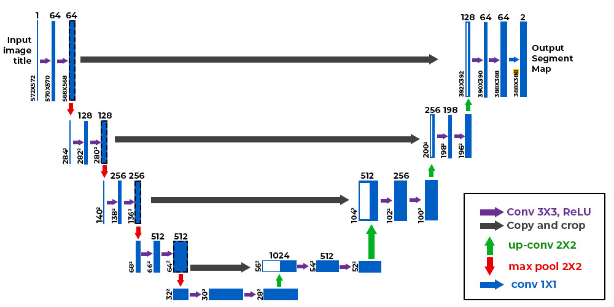
Methodology (contd.) Difference in the architecture of CNN and U-Net
Fig: Architecture of CNN
https://www.upgrad.com/blog/basic-cnn-architecture/
Fig: Architecture of U-Net
https://www.geeksforgeeks.org/u-net-architecture-explained/

Slide 13
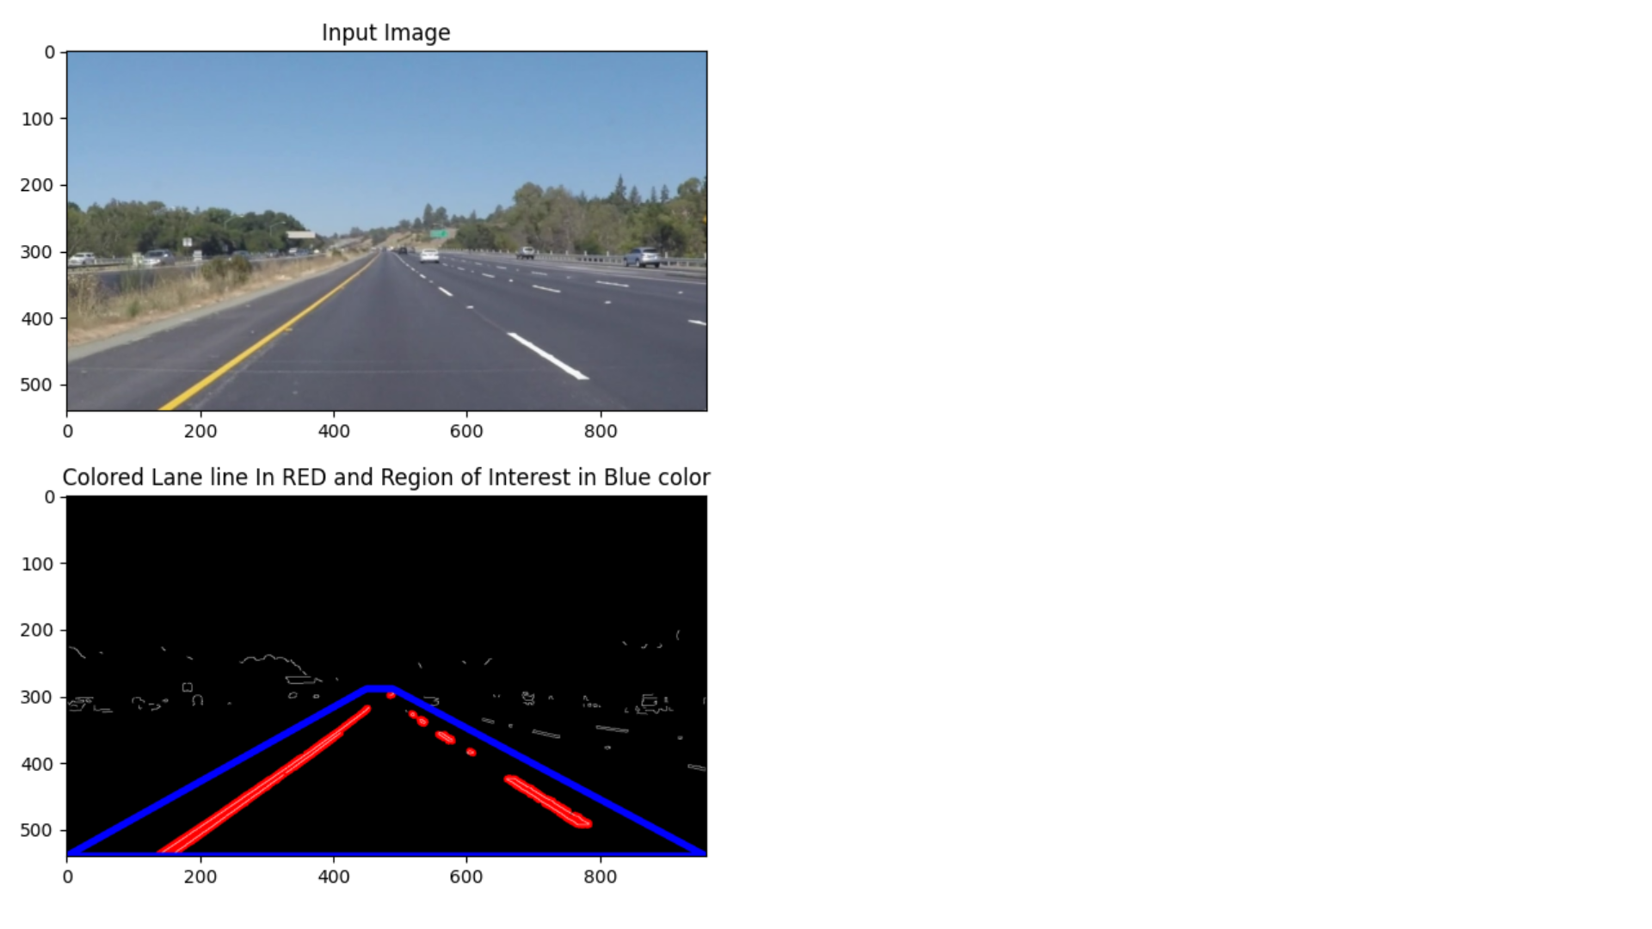
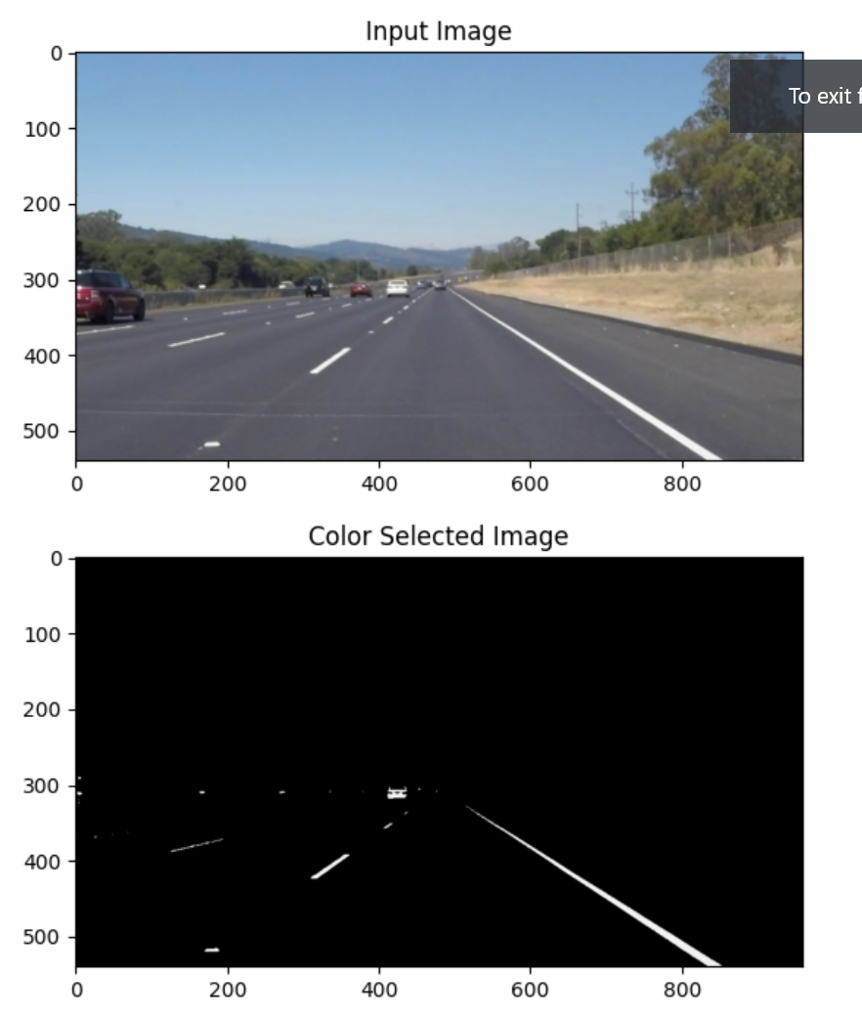
Working
Output of Hough Transform
Output of color selected image

Slide 14
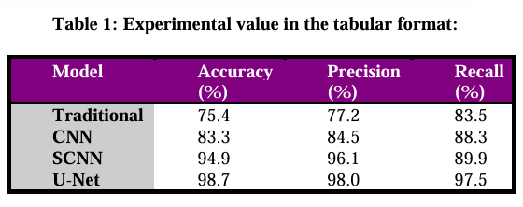

Slide 15
Advantages
Complementary Strengths: Combining CNN, SCNN, and U-Net can leverage the strengths of each model, resulting in improved lane detection performance.
Robustness: The combined approach can be more robust to variations in lighting conditions, occlusions, and road markings.
Accuracy: The integration of different models can lead to more accurate lane boundary predictions.

Slide 16
Conclusion
Lane detection is a critical component for autonomous driving and ADAS, enhancing vehicle safety and navigation.
The integration of deep learning and digital image processing techniques addresses the challenges of variability in road and environmental conditions.
Future work:
Continued improvement in algorithms for higher accuracy and efficiency.
Exploration of advanced hardware solutions for better real-time performance.
Robust lane detection systems are essential for the advancement of autonomous vehicles, contributing to safer and more reliable transportation.

Slide 17
References
[1] Canny, J. (1986). A Computational Approach to Edge Detection. IEEE Transactions on Pattern Analysis and Machine Intelligence, 8(6), 679-698.
[2] Hough, P. V. C. (1962). Method and Means for Recognizing Complex Patterns. U.S. Patent No. 3,069,654.
[3] RANSAC (Random Sample Consensus). (n.d.). Retrieved from https://en.wikipedia.org/wiki/Random_sample_consensus
[4] Long, J., Shelhamer, E., & Darrell, T. (2015). Fully Convolutional Networks for Semantic Segmentation. Proceedings of the IEEE Conference on Computer Vision and Pattern Recognition (CVPR), 3431-3440.
[5] Ronneberger, O., Fischer, P., & Brox, T. (2015). U-Net: Convolutional Networks for Biomedical Image Segmentation. Medical Image Computing and Computer-Assisted Intervention (MICCAI), 9351, 234-241.

Slide 18
[6] Redmon, J., & Farhadi, A. (2017). YOLO9000: Better, Faster, Stronger. Proceedings of the IEEE Conference on Computer Vision and Pattern Recognition (CVPR), 7263-7271. [7] Hochreiter, S., & Schmidhuber, J. (1997). Long Short-Term Memory. Neural Computation, 9(8), 1735-1780. [8] Girshick, R. (2015). Fast R-CNN. Proceedings of the IEEE International Conference on Computer Vision (ICCV), 1440-1448. [9] He, K., Gkioxari, G., Dollár, P., & Girshick, R. (2017). Mask R-CNN. Proceedings of the IEEE International Conference on Computer Vision (ICCV), 2961-2969. [10] Felzenszwalb, P. F., Girshick, R. B., McAllester, D., & Ramanan, D. (2010). Object Detection with Discriminatively Trained Part-Based Models. IEEE Transactions on Pattern Analysis and Machine Intelligence, 32(9), 1627-1645. [11] Ciresan, D., Giusti, A., Gambardella, L. M., & Schmidhuber, J. (2012). Deep Neural Networks Segment Neuronal Membranes in Electron Microscopy Images. Advances in Neural Information Processing Systems (NIPS), 2843-2851. [12] Lee, C. Y., Xie, S., Gallagher, P., Zhang, Z., & Tu, Z. (2015). Deeply-Supervised Nets. Proceedings of the 18th International Conference on Artificial Intelligence and Statistics (AISTATS), 562-570.

Slide 19
Thank You

