Slide 1
SINGLE FAMILY LOAN PERFORMANCE MODEL
Prepared by: SHASHANK SHRIVASTAVA

Slide 2
Introduction
The proposed model attempts to predict risk of a loan defaulting by estimating relationship between loan performance and other variables associated with loan like credit score, interest rates etc. The model will help financial institution to estimate the risk on their loan portfolio.

Slide 3
DATA DESCRIPTION
Data is made available from Freddie Mae
Single Family Loan-Level Dataset (1999-2005)
Monthly Performance Dataset
Some of Merged Dataset Columns :Credit score, CLTV, LTV, DTI, Current loan delinquency status, Monthly reporting period.

Slide 4
DATA WRANGLING
Clean Foreclosed Loan as its out of scope.
Clean loan data missing credit score.
Transform some string values to numeric so that statistical functions can be applied.
Define new column Non-performing as binary (0,1)
New columns YEAR and QUARTER added

Slide 5
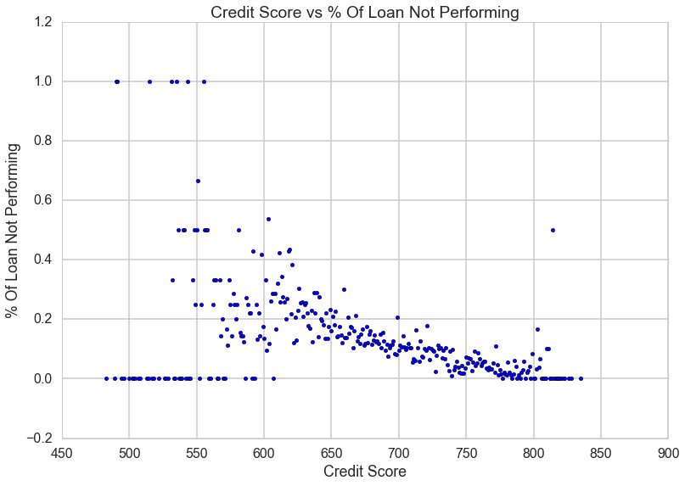
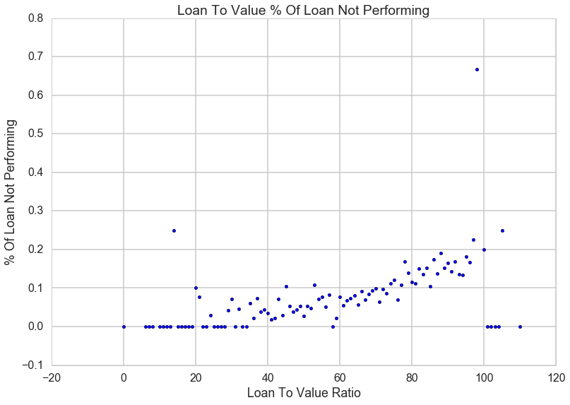
FEATURE CORRELATION
Credit Score vs. % Of Loan Not Performing
Negative Correlation
Loan to Value Ratio vs. % Of Loan Not Performing
Positive Correlation

Slide 6
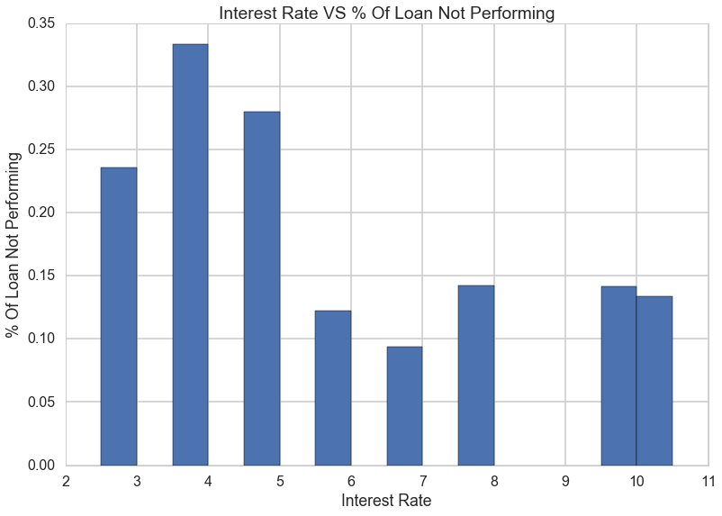
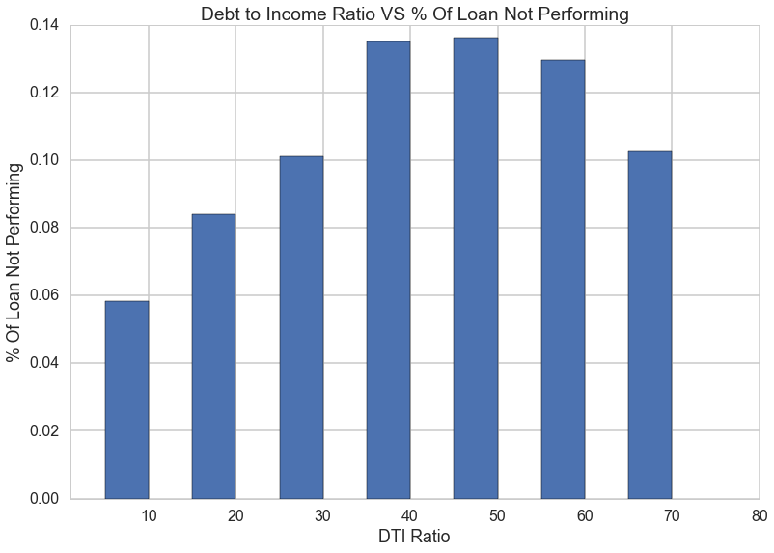
FEATURE CORRELATION
Interest Rate vs. % Of Loan Not Performing
A median value range with lowest % of non-performing loan
Debt to Income Ratio vs. % Of Loan Not Performing
Positive Correlation for most part

Slide 7
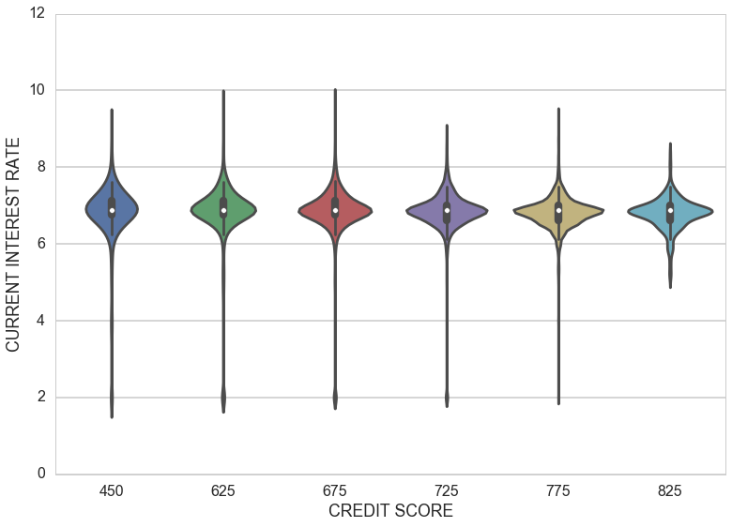
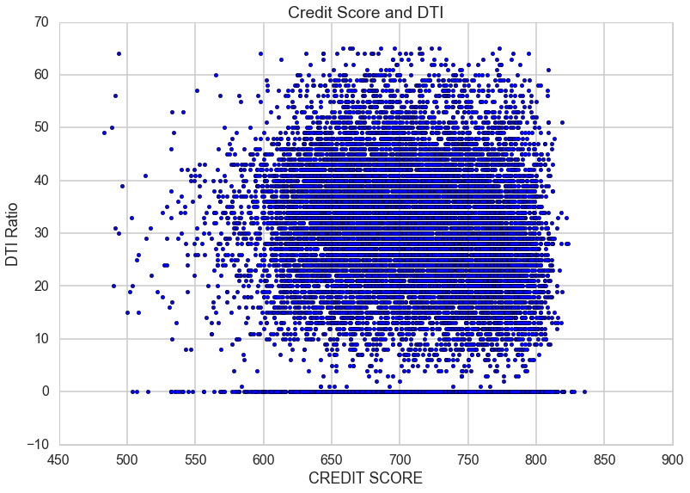
CORRELATION BETWEEN FEATURES
Credit score vs. interest rate
Not highly correlated
Credit score vs. Combined loan to value
Weak Correlation
 | CREDIT SCORE | CLTV
CREDIT SCORE | 1.000000 | -0.391254
CLTV | -0.391254 | 1.000000
Credit score vs. Debt to Income ratio
No Correlation

Slide 8
FEATURE LIST
Credit Score
Ranges from 400-850 Measures the credit worthiness of borrower
Current Interest Rate
Interest rate applied to the mortgage Any modification can result in change to this value
CLTV
The ratio is obtained by dividing the total mortgage loan amount by mortgaged property’s appraised value.
DTI Ratio
The sum of the borrower's monthly debt payments, including monthly housing expenses and mortgage payment divided by the total monthly income.

Slide 9
TRAINING THE MODEL
We take dataset for one quarter 2013 Q4
Non Performing Loan status as binary value
Rebalanced the dataset
GridSearchCV with 5 folds to get best regularization parameters for Logistic Regression
Estimated regression coefficient
FEATURES | COEFFICIENT
Credit Score | -0.00963969
Current Interest Rate | 0.05448207
CLTV | 0.02589876
DTI Ratio | 0.00706395
Intercept | 4.07803818

Slide 10
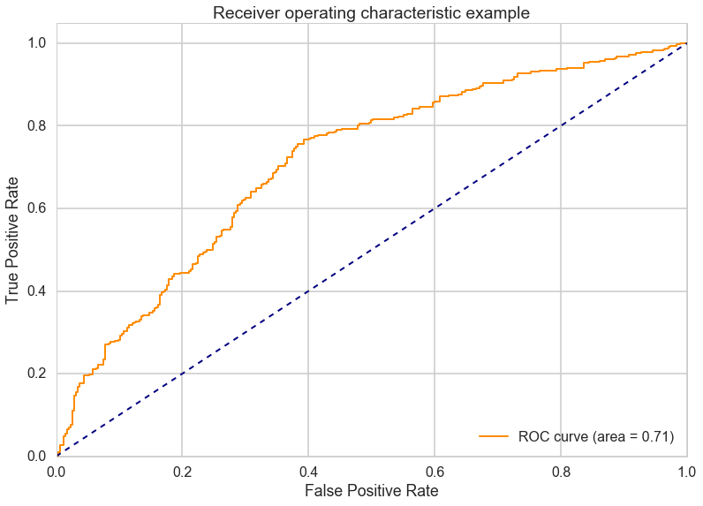
EVALUATE THE MODEL
Precision, Recall, F1 Metrics
Receiver Operating Characteristic (ROC)
 | Precision | Recall | F1-score | Support
Non-Performing | 0.65 | 0.68 | 0.67 | 335

Slide 11
EVALUATE THE MODEL
Statmodels statistics metrics assuming the model trained here is similar to one above
 | Coef | Std err | Z | P>|Z| | [95.0% Conf. Int.] | Odds Ratio
Credit Score | -0.0062 | 0.000 | -13.109 | 0.000 | -0.007 -0.005 | 0.99381918034
Cur. Interest Rate | 0.1909 | 0.044 | 4.315 | 0.000 | 0.104 0.278 | 1.21033841219
CLTV | 0.0340 | 0.003 | 12.323 | 0.000 | 0.029 0.039 | 1.03458460673
DTI Ratio | 0.0103 | 0.003 | 3.393 | 0.001 | 0.004 0.016 | 1.01035322759

Slide 12
RECOMENDATION
The large mortgage banks and other financial institutes buy loans from other banks and mortgage companies. This results in them having a variety of loans in their portfolio. Using a model that can identify potential Non Performing loans in advance gives these financial institution useful metrics that they can use to perform their risk analysis.
After the mortgage crisis of 2008, consumer habits have changed. Consumers constantly make choices between paying their mortgage and walking out. Its prudent for these financial institutes to identify loans that are at risk of default and provide them with incentives and other offers to keep them current in the mortgage payment.

