Slide 1
INVESTMENT ASSIGNMENT SUBMISSION
Name: Shashank Kumar

Slide 2
Finding potential sector and country for investment by Spark Funds
Spark Fund is on lookout to potentially invest between 5million to 15 million USD over multiple rounds of investments in an English speaking country. Out task is to analyse the data and recommend the CEO of the company about investment opportunities based on the global trends of investments

Slide 3
<Problem solving methodology>
Flow of solution:
Take Company info -> merge with rounds info -> this will provide us info like amount invested, countries, company name, type of company, sector of investment, funding category -> clean up data -> remove NaN with 0 or NA for numeric and text fields respectively -> remove extra information not needed -> group data and figures for analysis -> merge mapping information -> cleanup sector info - >analyse sector wise info -> analyse overall info for country and investment type

Slide 4
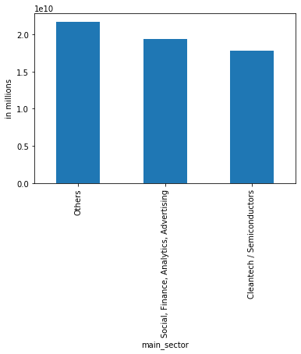
Country 1 - USA
First option for Spark fund to invest should be USA. In USA, huge investment is flowing in Other category followed by Social and then semiconductor

Slide 5
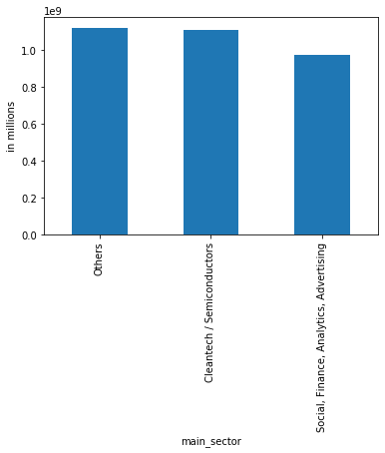
Country 2- Great Britain
First option for Spark fund to invest should be USA. In USA, huge investment is flowing in Other category followed by Semiconductor and then Social

Slide 6
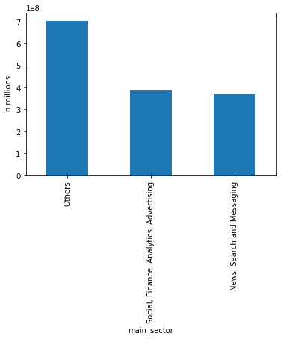
Country 3 - India
First option for Spark fund to invest should be USA. In USA, huge investment is flowing in Other category followed by Social and then News tech

Slide 7
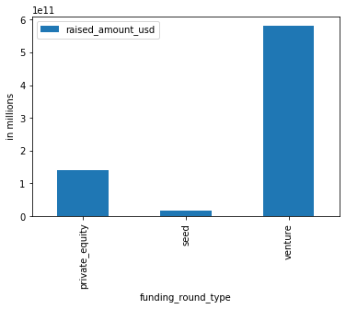
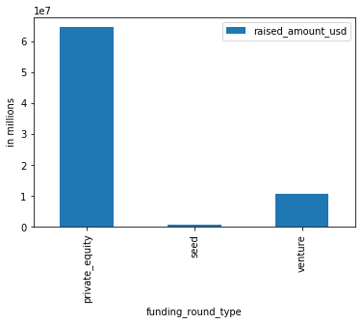
Mean and Average

Slide 8
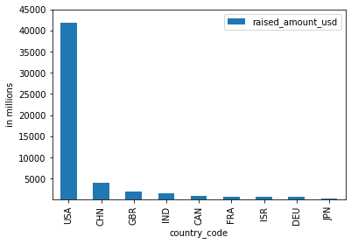
Top 9 countries

Slide 9
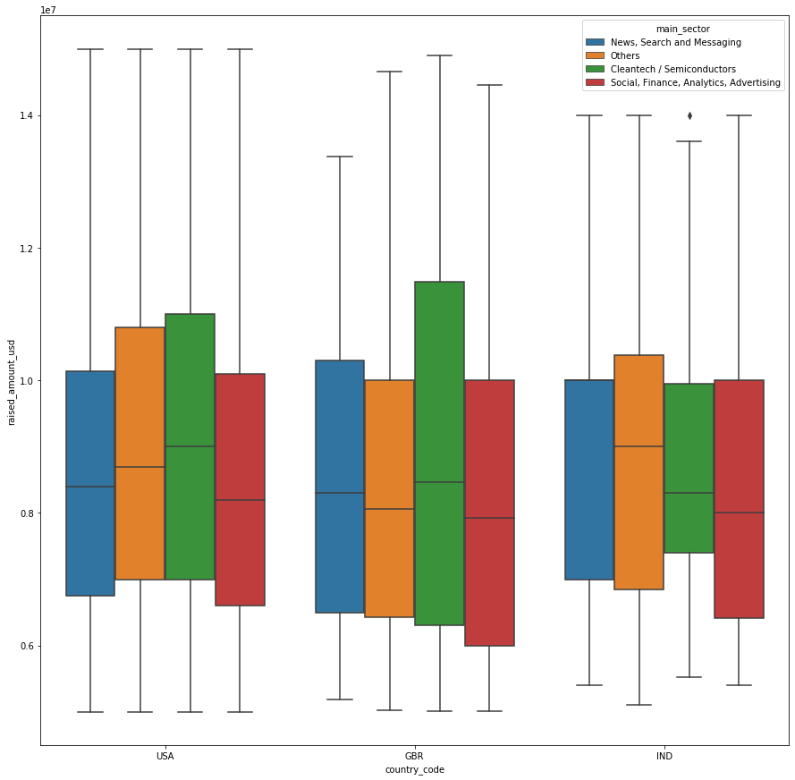
Top 3 countries

Slide 10
Final Conclusion
Recommendations:
Funding type = Venture
Countries in order of preference = USA, Great Britain, India
Best sectors to invest = Others and Social, Finance, Analytics, Advertising

