Slide 1
Welcome to Level-3 :)

Slide 2
A Typical Day in Level-3

Slide 3




Things to Do

Slide 4


Things NOT to Do

Slide 5
Welcome to CSE 310

Slide 6
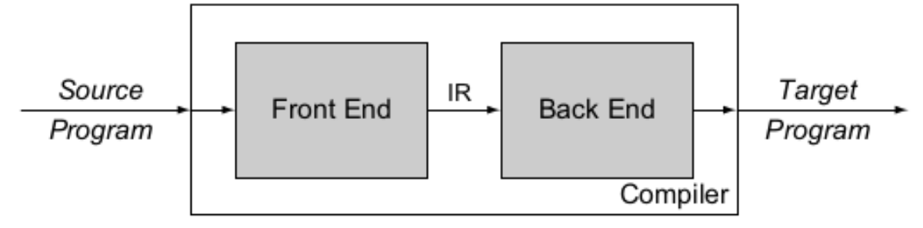
Compiler
Convert a source program to a target program
The compilation process usually divided into several phases

Slide 7
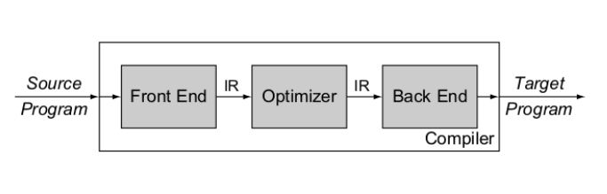
Compiler
Convert a source program to a target program
The compilation process usually divided into several phases

Slide 8
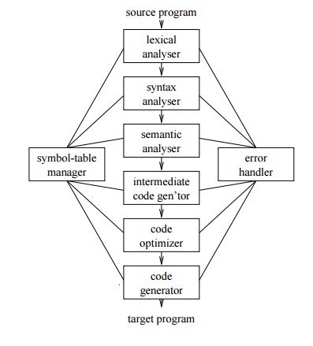
Compiler

Slide 9
Compiler
Record keeper

Slide 10
Compiler
Lexical Analyzer takes the source program as input and converts it into a stream of tokens
To be used by the syntax analyzer later on
Also detects some lexical errors
Ill formed number
Improper variable declaration
Unfinished string/comment etc.

Slide 11
Compiler
Syntax analyzer uses the tokens produced by the lexical analyzer to depict the grammatical structure of the token stream
Builds implicit syntax tree
Detects syntax errors

Slide 12
Compiler
Semantic analyzer uses the syntax tree and the information in the symbol table to check the source program for semantic consistency with the language definition
Check semantic errors
Type checking
Variable declared as void
Undeclared variable
Error in no./type of function argument during call

Slide 13
What will we do in this course?
Construct and manage symbol table
Perform lexical analysis using flex
Perform syntax analysis, semantic analysis, and intermediate code generation
Some code optimization too
So… We are going to build a COMPILER!

Slide 14
Some Info
Linux Platform
No Plagiarism

Slide 15
Symbol Table
A table storing information of occurrence of various entities in the source program
Function names, return type, no. parameters; variable name, type etc.
Information are:
Symbol Name
Type
Scope
Used in almost all phases of a compilation

Slide 16
Offline 1: Symbol Table Management
Implement a simple symbol table
Hash based (Chaining)
Each entry is mainly a two tuple <Symbol Name, Symbol Type>
Use Symbol Name as key of hash table

Slide 17
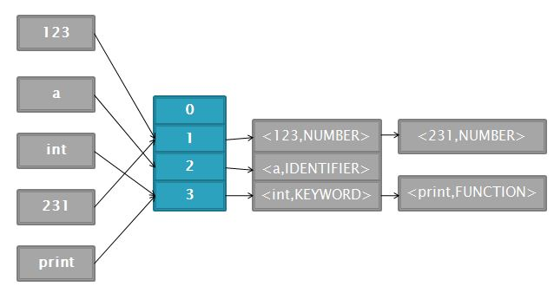
Offline 1: Symbol Table Management

Slide 18
How Symbol Table Helps?
How can this type of Symbol Table help?
Detect undeclared variable
Type checking
Add an extra field for each symbol named datatype
During an assignment operation, check datatype field of RHS and LHS
main(){
int a;
a=1;
b=2;
}
Insert a into symbol table
Search a into symbol table. SUCCESS!
Search b into symbol table. FAILURE!

Slide 19
How Symbol Table Helps?
How can this type of Symbol Table help?
Scope Management
Need to allow duplicate entry in symbol table
Also delete some entries when a block ends
How to accommodate this??
main(){
int a;
{
int a,b;
}
b=2;
}

Slide 20
Symbol Table for Scope Management
List of Hash Tables
main(){
int a;
{
int a,b;
}
b=2;
}
Current Scope
Current Scope
Hash Table#1
<a, var>
Hash Table#2
<a, var>
<b, var>
Parent
pointer

Slide 21
Symbol Table for Scope Management
List of Hash Tables
main(){
int a;
{
int a,b;
}
b=2;
}
Current Scope
Hash Table#1
<a, var>

Slide 22
Symbol Table for Scope Management
Stack of Hash Tables
How does accessing work?
Search the topmost scope table
If fail, search its parent scope table and so on

Slide 23
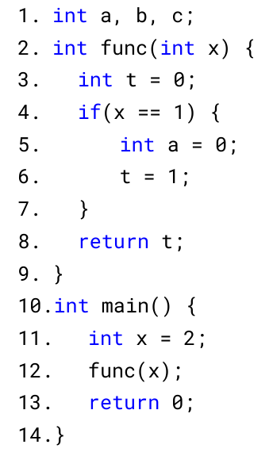
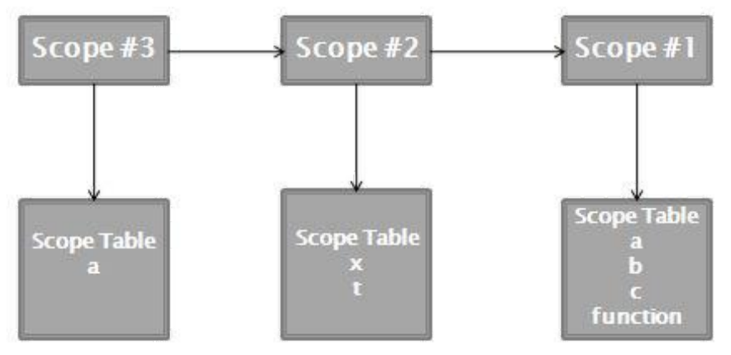
Symbol Table for Scope Management
Stack of Hash Tables

Slide 24
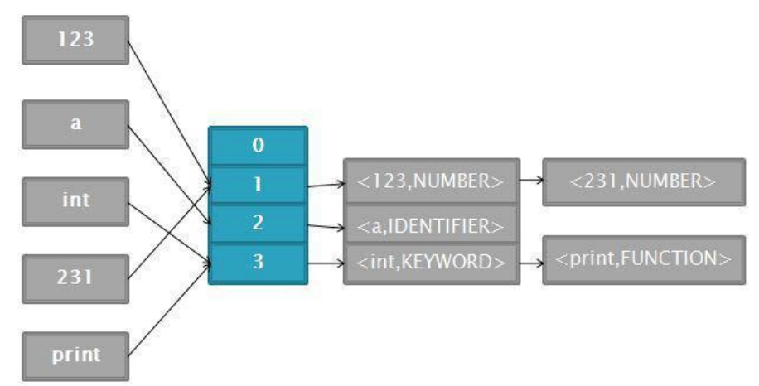
Offline 1: Symbol Table Management
Three Classes
1. SymbolInfo
Each entry of symbol table is an instance of SymbolInfo (Remember two tuples!!!)
Three member vars
name, type, pointer to SymbolInfo (separate chaining)

Slide 25
Offline 1: Symbol Table Management
Three Classes
2. ScopeTable
This class is the implementation of a hash table.
Represents each scope
Implement four operations
Insert
Lookup
Delete
Print

Slide 26
Offline 1: Symbol Table Management
Three Classes
3. SymbolTable
Maintains a list of Scope Tables
Implement six operations
Enter Scope
Exit Scope
Insert
Delete
Print All Scope Tables
Print Current Scope Table

Slide 27
No Memory Leak
use -fsanitize=address flag

Slide 28
Acknowledgement
Ajmain Yasar Ahmed Sahil

