Slide 1
Convolution
Convolution
Fully Connected
Fully Connected

Slide 2
Convolution
Convolution
Fully Connected
Fully Connected

Slide 3
Network
Act
Compute Loss
Update Collector
Compute Loss
Act
Agent 1
Agent 24

Slide 4
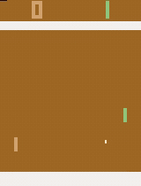
Action
Reward
State
Environment
s | a | r | s' | d
Target DQN
Policy
Mini
Batch
Online
DQN
Loss
Replay Memory
Learn
Agent

