Slide 1

FlareGuard: Cross-Chain Safety Intelligence
Real-time risk monitoring powered by Flare's decentralized oracle ecosystem—protecting DeFi users across chains.

Slide 2
The Challenge
DeFi Users Navigate Risk Blindly
Traditional DeFi platforms leave users vulnerable to market volatility, liquidation cascades, and cross-chain inconsistencies. Without real-time safety metrics, users can't make informed decisions about when to enter or exit positions.
FlareGuard solves this by aggregating decentralized price data, computing risk scores for individual tokens and entire markets, and delivering actionable safety intelligence through an intuitive interface.

Slide 3
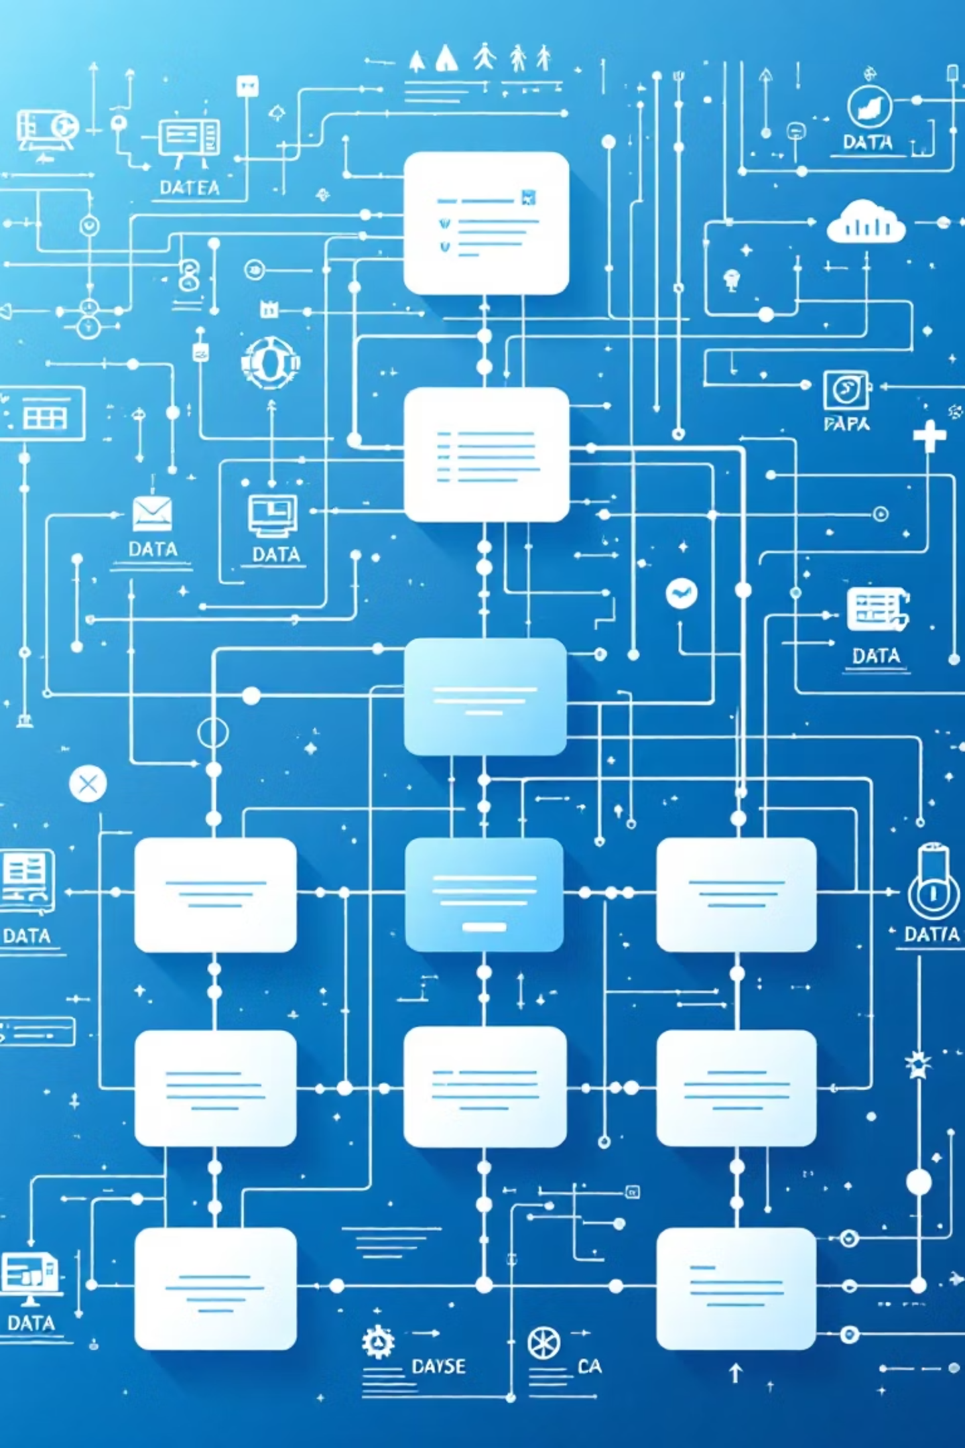




Architecture: Four Flare Technologies Working Together
FTSO Price Feeds
Decentralized oracle data provides baseline price information
FDC Queries
Backend queries time-series data via Flare Data Connector
Risk Engine
Computes per-token scores and market safety aggregates
Smart Account
On-chain state updates via updateRisk function

Slide 4
Data Flow Pipeline
01
02
03
FTSO feeds deliver price data
FDC enables historical queries
Risk computation happens off-chain
Real-time token prices from Flare's Time Series Oracle network
Backend pulls time-series data to analyze volatility patterns
Backend engine calculates individual token risk and aggregate market safety scores
04
05
Smart Account receives updates
Frontend visualizes results
On-chain state synchronized via updateRisk function call
Users see real-time risk dashboards combining API data and smart account status

Slide 5

Cross-Chain Intelligence with FAssets
Comparing Native vs. Wrapped Assets
2x
FlareGuard pulls data for both BTC and FAsset BTC, computing independent risk scores for each. The backend analyzes the delta between native and wrapped asset risk profiles.
Asset pairs analyzed
This cross-chain comparison reveals arbitrage opportunities, peg stability issues, and liquidity differences—critical intelligence for sophisticated DeFi users.
<5ms
Comparison latency

Slide 6




Feature Showcase: Judging Criteria Alignment
Completion
Originality
Learning
Fully functional backend risk engine
First to combine all four Flare technologies
Deep dive into FTSO mechanics
Mastered FDC historical queries
Smart account integration deployed
Novel cross-chain safety comparison
FAssets integration patterns
Smart account state management
Live frontend dashboard
Real-time risk aggregation methodology
End-to-end data pipeline operational

Slide 7

Technical Excellence
Design
Intuitive dashboard with color-coded risk indicators, real-time charts, and mobile-responsive layout. Clean architecture separates concerns between data ingestion, computation, and presentation layers.
Innovation
Market safety score aggregation algorithm synthesizes individual token risks into actionable ecosystem-wide metrics. Smart account integration enables on-chain verifiable risk assessments accessible to other protocols.

Slide 8




Flare Technology Integration Map
FTSO
FDC
Baseline price feeds for all monitored tokens
Historical time-series data retrieval for volatility analysis
Smart Accounts
FAssets
On-chain state management via updateRisk function
Cross-chain asset comparison and peg monitoring

Slide 9



The 60-Second Pitch
FlareGuard is a real-time DeFi safety dashboard that uses four Flare technologies to protect users from market risk. We pull price data from FTSO, query historical patterns via FDC, compare native and wrapped assets using FAssets, and store verifiable risk scores on-chain through Flare Smart Accounts.
Our backend computes per-token risk scores and aggregates them into a market safety index. Users get actionable intelligence: green means safe to deploy capital, yellow suggests caution, red signals elevated risk. By combining all four Flare primitives, we've built the first comprehensive cross-chain safety monitoring system for DeFi.

Slide 10

Impact & Next Steps
What We've Built
Future Roadmap
Production-ready risk monitoring system
Expand to 50+ token pairs and additional chains
Full integration across Flare's technology stack
Machine learning models for predictive risk scoring
Scalable architecture supporting multiple chains
Protocol partnerships for embedded risk widgets
Open-source codebase for community contributions
Mobile app with push notifications for risk alerts

