Slide 1
IBM SB Data Insight With Python WCP
MUHAMMED SHAHZAD
COCHIN UNIVERSITY COLLEGE OF ENGINEERING KUTTANADU
KERALA

Slide 2
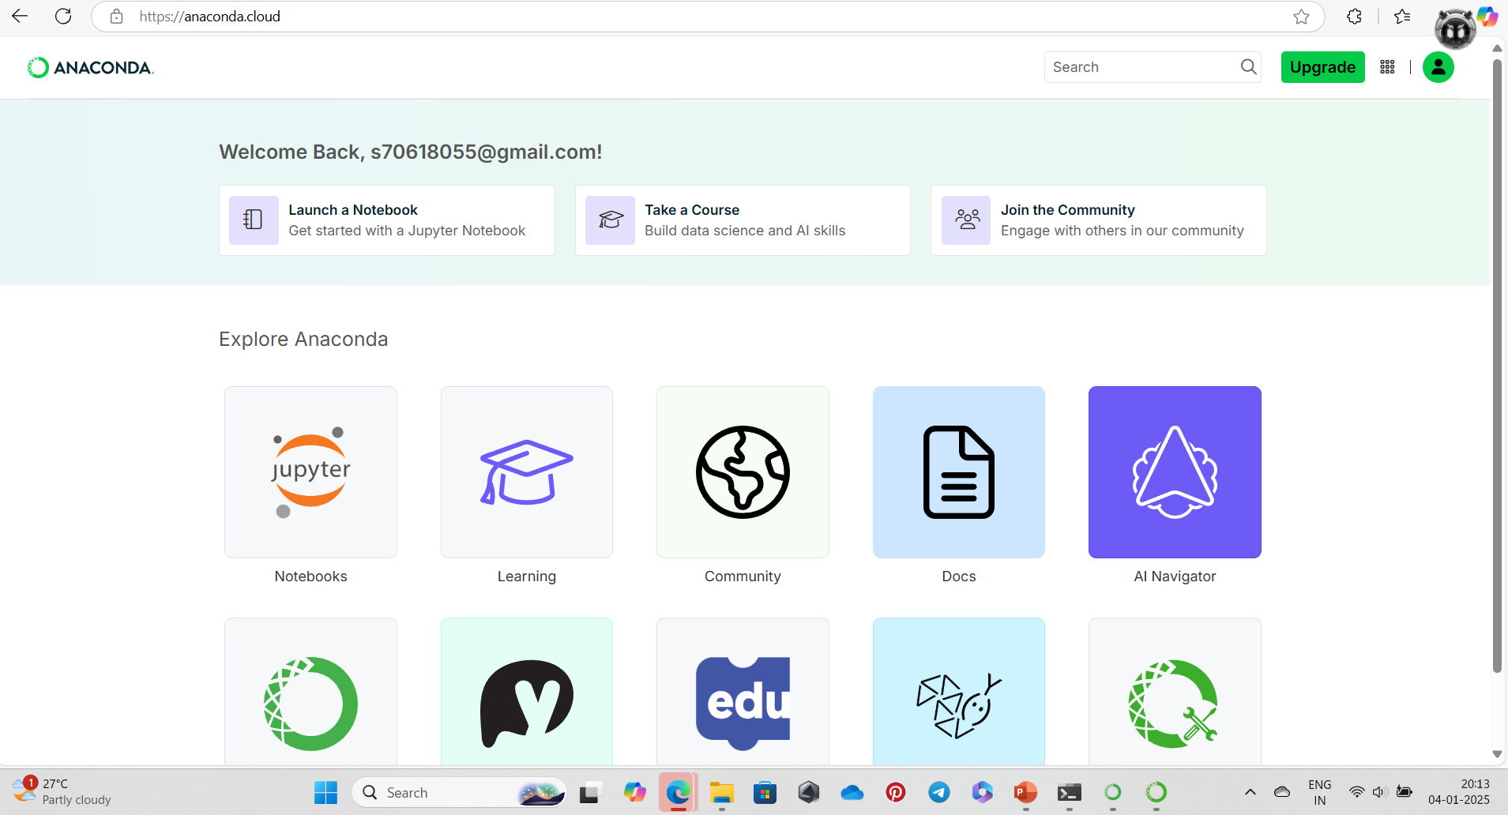
ASSIGNMENT-1

Slide 3
ASSIGNMENT-2

Slide 4
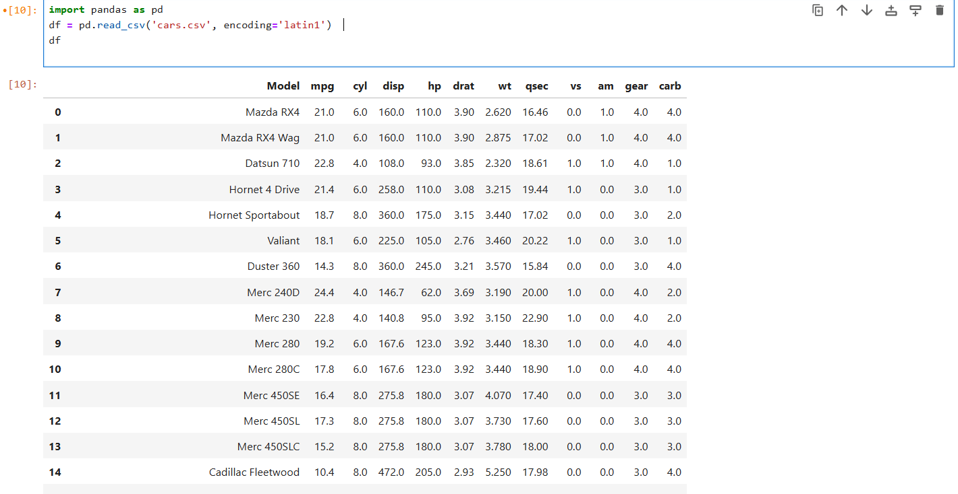
1.Read data inside python

Slide 5
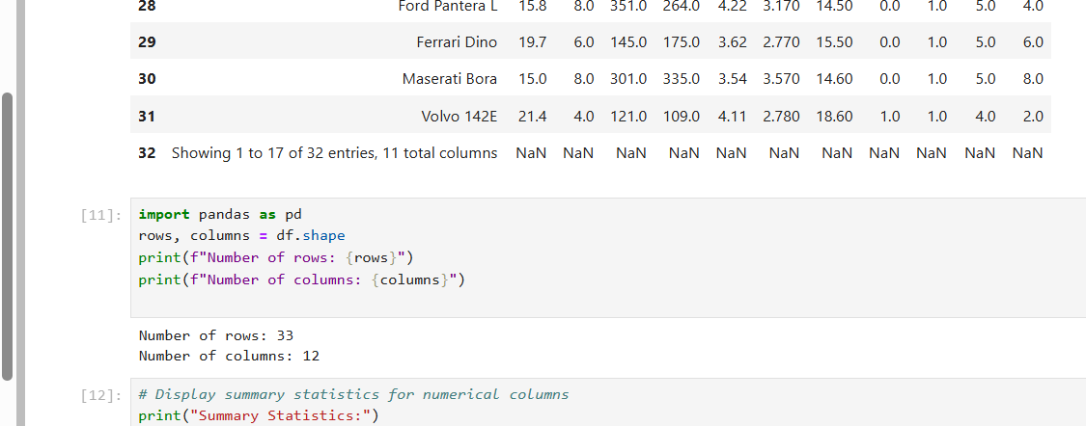
2.Rows and columns printing

Slide 6
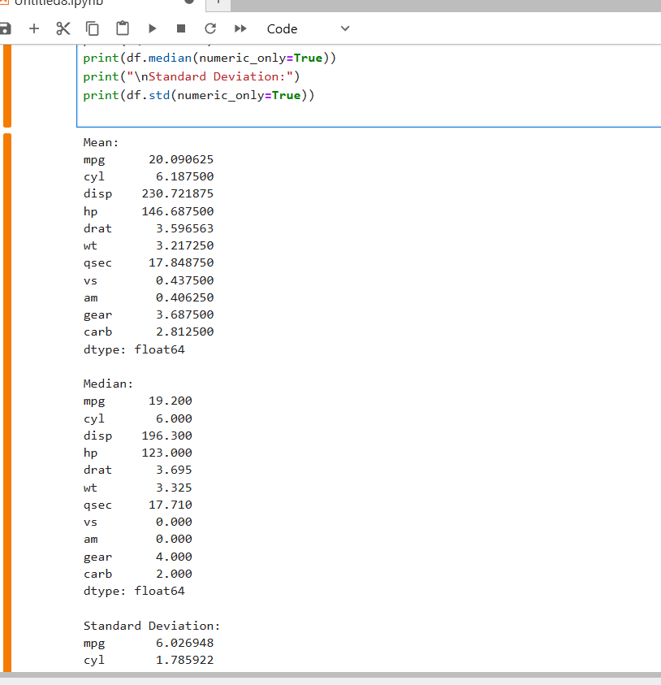
3.mean,median and standard deviation

Slide 7
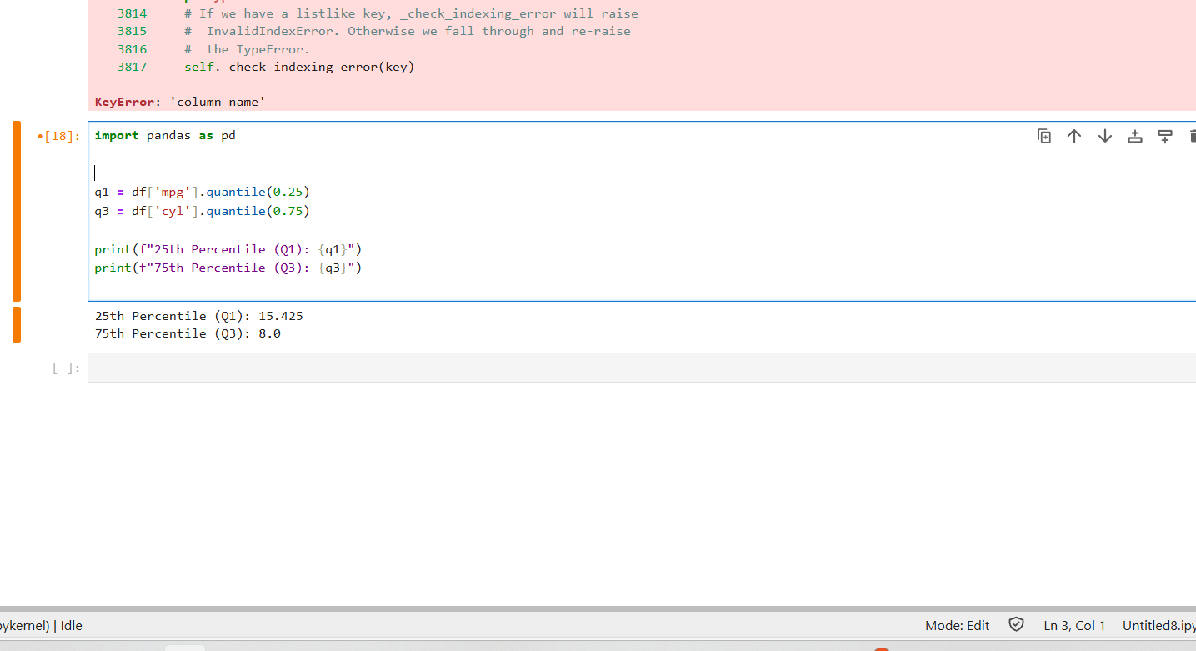
4.Interpretation of 25% and 75%

Slide 8
ASSIGNMENT-3

Slide 9
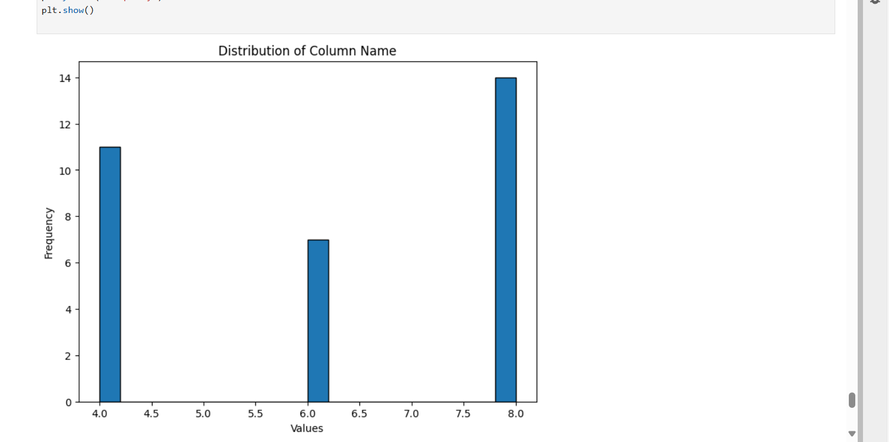
Histogram

Slide 10
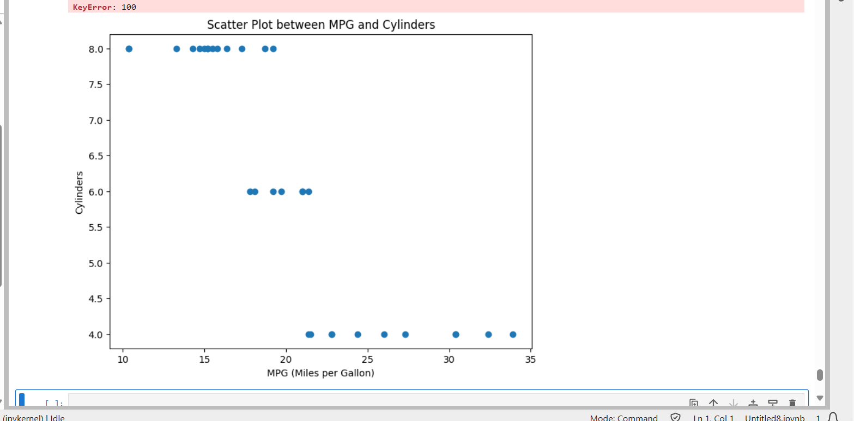
Scatter plot

