Slide 1
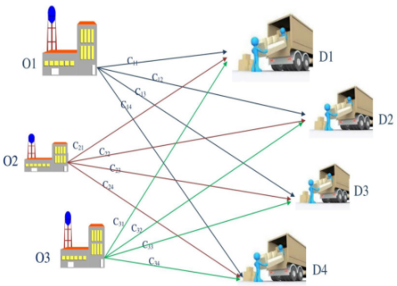
Transportation Problem Professor: Dr.Shokri
Winter 2021
Producers:
Mohammadali Shakerdargah
Behnam Moradkhani
Sahand Divsalar

Slide 2
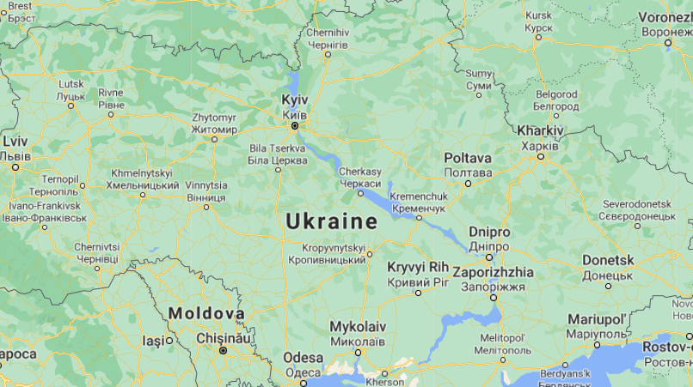
Chosen Country:
Ukraine

Slide 3
Purpose:
Electricity is the vital energy source in both industrial production manufacturing and people’s daily lives so the importance of electric power generation and transmission is beyond question. As a link between electric power generation and transmission, electric power dispatching decides the effective and healthy operation of the whole power grid. The automation and intelligence of electric power dispatching is a long time issue concerning power grids deserving thorough research.

Slide 4
Abstract:
The transportation problem is a special type of linear programming problem where the objective consists in minimizing transportation cost of a given commodity from a number of sources or origins (e.g. factory, manufacturing facility) to a number of destinations (e.g. warehouse, store). Each source has a limited supply (i.e. maximum number of products that can be sent from it) while each destination has a demand to be satisfied (i.e. minimum number of products that need to be shipped to it). The cost of shipping from a source to a destination is directly proportional to the number of units shipped. Finding an initial basic feasible solution is the prime requirement to obtain an optimal solution for the transportation problems.

Slide 5
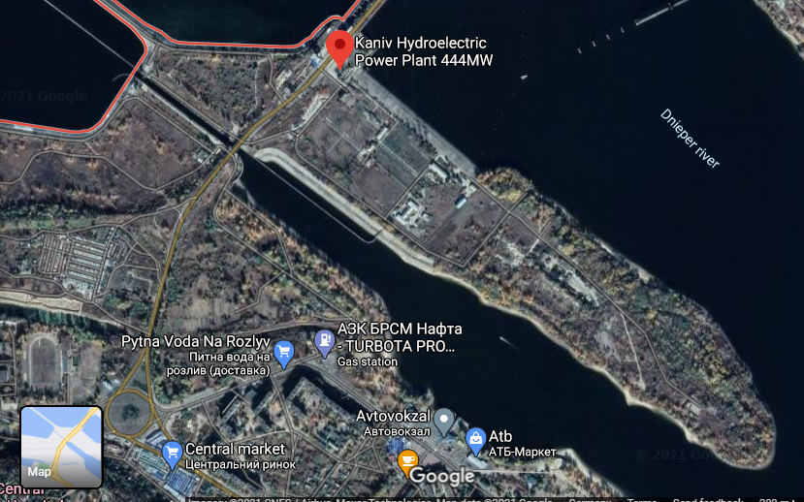
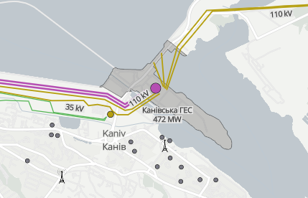
Data:
We considered 11 cities and 69 plants that supply the electrical network of the simplified country.

Slide 6
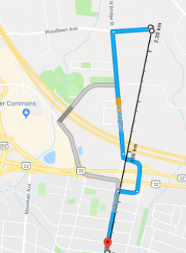
Distance Measurement:
To determine the distance of power lines, we used algebraic distance.

Slide 7

Cost of using each line:
We supposed that all transmitting lines are 3rd order bundles!

Slide 8

Cost Function:
Represents the loss of power in the network.

Slide 9

Constraint 1:
Each power plant can produce its capacity or less.

Slide 10

Constraint 2:
The power transmitted to each city must answer the demand of that city completely.

Slide 11

Constraint 3:
The power transmitted in each line from plant to city must be positive.

Slide 12
Final Results
Now we want to represent the final results for each city in the form of histogram.

Slide 13
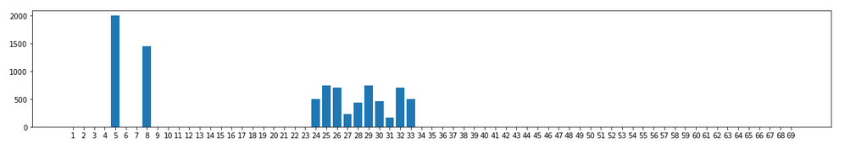
Kyiv:

Slide 14
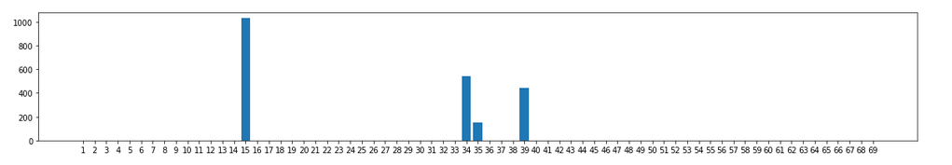
Lviv:

Slide 15
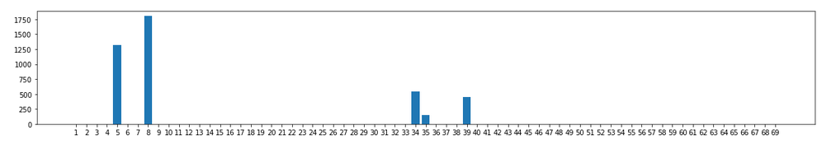
Kharkiv:

Slide 16
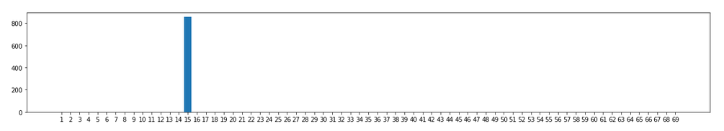
Poltava:

Slide 17
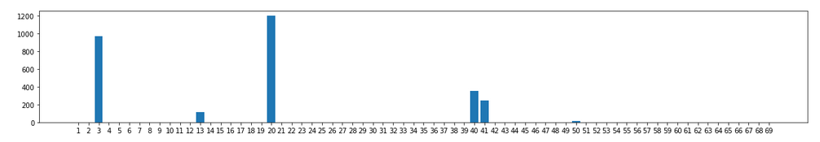
Dnipro:

Slide 18
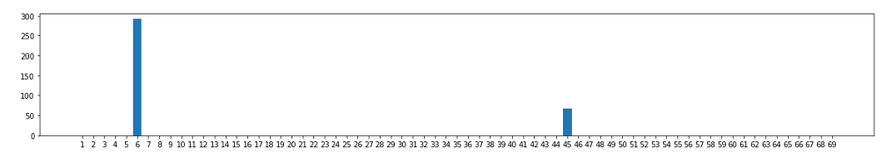
Odesa:

Slide 19
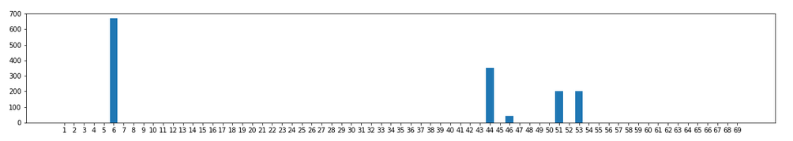
Mykolaiv:

Slide 20
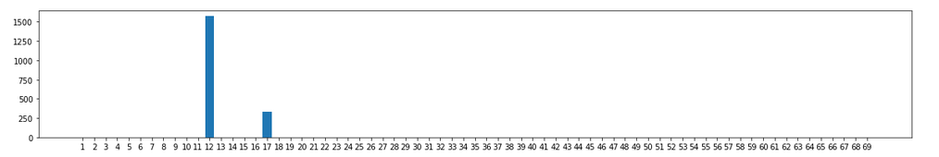
Kryvyi Rih:

Slide 21
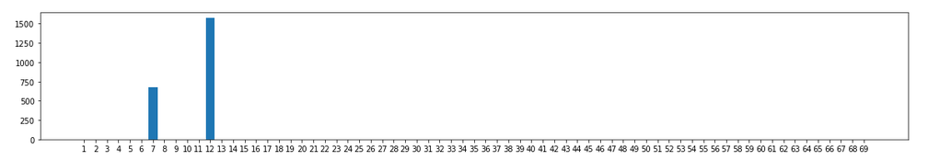
Zaporizhzhia:

Slide 22
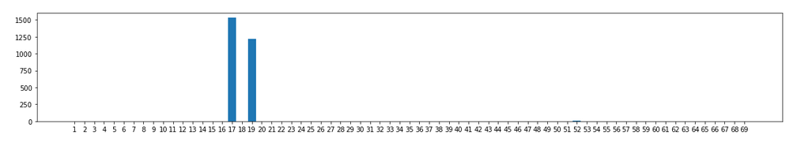
Donetsk:

Slide 23
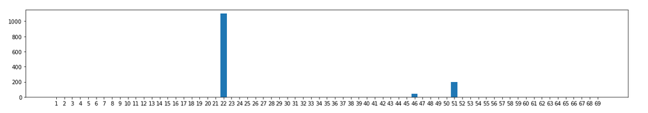
Mariupol':

Slide 24
Thank you for your attention

