Slide 1

BUILDING PERMITS
CLUSTERING ANALYSIS
Discovering Natural Groups of Construction Projects in San Francisco

Slide 2
AGENDA
01
Project Goal & Motivation
Why cluster building permits?
02
Dataset & Feature Selection
What we used and what we deliberately excluded
03
Methodology
Preprocessing, choosing k, final model
04
Cluster Results & Profiles
Three distinct groups of projects
05
Neighborhood Analysis
Where each type of project concentrates
06
Insights, Code & Next Steps
Key findings and future work
Building Permits Clustering | K-Means Analysis
2 / 18

Slide 3
PROJECT GOAL
Group building permits by the nature of the project
(size, cost, construction type) then discover which
neighborhoods are associated with each group.
Unsupervised Discovery
Actionable Insights
Policy & Planning Value
Let the data reveal natural groups instead of imposing labels
Understand where large vs small projects concentrate in the city
Help city planners anticipate workload by neighborhood type
Building Permits Clustering | K-Means Analysis
3 / 18

Slide 4
DATASET OVERVIEW
~111k
k = 3
SF
Cost > $1k
Rows after cleaning
Final clusters
City data source
Filter applied
Features Used for Clustering
▸ Number of Stories (Existing & Proposed)
▸ Number of Units (Existing & Proposed)
▸ Plansets
▸ Estimated Cost & Revised Cost
▸ Construction Type codes
▸ Permit Type Definition
▸ Existing Use & Proposed Use
▸ Construction Type Descriptions
Building Permits Clustering | K-Means Analysis
4 / 18

Slide 5
KEY DESIGN DECISION
Neighborhood was deliberately EXCLUDED from clustering features
We want the algorithm to group permits by the nature of the project
(size, cost, type of work). Afterwards we examine which neighborhoods appear in each group.
Avoid wrong reasoning
If we include neighborhood, clusters would largely just recreate geographic areas.
Discover project types first
Clustering on physical & cost attributes reveals the real structure of the work.
Then map to location
After clustering we can ask: where do mega-projects vs everyday permits concentrate?
Building Permits Clustering | K-Means Analysis
5 / 18

Slide 6
METHODOLOGY
1
2
3
Clean & Filter
Select Features
Preprocess
Keep Revised Cost > $1,000. Median / Unknown imputation.
Size, cost, construction type, permit type, use. Exclude neighborhood.
StandardScaler for numerics + OneHotEncoder for categoricals.
4
5
6
Choose k
Final Model
Interpret
Elbow method + Silhouette score on a sample.
KMeans with chosen k on the full dataset.
Profiles + neighborhood distribution + PCA plot.
Building Permits Clustering | K-Means Analysis
6 / 18

Slide 7
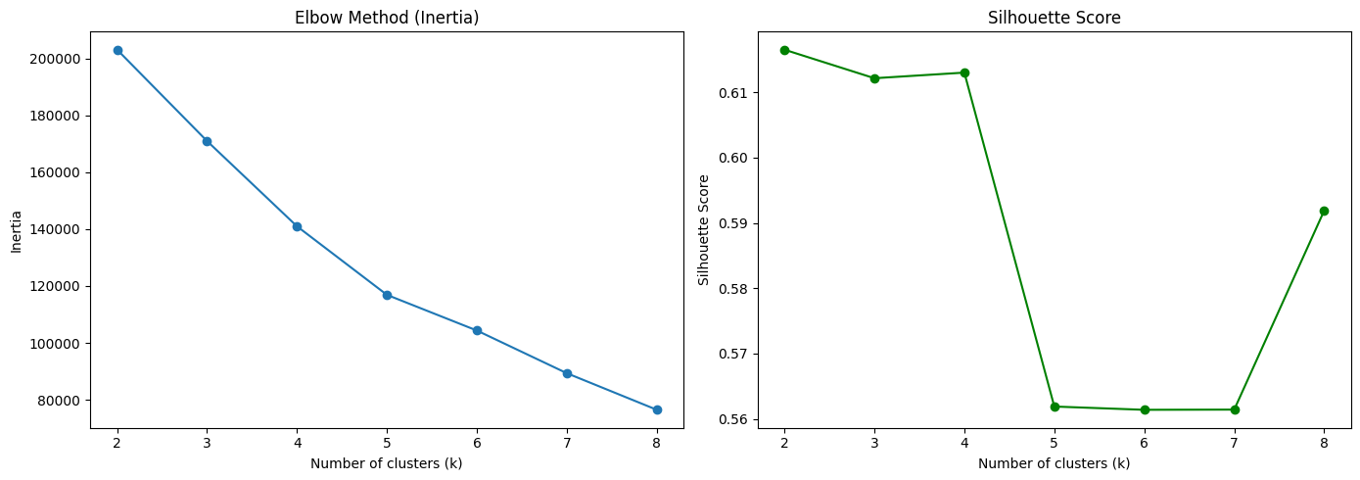
CHOOSING THE NUMBER OF CLUSTERS (k)
We selected k = 3 for the final model. It provides a clear separation between everyday permits, significant mid/high-rise projects, and rare mega high-rise developments.
Building Permits Clustering | K-Means Analysis
7 / 18

Slide 8
FINAL CLUSTERS
CLUSTER 0
CLUSTER 1
CLUSTER 2
Everyday / Residential
Mid-to-High Rise
Mega High-Rise
91,932
17,852
1,295
permits
permits
permits
~83% of total
~16% of total
~1% of total
Building Permits Clustering | K-Means Analysis
8 / 18

Slide 9
CLUSTER 0
Everyday / Residential Permits
91,932 (~83%)
$59,400
2.7
6.1
Size
Avg Revised Cost
Avg Stories
Avg Units
Description
The dominant group of ordinary residential and small scale work. Typical projects include home renovations, minor additions, and low rise multi unit buildings. Costs and building sizes stay low/modest.
Top Neighborhoods
Sunset/Parkside (8.1%) • Mission (7.6%) • West of Twin Peaks (6.9%) • Outer Richmond (5.3%) • Noe Valley (5.0%)
Classic residential neighborhoods, exactly where everyday permits are expected to concentrate.
Building Permits Clustering | K-Means Analysis
9 / 18

Slide 10
CLUSTER 1
Significant Mid-to-High Rise Projects
17,852 (~16%)
$212,800
17.6
27.1
Size
Avg Revised Cost
Avg Stories
Avg Units
Description
Substantial commercial and residential projects that are clearly larger than everyday work. Typical mid-to-high-rise buildings with meaningful unit counts and costs in the low hundreds of thousands.
Top Neighborhoods
Financial District / South Beach (56.7%) • South of Market (9.6%) • Chinatown (5.5%) • Western Addition (4.3%) • Nob Hill (4.1%)
Strongly concentrated in the downtown core and similar dense neighborhoods.
Building Permits Clustering | K-Means Analysis
10 / 18

Slide 11
CLUSTER 2
Mega High-Rise Developments
1,295 (~1%)
$248,500
26.8
521
Size
Avg Revised Cost
Avg Stories
Avg Units
Description
Rare but extreme projects: very tall buildings with hundreds of units. Although average cost is lower than expected for this scale, the unit count and height clearly identify them as major high-rise developments.
Top Neighborhoods
Financial District / South Beach (36.8%) • Tenderloin (30.2%) • Mission Bay (8.7%) • Western Addition (5.6%) • Japantown (5.6%)
Concentrated in the downtown core and areas of major dense public.
Building Permits Clustering | K-Means Analysis
11 / 18

Slide 12
CLUSTER PROFILES COMPARISON
Metric | Cluster 0 | Cluster 1 | Cluster 2
Revised Cost (avg) | $59.4k | $212.8k | $248.5k
Estimated Cost (avg) | $49.6k | $192.1k | $210.8k
Proposed Stories | 2.7 | 17.6 | 26.8
Existing Stories | 2.7 | 17.6 | 26.8
Proposed Units | 6.1 | 27.1 | 520.6
Existing Units | 6.0 | 26.9 | 520.5
Share of Permits | ~83% | ~16% | ~1%
Building Permits Clustering | K-Means Analysis
12 / 18

Slide 13
NEIGHBORHOOD PATTERNS SUMMARY
Residential Neighborhoods → Cluster 0
Sunset/Parkside, Mission, West of Twin Peaks, Outer Richmond, and Noe Valley are dominated by everyday low-rise permits.
Downtown Core → Clusters 1 & 2
Financial District / South Beach is the clear hotspot (57% of Cluster 1, 37% of Cluster 2). SoMa, Chinatown, and Nob Hill also appear.
Tenderloin & Mission Bay → Cluster 2
These areas show elevated presence of the rare mega high-rise projects, reflecting dense public and major development activity.
Building Permits Clustering | K-Means Analysis
13 / 18

Slide 14
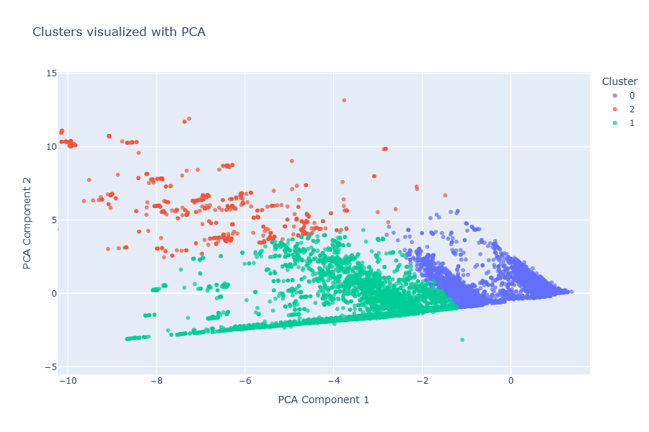
CLUSTERS IN 2D (PCA VISUALIZATION)
PCA reduces the high-dimensional feature space so we can visually confirm that the three groups are reasonably separated.
Building Permits Clustering | K-Means Analysis
14 / 18

Slide 15
KEY INSIGHTS
Clear Scale Separation
K-Means separated permits into everyday work (~83%), significant mid/high-rise (~16%), and rare mega high-rise (~1%) based on size and cost attributes.
Geography Follows Project Type
Large projects concentrate heavily in the Financial District / South Beach and Tenderloin. Everyday permits dominate residential neighborhoods.
Design Choice
Excluding neighborhood from the features prevented the model from simply rediscovering geography and forced it to learn project characteristics.
Actionable for Planning
City planners can anticipate that a surge in Cluster 1 or 2 permits will heavily impact downtown infrastructure and review resources.
Building Permits Clustering | K-Means Analysis
15 / 18

Slide 16
KEY CODE SNIPPETS
Feature selection (neighborhood excluded)
features = ["Number of Existing Stories", "Number of Proposed Stories",
"Existing Units", "Proposed Units", "Plansets", "Revised Cost",
"Permit Type Definition", "Existing Use", "Proposed Use", ...]
# Neighborhood deliberately left out
Preprocessing + KMeans Pipeline
pipeline = Pipeline([
("preprocessor", ColumnTransformer([...])),
("cluster", KMeans(n_clusters=3, random_state=42, n_init=10))
])
pipeline.fit(X)
Neighborhood analysis after clustering
ct = pd.crosstab(df_cluster["Cluster"],
df_cluster["Neighborhoods - Analysis Boundaries"], normalize="index")
Building Permits Clustering | K-Means Analysis
16 / 18

Slide 17
THANK YOU
Questions & Discussion
Three clear project types were found:
Everyday residential • Mid/High-rise • Mega high-rise
Geography follows the nature of the work.

