Slide 1
Smartgateway
- Dr. Yann-Hang Lee
- Shankar Nair

Slide 2
4 Basic Components
Device Manager
Low level backend
Http Restful Server
High level frontend
User explicit control
Data Manager
Streaming data storage
Allows subscribing/publishing data
Reasoning Engine
Detect temporal complex events
Execute actions based on defined rules

Slide 3
Smartgateway Architecture
Mash-ups
Queries
Device Commands
Rule Definitions
HTTP Restful Server
Data Manager
Register rules
Rule Processor
IPC
Pub/Sub
Complex
Events, Actions
Reasoning Engine
Pub/Sub Data
Receive commands, Publish data
Device Manager
Sensors
Actuators

Slide 4
Device Manager
Main Purpose
Handle communication with physical devices.
Publish device-status changes to higher layers.
Receive commands that must be run on the physical device. These commands can come from:
HTTP Rest Server
Reasoning Engine
Exposes a device-instantiation server to handle dynamic device creations

Slide 5
Device Manager - Architecture
DeviceBase
This is an abstract class that models the communication with a physical device such as its read/write frequency, and lays out a framework so that upper layers need only implement device specific functionality and do not care about the actual communication with the device.
It also takes care of multithreading and error handling.

Slide 6
Device Manager - Architecture
Device
The template class inherits from the DeviceBase and adds the capability of adding a custom handler.
E.g. int for FDs or CvCapture for OpenCV programs
DeviceDbus
Every physical device is represented by a Dbus object.
Implements interface as specified in the interface-xml file.

Slide 7
Http rest server
Main purpose
Expose RESTful web-interface.
Maintains catalog of devices.
Provides framework to access functionality of devices.
Provides basic query capabilities to lookup devices.
Handles actual instantiation of devices by contacting the DeviceManager.
Provides view of data and supports rule registrations (more on this later)

Slide 8
Http rest server – Architecture
Httphandler
Implements HTTP web-server handling.
RestAPI
Provides necessary framework to register Rest APIs.
Executor
Implements RestAPIs.
Formats response output.

Slide 9
Http rest server - Architecture
OntologyManager
Provides APIs to support querying of devices.
Processes OWL file to initialize the DeviceCatalog
DeviceCatalog
Maintains map of all active devices.
Provides APIs for invoking methods on the devices.
Processes interface-xml to extract interface information.
Associates physical devices to their respective interface based on the Ontology.

Slide 10
Data Manager
In-memory data store to archive time-stamped RDF triples.
Continuous incoming stream of data from sensors.
TimeManager sub-component maintains the temporal flow for the whole DataManager.
Every device/sensor has its corresponding StorageSlot.
Global map contains the information regarding the different storage slots present and active in the system.
Provides APIs to create, insert and query the RDF triples.

Slide 11
Rule Manager
Its main purpose is to register rules via the HTTP_REST_SERVER and execute them.
Internally it takes as input, the base Logic Program created from the conversion of the Smarthome Ontology file.
To this, new streaming information is appended and the query is rerun to check if the rule is satisfied.
This component also takes care of any notifications to devices or actuators via the Device Manager.

Slide 12
Rule Manager - Architecture
Composed of 2 threads – Main and Worker
Main Thread:
Initializes the XSB Prolog system
Registers itself on the D-Bus IPC subsystem
Listens for new incoming Rules from the HTTP Server.
Inserts the Rules into a shared map and into the Logic Program.
Worker Thread:
Executes every second
For every execution, checks whether a Rule from the RuleMap was satisfied and performs the appropriate action via the DeviceManager.

Slide 13
Main Tasks of the Framework
Handle queries for data from devices/sensors.
“get (tempSensor1, Value, Time)”
Handle queries for structural information from the ontology.
“Device(X), hasLocation(X, kitchen1), measures(X, temperature1).”
Handle commands to perform actions.
“lighting1?set_status=1”
Handle rule-based action execution.
“set (lighting1, set_status, 1, Time) :- get (tempSensor1, Value, Time), Value > 100”

Slide 14
HTTP Web Service
D-Bus Daemon
RestAPI
Device Catalog
Executor
Ontology Manager
Device Representation
Virtual Device
Device Interface Files
OWL file
DbusDevice
Device
Physical
Device
DeviceBase

Slide 15
Why Represent Knowledge ?
To perform high-level queries like “Where is person X now?” or “How hot/cold is the living room?” or “How many people are in the meeting room currently?”
To perform high-level actions like “Notify user whenever he runs out of groceries, maintaining lighting and temperature conditions based on user activities and preferences, medical and health related recommendations on food and exercise, advise on purchases” and so on…

Slide 16
Why use Ontologies to Represent Knowledge ?
Current Smarthome solutions are merely remote control frameworks and standards that need the user to deal with the sensors and devices manually.
Google Nest, Apple HomeKit Framework.
All “smart” decisions are still made by the user. They do have static rules that auto-adjust certain settings based on feedback from the sensors. But it is very limited.
Example query: How many people are standing on the front porch?
Current Solutions: User requests a live feed on his smartphone from the specific webcam overlooking the front door and then decides how many people are there.
These frameworks do not “understand” the expectations of the user.
SmartGateway Solution: Models a knowledge graph based on device capabilities, location, physical phenomenon, time frame, person, device and user-activity. Find all devices that “hasLocation” “FrontPorch” AND “hasCapability” “detects” AND “detects” “objects”. This sub-query will return the specific webcam and would query the webcam for face-count in its feed.
The above representation is very naturally modeled and queried using Ontologies.

Slide 17
Semantic Drivers
Till now we have seen how we can access the functionality of devices using their device drivers.
Can we represent their capabilities in such a way that their capabilities can be queried and accessed by a machine?
YES! We create a generic model that when implemented by a device will allow it to become a part of a larger “web” of knowledge that is machine-processable.
Bring “understanding” to machines.
This generic model is known as its Semantic Driver.

Slide 18
Semantic Driver Model for a Simple Temperature Sensor
Heat, hot, warm, cold, chill, freezing…
hasAnnotation
Degrees, Kelvin, Fahrenheit
temperature1
hasMeasurementUnit
annotates
isMeasuredBy
measures
hasLocation
tempSensor1
hasCapability
room1
measures
hasDevice
hasOutputUnit
producesData
degrees
tempData1

Slide 19
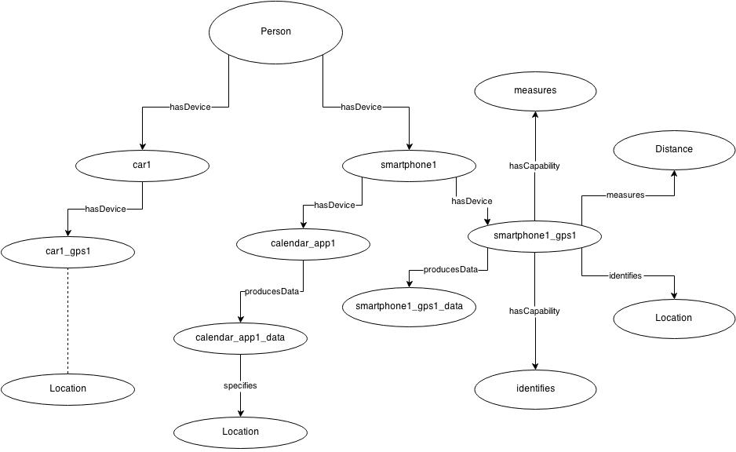
Where is person X right now?

Slide 20
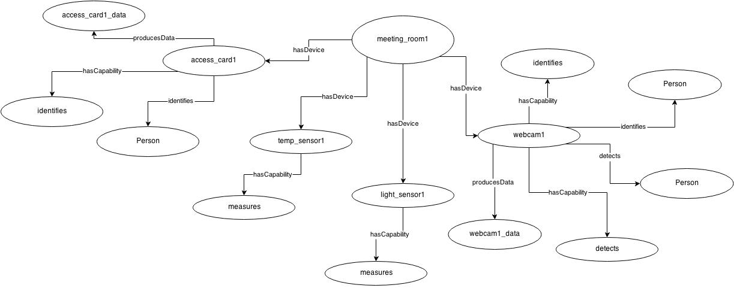
Is Person X really at that Location?

Slide 21
Libraries
Glib-2.0 (-lgobject-2.0 -lglib-2.0)
Used for the internal representation of a D-Bus Object using Glib.
D-bus (-ldbus-glib-1 -ldbus-1)
Used for D-bus support.
Microhttpd (-lmicrohttpd)
Used to support the HTTP server implementation.
OWLCPP (-lowlcpp_io -lowlcpp_logic -lowlcpp_rdf)
Used to read, parse and query OWL ontology files within program.
Raptor (-lraptor)
Used by OWLCPP to parse the Ontology file.
XML (-lxml2)
Used by OWLCPP to read the Ontology file.
FaCT++ (-lfactpp_kernel)
Used by OWLCPP to support DL reasoning within the program.
Boost (-lboost_filesystem -lboost_program_options -lboost_system)
Used to ease file-io, string handling and various HTTP response output formating such as JSON, XML etc.

Slide 22
Thank you!
Notes:
The new developments since the last iteration include:
Resolved the ontology issues. It can now be queried and updated.
Found suitable tool to convert OWL to LP
Resolved issues to make tool compatible with our framework
Developed base code for DataManager
Based on discussions with creator of the tool, decided to use XSB Prolog as the reasoning engine.

