Slide 1
KAPOTAH
A Cross Platform LAN Messaging and File Transfer System
Sudhendu Kumar
1BM07IS082
Information Science and Engineering
sudhendu.kumar.roy@gmail.com
www.sudhendu.in

Slide 2
KAPOTAH
A Cross Platform LAN Messaging and File Transfer System
Shantanu Tushar
1BM07CS068
Computer Science and Engineering
shaan7in@gmail.com
www.shantanutushar.com

Slide 3
Today's Agenda
Motivation
Goal
About Kapotah - and whats new!!
Use Cases
The Architecture – Modules used in Kapotah
Implementation
Technology Used
Future Enhancements
Conclusion

Slide 4



Motivation
… why another messaging and transfer system?
… commonly used systems are not perfectly cross platform
… common usecase of searching of files on the network had to be done manually by the sender
… lack of exact progress estimates for incoming and outgoing transfers
… demand was for a less intriguing notifications system
… make a simple and lucid GUI, instead of commonly used crowded GUIs
… most of existing software are proprietary and hence forbid further extension

Slide 5
Goal
Use a cross platform library which generates native instructions, rather than virtualizing
Use an automation for the search and transfer use-case
Calculate the overall transfer progress, both incoming and outgoing
Make use of passive notifications
Do not crowd the GUI with lots of options, use self explanatory icons
Use a free to use and modify license, the GNU General Public License v3

Slide 6




About Kapotah
Cross platform – works on GNU/Linux, Windows and Mac with native look and feel and integration
LAN Messaging and File Transfer supported
Sharing files and searching for them over the network
Supports inter-subnet communications

Slide 7
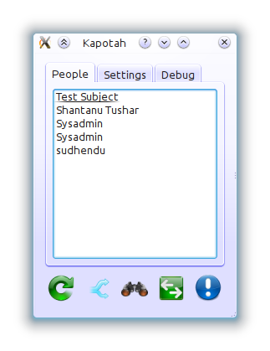
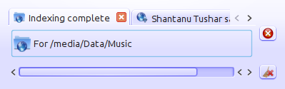
About Kapotah (continued)
Multithreaded – multiple messages. And transfers can continue at the same time
User friendly GUI – usage of self explanatory icons, simple layout, transfers continue even if minimized
Better notifications – don't disturb the user

Slide 8
Use Cases
Shantanu works in a company and he needs to share informtion with Sudhendu without putting it on sharing services or a central server
Residents of a college hostel can use it to share files among themselves, hence saving precious bandwith if they download the same thing more than once
Rather than asking people manually ”Do you have XYZ”, users can search for XYZ and let Kapotah auto-find it in shared directory

Slide 9
The Architecture

Slide 10
Implementation

Slide 11
Technology Used
Nokia's Qt cross platform application development framework 4.7 and higher
The GNU Compiler Collection, Cmake from Kitware, other GNU tools, the MINGW project, GIT – the distributed source control management system
UDP datagrams for non-critical messages
TCP for messages and transfers
XML for providing common format for composing and parsing data
Software Architecture concepts such as Model/View Singleton for robust system

Slide 12
Future Enhancements

Slide 13
Conclusion
Qt everywhere™

