Slide 1
CS 35L Software Construction Lab Week 3 - 1

Slide 2
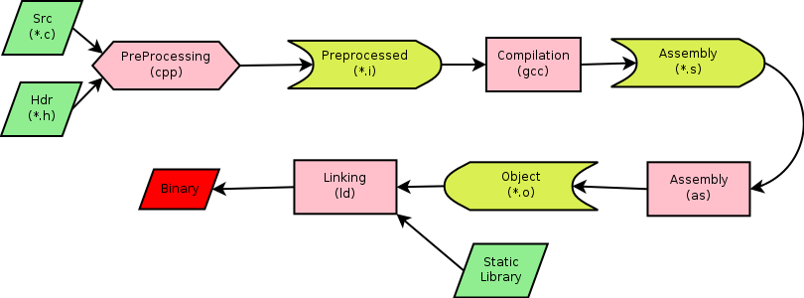
GCC Compilation Process

Slide 3
Command-Line Compilation
shop.c
#includes shoppingList.h and item.h
shoppingList.c
#includes shoppingList.h
item.c
#includes item.h
How to compile?
gcc -Wall shoppingList.c item.c shop.c –o shop

Slide 4
Expanding the command
gcc - compiler program
-W - turn on the warnings
-Wall - turn all warnings on
-o - to name the executable as the name given instead of a.out

Slide 5
What if…
We change one of the header or source files?
Rerun command to generate new executable
We only made a small change to item.cpp?
not efficient to recompile shoppinglist.c and shop.c
Solution: avoid waste by producing a separate object code file for each source file
gcc -Wall –c item.c… (for each source file)
gcc item.o shoppingList.o shop.o –o shop (combine)
Less work for compiler, saves time but more commands

Slide 6
What if…
We change item.h?
Need to recompile every source file that includes it & every source file that includes a header that includes it. Here: item.c and shop.c
Difficult to keep track of files when project is large
Windows 7 ~40 million lines of code
Google ~2 billion lines of code
=> Make

Slide 7
Make
Utility for managing large software projects
Compiles files and keeps them up-to-date
Efficient Compilation (only files that need to be recompiled)

Slide 8
Makefile Example
# Makefile - A Basic Example
all : shop #usually first
shop : item.o shoppingList.o shop.o
g++ -g -Wall -o shop item.o shoppingList.o shop.o
item.o : item.cpp item.h
g++ -g -Wall -c item.cpp
shoppingList.o : shoppingList.cpp shoppingList.h
g++ -g -Wall -c shoppingList.cpp
shop.o : shop.cpp item.h shoppingList.h
g++ -g -Wall -c shop.cpp
clean :
rm -f item.o shoppingList.o shop.o shop
Rule

Slide 9
Build Process
configure
Script that checks details about the machine before installation
Dependency between packages
Creates ‘Makefile’
make
Requires ‘Makefile’ to run
Compiles all the program code and creates executables in current temporary directory
make install
make utility searches for a label named install within the Makefile, and executes only that section of it
executables are copied into the final directories (system directories)

Slide 10
Lab 3
Coreutils 7.6 has a problem
Different users see different date formats
$ ls –l /bin/bash
-rwxr-xr-x 1 root root 729040 2009-03-02 06:22 /bin/bash
-rwxr-xr-x 1 root root 729040 Mar 2 2009 /bin/bash
Why?
Different locales
Want the traditional Unix format for all users
Fix the ls program

Slide 11
Getting Set Up (Step 1)
Download coreutils-7.6 to your home directory
Use ‘wget’
Untar and Unzip it
tar –xzvf coreutils-7.6.tar.gz
Make a directory ~/coreutilsInstall in your home directory (this is where you’ll be installing coreutils)
mkdir coreutilsInstall

Slide 12
Building coreutils (Step 2)
Go into coreutils-7.6 directory. This is what you just unzipped.
Read the INSTALL file on how to configure “make”, especially --prefix flag
Run the configure script using the prefix flag so that when everything is done, coreutils will be installed in the directory ~/coreutilsInstall
Compile it: make
Install it: make install

Slide 13
Reproduce Bug (Step 3)
Reproduce the bug by running the version of ‘ls’ in coreutils 7.6
If you just type $ ls at CLI it won’t run ‘ls’ in coreutils 7.6
Why? Shell looks for /bin/ls
To use coreutils 7.6: $ ./ls
This manually runs the executable in this directory

Slide 14
Patching
A patch is a piece of software designed to fix problems with or update a computer program
It’s a diff file that includes the changes made to a file
A person who has the original (buggy) file can use the patch command with the diff file to add the changes to their original file

Slide 15
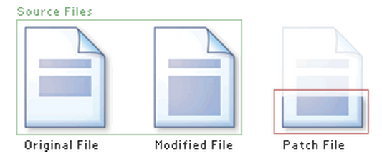
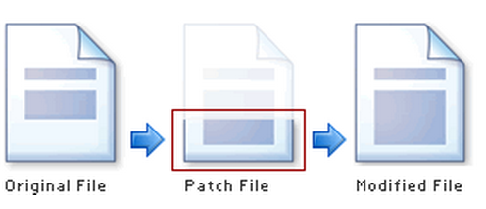
Applying a Patch

Slide 16
diff Unified Format
diff –u original_file modified_file
--- path/to/original_file
+++ path/to/modified_file
@@ -l,s +l,s @@
@@: beginning of a hunk
l: beginning line number
s: number of lines the change hunk applies to for each file
A line with a:
- sign was deleted from the original
+ sign was added to the original
stayed the same

Slide 17
Patching and Building (Steps 4 & 5)
cd coreutils-7.6
vim or emacs patch_file: copy and paste the patch content
patch –pnum < patch_file
‘man patch’ to find out what pnum does and how to use it
cd into the coreutils-7.6 directory and type make to rebuild patched ls.c.

Slide 18
Testing Fix (Step 6)
Test the following:
Modified ls works
Installed unmodified ls does NOT work
Test on:
1) a file that has been recently modified
Make a change to an existing file or create a new file
2) a file that is at least a year old
touch –t 201401210959.30 test_file

Slide 19
CS 35L Software Construction Lab Week 3 – 2

Slide 20
What is Python?
Not just a scripting language
Object-Oriented language
Classes
Member functions
Compiled and interpreted
Python code is compiled to bytecode
Bytecode interpreted by Python interpreter
Not as fast as C but easy to learn, read and use

Slide 21
Python List
Common data structure in Python
A python list is like a C array but much more:
Dynamic (mutable): expands as new items are added
Heterogeneous: can hold objects of different types
How to access elements?
List_name[index]

Slide 22
Example
>>> t = [123, 3.0, ‘hello!’]
>>> print t[0]
123
>>> print t[1]
3.0
>>> print t[2]
hello!

Slide 23
Example – Merging Lists
>>> list1 = [1, 2, 3, 4]
>>> list2 = [5, 6, 7, 8]
>>> merged_list = list1 + list2
>>> print merged_list
Output: [1, 2, 3, 4, 5, 6, 7, 8]

Slide 24
Python Dictionary
Essentially a hash table
Provides key-value (pair) storage capability
Instantiation:
dict = {}
This creates an EMPTY dictionary
Keys are unique, values are not!
Keys must be immutable (strings, numbers, tuples)

Slide 25
Example
dict = {}
dict[‘hello’] = “world”
print dict[‘hello’]
world
dict[‘power’] = 9001
if (dict[‘power’] > 9000):
print “It is over “, dict[‘power’]
It is over 9001
del dict[‘hello’]
del dict

Slide 26
for loops
list = [‘Mary’, ‘had’, ‘a’, ‘little’, ‘lamb’]
for i in list:
print i
Result:
Mary
had
a
little
lamb
for i in range(len(list)):
print i
Result:
0
1
2
3
4

Slide 27
Indentation
Python has no braces or keywords for code blocks
C delimiter: {}
bash delimiter:
then…else…fi (if statements)
do…done (while, for loops)
Indentation makes all the difference
Tabs change code’s meaning!!

Slide 28
Homework 3
randline.py script
Input: a file and a number n
Output: n random lines from file
Get familiar with language + understand what code does
Answer some questions about script
Implement comm utility in python

Slide 29
Running randline.py
Run it
./randline.py –n 3 filename (need execute permission)
python randline.py –n 3 filename (no execute permission)
randline.py has 3 command-line arguments:
n: specifies the number of lines to write
option
3: number of lines
option argument to n
filename: file to choose lines from
argument to script
Output: 3 random lines from the input file

Slide 30
Comm.py
Comm C source code :
comm C source code
This will give you an idea of the logic behind the operation that comm executes
Python OptionParser link :
Python OptionParser
How to add your own options to the parser
-1 -2 –u etc

Slide 31
Comm.py
Support all options for comm
-1, -2, -3 and combinations
Extra option –u for comparing unsorted files
If you are unsure of how something should be output, run a test using existing comm utility!
Create your own test inputs

