Slide 1

Diabetic patients Re-admission detection
Elad Havshush & Samuel Shwarcz

Slide 2
Presentation of the problem:
In many cases of admission of patients that have diabete , the possible relasement of the patient are divided in three possibilities:
The patients that will have to get readmitted within 30 days
The patients that will be readmitted after 30 days
The patients that will not be readmitted
Medical personal believes that a better care of some of the patients can prevent a non-wanted readmission
That is why they tried to figure out the causality of early readmission or readmission in general
Finding a model like this that works will mean that the causality exists between this data and readmission
We have data from around 130 hospitals in the US, of over 100,000 diabetic patients that shows the treatments, medications etc that they had and the data of weather they were re-admitted, and if so when.

Slide 3
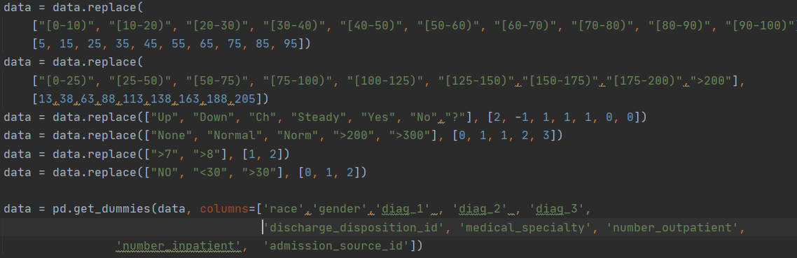
Features
The database that has been given contains multiples features , some of them can be relevant some of them can’t
-encounterid, patientnbr: not relevant
-race: Caucasian, Asian, African American, Hispanic, and other
-gender: male, female, and unknown
-Age: Grouped in 10-year intervals: [0, 10), [10, 20), ..., [90, 100)
-weight: in pounds (we don’t know if this data is relevant because only 3% of the dataset got it)
-admissiontypeid: identifier corresponding to 9 distinct values, for example, emergency, urgent, etc…
-dischargedispositionid: identifier corresponding to 29 distinct values, for example, discharged to home, expired, and not available, etc…
-admissionsourceid : identifier corresponding to 21 distinct values, for example, physician referral, emergency room, and transfer from a hospital, etc…
-timeinhospital: number of days between admission and discharge
-payercode : 23 distinct values, for example, Blue Cross\Blue (not necessarily relevant)
-medicalspecialty: identifier of a specialty of the admitting physician, corresponding to 84 distinct values, for example, cardiology, internal medicine, family\general practice, and surgeon, etc…
-numlabprocedures: Number of lab tests performed during the encounter
-numprocedures: Number of procedures (other than lab tests) performed during the encounter
-nummedications: Number of distinct generic names administered during the encounter
-numberoutpatient: Number of outpatient visits of the patient in the year preceding the encounter
-numberemergency: Number of emergency visits of the patient in the year preceding the encounter
-numberinpatient: Number of inpatient visits of the patient in the year preceding the encounter
-diag1, diag2, diag3, numberdiagnoses: The primary diagnosis( 848 distinct values ) Secondary diagnosis (923 distinct values) , Additional secondary diagnosis (954 distinct values) and Number of diagnoses entered to the system
-28 features: maxglu_serum, A1Cresult, metformin, repaglinide, nateglinide, chlorpropamide, glimepiride, acetohexamide, glipizide, glyburide, tolbutamide, pioglitazone, rosiglitazone, acarbose, miglitol, troglitazone, tolazamide, examide, citoglipton, insulin, glyburide-metformin, glipizide-metformin, glimepiride-pioglitazone, metformin-rosiglitazone, metformin-pioglitazone, chane, diabetesMed…

Slide 4
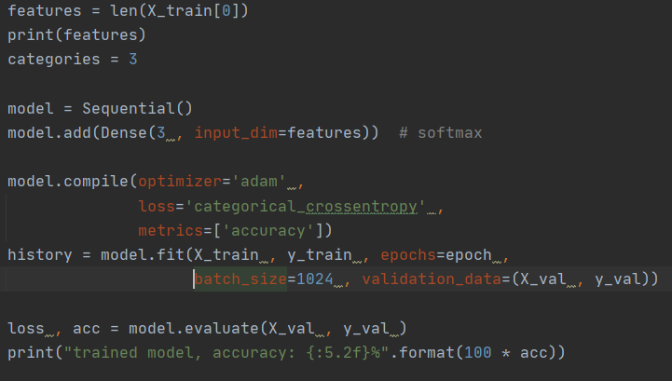
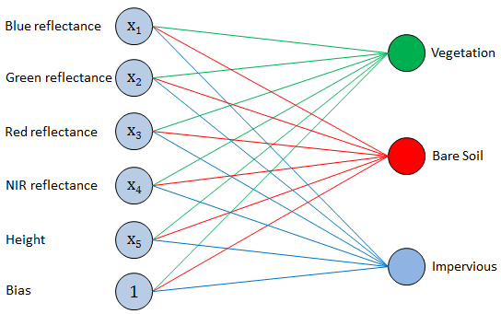
Softmax
To do so , we are going to try to train a model that uses the data to predict whether the patient is supposed to be readmitted
We will first build an algorithm softmax to predict the problem
No readmission
Readmission within 30 days
2477 features
Readmission after 30 days

Slide 5
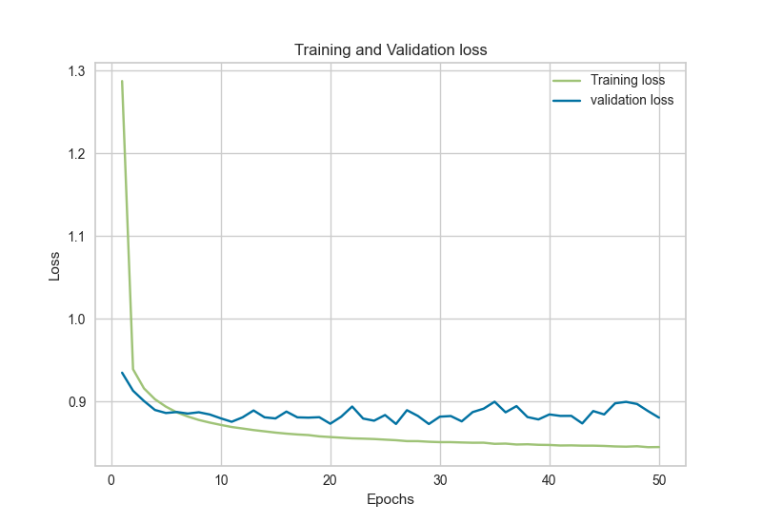
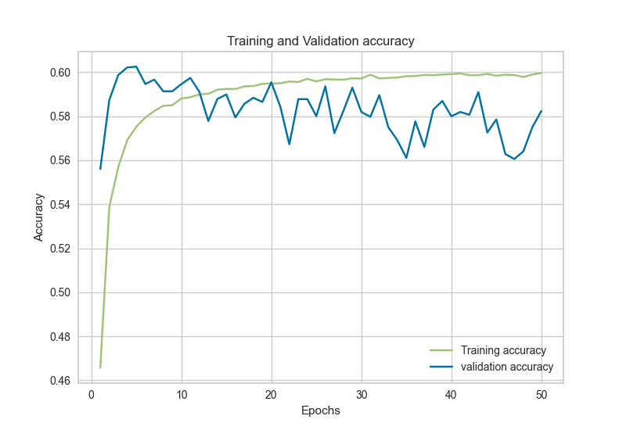
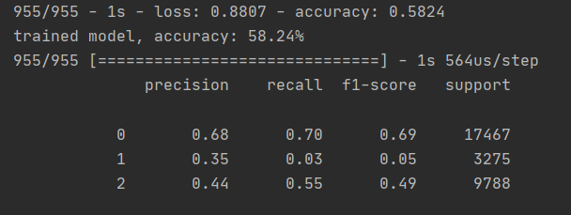
Softmax Results

Slide 6
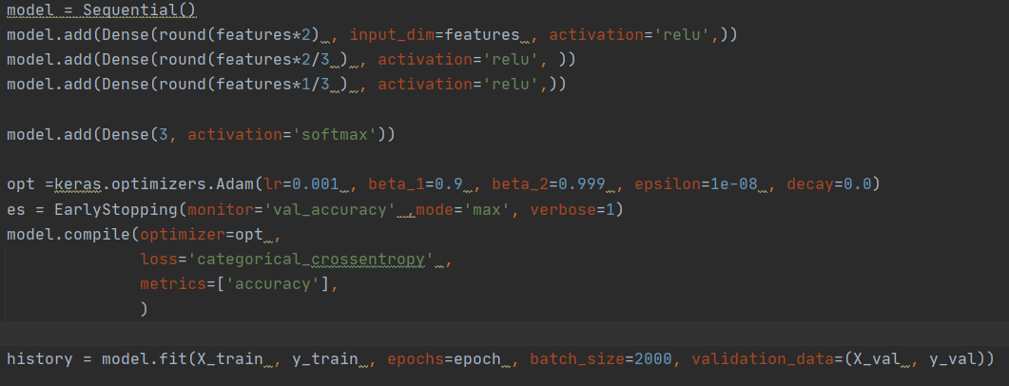
Model
As the Softmax get an 58% accuracy but low F1-score for the important classes we will try to improve the prediction by using an MLP and try few attempts with few different settings in order to get better result
Basically, we tried with many kinds of hidden layer and we have seen that it doesn’t change the result significatively then we did it with 3 hidden layers
With the number of the features
2/3 of the number of the features
1/3 of the number of the features

Slide 7
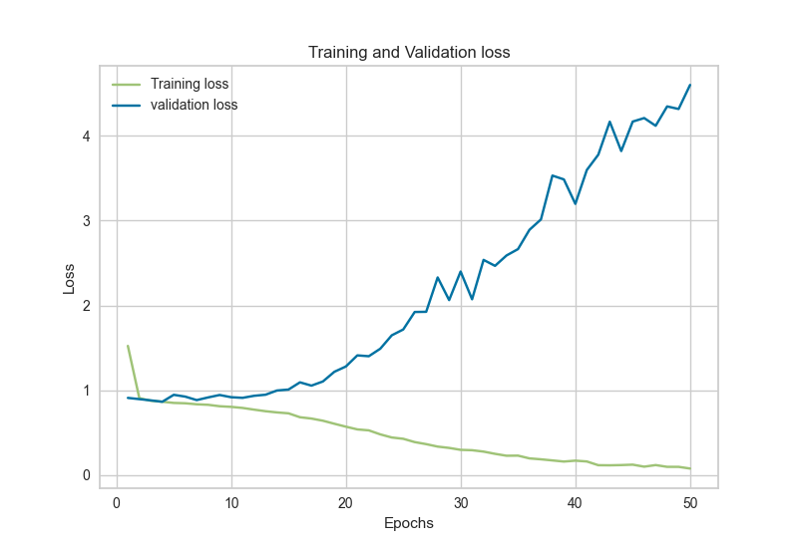
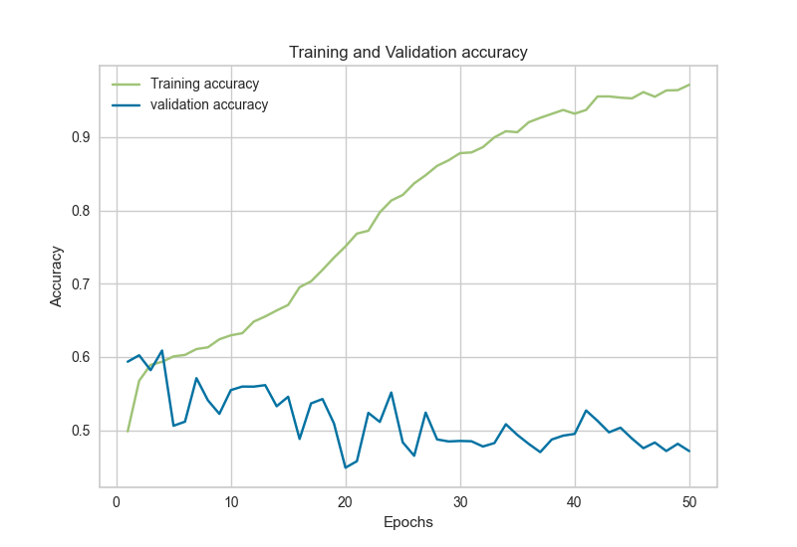
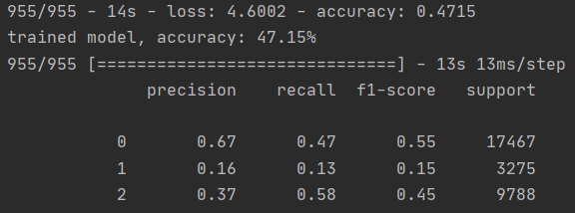
MLP results
Overfitting

Slide 8
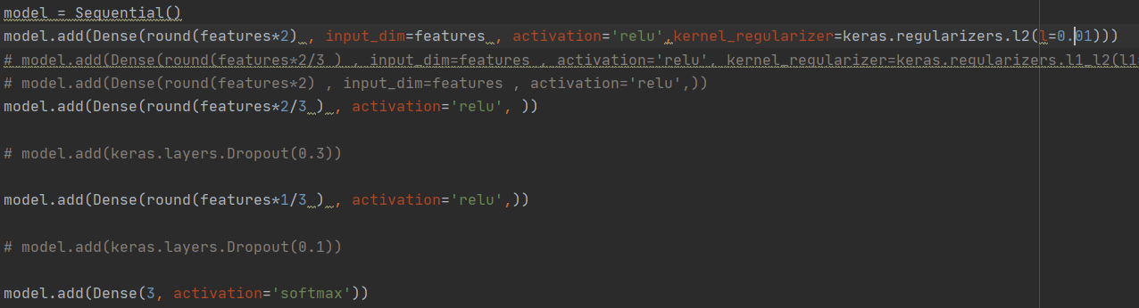
Attempts of improvement
After we have seen that the model was overfitting we tried to improve him by using regularizations , early stoping wasn’t an option so we used 3 of them
Lasso
Ridge Regression
Dropout

Slide 9
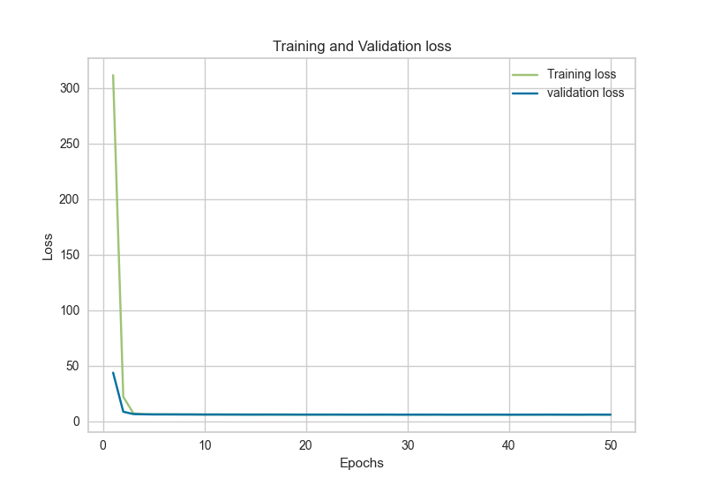
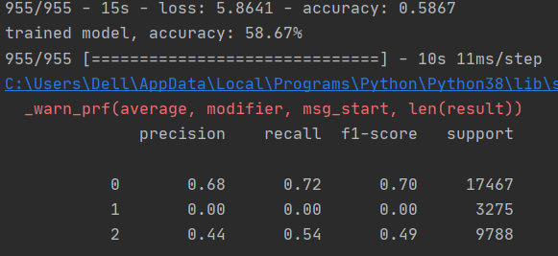
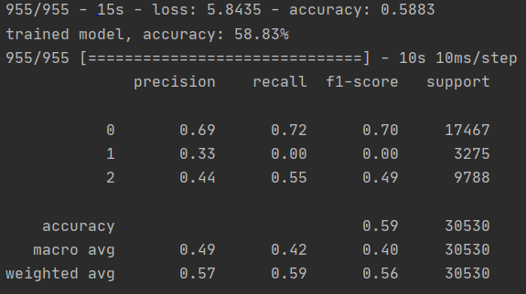
Regularization
Lasso
Ridge regression

Slide 10
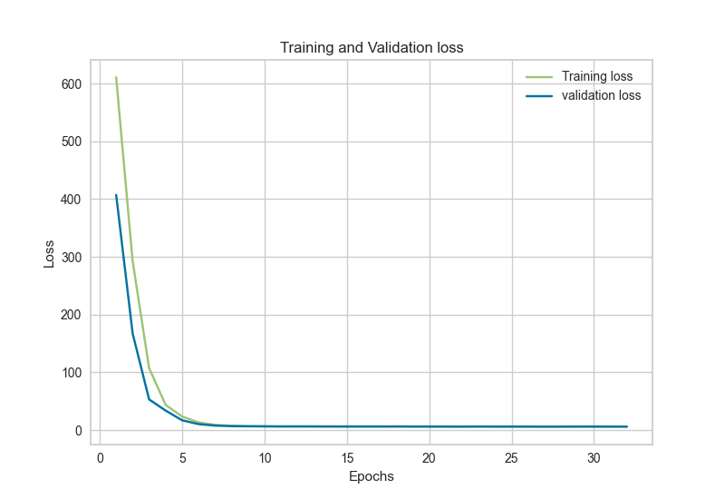
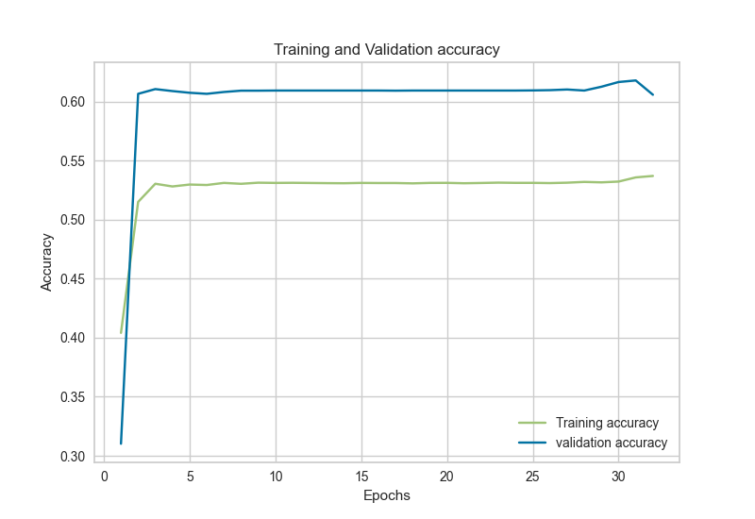
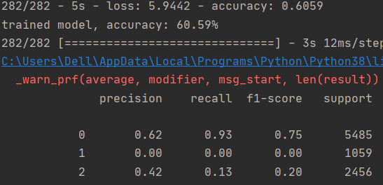
Regularization-Dropout
We get the higher global accuracy with dropout 61% but when we look at the confusion matrix, we can see that the two more important class are underrepresented, and we understood that regularization may be not good for the little weight that can help to predict more of class 1, so we tried to reduce the number of features to train the model without regularization and to avoid overfitting

Slide 11
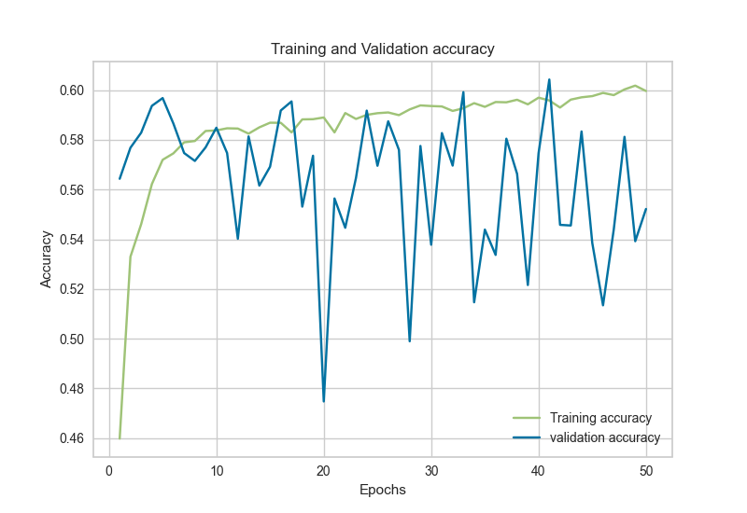
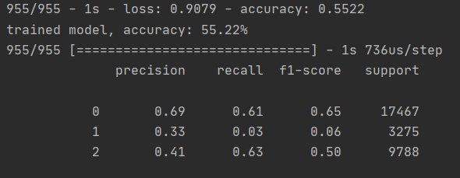
Features selection
In order to resolve the number of feature problem , we first tried to reduce the number of feature and drop the diagnoses features that take more than 2000 features and train the model without
We can see that the class 1 is getting higher but not enough to give good prediction, so we decided to select the 100 diagnoses the more relevant with the help of a library that select features

Slide 12
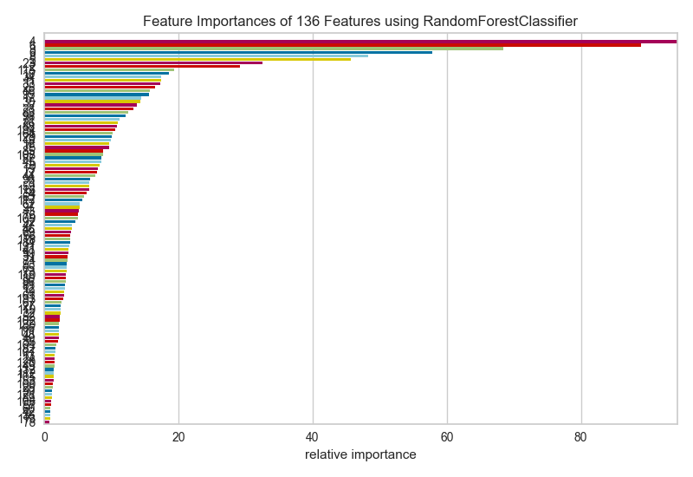
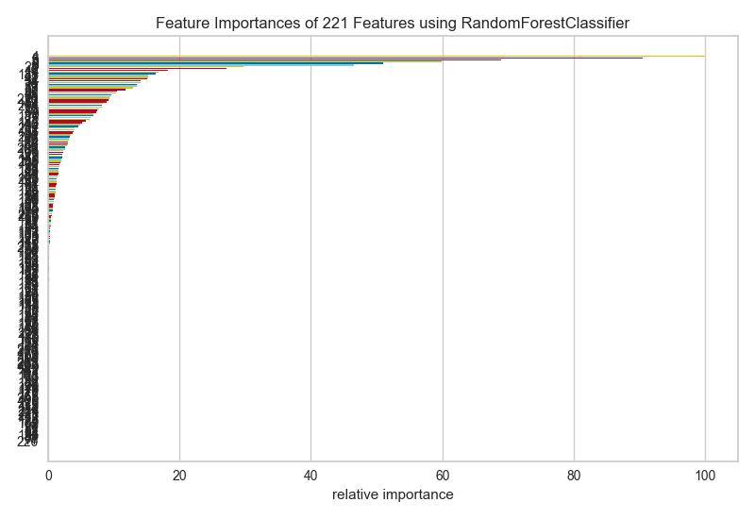
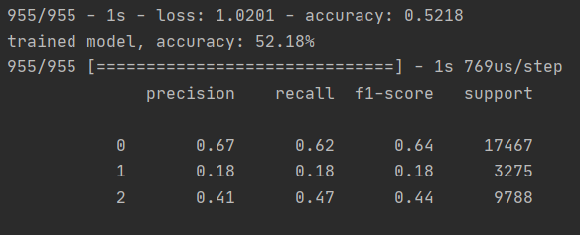
Feature selection -2
Here we selected the 100 diagnoses the most important to add them as a features , then we can see that the class 1 gets higher but still not enough

Slide 13
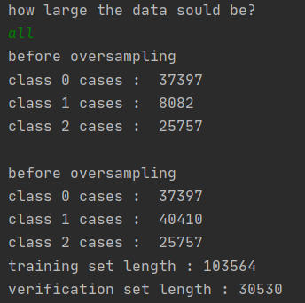
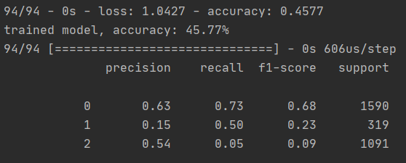
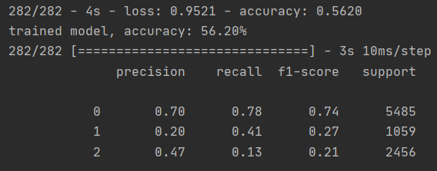
Over /under-sampling
As we see the detection of class 1 is the most important and the hardest to predict one of the reasons is the under-representation of the case in our dataset, so we are going to duplicate or reduce the cases in order to get the same order of magnitude in each class
after
Over-sampling class 1 + ridge regression
Over-sampling class 1

Slide 14
Conclusion
We build few models that may be used to predict readmission , some have higher accuracy , some have a better balance between prediction of all classes , but none of them are strong enough to be used in pratique
The weak result of prediction can be due to many problems, it may be because the data is not enough relevant to the problem , it can be because the problem is not a linear problem and the problem is random , at the end we talk about human being that are composed by random different strength and resistance against disease

