Slide 1
Chaos Systems
Experiments starting 28/09/2020

Slide 2
Making H constant
One way to guarantee H is constant is to compute dH/dt and force it to be zero.
General configuration:
simple pendulum 100 trajectories, Tmax 1.01, dt 0.01
Experiment Grid: we have 3 loss options:
Integrator/no integrator
Energy loss/no energy loss
dH/dt penalty/no dH/dt penalty
Yielding 2^3 = 8 configurations to test

Slide 3
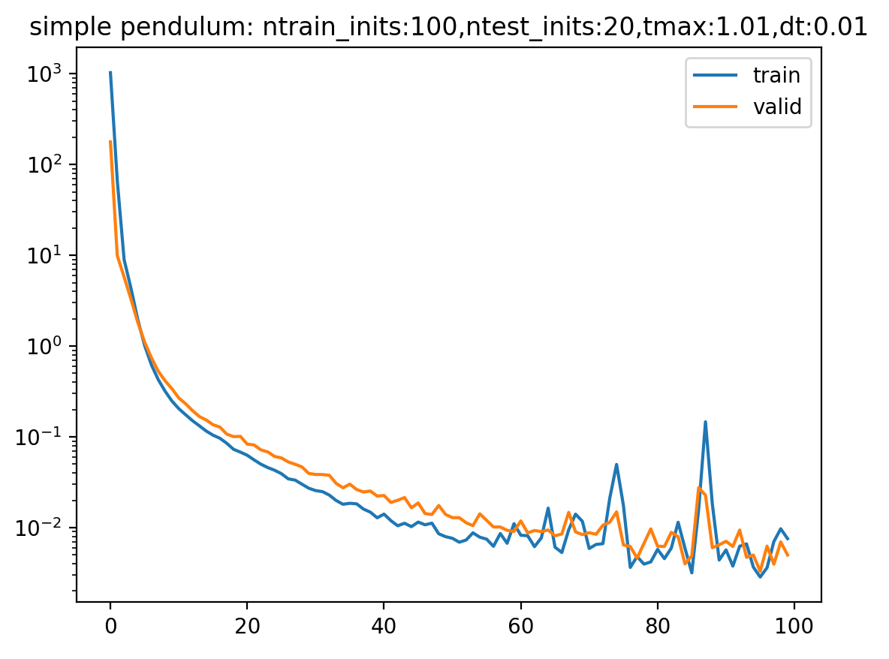
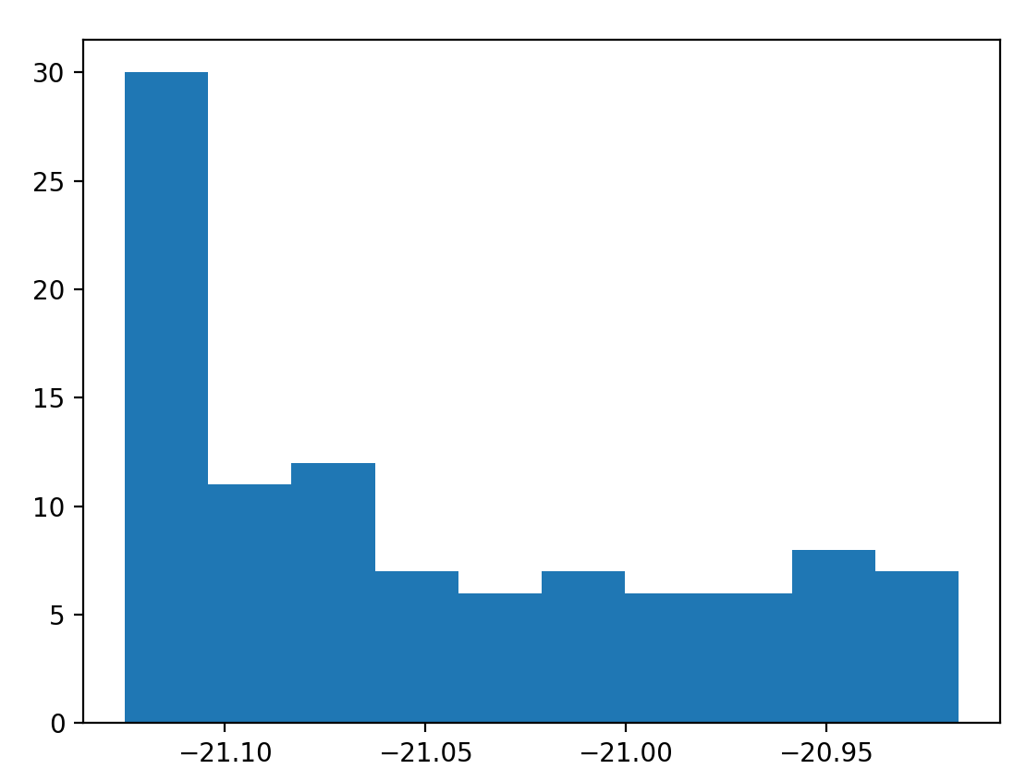
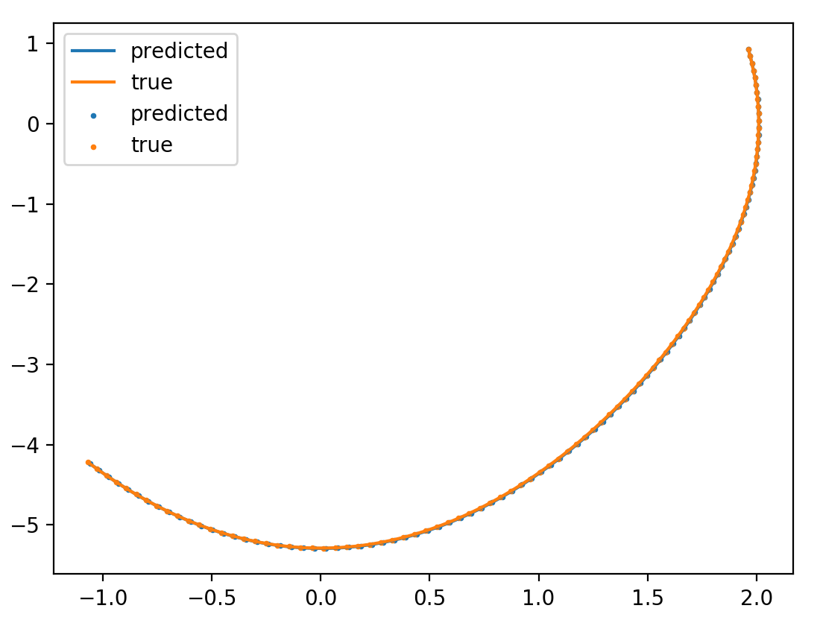
No integrator/no energy/ no dH/dt

Slide 4
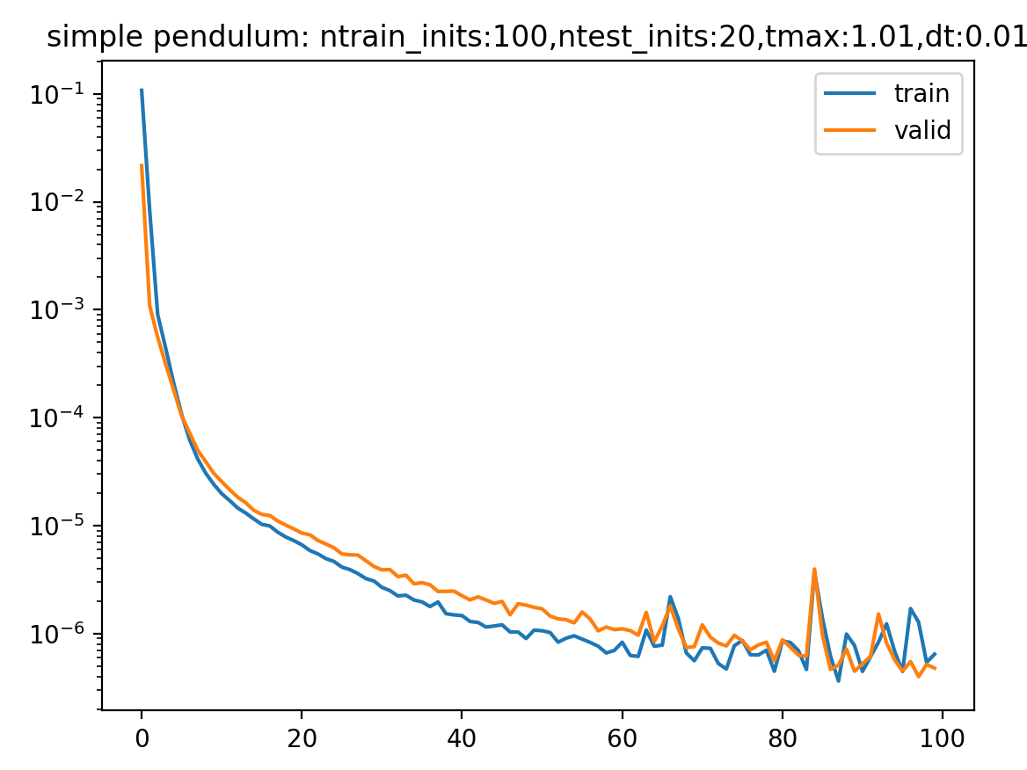
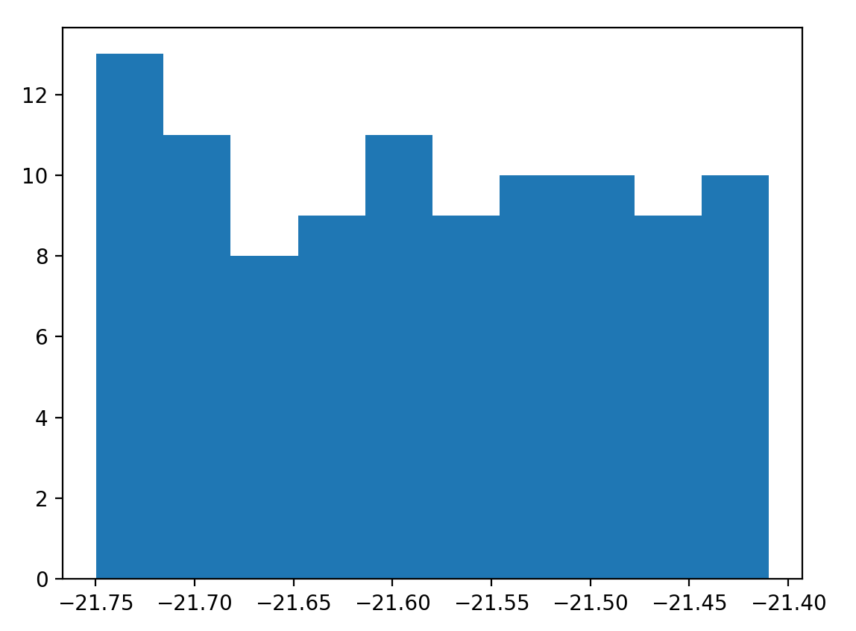
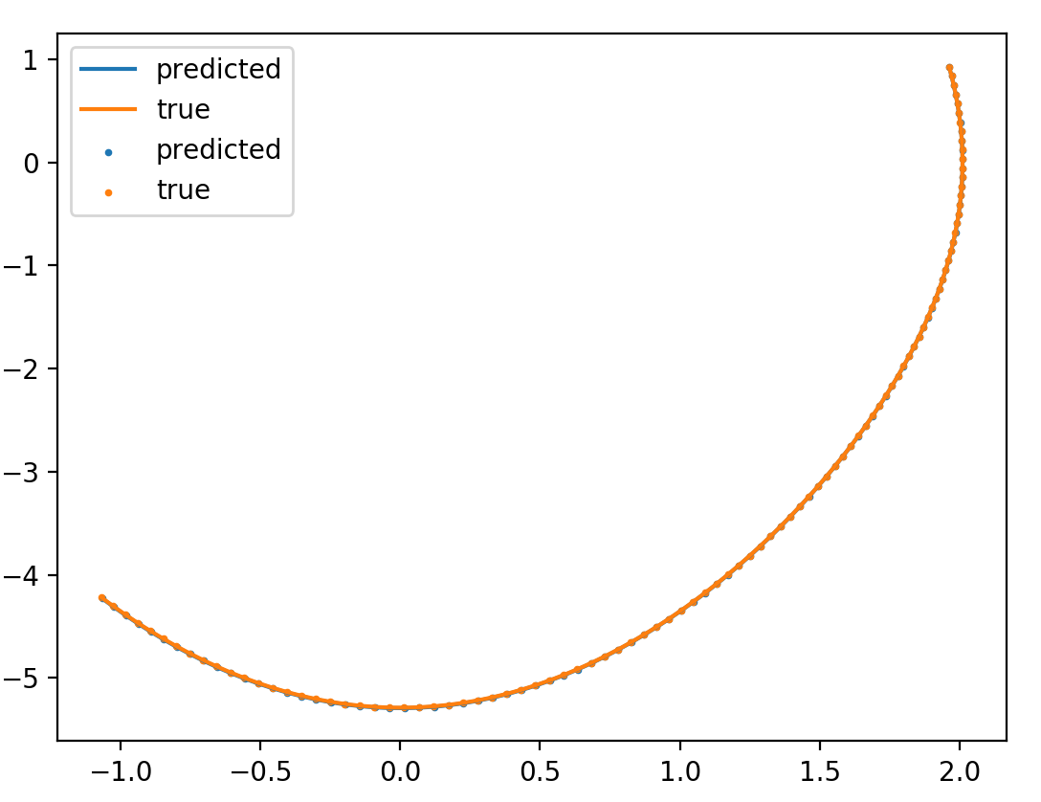
integrator/no energy/ no dH/dt

Slide 5
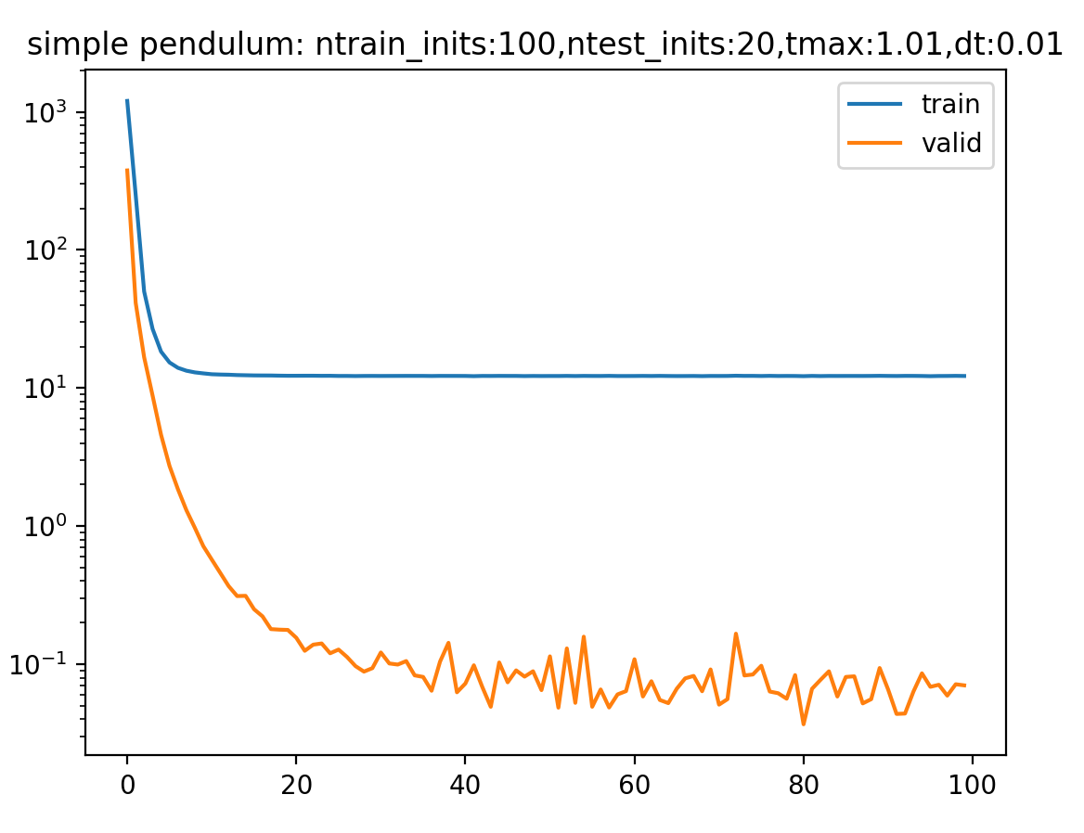
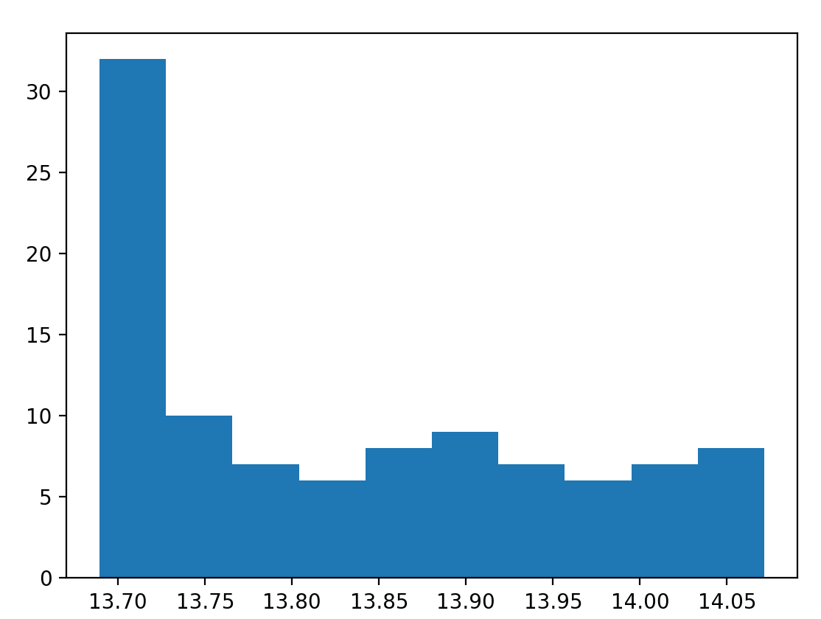
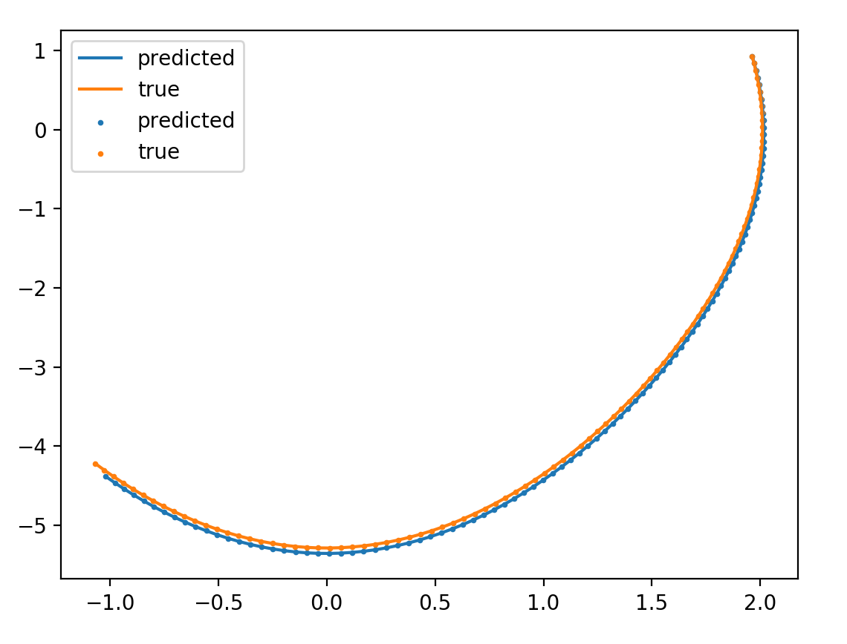
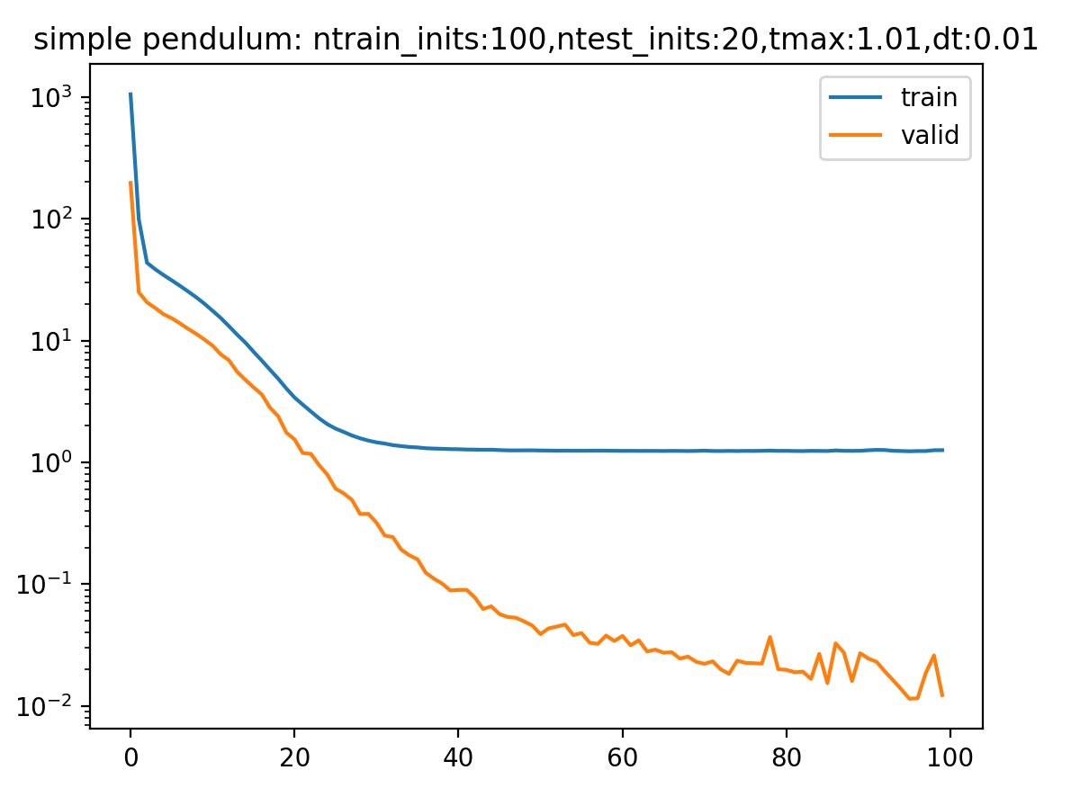
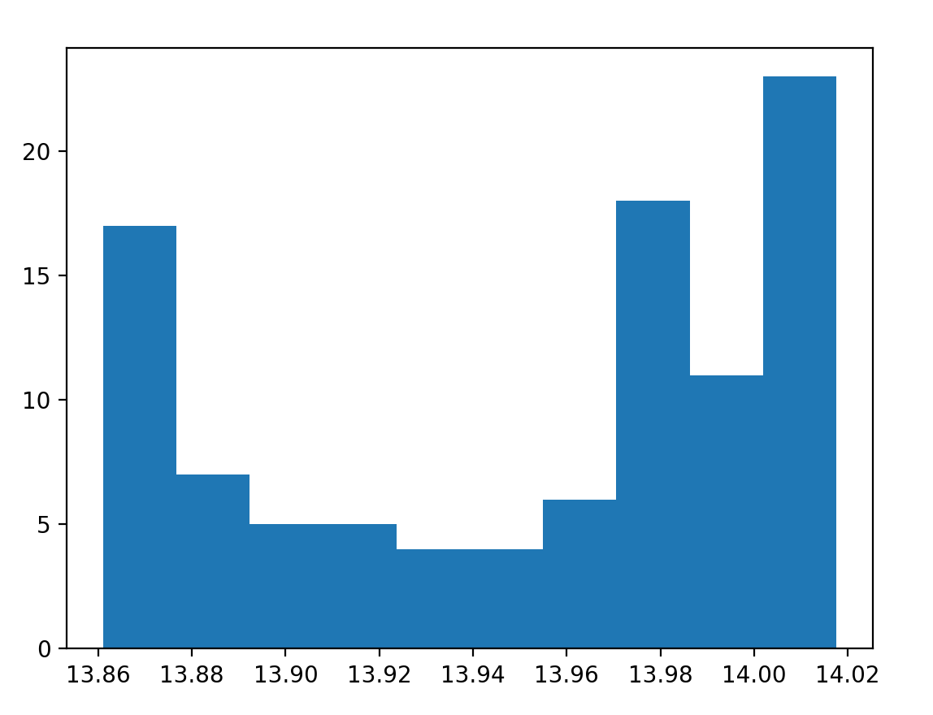
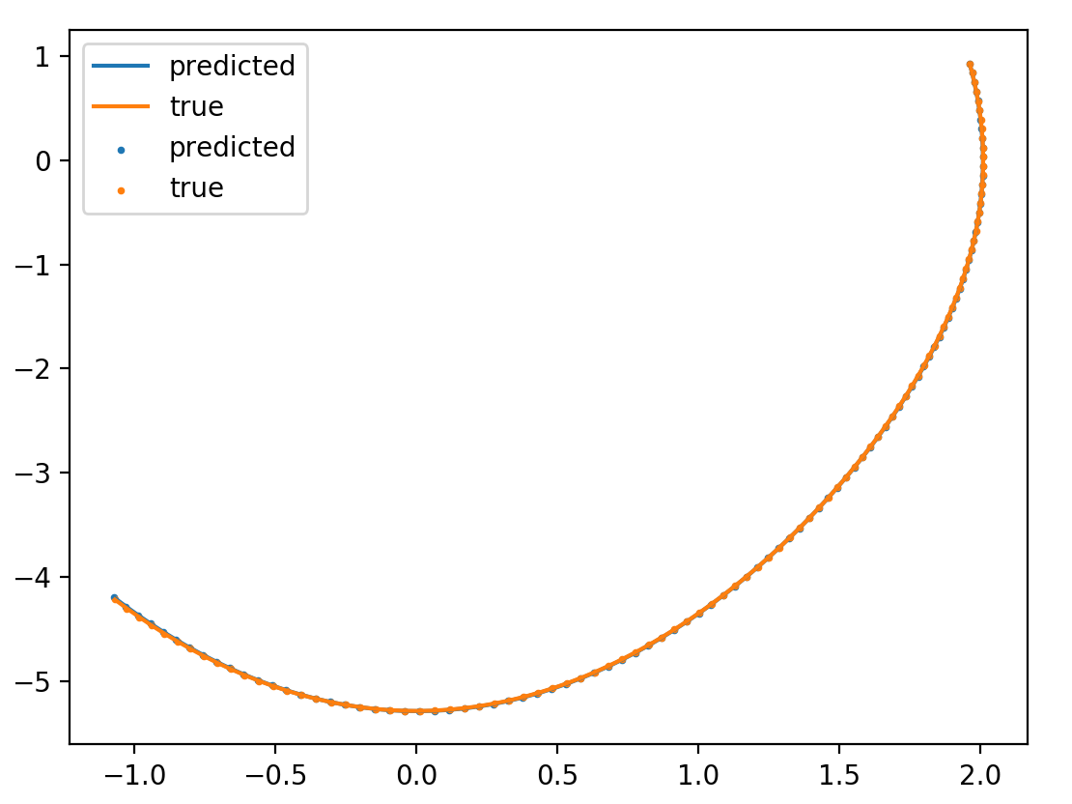
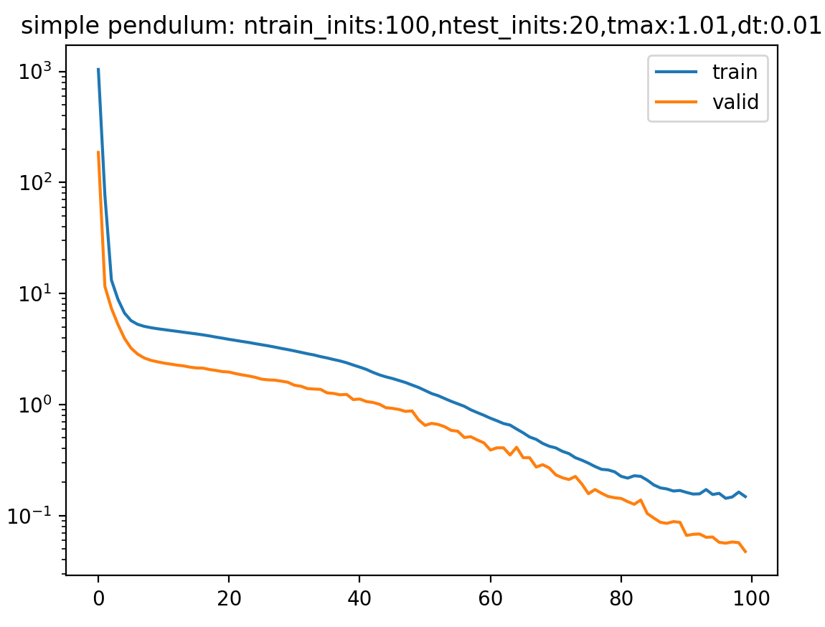
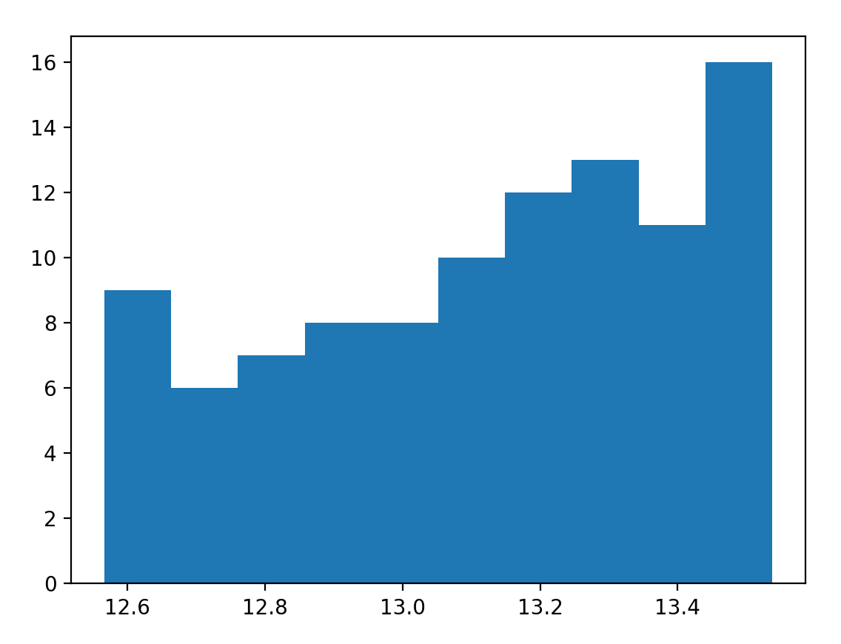
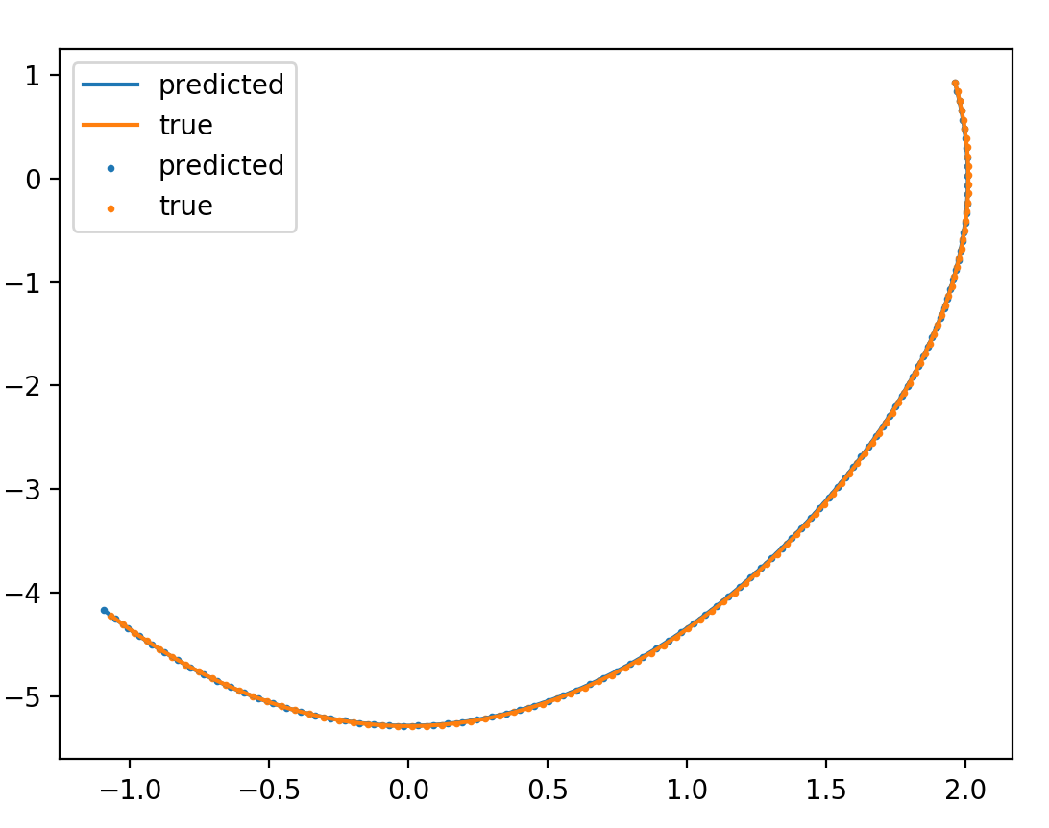
no integrator/energy/ no dH/dt
\beta = 0.01
\beta = 0.001
\beta = 0.0001

Slide 6
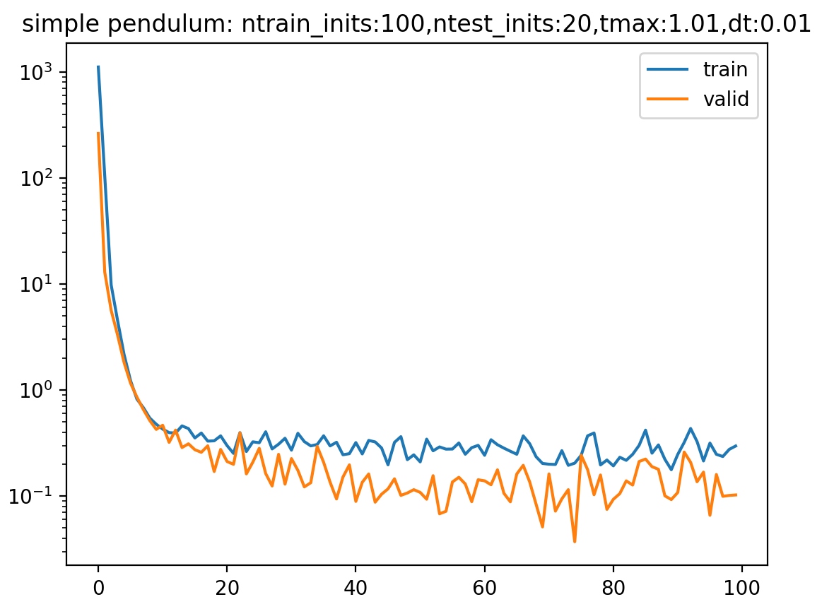
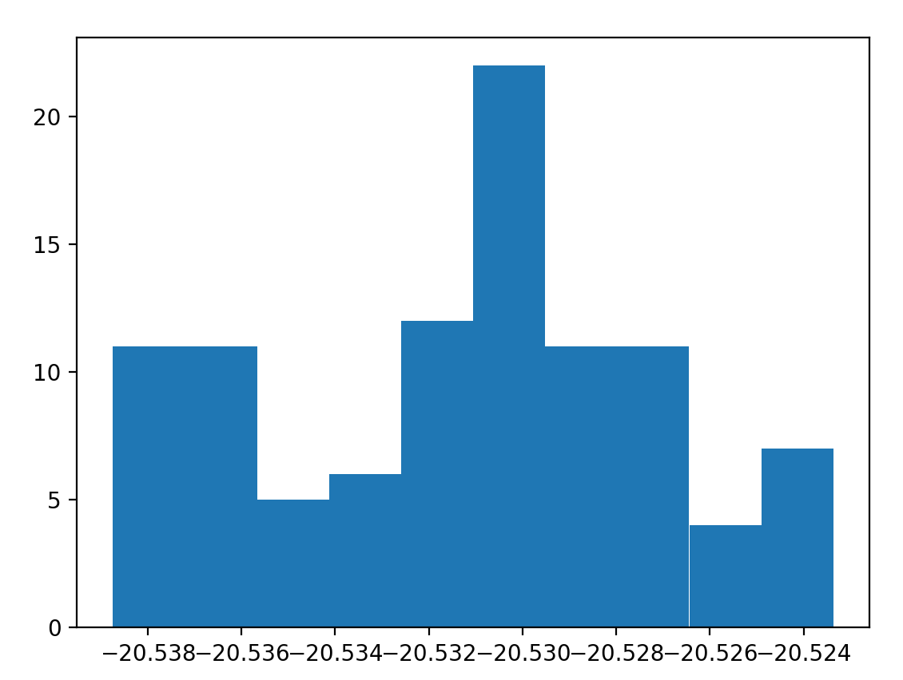
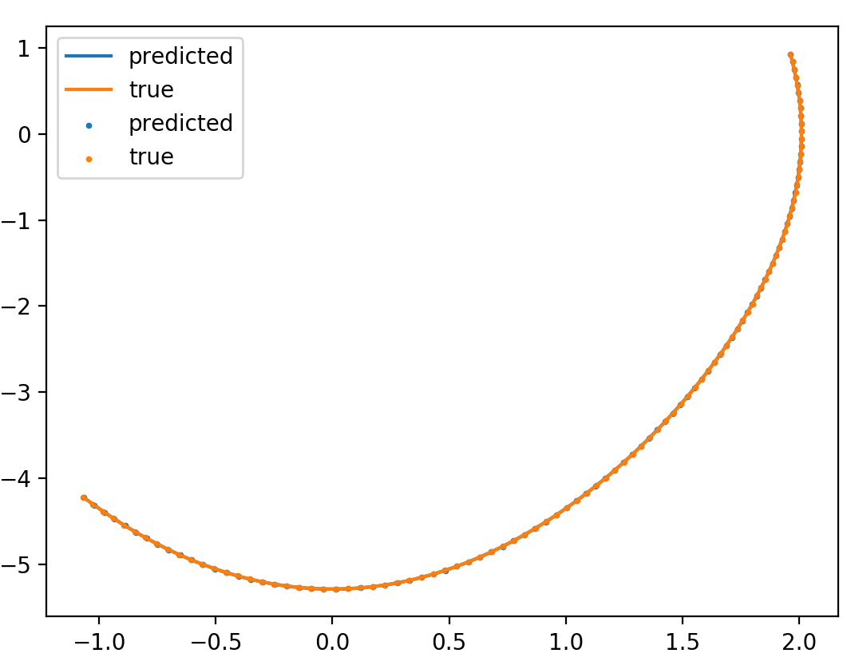
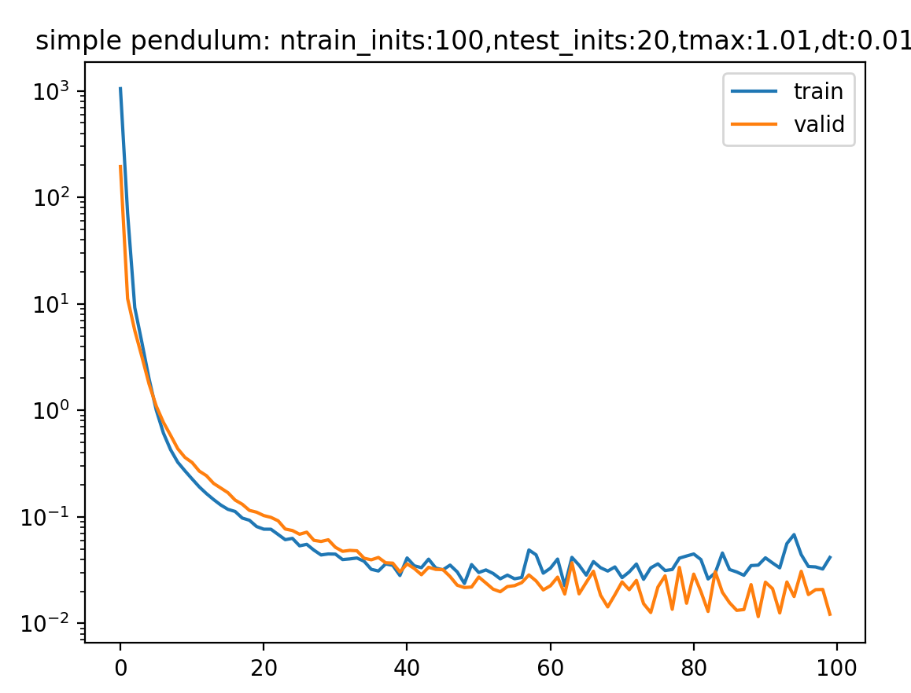
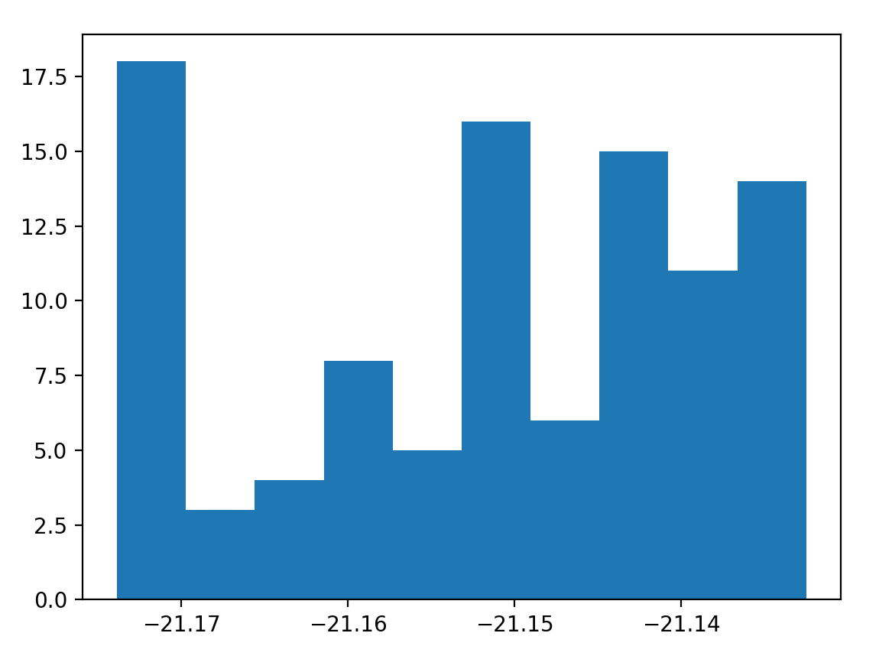
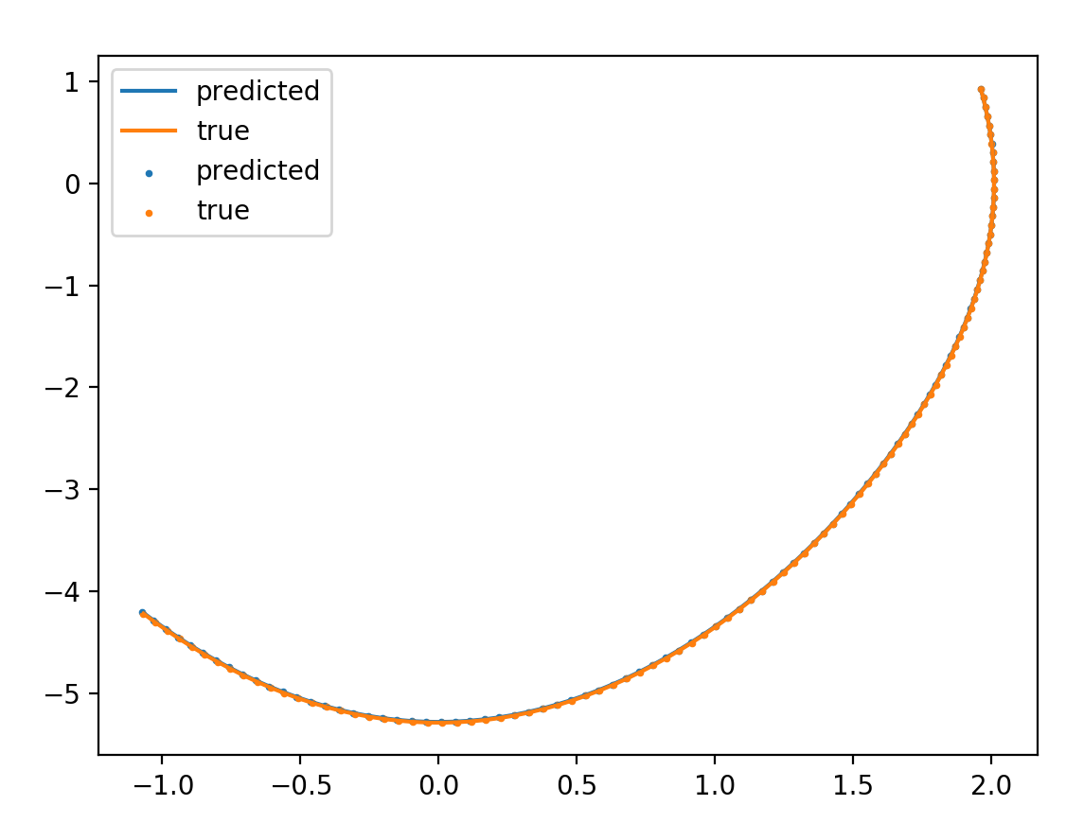
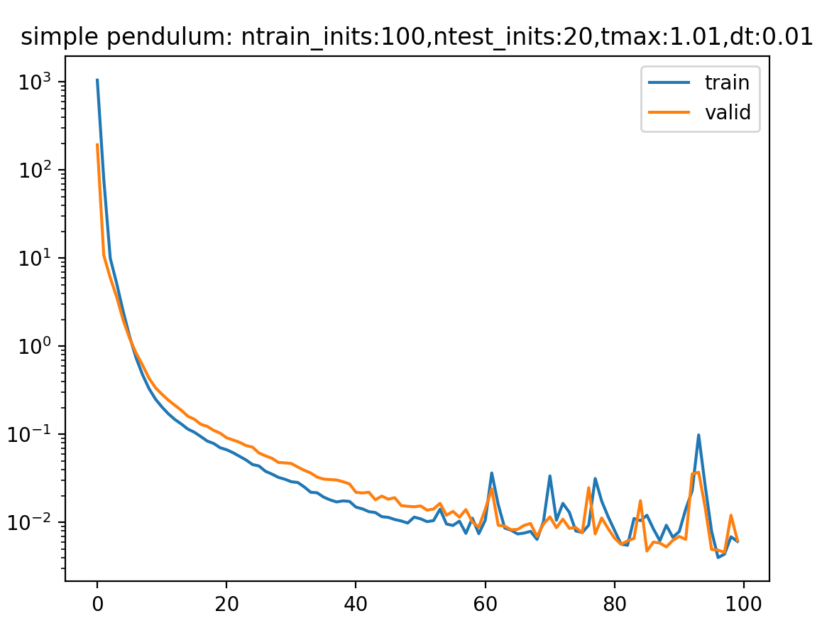
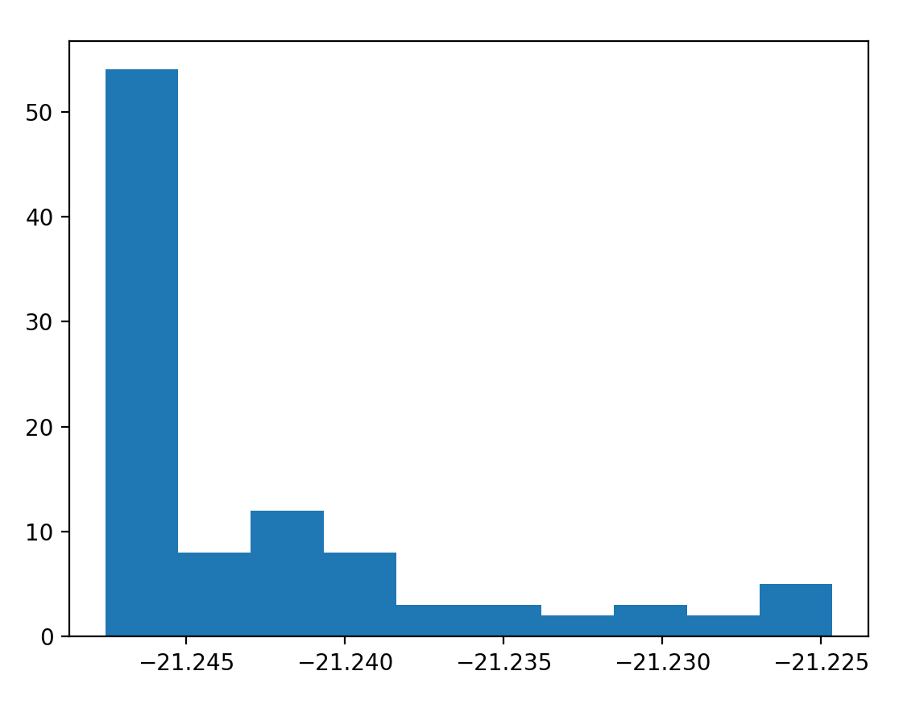
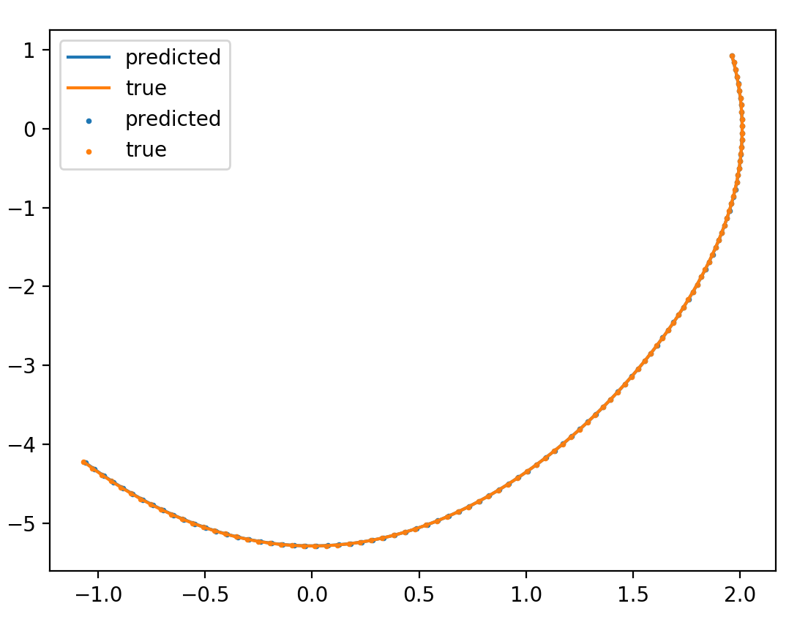
no integrator/no energy/ dH/dt
\gamma = 1
\gamma = 0.1
\gamma = 0.01

Slide 7
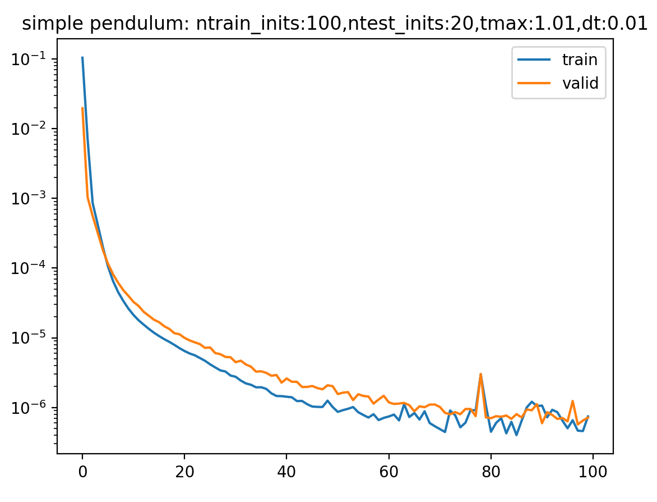
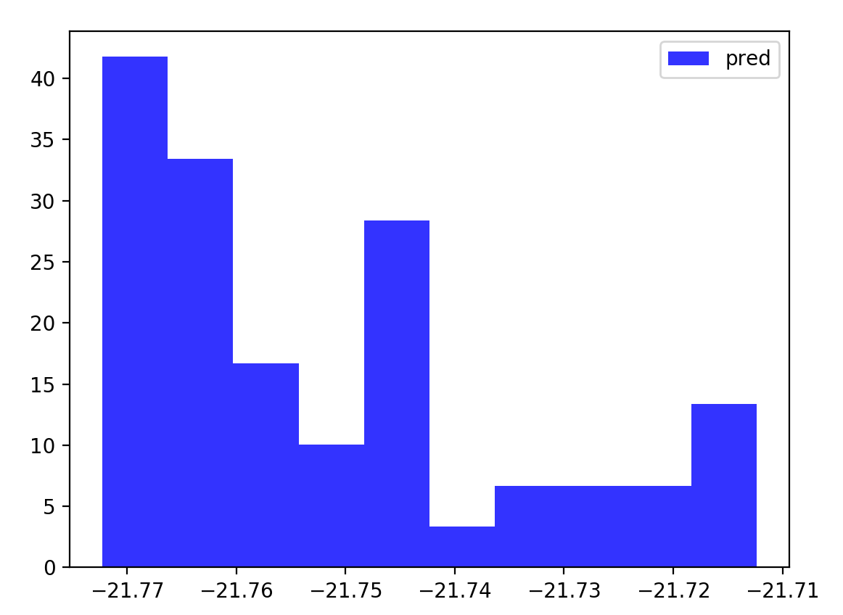
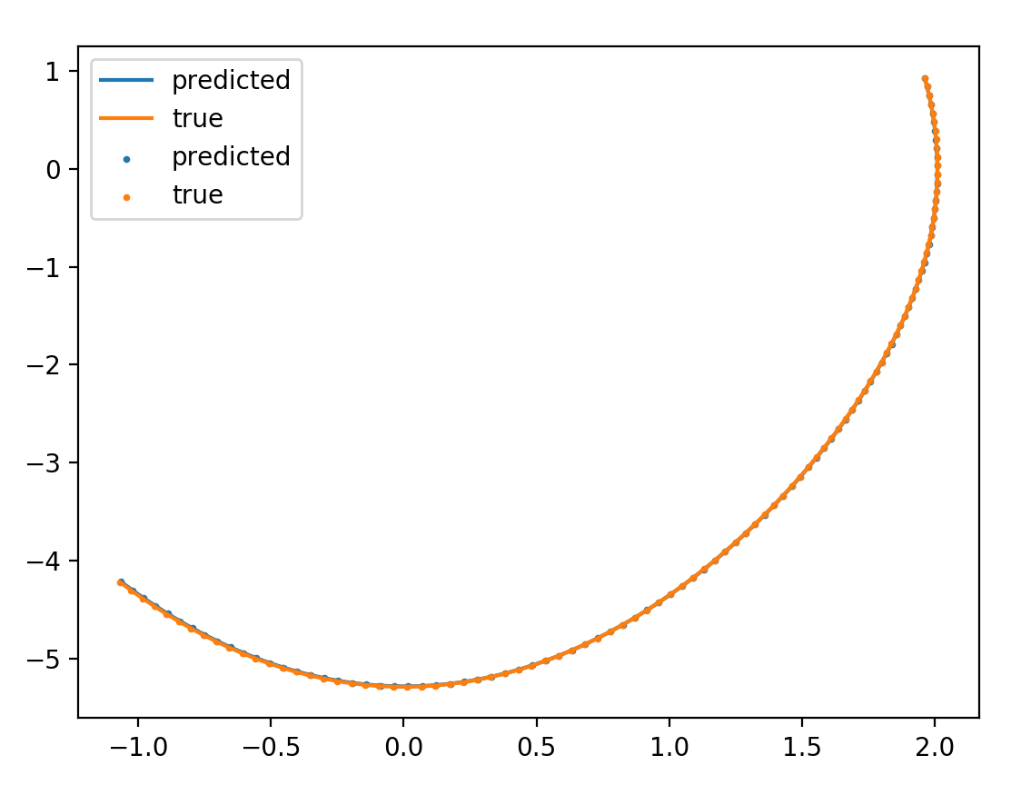
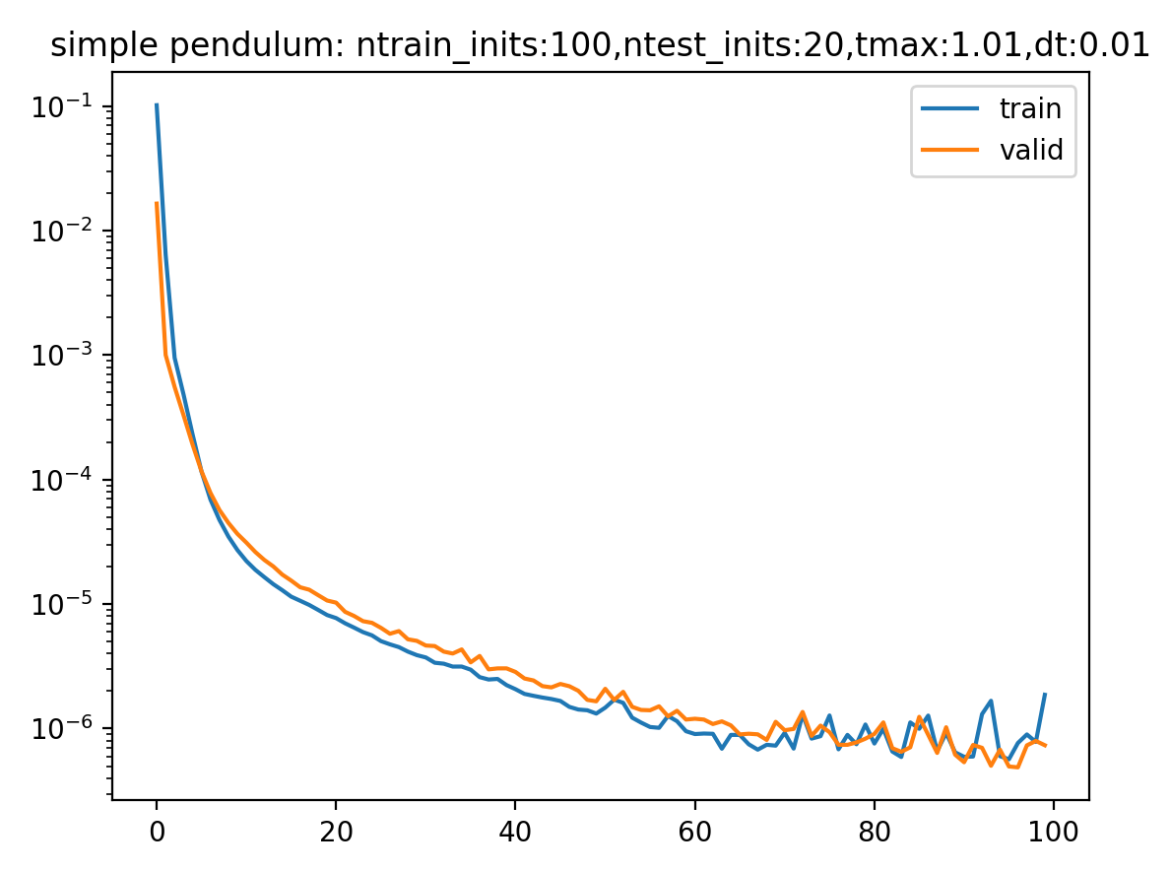
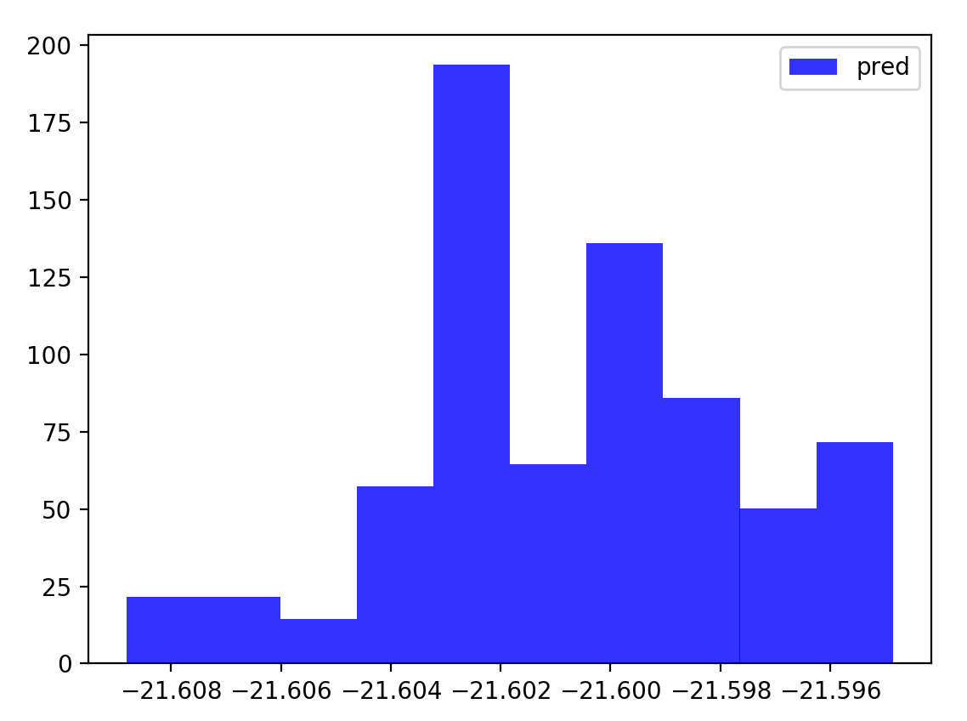
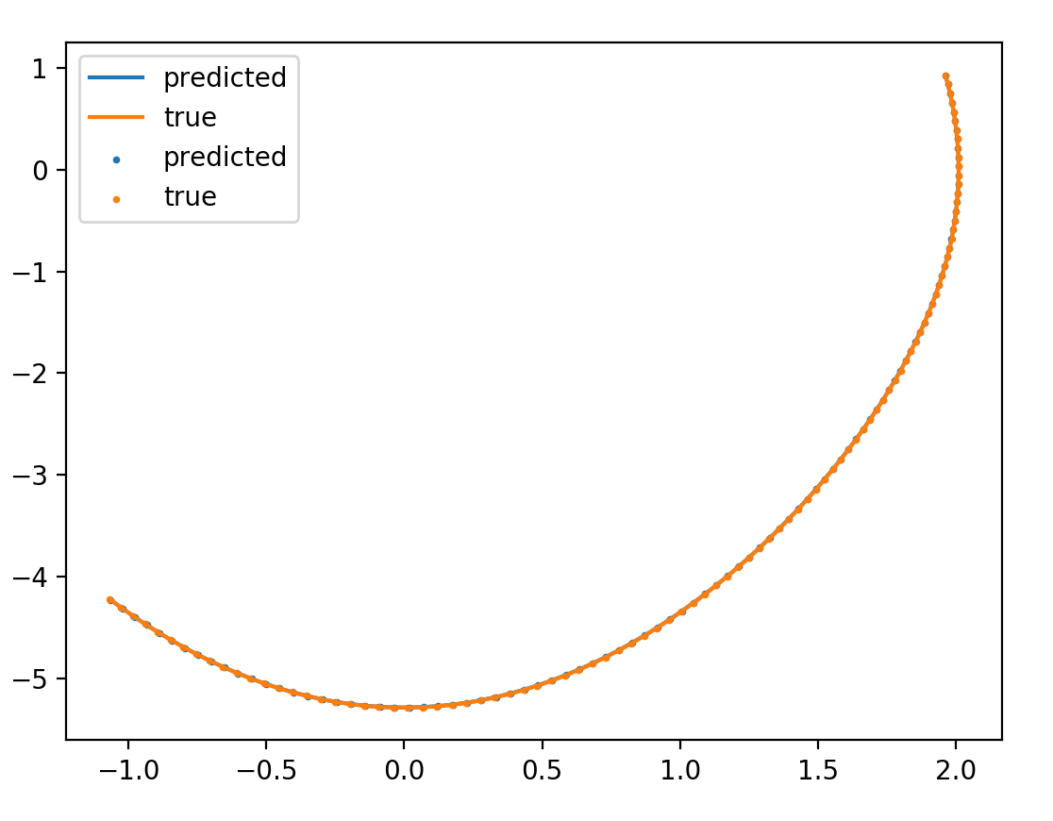
integrator/no energy/ dH/dt
\gamma = 1e-8
\gamma = 1e-6

Slide 8
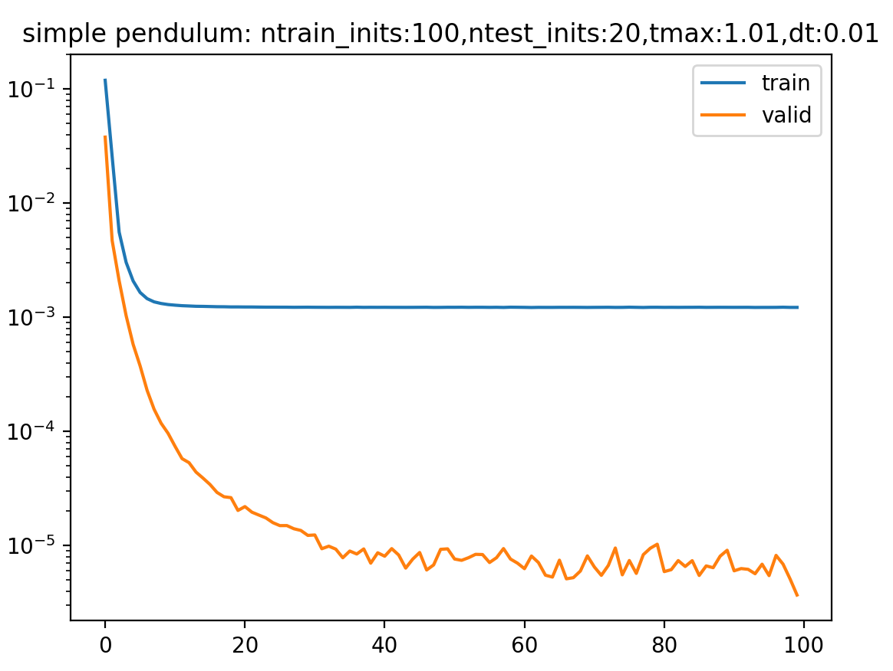
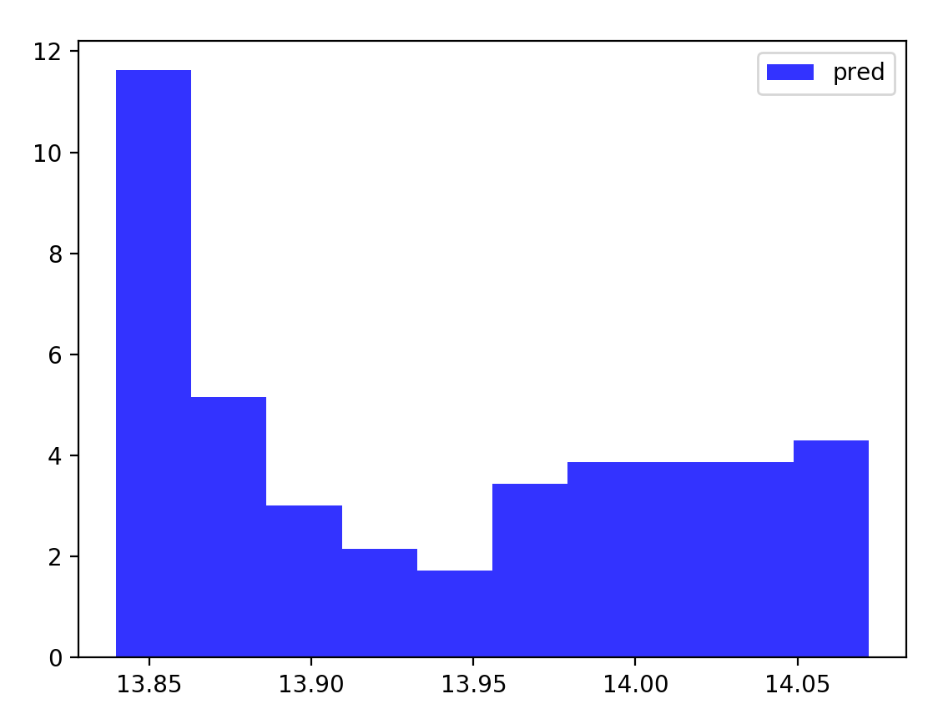
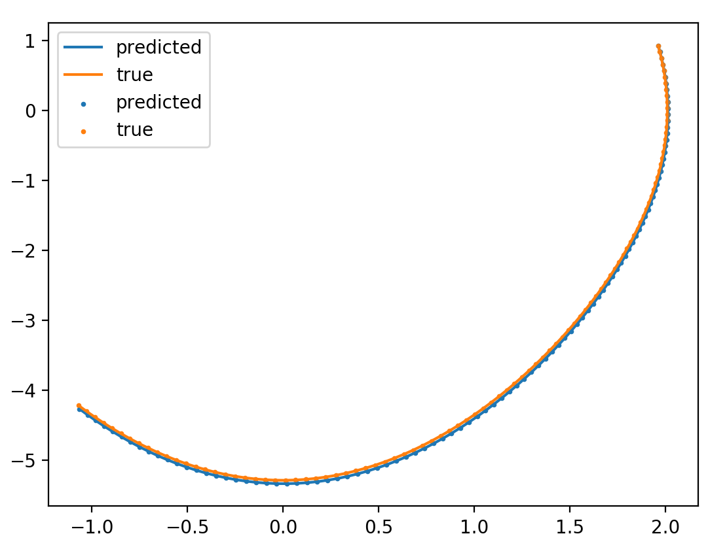
integrator/energy/ no dH/dt
\beta = 1e-6

Slide 9
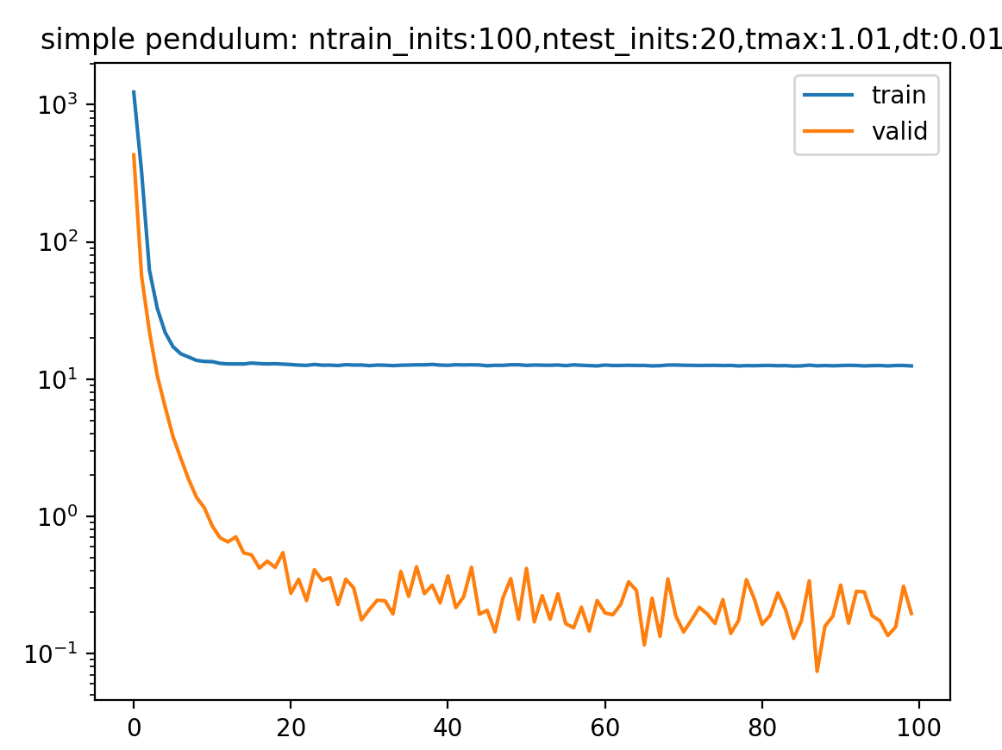
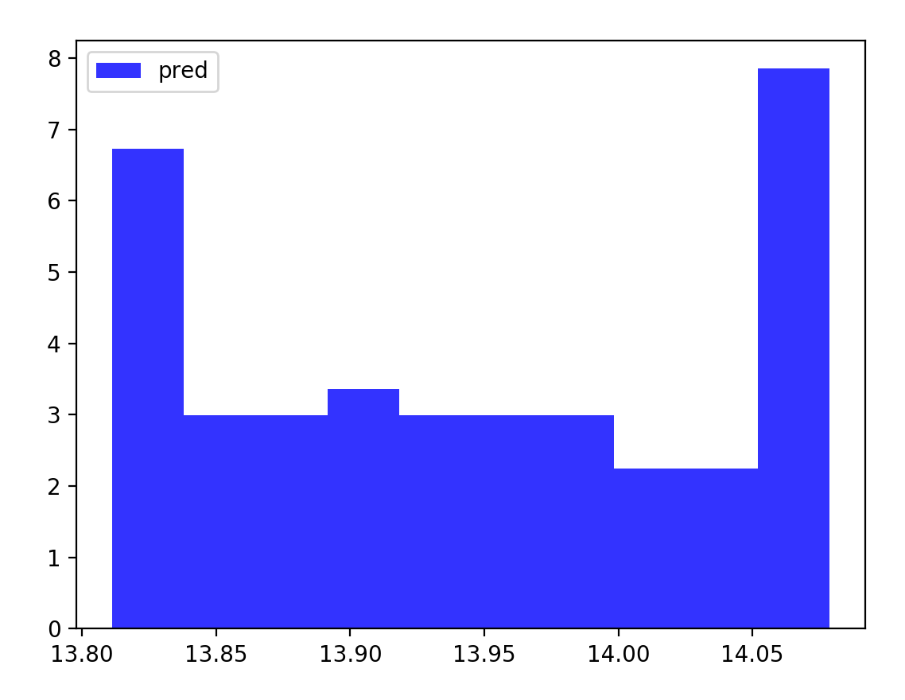
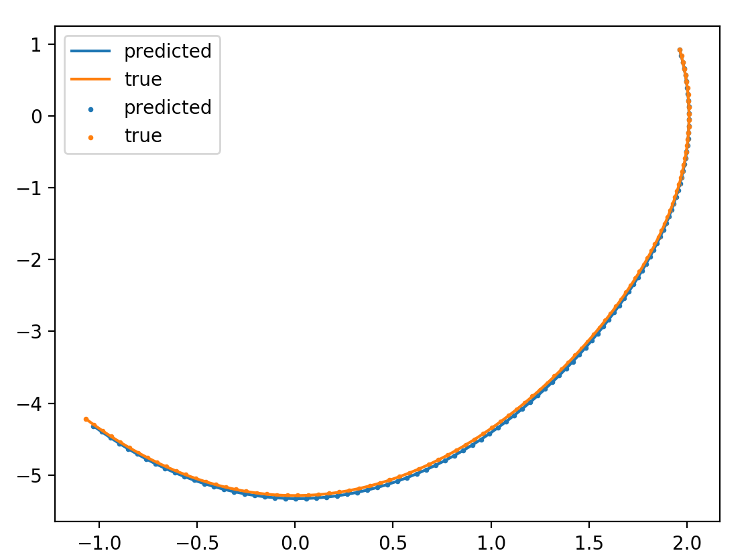
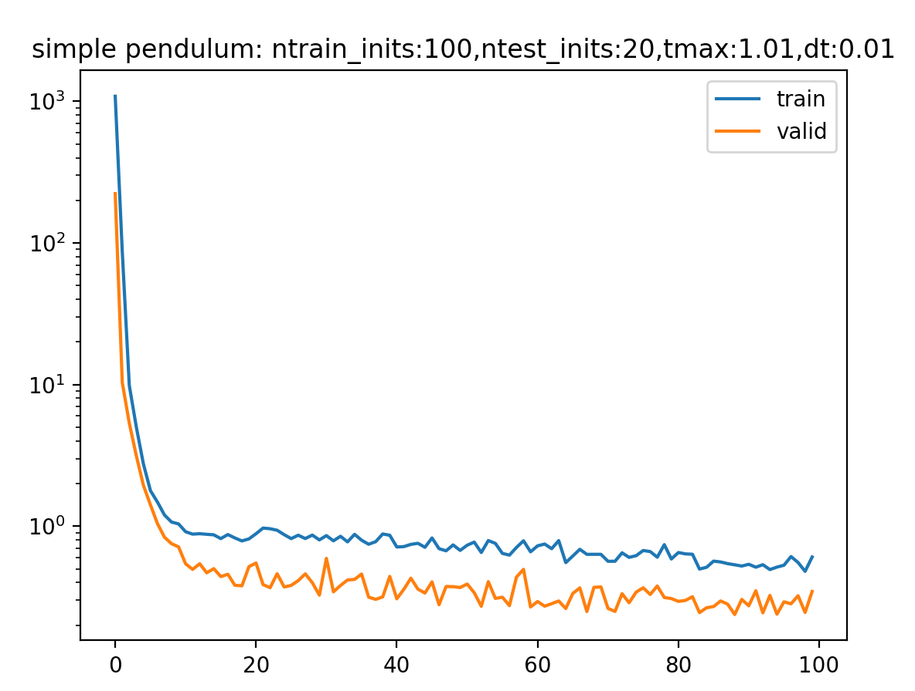
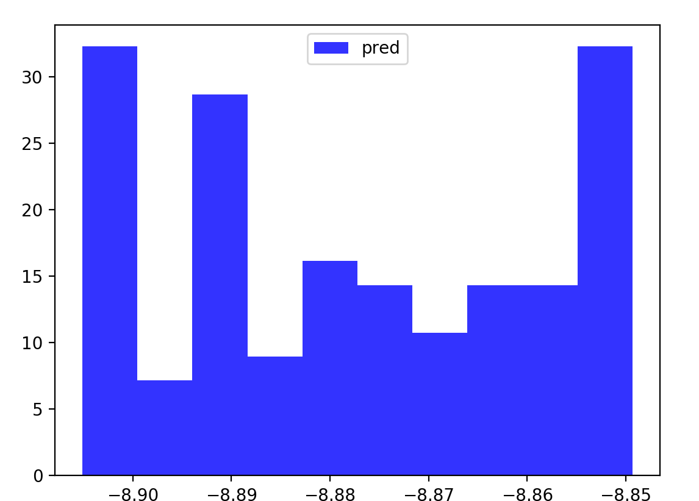
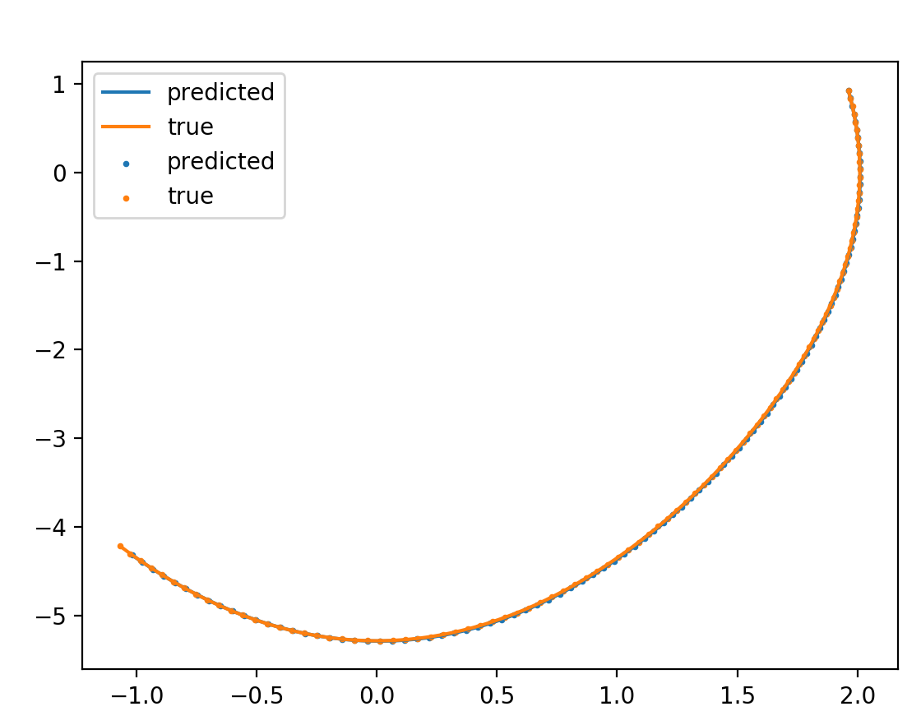
No integrator/energy/ dH/dt
\beta = 1e-2
\gamma = 1
\beta = 1e-5
\gamma = 1

Slide 10
Double Pendulum
Coordinate aware

Slide 11
Physics simulator with RK(5)4 integrator

Slide 12
Time dependent systems
Current Review:
We saw that once we include time, HNN struggles to conserve energy
Therefore we need dh/dt
Which explains why we saw better performance with the term
However, compared to the above, hnn alone without t does much better
Even after hyperparameter tuning
I then tested HNN with a forced pendulum
Results look promising
But just not there
H = 1/2 kq^2 + ½ p^2/m + qF(cos(wt))
dH/dq = pdot = qddot = -q – F(cos(wt)) + (damping)

Slide 13
Time dependent systems
Run experiment with only 1 training point
Test convergence
Notice that additional hidden layer does help when only 1 trajectory is provided
When more training points are added, training not improving
Also notice learning is highly sensitive to the amplitude of forcing?
Run experiment where we use mass-spring system
Noticing similar behaviour with angular data that we had with the double pendulum
Notice that if we do use mass-spring systems with forcing then we get good results
The only papers which propose tackling angular data involve directly embedding/enforcing S1 manifold
VIN paper
Symp ODEN
Mass-spring with damping and forcing – needs testing
High frequency oscillations are much harder to learn
Issue with learning damping

