Slide 1
Cognitive Ability Classification from Domographic Data

Slide 2
Task
We aim to classify subjects into two classes of cognitive ability
High Cognitive Ability
Low Cognitive Ability
The prediction is made based on subjects’ demographic data
We frame it as a classification problem with binary-class

Slide 3
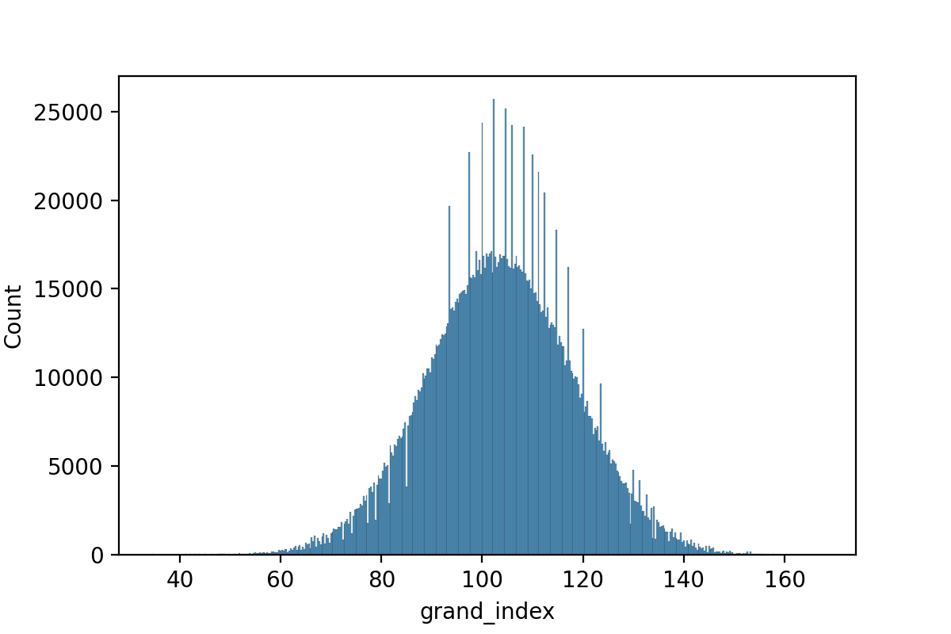
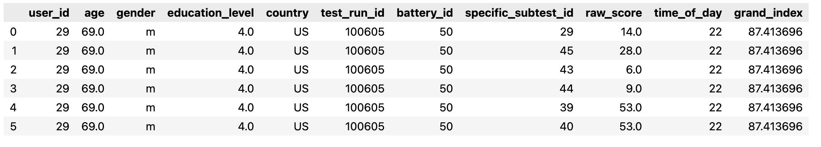
Data
Raw Data
(2302948, 11)
All columns with missing values are dropped
Duplicated rows are merged
Redundent features are dropped
user_id
test_run_id
battery_id
Specific_subtest_id
raw_score
We frame it into a classification problem
Subjects with top 25% grand index are considered high cognitive ability
Subjects with bottom 25% grand index are considered low cognitive ability
62679 observants in each class

Slide 4
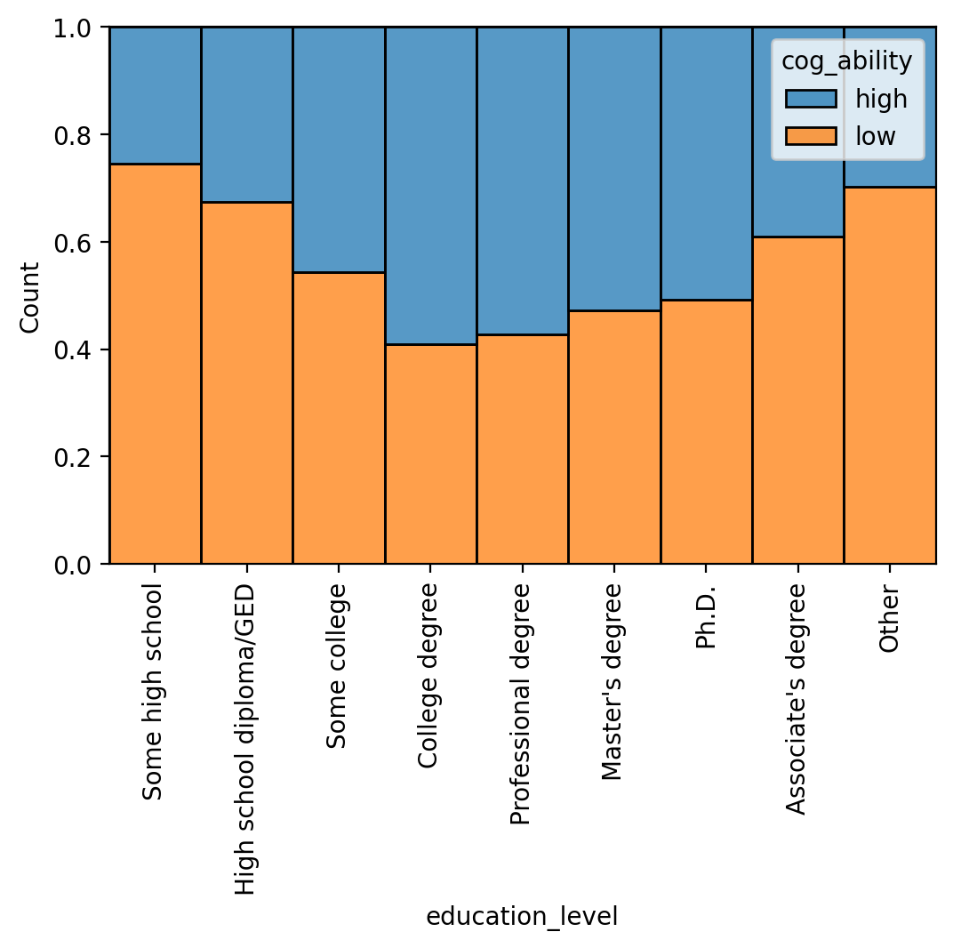
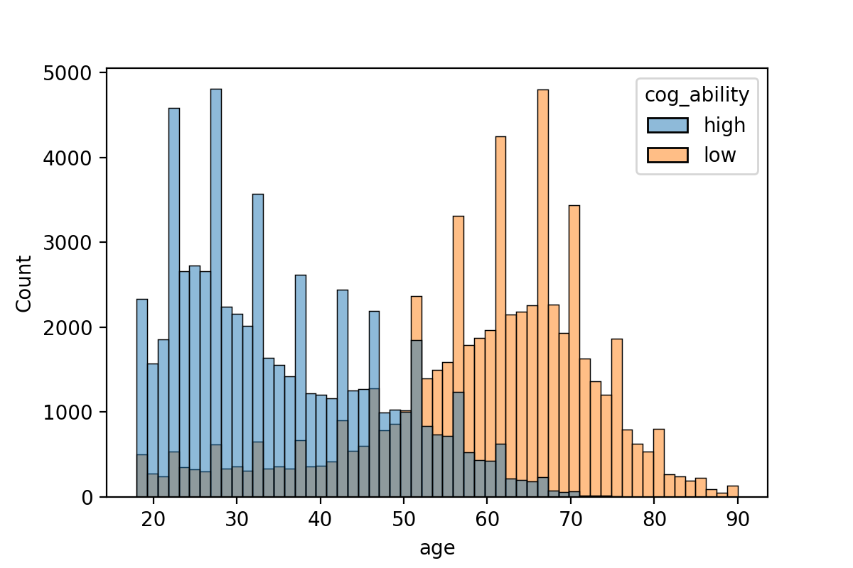
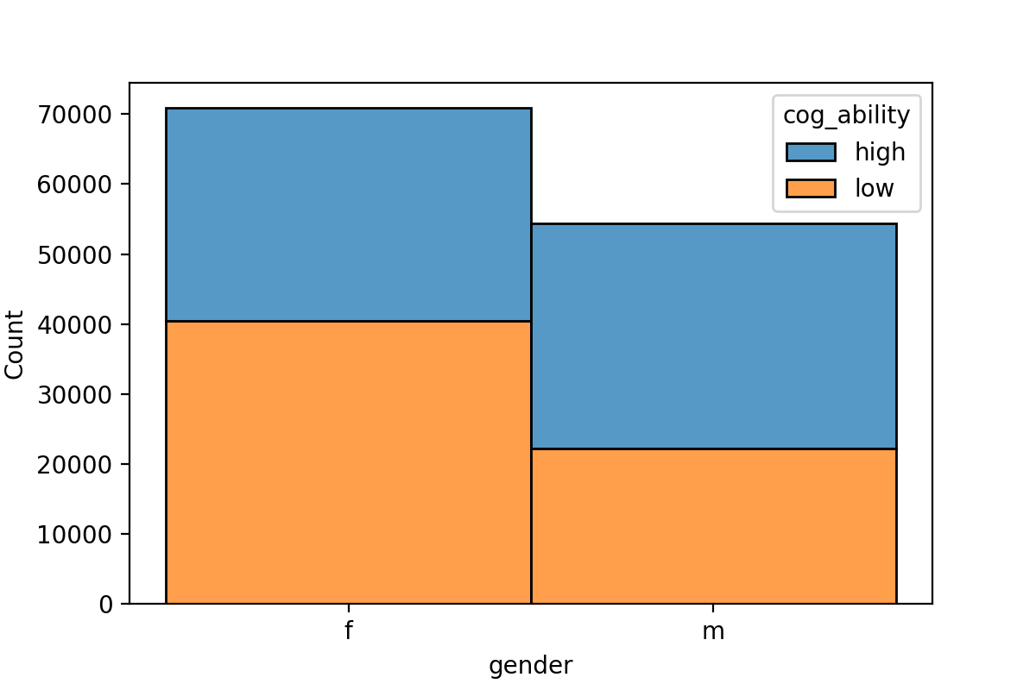
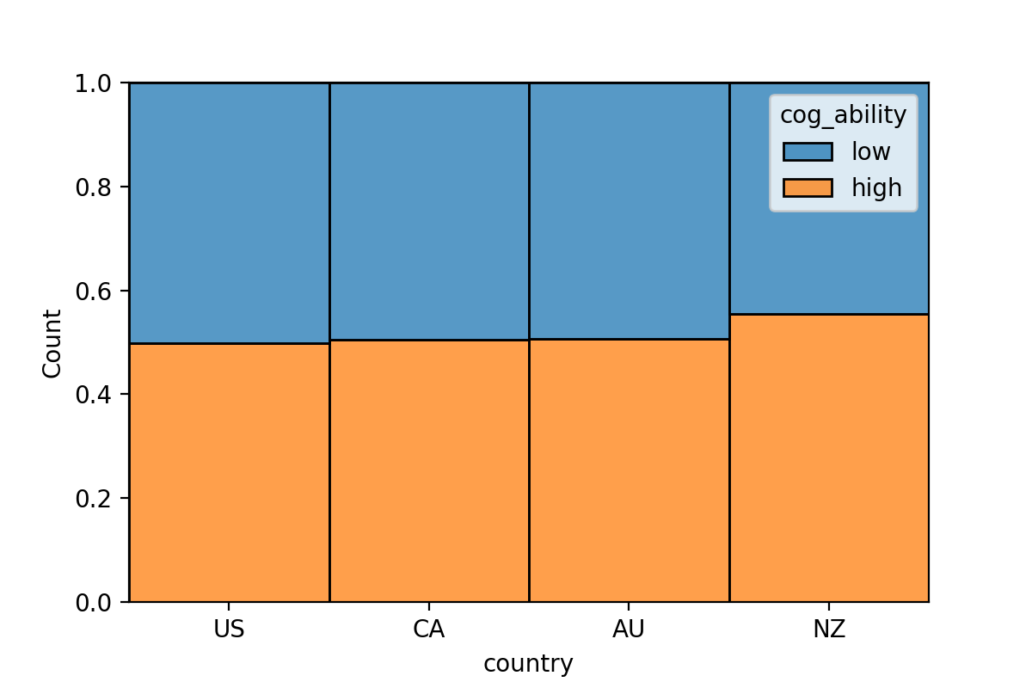
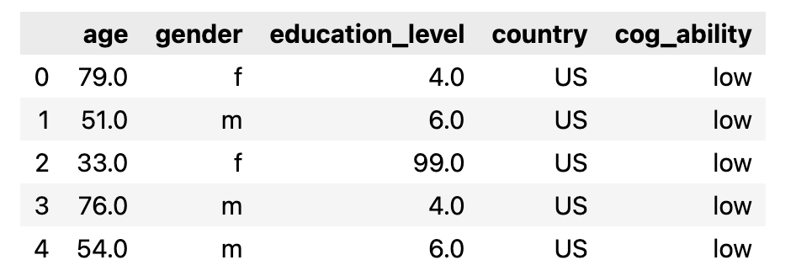
Data
1 numeric feature
age
3 categorical feature
Cleaned DataFrame
(125358, 5)

Slide 5
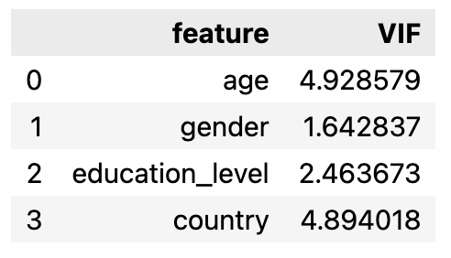
Data
one-hot encoding for categorical features
standarization of the numeric feature age
Detecting Multicollinearity with VIF
Train-Test Split
20% of the data as test data
with train_test_split function
Classes are splitted equally
Test Data
12570, High
12502, Low

Slide 6
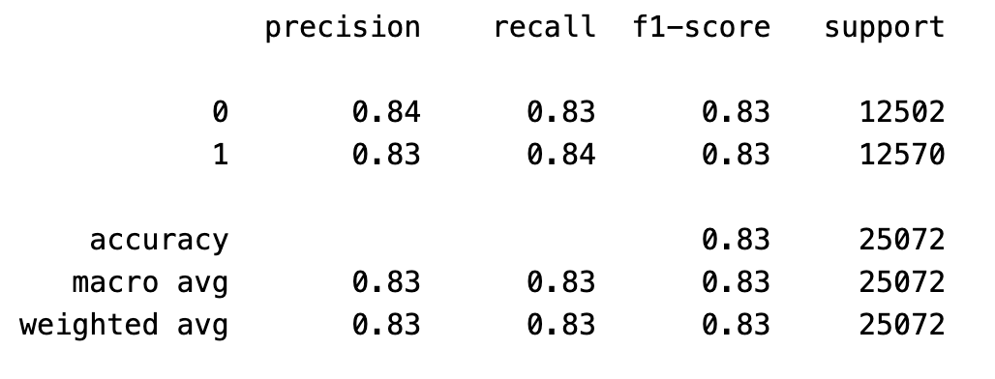
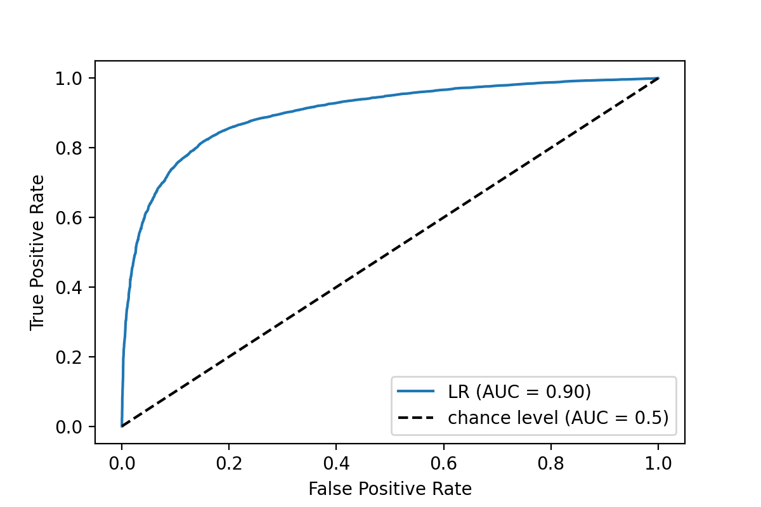
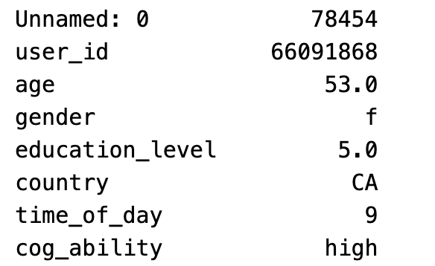
Models
Logistic Regression
Grid-search for hyperparameters
parameters = [{'penalty':['l1','l2’],
'C':[0.1, 1, 10, 100, 1000]}]
AUC as the score criteria
Best AUC score: 0.9041449584055424
Best parameter combination: {'C': 0.1, 'penalty': 'l1'}
Weights
Some high school | 2.11
High school diploma/GED | 1.19
Some college | 0.35
College degree | -0.58
Professional degree | -0.77
Master’s degree | -0.79
Ph.D. | -0.99
Associate’s degree | 0.34
Other | 1.34
female | male
0.25 | 0
AU | CA | NZ | US
0 | 0.11 | 0 | 0.04
age
2.11
Failed Case

Slide 7
Models
Random Forest

Slide 8
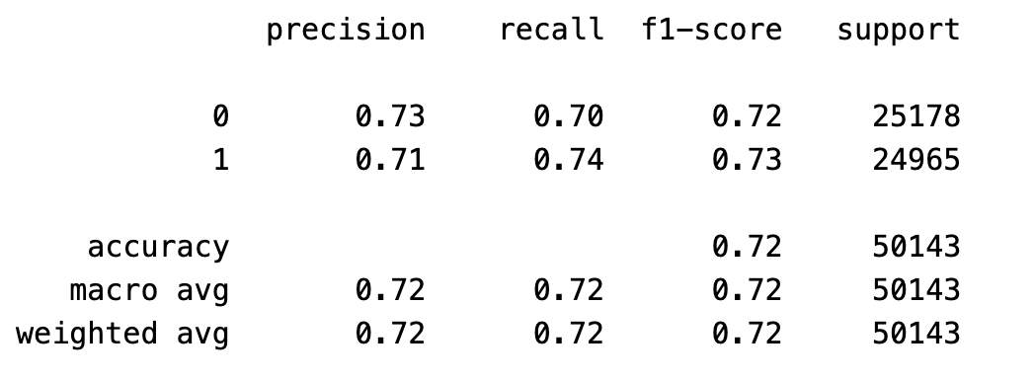
Conclusion
We could use two different models (LR and RF) to successfully classify cognitive ability with demographic data
Both age and educational level are important for prediction.
In additon, we also used the whole dataset instead of typical subjects
same pipeline of Logistic Regression
Performance drop as expected but still effective

