Slide 1
Surrogate modeling for efficient science with tensor completion
Shaan Pakala

Slide 2
Topics
Background
Automating Data Science Pipelines with Tensor Completion
Surrogate Modeling for the Design of Optimal Lattice Structures using Tensor Completion

Slide 3
Topics
Background
Automating Data Science Pipelines with Tensor Completion
Surrogate Modeling for the Design of Optimal Lattice Structures using Tensor Completion

Slide 4
Tensors
1st Order (vector)
2nd Order (matrix)
3rd Order and above (tensor)

Slide 5
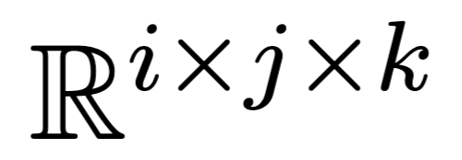
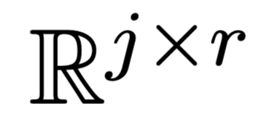
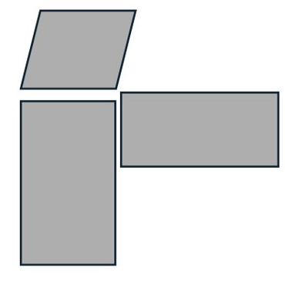
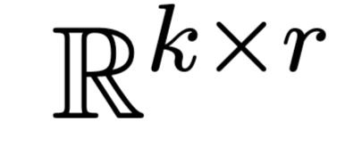
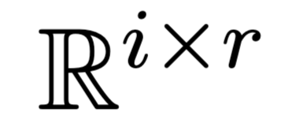
Tensor Decomposition
≈
Tensor
Factors

Slide 6
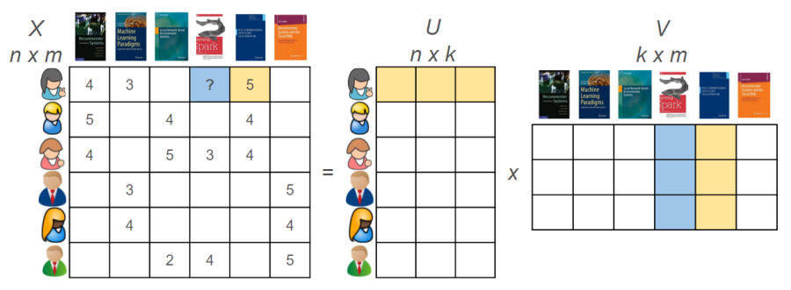
Tensor Decomposition
Figure from Toudeshki Medium (2020)

Slide 7
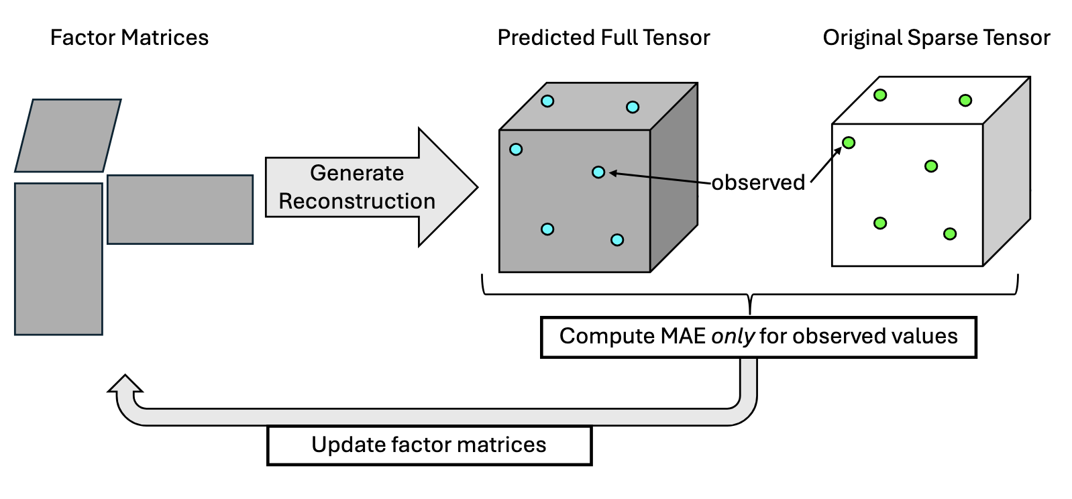
Tensor Completion

Slide 8
Topics
Background
Automating Data Science Pipelines with Tensor Completion
Surrogate Modeling for the Design of Optimal Lattice Structures using Tensor Completion

Slide 9
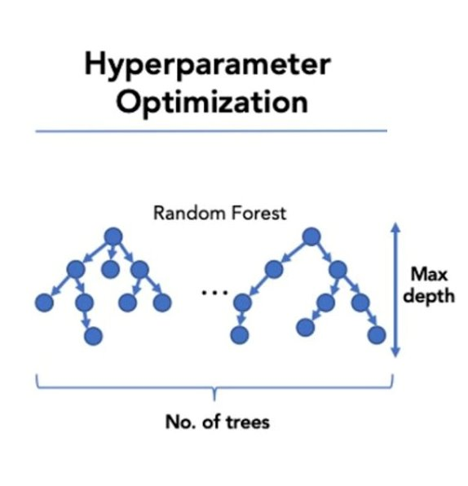
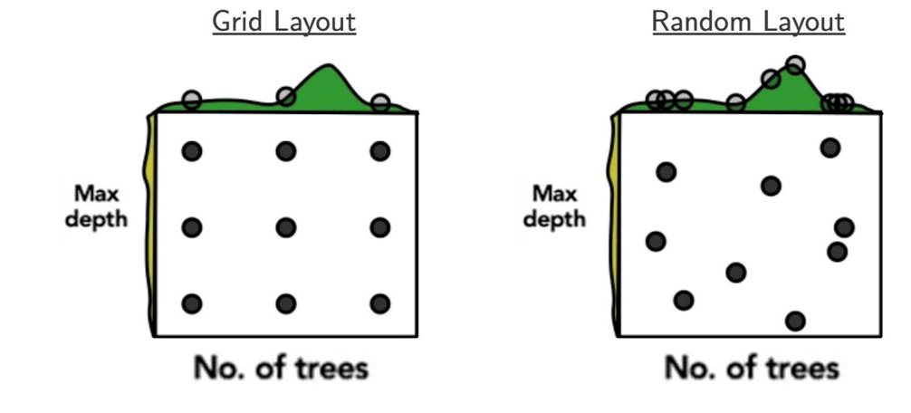
Hyperparameter Optimization
ML Evaluation (e.g. MAE, F1)
Figure from Bergstra et al. Journal of Machine Learning Research (2012)

Slide 10
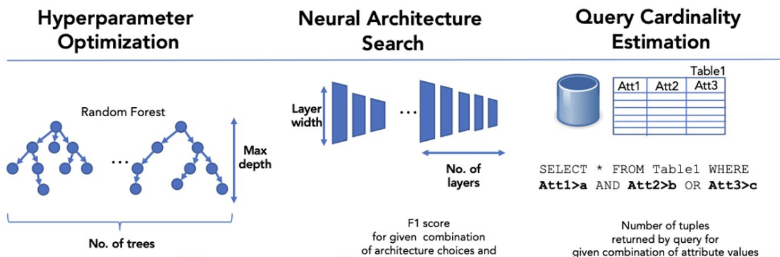
Figure from Pakala et al. International Conference on Big Data (2024)

Slide 11
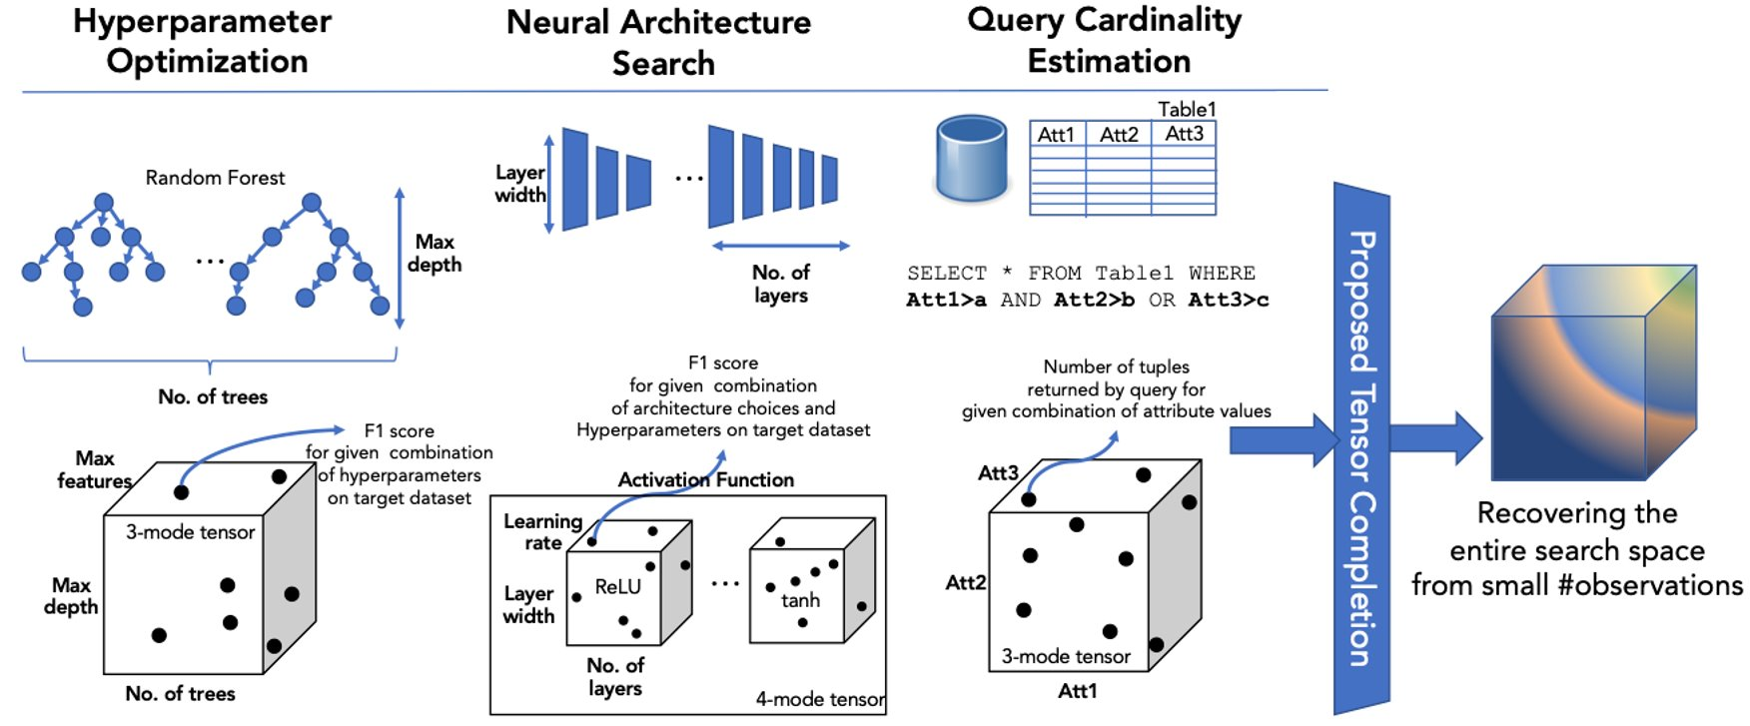

Slide 12
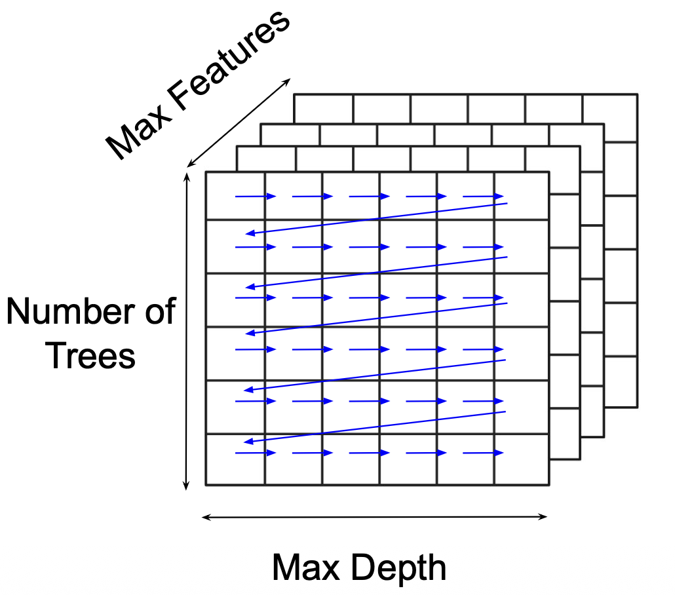
Evaluation
Exhaustively traverse search space & record performance
Remove majority of entries (90-99%) to see how well we can predict them back

Slide 13
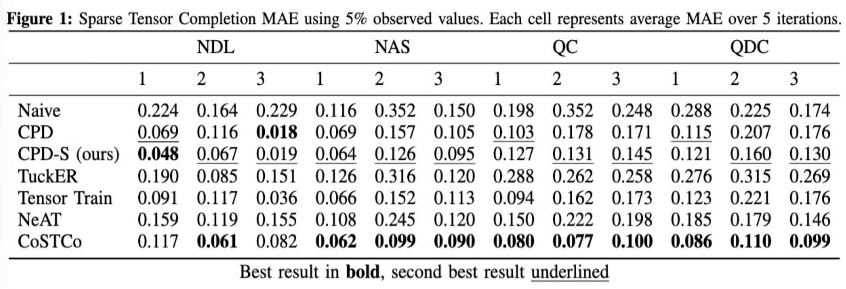
Results

Slide 14
Topics
Background
Automating Data Science Pipelines with Tensor Completion
Surrogate Modeling for the Design of Optimal Lattice Structures using Tensor Completion

Slide 15
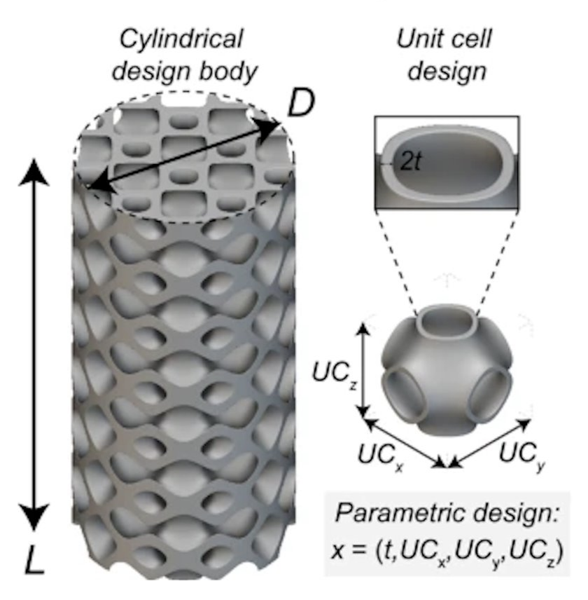
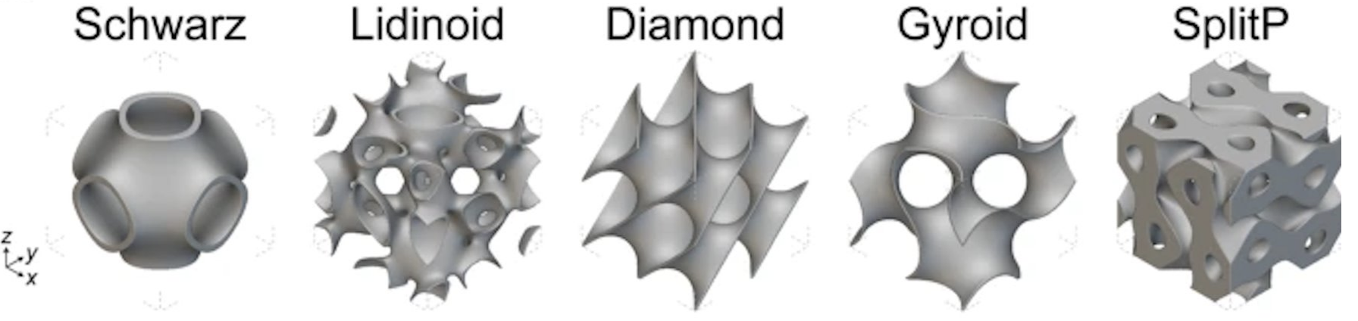
Designing an Optimal Material
With many "hyperparamters" for designing this material, how do we find the optimal configuration?
Figure from Gongora et al. Scientific Reports (2024)

Slide 16
Geometry
0.8
0.7
t
0.8
0.4
UC_{x/y/z}
Figure from Gongora et al. Scientific Reports (2024)

Slide 17
Geometry
0.8
ML Surrogate Model (Tensor Completion)
0.7
t
0.8
0.4
UC_{x/y/z}

Slide 18
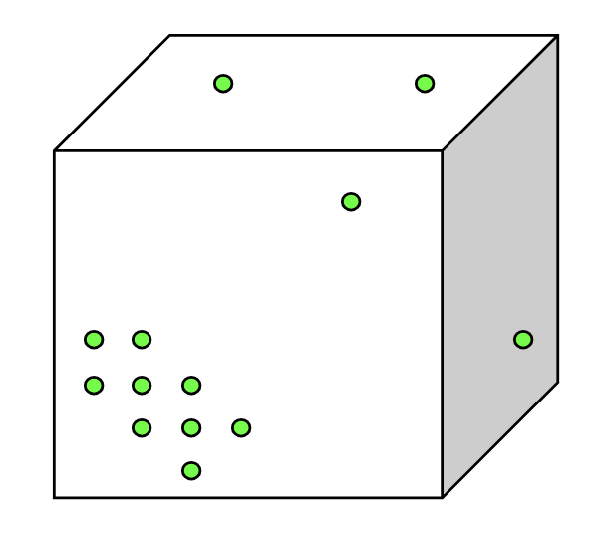
Geometry
What happens when search space is unevenly sampled?
t
UC_{x/y/z}

Slide 19
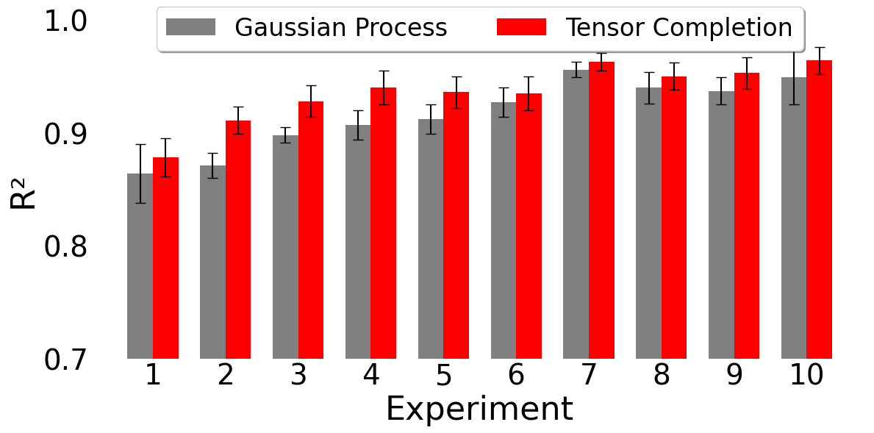
Results

