Slide 1
Driver Drowsiness Detection Using the YOLOv8 Model
Deep Learning course project · Final year EEE, 8th semester
SHAARON V G CB.EN.U4EEE23033
PASHUPATHIK KUMARAN M CB.EN.U4EEE23021
Notes:
Opening. Nine-class YOLOv8s detector plus a time-based alert rule.

Slide 2
Why drowsy driving needs an early warning
Fatigue slows reactions and narrows attention, like alcohol does.
Eye-aspect-ratio methods need landmarks and break with head turns, glasses or off-axis cameras.
Our approach: detect the driver's state directly with one YOLOv8s network, then decide with a timer.
9
6,391
classes of driver state
images
YOLOv8s
640²
single-stage detector
input size (px)
Objective: a real-time detector that recognises eye closure, head pose, gaze and yawning, and raises an alarm only when the cue persists.

Slide 3
Dataset: Roboflow drowsiness detection
Pre-processing
Auto-orient, stretch to 640×640
Augmentation (3 copies per source)
Crop 0–20%, rotation ±15°, brightness ±15%
Gaussian blur ≤2.5 px, salt-and-pepper 6.36%
Classes (index order)
eyes_closed, eyes_closed_head_left/right, focused, head_down, head_up, seeing_left/right, yawning

Slide 4
System pipeline and temporal alert rule
Camera frame
Resize 640×640
YOLOv8s
9 classes
Conf ≥ 0.45
cue timers
Drowsy?
alarm
→
→
→
→
drowsy = OR over cues k of [ t_k ≥ τ_k ]
1.2 s
1.5 s
1.0 s
eyes closed (classes 0, 1, 2)
head down (class 4)
yawning (class 8)
A single closed-eye frame is only a blink; the timer filters it out.

Slide 5
Model and training configuration
Parameter | Value | Parameter | Value
Model | YOLOv8s (COCO-pretrained) | Initial LR / final factor | 0.01 / 0.01
Epochs (set) | 100 | Momentum / weight decay | 0.937 / 5e-4
Batch / image size | 16 / 640 | Warm-up epochs | 3
Optimizer | auto | Mosaic / close mosaic | 1.0 / last 10 epochs
Loss weights | box 7.5, cls 0.5, dfl 1.5 | Horizontal flip | 0.5
Mixed precision | on | Seed / framework | 0 / Ultralytics 8.2.18
Values read from the training arguments stored inside the detector weights.

Slide 6
Training and validation loss curves
Classification loss falls 2.57 → 0.27 and box loss 1.05 → 0.38. Curves flatten after ~epoch 40 and validation loss never rises: no overfitting. Validation sits below training because training images are mosaic-augmented.
Notes:
Source: 72-epoch log stored in best.pt, which ends at the best epoch. Not our own run.

Slide 7
Precision and recall
0.977
0.982
precision (ep. 72)
recall (ep. 72)
Both start at 0.77 / 0.87 after epoch 1 and settle in the 0.97–0.99 band. Peak precision 0.985 (epoch 67), peak recall 0.992 (epoch 52). They stay close, so neither is traded for the other.

Slide 8
mAP@0.5 and mAP@0.5:0.95
0.991
0.960
mAP@0.5
mAP@0.5:0.95
mAP@0.5 reaches 0.98 by epoch 6 and 0.99 from epoch 26. The stricter mAP@0.5:0.95 passes 0.90 at epoch 10 and 0.95 at epoch 38, then gains only ~0.003 per 10 epochs: converged.

Slide 9
Progress at selected epochs
Epoch | Train loss | Val loss | Precision | Recall | mAP@0.5 | mAP@0.5:0.95
1 | 4.97 | 2.66 | 0.768 | 0.869 | 0.883 | 0.726
5 | 2.66 | 1.93 | 0.934 | 0.948 | 0.971 | 0.872
10 | 2.28 | 1.70 | 0.968 | 0.963 | 0.984 | 0.911
20 | 2.01 | 1.56 | 0.972 | 0.970 | 0.984 | 0.930
30 | 1.88 | 1.50 | 0.977 | 0.981 | 0.991 | 0.940
40 | 1.78 | 1.47 | 0.970 | 0.983 | 0.989 | 0.948
50 | 1.70 | 1.44 | 0.977 | 0.977 | 0.988 | 0.950
60 | 1.64 | 1.44 | 0.976 | 0.976 | 0.988 | 0.954
72 | 1.58 | 1.41 | 0.977 | 0.982 | 0.991 | 0.960
Total loss = box + class + DFL. Epoch 72 is the best-fitness epoch (fitness = 0.1·mAP@0.5 + 0.9·mAP@0.5:0.95).

Slide 10
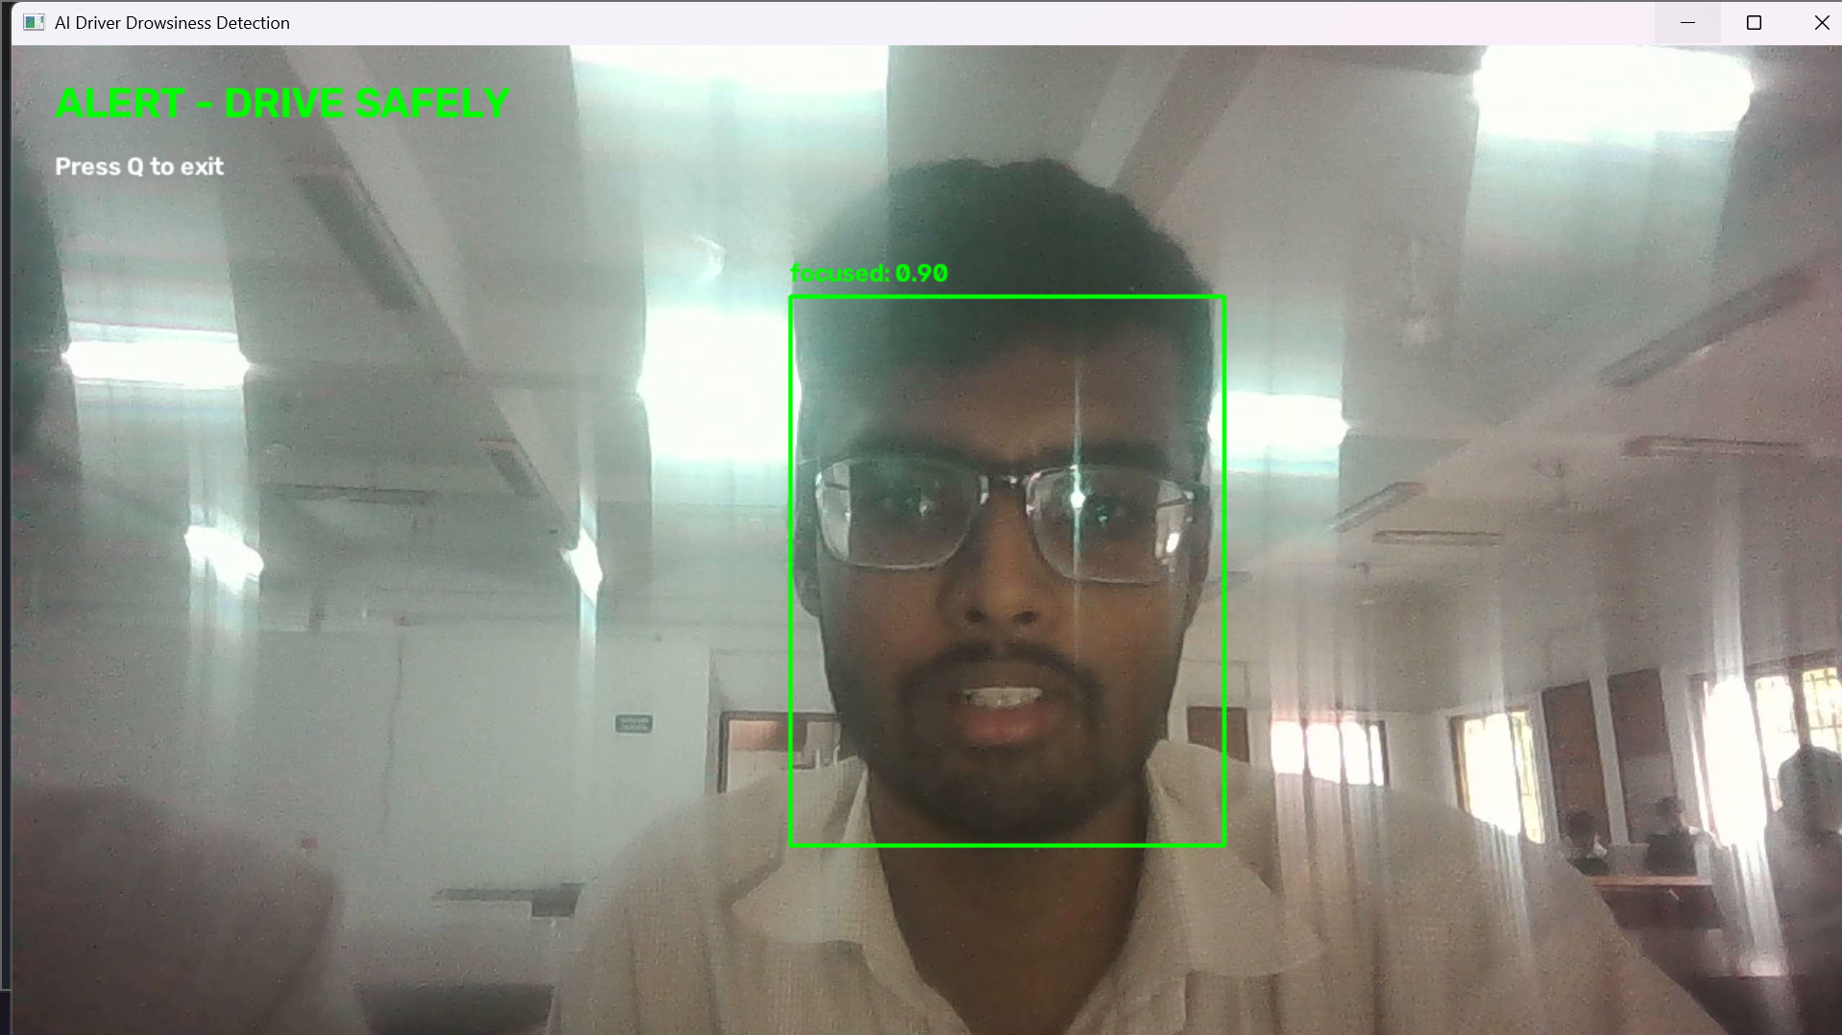
Live Webcam Test Results

Slide 11
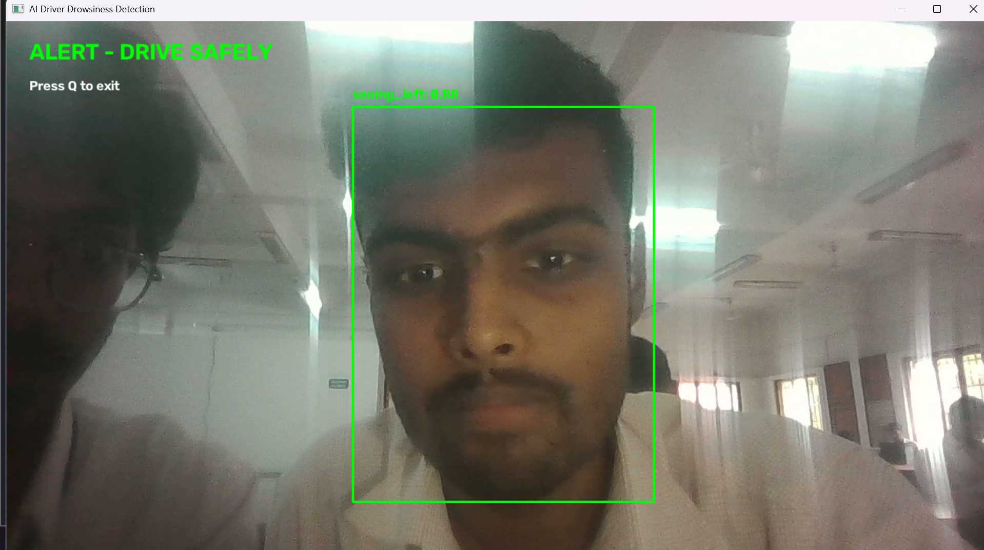

Slide 12
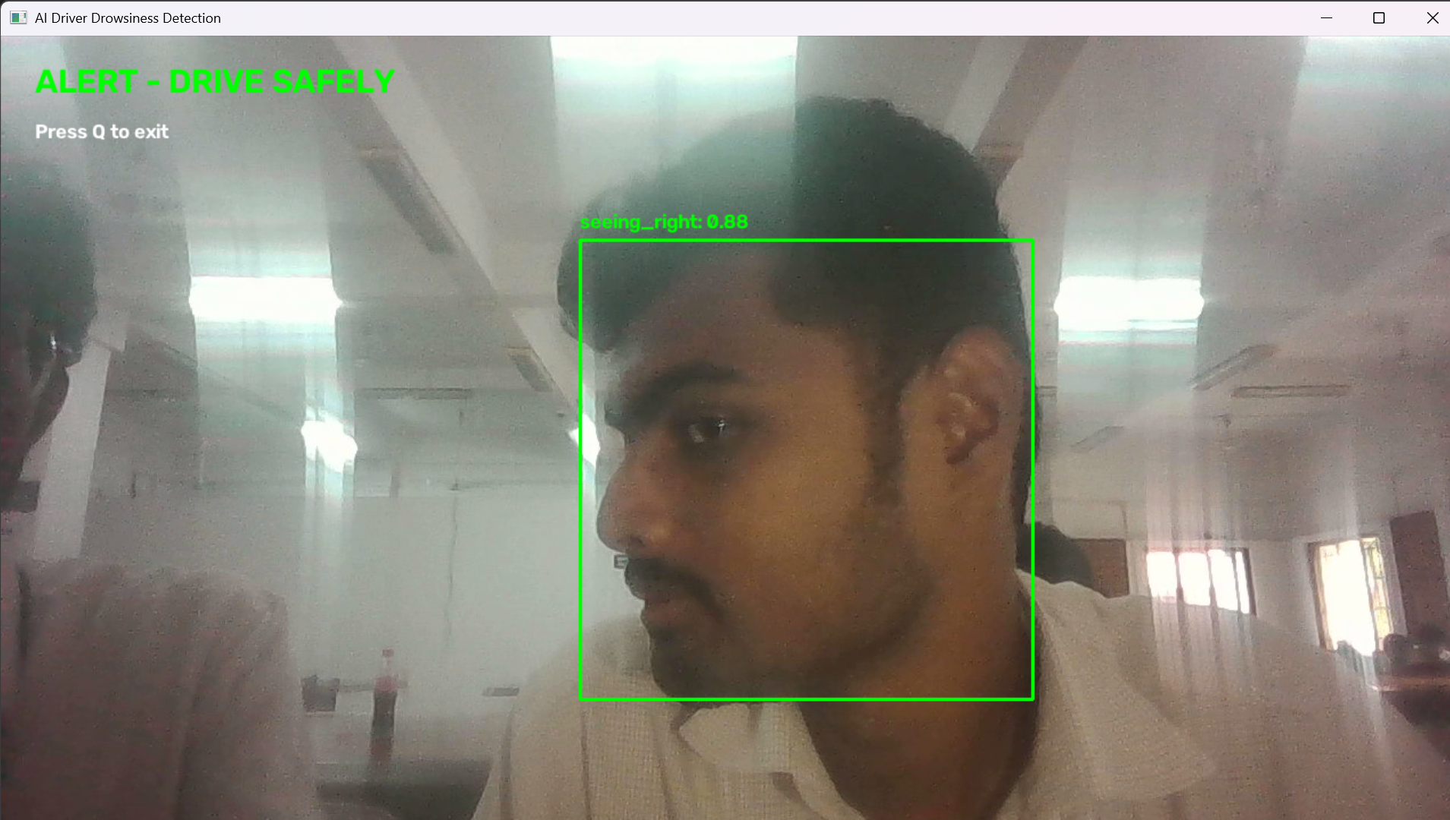

Slide 13
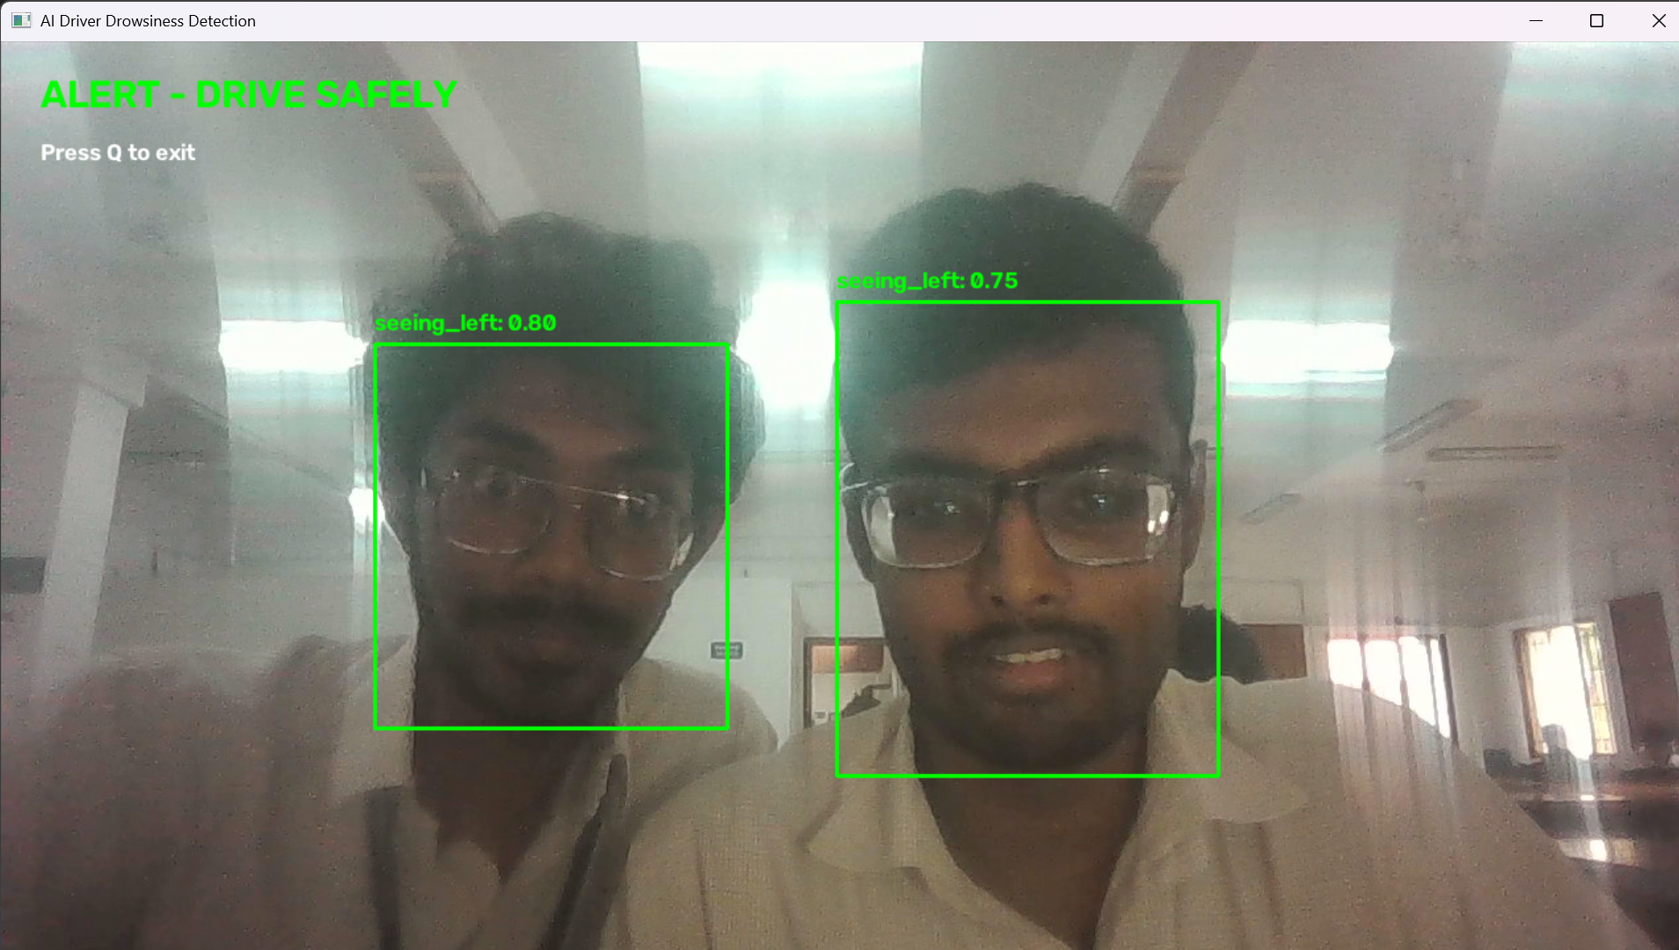

Slide 14
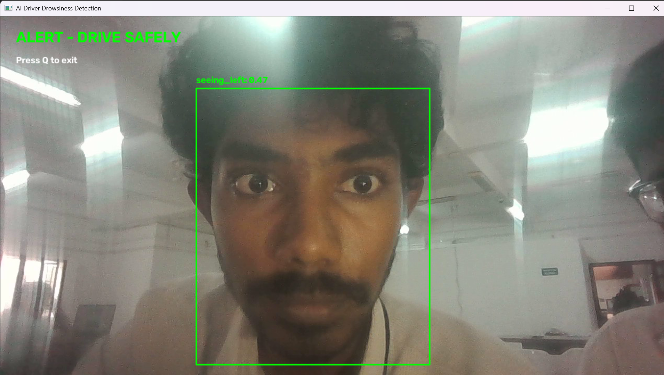

Slide 15
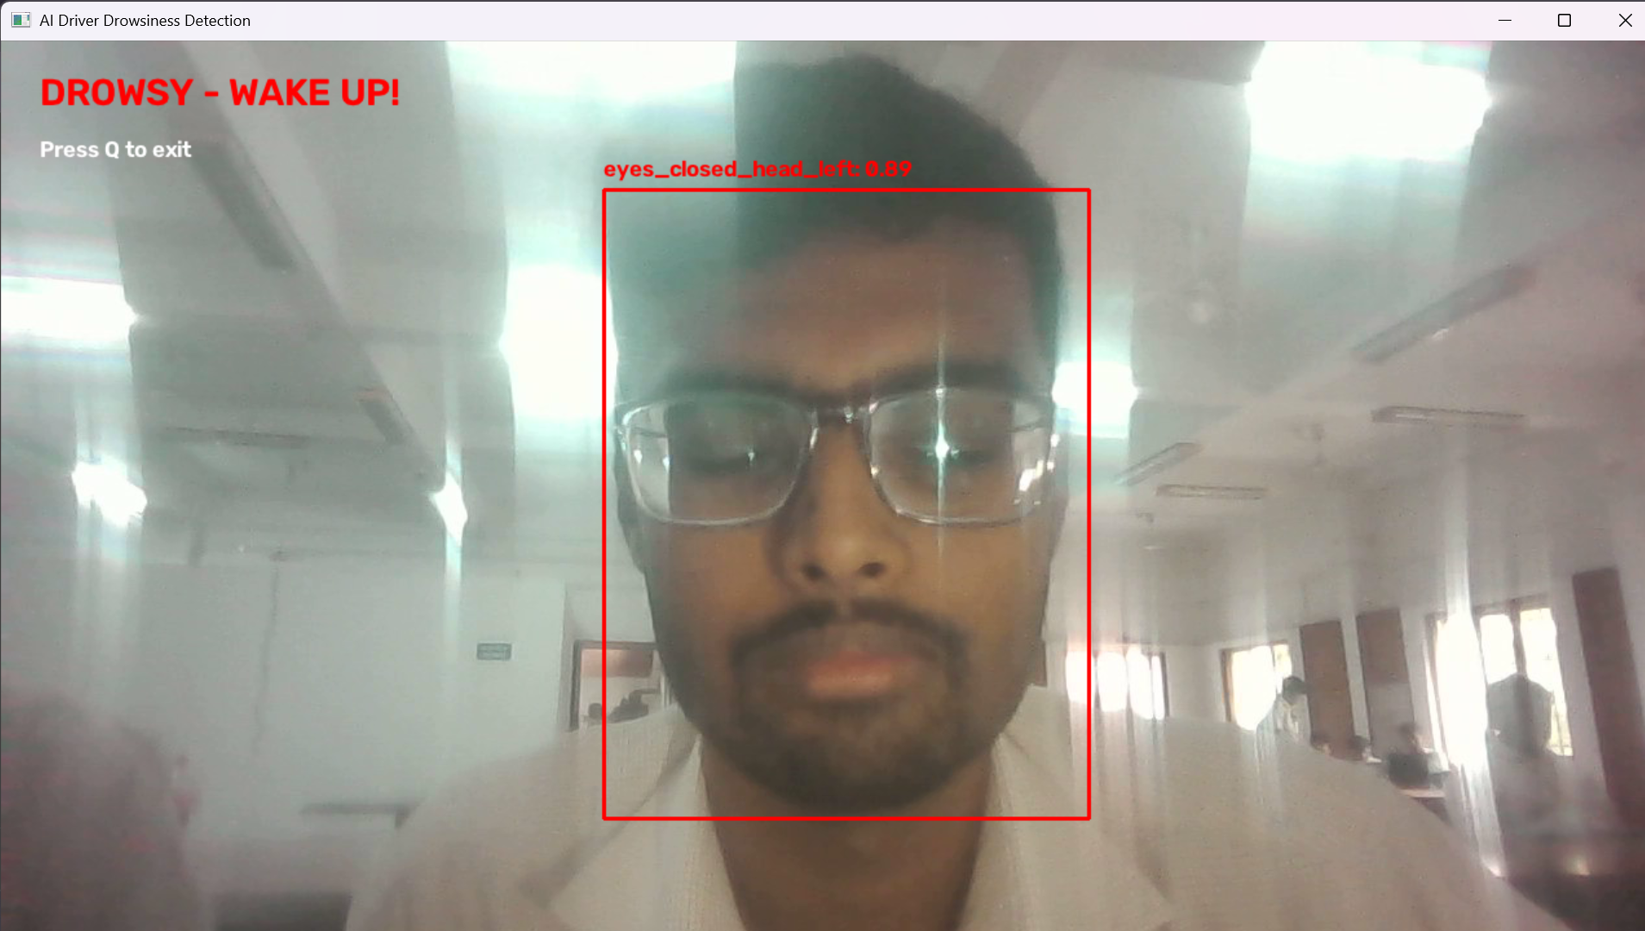

Slide 16
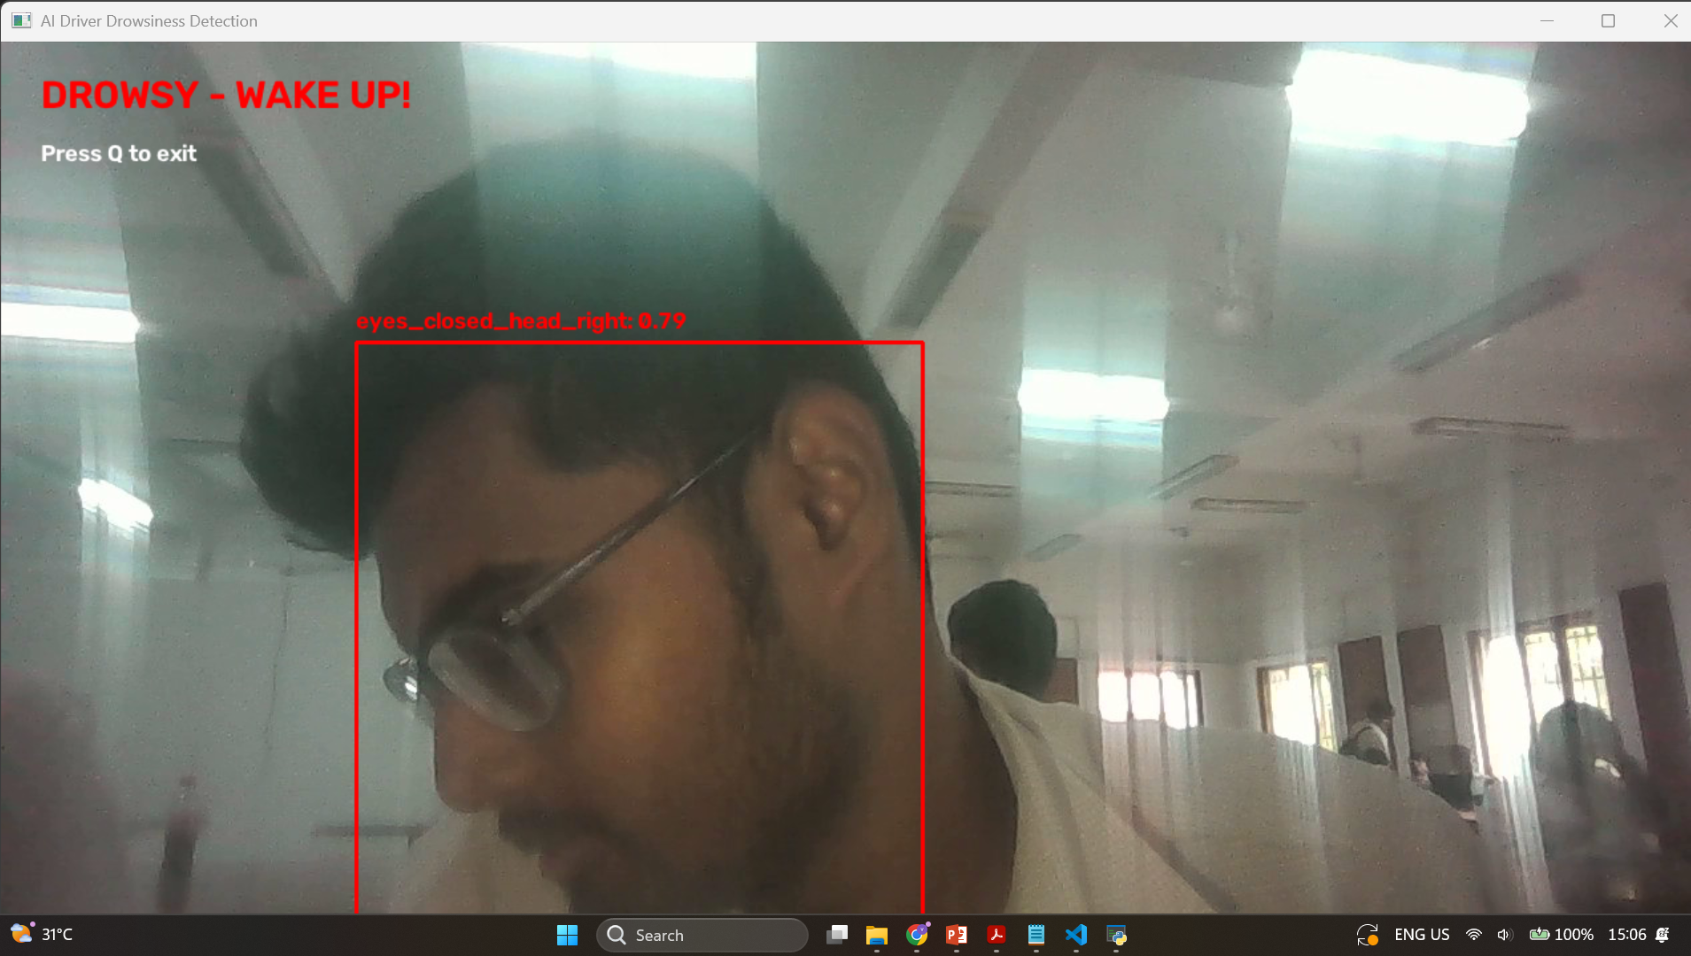

Slide 17
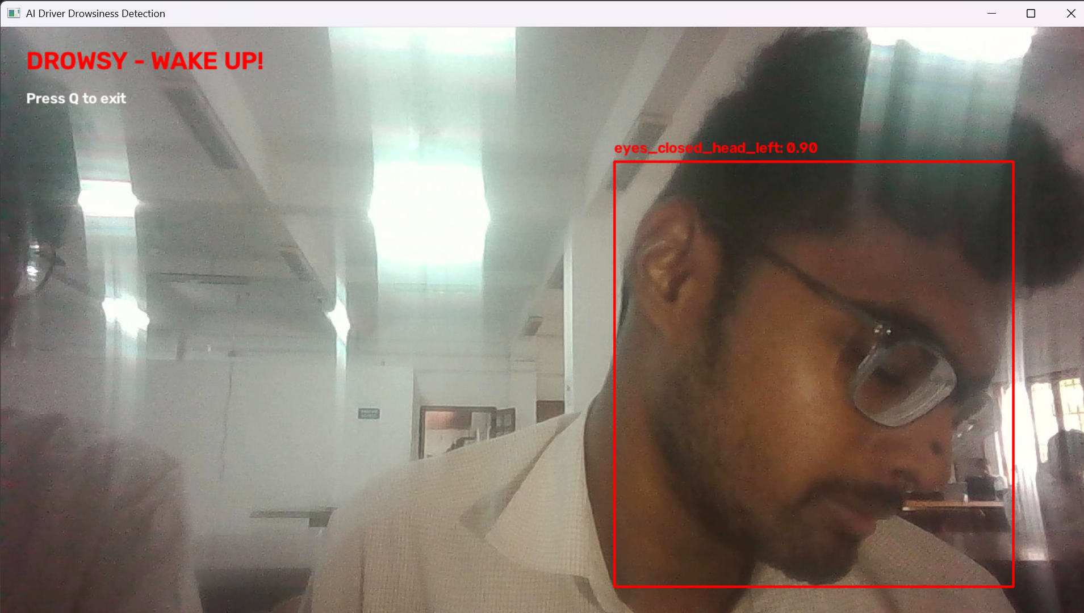

Slide 18
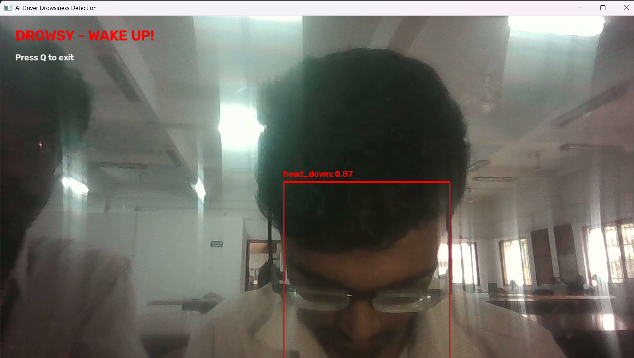

Slide 19
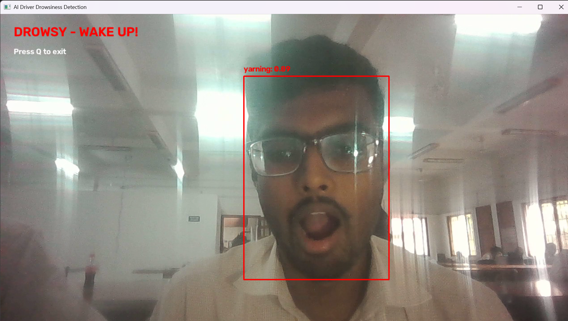

Slide 20
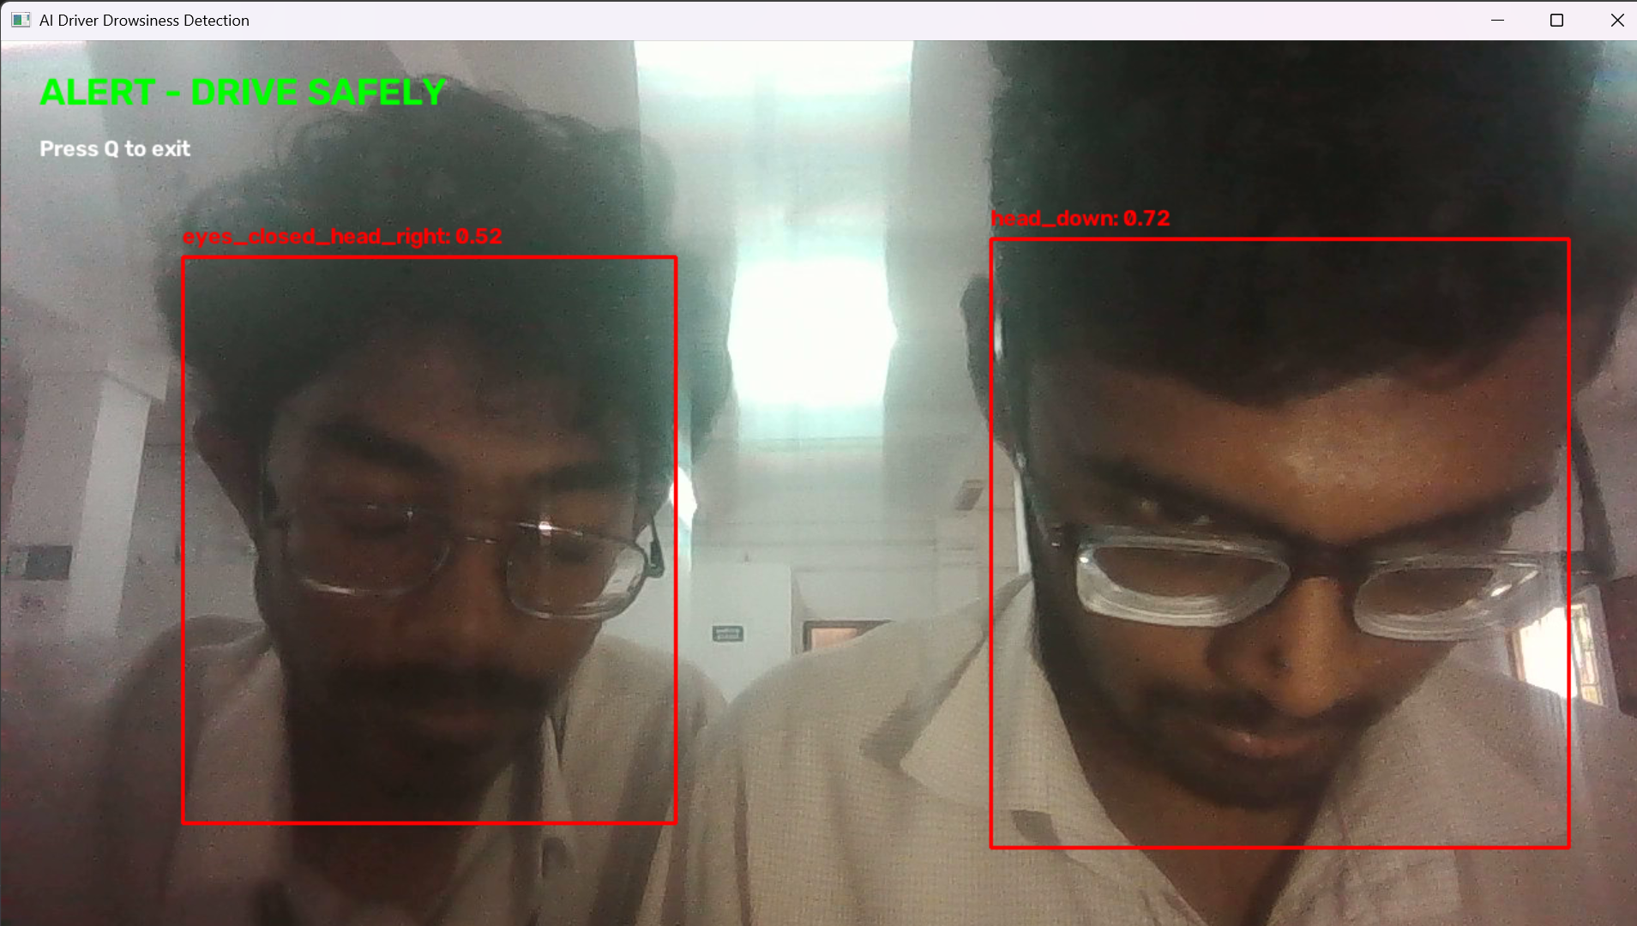

Slide 21
Conclusion
A nine-class YOLOv8s detector plus a 1.0–1.5 s timer gives a practical drowsiness alarm.
Validation: P 0.977, R 0.982, mAP@0.5 0.991, mAP@0.5:0.95 0.960 at the best epoch.
Smooth convergence and no overfitting in the recorded 72 epochs.
Audit fixed the training pipeline; test-set evidence comes from the next run.
Thank you

