Slide 2
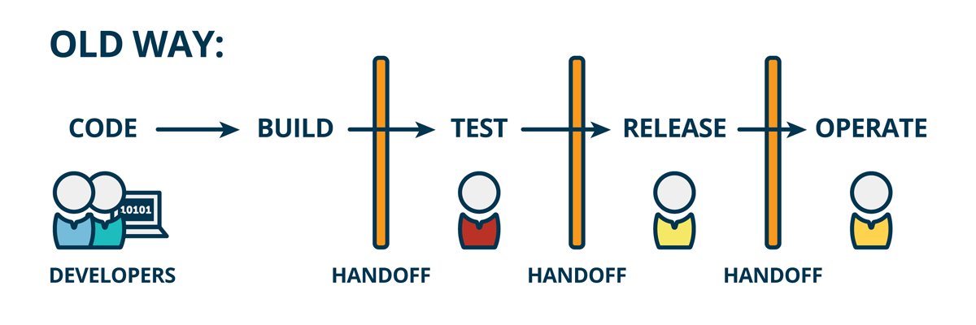
Traditional software development process

Slide 3
drawbacks
Infrequent code integration → Infrequent builds → tough debugging → More time
Less number of releases → Tested only a few times → Poor Quality
Code + {Integrate, Build, Test}
Repetitive Labor Work of Integrating, Building and Testing the code

Slide 4

Continuous integration & continuous deployment

Slide 5
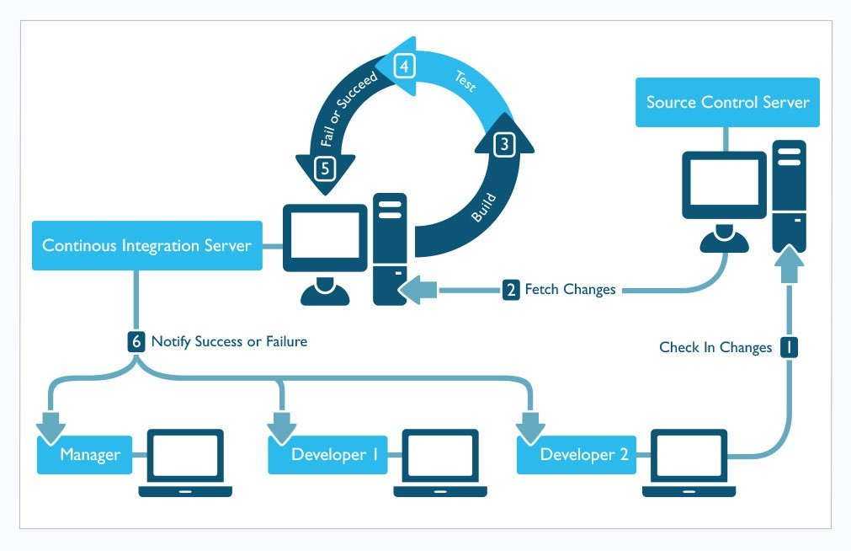

Slide 6
drawbacks
Cost involved in constructing the infrastructure
Setting up the Jenkins server for every project
Inconsistencies in the development & production environment
Lack of portability
Lack of Modularity
Micro-services culture not fit for VMs
Heavy weight applications

Slide 7
My mission

Slide 8
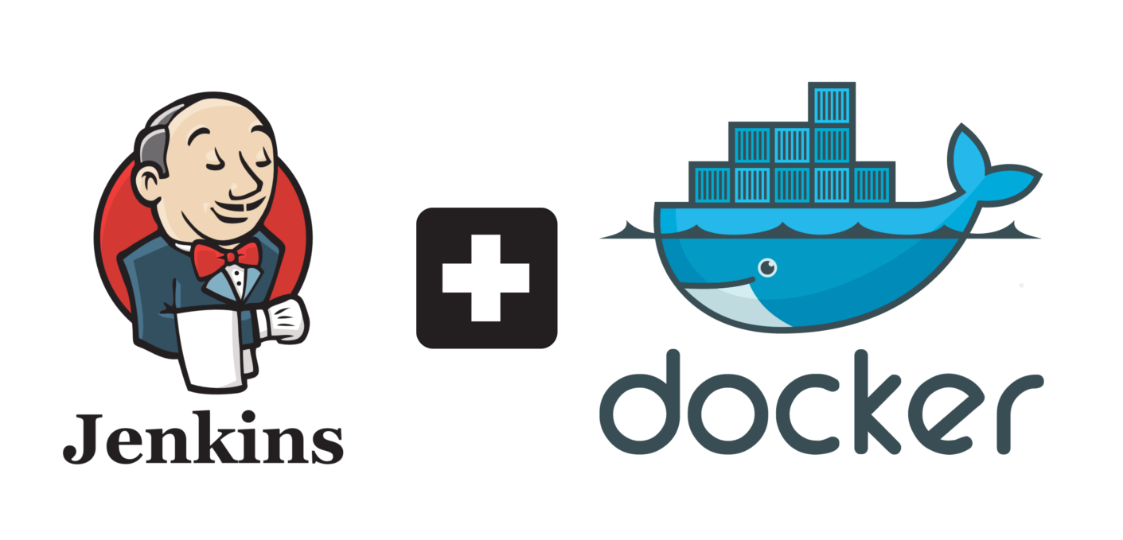
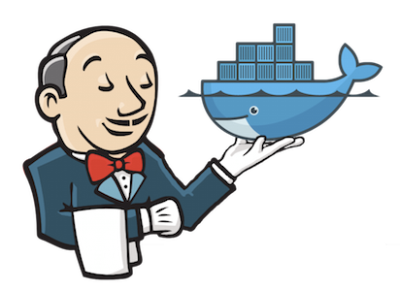
Docker with ci/cd

Slide 9
How docker solves the problem ?
Ready to use infrastructure and environment → speed → time to market.
Light weight → Improved performance
Highly portable & Modular
Isolated environment
Consistent Environment

Slide 10
Background of my work
Current scenario assunption

Slide 11
d1
config

Slide 12
d2
flow

Slide 13
demo

Slide 14
Future plan
Create an environment for
Compare my work with the traditional method on Quality, Time, Speed

Slide 15
Outcome

