Slide 1
Mid-term demonstration
Ci / cd with docker using Devops

Slide 2
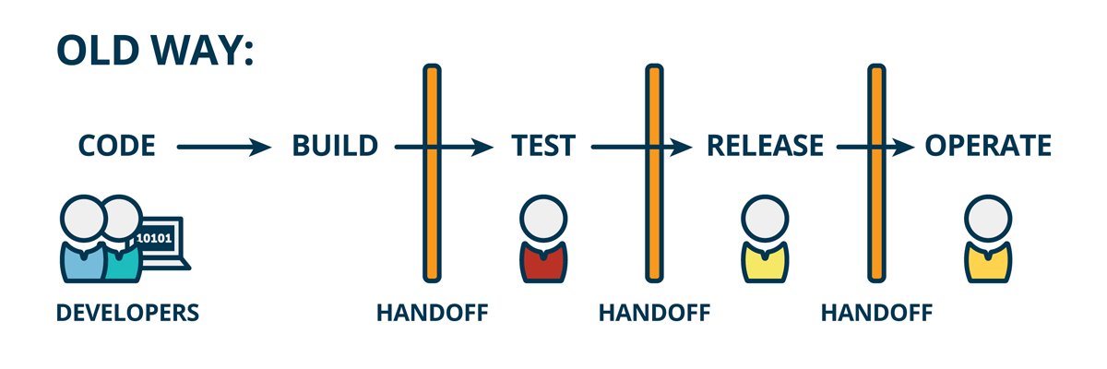
Traditional software development process

Slide 3
drawbacks
Infrequent code integration → Infrequent builds → tough debugging → More time
Less number of releases → Tested only a few times → Poor Quality
Code + {Integrate, Build, Test}
Repetitive Labor Work of Integrating, Building and Testing the code

Slide 4

Continuous integration & continuous deployment

Slide 5
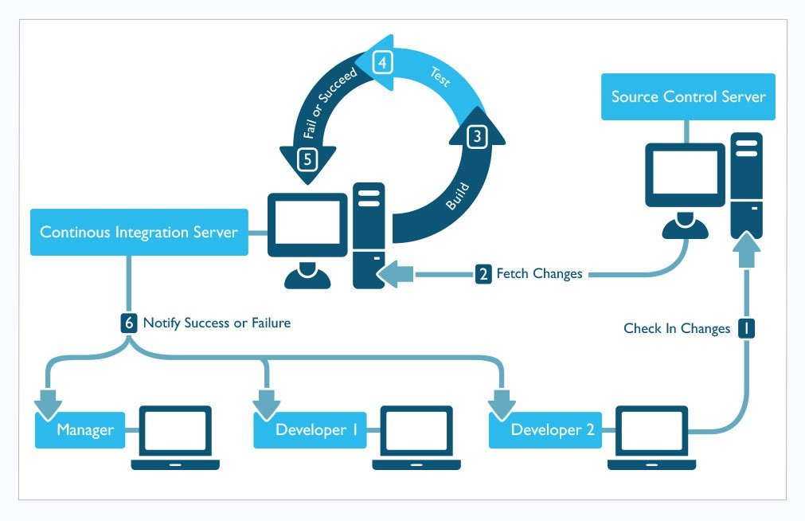

Slide 6
Problems in introducing ci/cd
Lack of portability → Increases cost of constructing the infra
Re-installing the same Jenkins configured environment for all projects separately
Increased Delivery time
Inconsistencies in the development & production environment → Difficult to maintain good Quality
Unnecessary increase in Man-hours leads to increase in cost
Micro-services culture not fit for VMs
Heavy weight applications

Slide 7
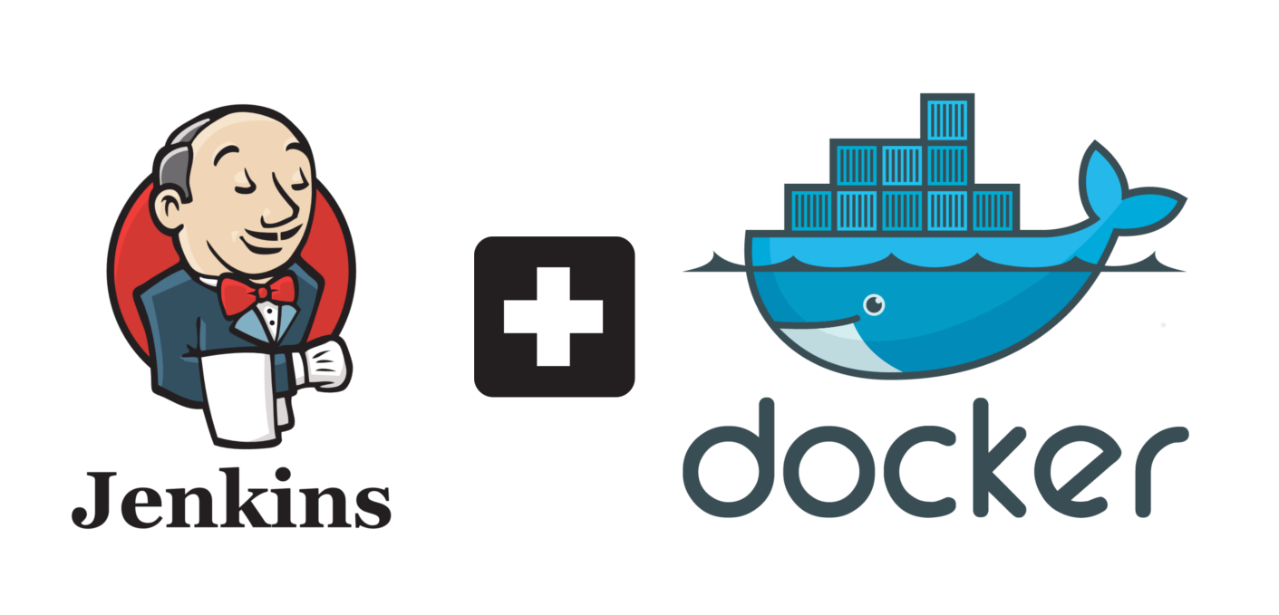
CI/CD with Docker
My mission

Slide 8
My mission
Introducing the CI/CD environment in existing projects using Docker
Creating a standard Jenkins automated environment
Compare the docker way with the traditional way for :
Cost
Quality
Delivery

Slide 9
How docker solves the problem ?
Ready to use infrastructure and environment → speed → time to market.
Light weight → Improved performance
Highly portable & Modular
Isolated environment
Consistent Environment

Slide 10
Background of my work
Java Project : Terasoluna
SCM : Gitlab
CI Server : Jenkins
Build Tool : Maven
Testing Tool :
Environment : Jenkins inside a docker container

Slide 11
d1
config

Slide 12
d2
flow

Slide 13
demo

Slide 14
Future plan
Create an environment for
Compare my work with the traditional method on Quality, Time, Speed

Slide 15
Outcome

