Slide 1
こんにちわ

Slide 2
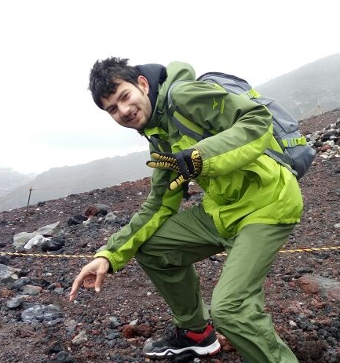
Name : Shayan Khan
Team : Advanced DevOps
Origin : Delhi, India
College : College of Engineering Pune Major : Computer Engineering
Hobbies : Bike riding, Travelling, Trekking, Basketball, Hackathons

Slide 3
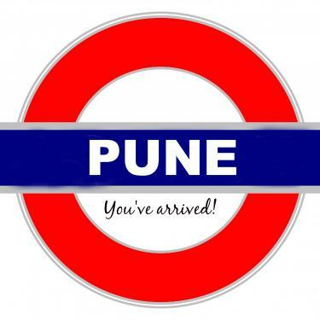
Pune
A lot of historical places to visit
A variety of food to try
Experience the traditional Pune at Dagdu Seth Mandir
Lonavala – khandala : Natural Beauty
Heavy Rain, Strong Sun During day
Use Uber & Ola to travel
Rash traffic

Slide 4
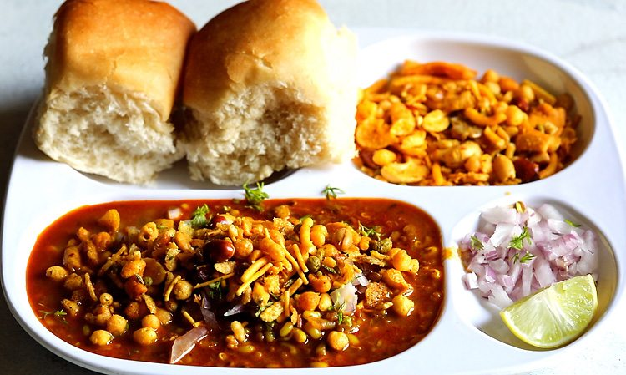
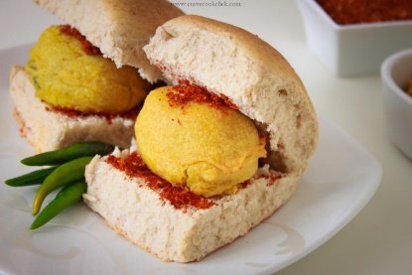
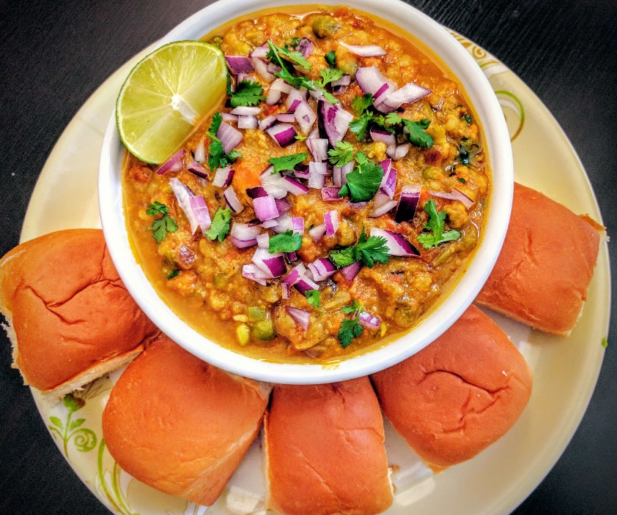

STREE FOOD
MISAL PAV
VADA PAV
PAV BHAJI
BHAKARWADI

Slide 5
Culture & Festivals
of
India

Slide 6
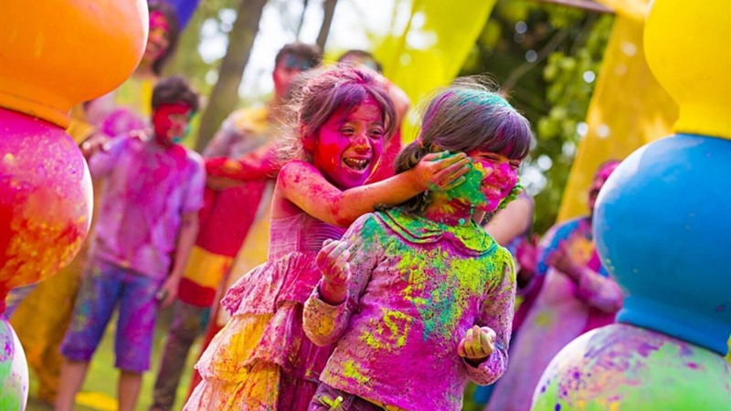
Holi
A Festival of Colours
People put ‘gulal’ & throw water on each other
Signifies arrival of spring

Slide 7
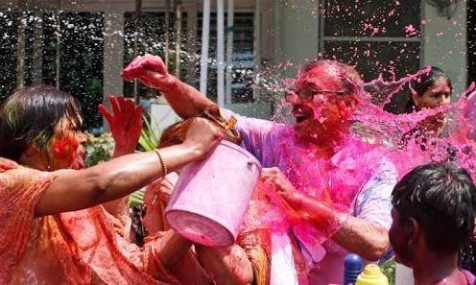

Slide 8
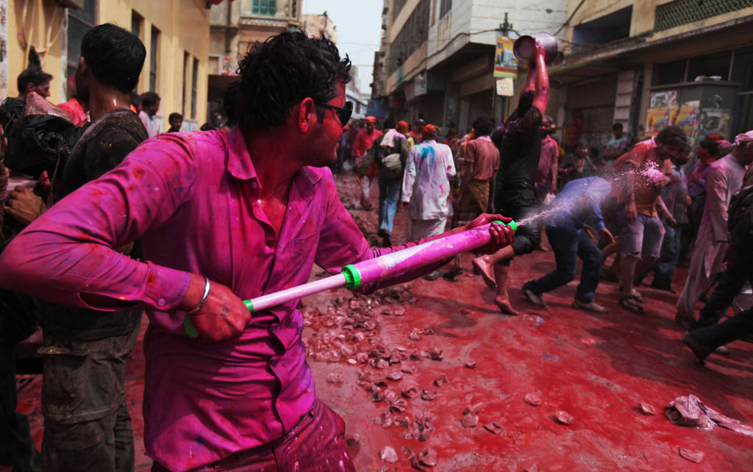
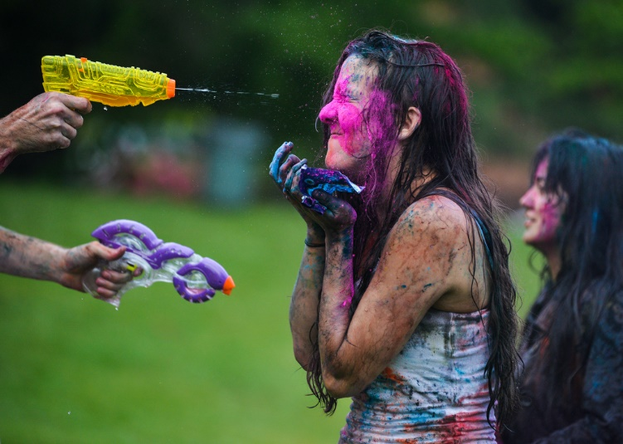
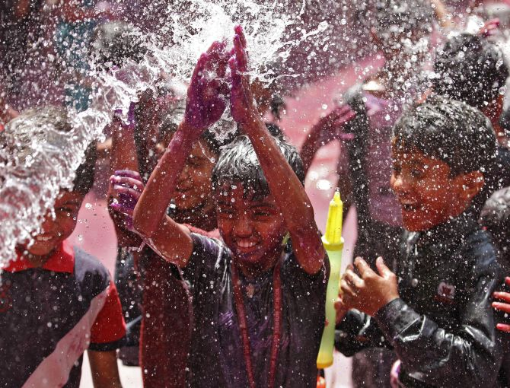
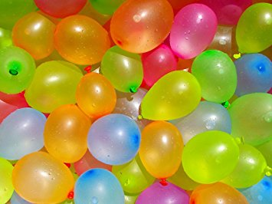

Slide 9
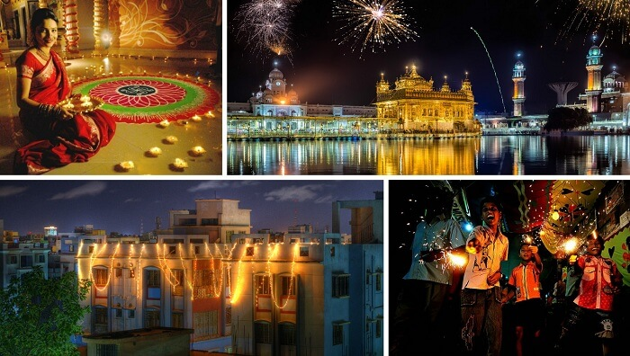
Diwali
A Festival of Lights & happiness.
Light up diyas inside and outside home.
Participate in family puja of Goddess Laxmi.
After puja, fireworks follow, People give mithai & gifts to each other.

Slide 10
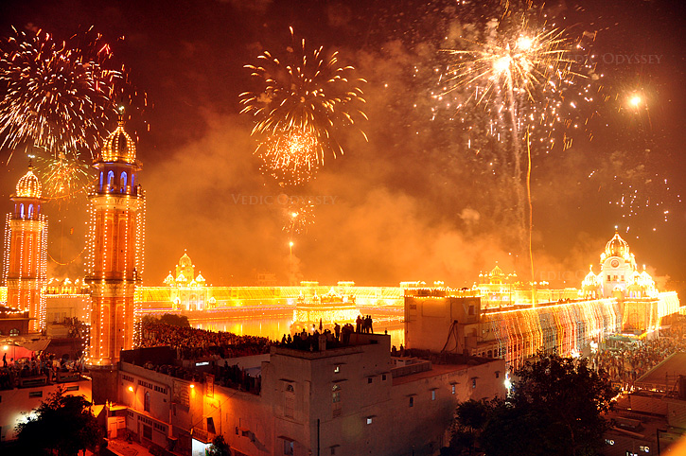

Slide 11
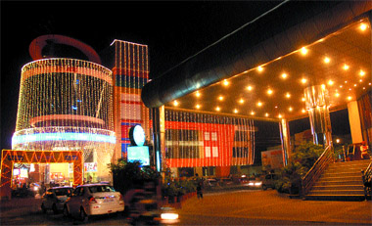
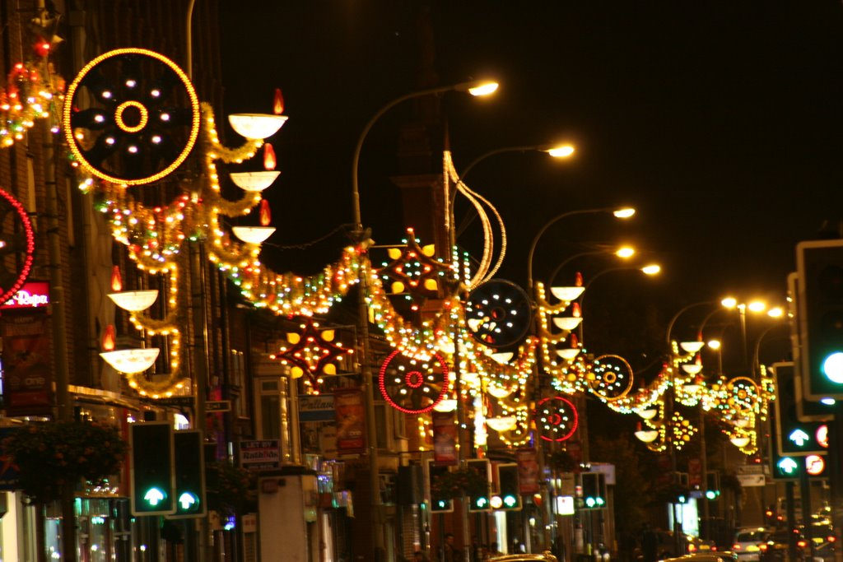
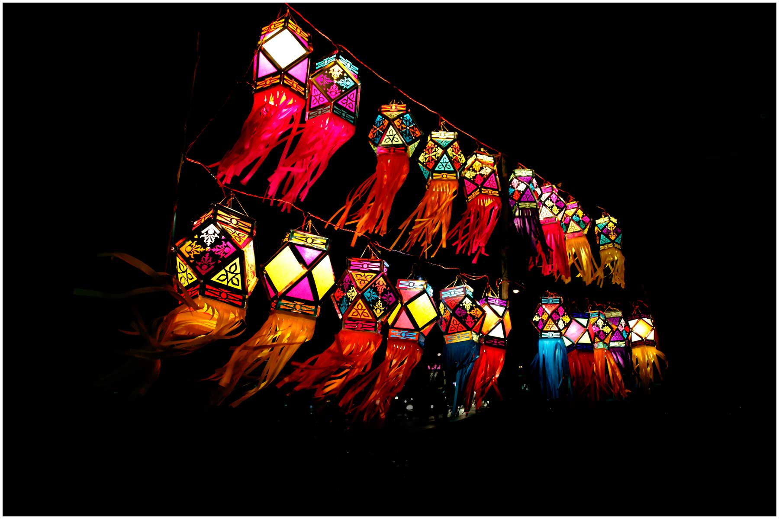
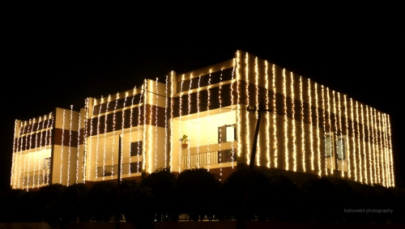

Slide 12
