Slide 1

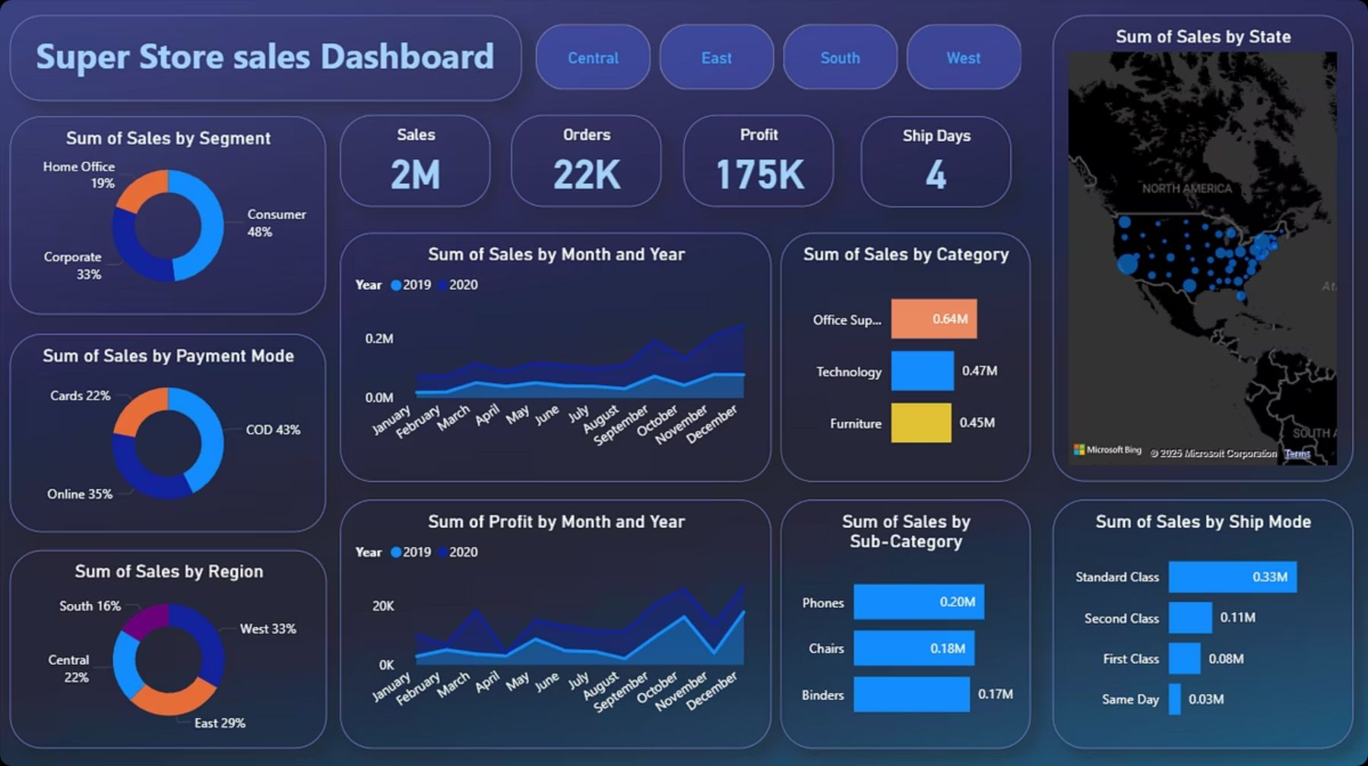
Super Store Sales Dashboard
TASK 3 : Data Analytics
Presented by : SHAAZ IBRAHEEM

Slide 2
Executive Summary: Strong Performance
$2M
22K
$175K
4
Total Sales
Orders
Total Profit
Avg. Ship Days
Achieved strong overall sales performance.
High volume of customer transactions.
Healthy profit margins across all operations.
Efficient order fulfillment.

Slide 3
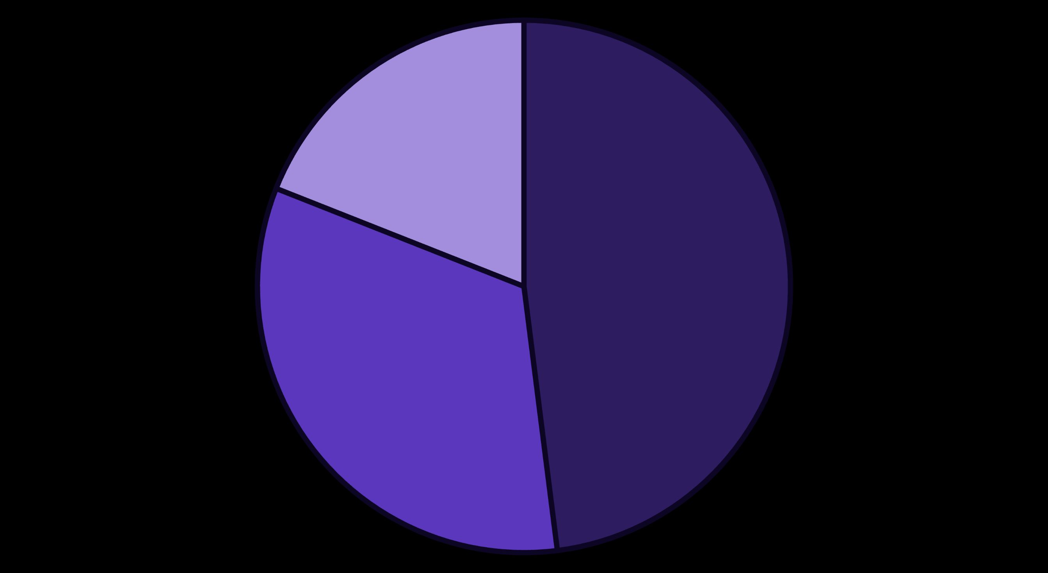
Sales Breakdown by Customer Segment
Understanding which customer segments drive our sales.
Consumer
Corporate
Home Office
Consumer segment leads at 48%, followed by Corporate at 33%, and Home Office at 19%. This distribution suggests targeted strategies for each segment can optimize sales.

Slide 4

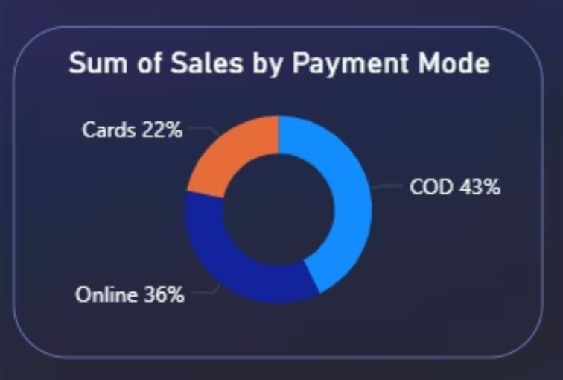


Payment Mode Preferences
Cash on Delivery (COD) remains the most preferred payment option for customers.
43%
COD
Most preferred payment method.
35%
Online
Significant portion of transactions.
22%
Cards
Lesser but still important.

Slide 5








Regional Sales Distribution
West: 33%
East: 29%
Leading the sales performance.
Strong second in sales volume.
Central: 22%
South: 16%
Consistent contribution to overall sales.
Opportunity for growth.
Sales are concentrated in the Western and Eastern U.S. states, indicating potential for expansion and targeted campaigns in the Central and Southern regions.

Slide 6
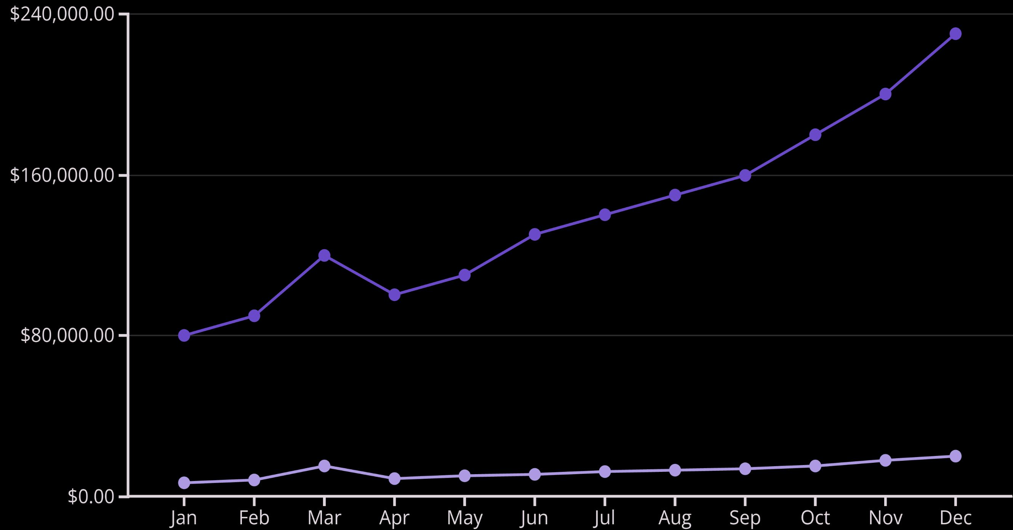
Monthly Sales and Profit Trends (2019–2020)
Sales show a significant increase towards the end of 2020, with profit peaking in March and December of the same year.
Sales
Profit

Slide 7
Top-Performing Categories & Sub-Categories
Top Categories by Sales
Top Sub-Categories by Sales
Office Supplies: $0.64M
Phones: $0.20M
Technology: $0.47M
Chairs: $0.18M
Furniture: $0.45M
Binders: $0.17M
Office Supplies, Technology, and Furniture are our primary sales drivers, with Phones, Chairs, and Binders as top sub-categories. Focus on these areas for sustained growth and promotional efforts.

Slide 8








Shipping Mode Analysis
Standard Class is our most utilized and profitable shipping method.
Standard Class
Second Class
$0.33M
$0.11M
Same Day
First Class
$0.03M
$0.08M
This data suggests opportunities to optimize shipping costs and customer satisfaction by promoting faster shipping options where feasible.

Slide 9
Key Insights & Recommendations
01
02
03
Optimize Regional Focus
Enhance High-Profit Categories
Refine Shipping Strategies
Allocate marketing resources to Central and Southern regions to balance sales distribution and unlock new growth opportunities.
Evaluate the cost-effectiveness of Same Day and First Class shipping. Consider tiered shipping incentives to encourage customer upgrades while maintaining profitability.
Prioritize inventory and promotions for Office Supplies, Technology, and Furniture, and their top sub-categories like Phones and Chairs, to maximize profit margins.

Slide 10
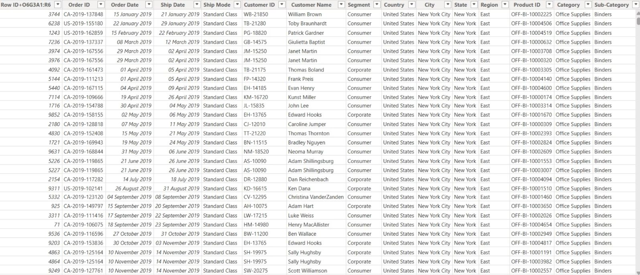
Next Steps: Driving Future Growth
Q1 Review: Analyze sales and profit performance against these recommendations.
Cross-Functional Workshops: Align marketing, operations, and supply chain on regional and category strategies.
Dashboard Enhancements: Integrate more granular data points for deeper insights into customer behavior and regional performance.
Pilot Programs: Test new promotional strategies in underperforming regions or for specific product categories.

