Slide 1
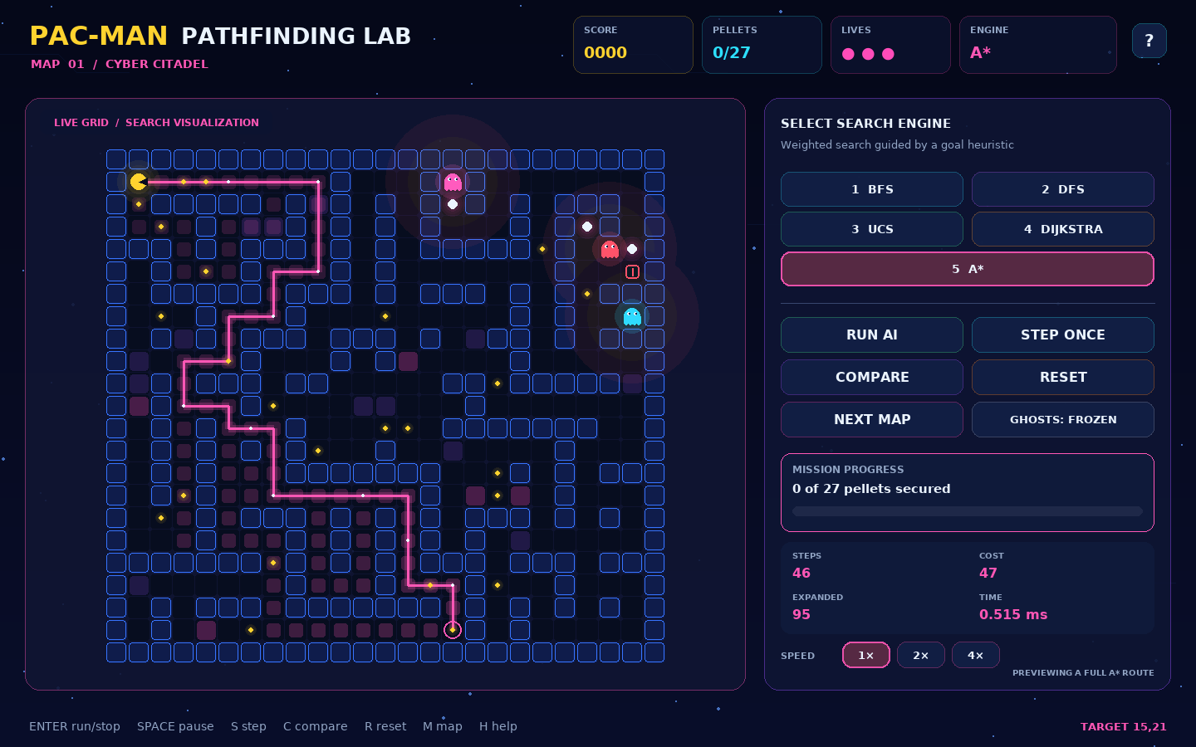
OPTIMIZED
PAC-MAN
PATHFINDING
Interactive artificial intelligence search demonstration
BFS, DFS, UCS, Dijkstra, and A*
LIVE ROUTE VISUALIZATION
Explored nodes, route cost, timing, and algorithm controls
Python 3.10+ with Pygame Community Edition
Notes:
Introduce the project as an interactive comparison of five classical search algorithms.

Slide 2
Costs, constraints, and moving hazards
02
Problem statement
A route with fewer steps can cross expensive terrain or move too close to a ghost.
Competing objectives
Objective | What it optimizes | Limitation
Fewest steps | Number of moves | Ignores weighted risk
Lowest cost | Terrain and danger | May use more steps
Live safety | Current ghost positions | Needs replanning
Full mission | All pellets and exit | Requires repeated searches
Walls remove possible moves and create dead ends.
Each collected pellet creates a new search goal.
Terrain and ghost proximity change movement cost.
Moving ghosts can invalidate a previously safe route.
The project must expose these trade-offs instead of reporting only one final path.

Slide 3
Search and replanning workflow
03
Proposed solution
Every walkable cell becomes a graph node. Legal horizontal and vertical moves become edges.
1
2
3
4
5
Load map
Choose target
Run search
Move
Replan
Generate and validate a connected maze
Select a pellet or the unlocked exit
Apply the selected algorithm and costs
Advance one cell and update game state
Search again when the route ends or blocks
Output: explored cells, selected route, step count, weighted cost, frontier peak, and planning time

Slide 4
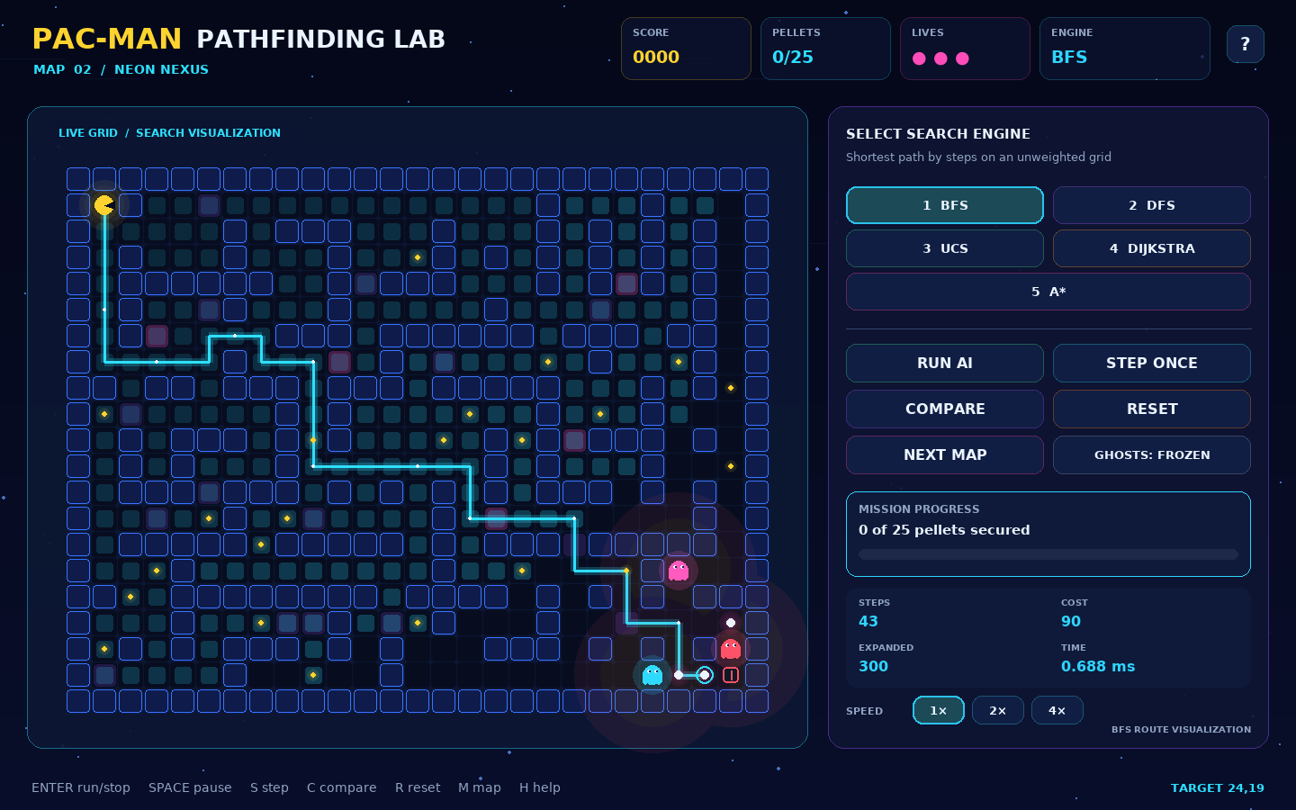
Interactive pathfinding laboratory
04
Key features
The demo supports
Animated explored cells and current route
Three deterministic, replayable mazes
Moving ghosts with automatic replanning
Pellets, power mode, lives, score, and exit
Pause, single-step, speed, reset, and map controls
Fair same-snapshot algorithm comparison
The interface makes internal search behavior visible during the game.

Slide 5
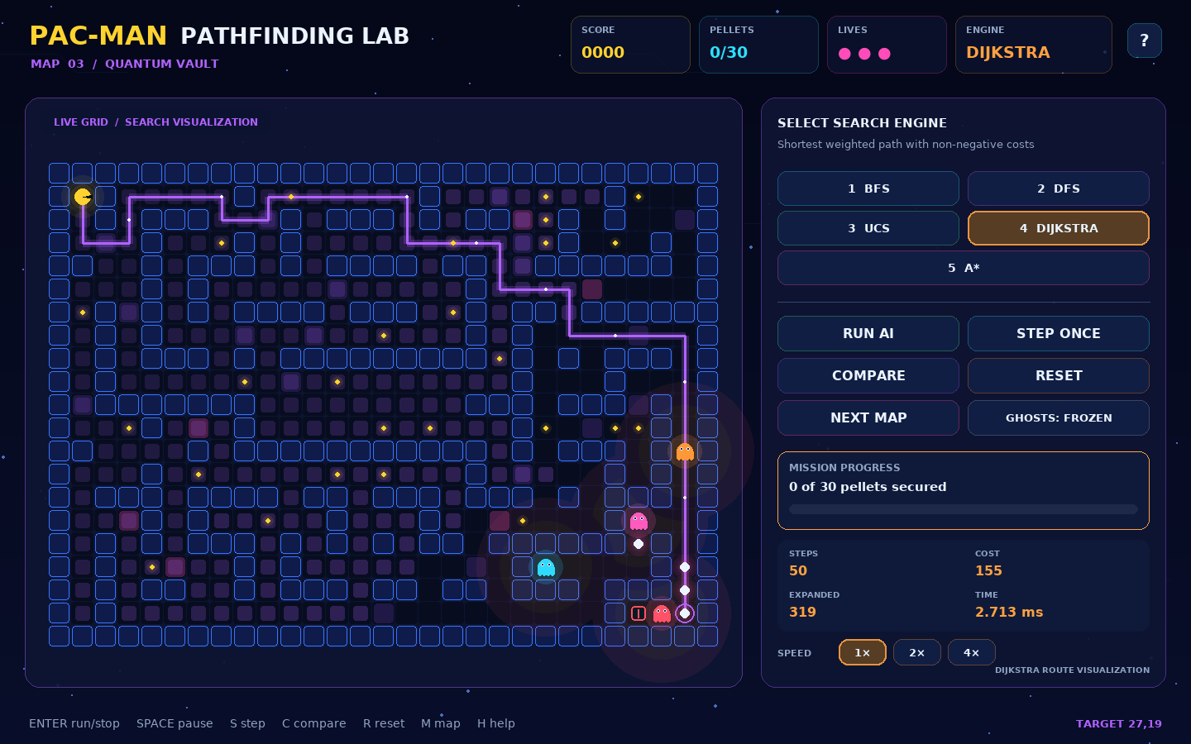
Grid state and movement cost
05
Search representation
State
(x, y) with up to four valid neighbors
Weighted step
step_cost = terrain_cost + ghost_danger
Ghost danger penalty
Distance | 0 | 1 | 2 | 3 | 4+
Added cost | 40 | 12 | 5 | 2 | 0
Terrain costs are 1, 2, or 3. BFS and DFS ignore weights while choosing a path, but the interface still reports the real cost.

Slide 6
Five algorithms, one search problem
06
Algorithm approach
Algorithm | Frontier | Uses weights | Guarantee | Best demonstration point
BFS | Queue | No | Fewest steps | Unweighted baseline
DFS | Stack | No | Finds a path | Non-optimal exploration
UCS | Min-heap | Yes | Minimum cost | Accumulated path cost
Dijkstra | Min-heap | Yes | Minimum cost | Shortest-distance model
A* | Min-heap + h | Yes | Minimum cost | Goal-directed search
UCS and Dijkstra normally match here because the grid has non-negative costs, one source, and one target. Separate implementations support syllabus comparison.

Slide 7
System architecture
07
Module responsibilities and data flow
Pygame interface
Why this separation matters
app.py • ui.py
Search code does not depend on Pygame.
Tests can use a tiny in-memory grid.
Maps can change without rewriting algorithms.
UI changes do not alter path correctness.
New algorithms use the same SearchProblem contract.
Game state and planning
session.py • planner.py
Search engine
algorithms.py
Maze, models, and configuration
maze.py • models.py • JSON maps
SearchProblem(start, goal, neighbors, step_cost)

Slide 8
Programming language and technologies
08
Implementation stack
PYTHON
Pygame CE 2.5.6
Window, graphics, input, timing, and optional audio
3.10+
JSON
Readable deterministic map configurations
SearchProblem(
start=(x1, y1),
goal=(x2, y2),
neighbors=maze.neighbors,
step_cost=cost_function
)
Python standard library
dataclasses, enum, heapq, deque, and timing
unittest and pytest
Automated algorithm, map, and session verification
Git and GitHub
Branch-based collaboration and code review
No API key, database, or network service is required.

Slide 9
Role-based task assignment
09
Ownership without personal identifiers
Owner role | Primary responsibility | Required cross-review
Integration lead | Architecture, branches, releases, final build | Game-state integration
Search lead A | BFS, DFS, UCS, and algorithm tests | Dijkstra and A* behavior
Search lead B | Dijkstra, A*, cost model, and metrics | BFS, DFS, and UCS behavior
Interface lead | Pygame UI, animation, controls, and readability | Gameplay and demo flow
Quality lead | Maps, game rules, testing, documentation, rehearsal | Acceptance checklist
Shared familiarity requirement
Every contributor should explain the graph model, queue versus stack versus priority queue, the cost function, the A* heuristic, UCS–Dijkstra equivalence, and one automated test.

Slide 10
Three-week implementation roadmap
10
Milestones and deliverables
 | Week 1: Search foundation | Week 2: Game integration | Week 3: Validation and presentation
Main work | Problem model, five algorithms, path reconstruction, map validation | Game rules, dynamic ghosts, route visualization, controls | Cross-platform tests, visual QA, documentation, rehearsal
Milestone | Every engine returns a valid SearchResult on connected maps | Pac-Man completes a static mission and replans around movement | A clean ZIP installs, passes tests, and supports a five-minute demo
Deliverables | Algorithms, models, maps, and unit tests | Playable application, comparison screen, and screenshots | README, report, viva guide, test log, and final release
Completion gate: every owner runs the tests, opens the game, explains an assigned module, and signs the shared familiarity checklist.

Slide 11
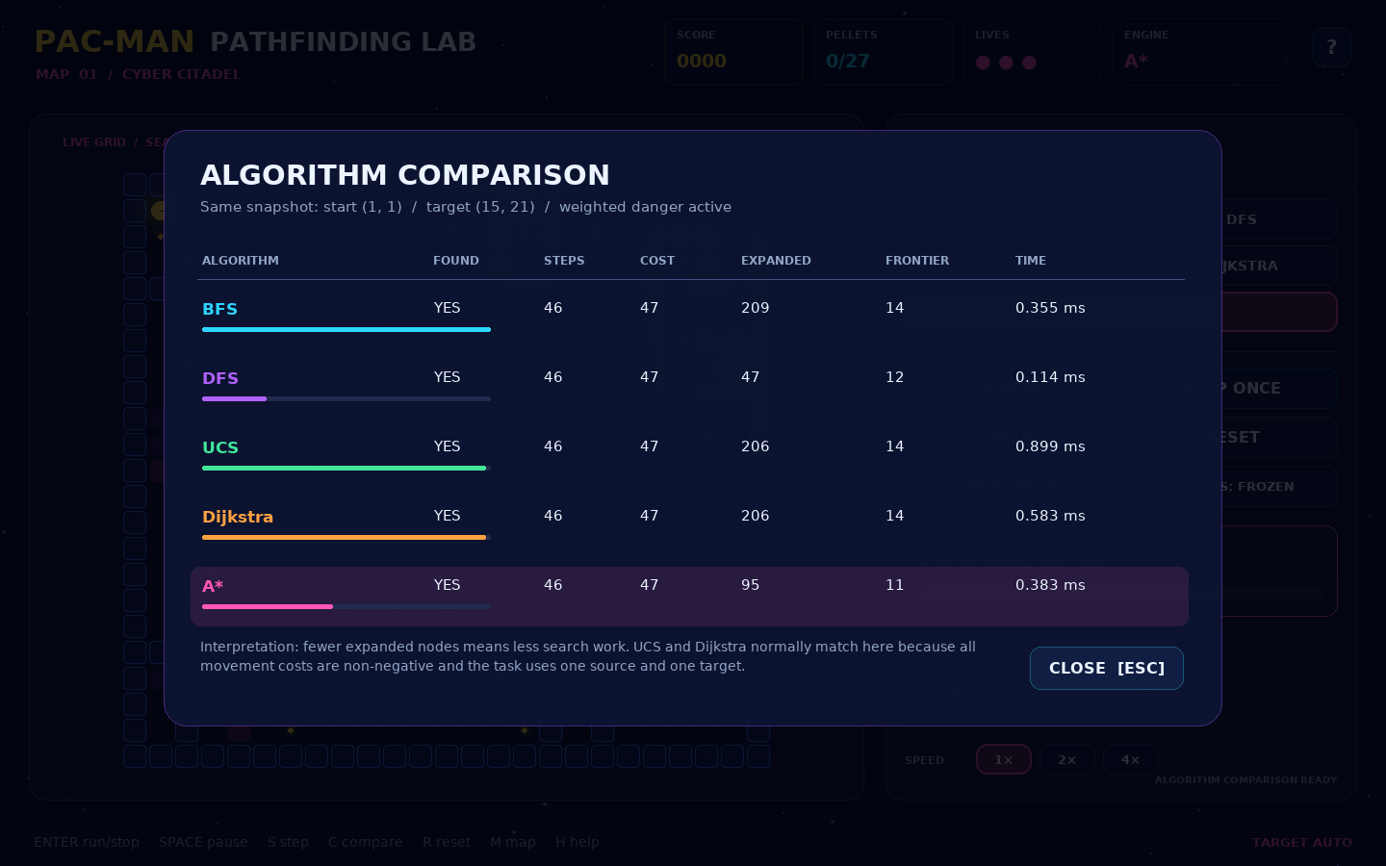
Verified demonstration results
11
Controlled first-map run with ghosts removed for repeatability
Algorithm | Steps | Cost | Expanded
BFS | 250 | 272 | 1,168
DFS | 664 | 706 | 4,137
UCS | 252 | 260 | 1,093
Dijkstra | 252 | 260 | 1,093
A* | 252 | 260 | 624
10/10
624
automated tests passed
A* expanded nodes
Single-target comparison screen
The controlled result shows the expected trade-off: BFS used fewer steps, weighted methods reduced cost, and A* reduced search work.
Notes:
Clarify that these figures describe the packaged map and controlled configuration, not every possible maze.

