Slide 1
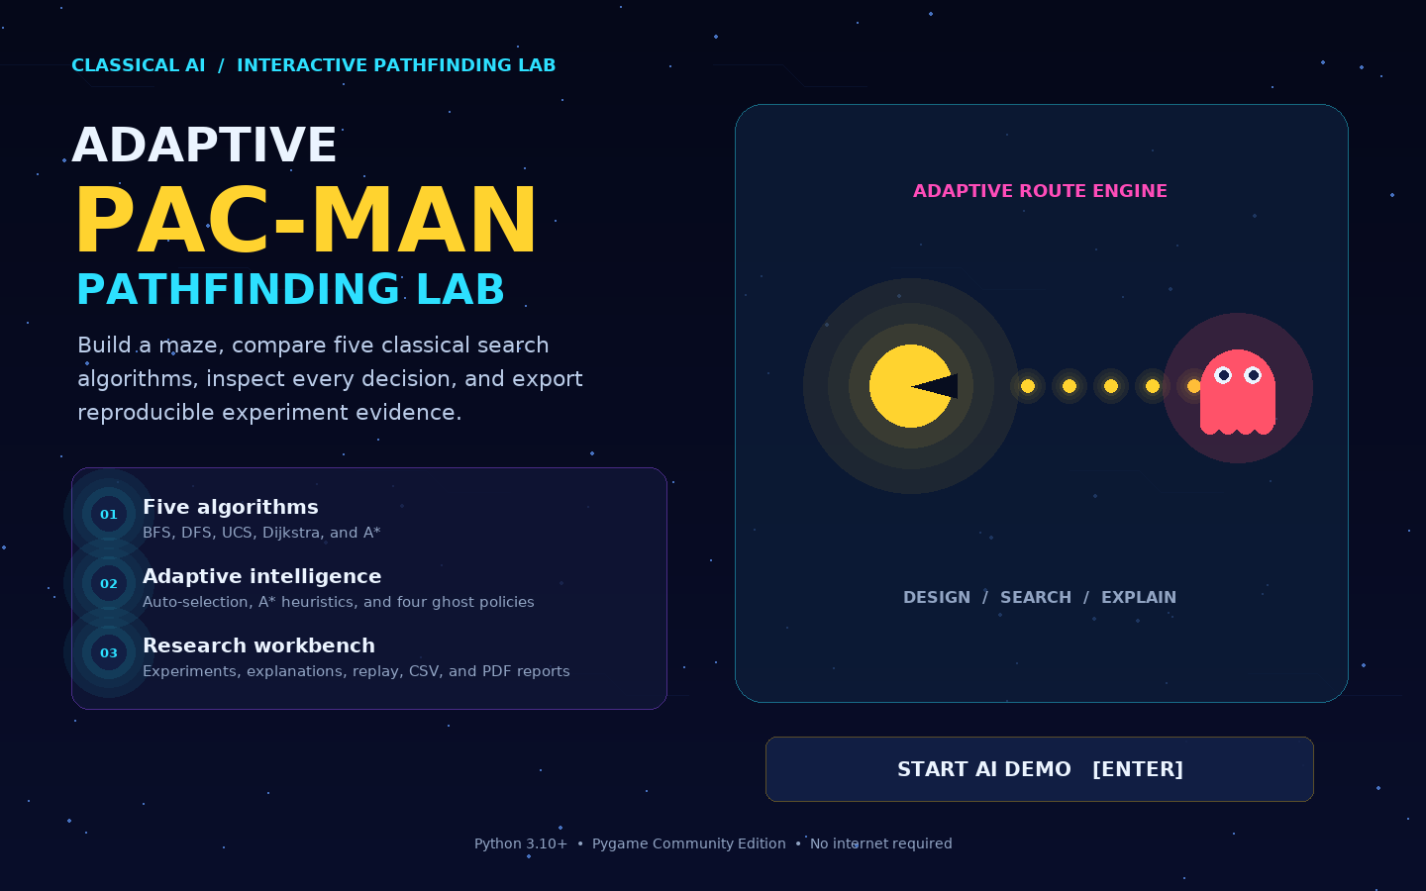
UPGRADED AI LAB PROJECT
ADAPTIVE
PAC-MAN
AI PATHFINDING LAB
A polished playable game and transparent search laboratory
BFS • DFS • UCS • Dijkstra • A* • AUTO
Map Studio | Heuristic Lab | Replay | CSV + PDF evidence
ESTABLISHED OUTCOME
Play a mission, inspect every search decision, build a map, compare algorithms, then export proof.
Python 3.10+ with Pygame CE
Notes:
Introduce the project as both a finished Pac-Man-style game and an AI laboratory. Emphasize that every feature shown in this deck exists in the delivered project.

Slide 2
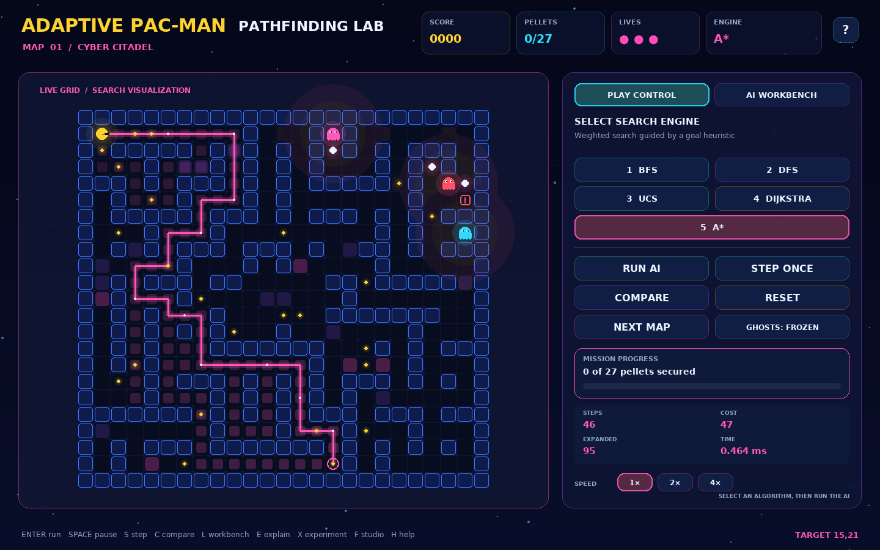
The game is a live decision problem
02
Problem statement
01
Shortest is not always safest
A low-step route can pass through expensive terrain or a ghost danger zone.
02
The world changes after planning
Moving ghosts can invalidate a route, so the agent must detect risk and replan.
03
One score hides the AI trade-off
A useful demo must expose cost, steps, explored nodes, frontier size, and timing.
Goal
Build an agent that reaches the exit safely and explainably while allowing fair, repeatable algorithm comparison.
Notes:
Explain the three problems: weighted movement cost, dynamic ghost danger, and the need for transparent comparisons. Point to the live overlays in the screenshot.

Slide 3
Observe, search, move, and replan
03
Core AI workflow
1
2
3
4
5
OBSERVE
MODEL COST
SELECT
SEARCH
ACT
Read Pac-Man, pellets, terrain, exit, and ghost positions.
Combine terrain weight with distance-based ghost danger.
Use the chosen solver or let AUTO select one.
Generate route, cost, explored order, and metrics.
Move one cell, collect, detect change, and repeat.
REACTIVE LOOP
A ghost movement, blocked route, or collected target triggers a fresh search. The plan is never treated as permanently valid.
Notes:
Walk from left to right. The important distinction is that planning repeats during play. A route is evidence for the next move, not a fixed script for the entire mission.

Slide 4
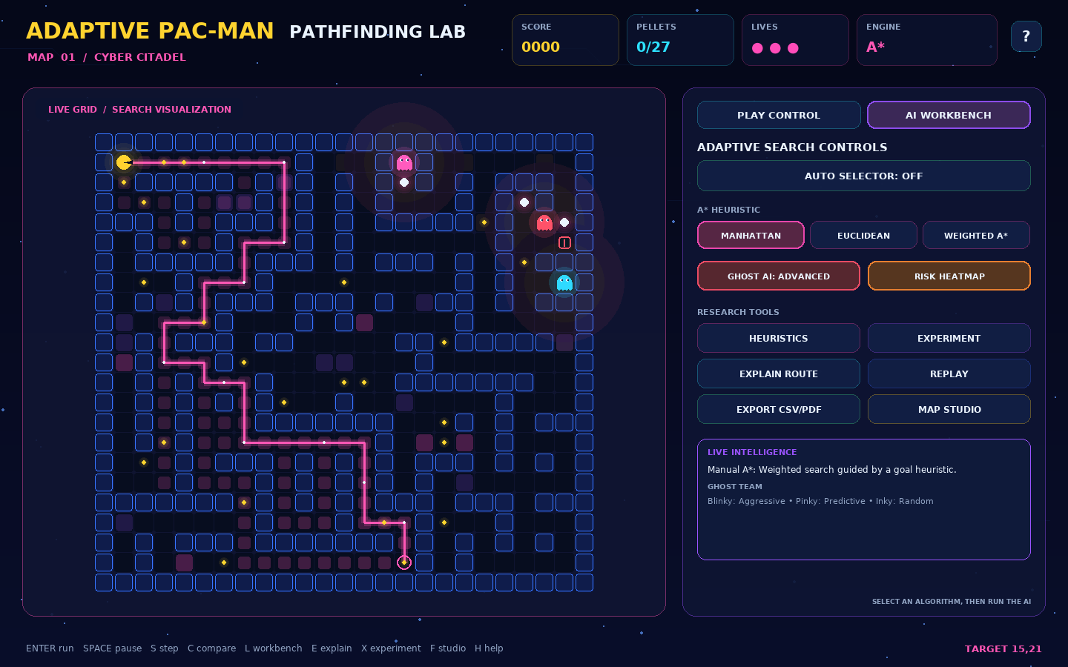
One application, two complementary experiences
04
Playable game plus AI Workbench
PLAY CONTROL
Animated Pac-Man, pellets, power mode, lives, score, and mission exit
Aggressive, predictive, random, and defensive ghost behaviors
Route animation, explored cells, frontier, and risk heatmap
AI WORKBENCH
BFS, DFS, UCS, Dijkstra, A*, and adaptive AUTO selection
Heuristic comparison and five-scenario experiment runner
Explanation, replay, CSV, JSON, and polished PDF export
Notes:
Show that the interface is not only visual polish. The Play Control tab supports the game loop, while the AI Workbench exposes algorithms, experiments, explanations, and exports.

Slide 5
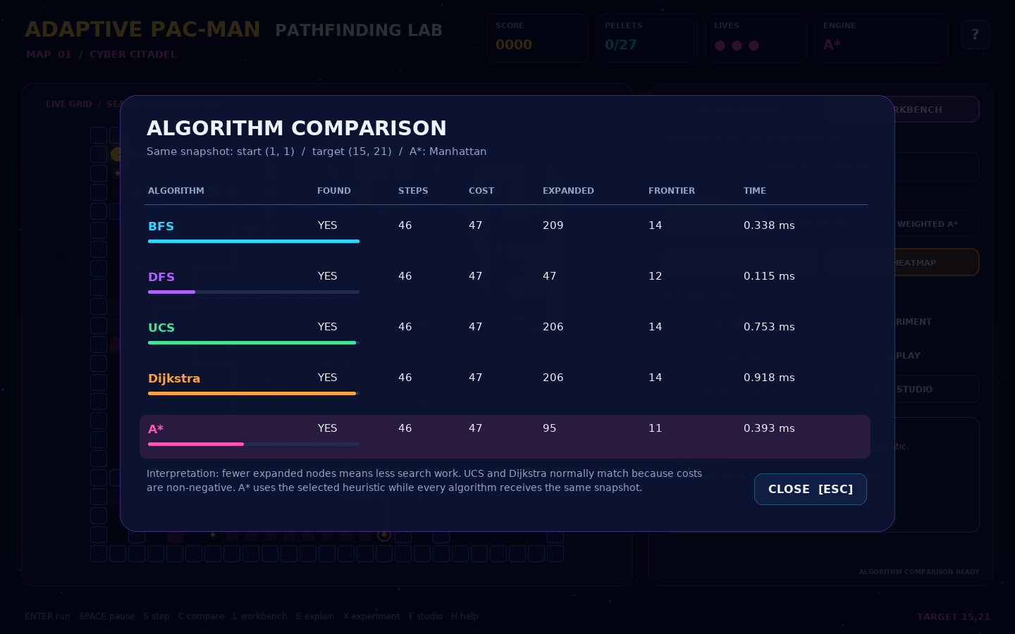
The same grid supports different definitions of better
05
Cost model and fair comparison
Movement cost model
step cost = terrain cost + ghost danger
Input | Purpose | Typical effect
Terrain | Weighted floor cells | Cost 1, 2, or 3
Ghost distance | Dynamic safety penalty | Higher near ghosts
Walls | Movement constraint | Node is unavailable
Target | Pellet or exit | Ends current search
The dashboard compares route steps, weighted cost, explored nodes, frontier peak, and search time without changing the problem between runs.
Fair snapshot rule
Every solver receives the same start, target, walls, terrain, and ghost state.
Notes:
Explain the cost function. BFS and DFS ignore weights while choosing a path. UCS, Dijkstra, and A* use non-negative weighted cost. Fair comparison requires an identical frozen game state.

Slide 6
Five algorithms plus an adaptive mode
06
Algorithm portfolio
Mode | Frontier | Uses weights | Guarantee | Best teaching point
BFS | Queue | No | Fewest steps | Unweighted shortest path
DFS | Stack | No | Finds a path | Fast exploration can be non-optimal
UCS | Min-heap | Yes | Minimum cost | Accumulated path cost
Dijkstra | Min-heap | Yes | Minimum cost | Classic shortest-distance search
A* | Min-heap + h | Yes | Optimal with admissible h | Goal-directed informed search
AUTO | Rule-based | Context | Chooses a solver | Adapts to weights and board size
UCS and Dijkstra usually match here because the grid has non-negative costs, one start, and one target. Separate implementations support syllabus comparison.
Notes:
Compare the data structures and guarantees. Clarify the UCS and Dijkstra relationship. AUTO is a transparent selection rule, not a new search algorithm.

Slide 7
A* can trade exploration for speed
07
Heuristic laboratory using five repeatable scenarios
MANHATTAN
Grid-aware and admissible for four-direction movement.
EUCLIDEAN
Straight-line estimate. It remains admissible but is less grid-specific.
WEIGHTED A*
Uses 1.65 × Manhattan. It explored fewer nodes in this sample, but optimality is not guaranteed.
Sample means are generated by the included deterministic experiment runner.
Notes:
Use the editable chart to compare the three implemented heuristic modes. Manhattan preserves the standard optimal A* property. Weighted A* is intentionally more aggressive and must be described as a speed trade-off.

Slide 8
Modular architecture keeps the AI testable
08
Upgraded project structure
EXPERIENCE LAYER
Pygame UI • game scenes • Map Studio • modals
app.py | ui.py | editor.py
SESSION AND DECISION LAYER
game state • AUTO choice • ghost policy • replanning
session.py | planner.py
SEARCH AND DOMAIN LAYER
BFS • DFS • UCS • Dijkstra • A* • weighted grid
algorithms.py | maze.py | models.py
EVIDENCE LAYER
experiments • explanation • replay • CSV/PDF/JSON
experiments.py | explain.py | replay.py
Pure search logic remains independent from rendering, so 19 automated tests run without opening the game window.
Notes:
Describe the separation of concerns. Algorithms do not depend on Pygame. The session coordinates live state. Evidence modules turn AI behavior into files that can be reviewed after the demo.

Slide 9
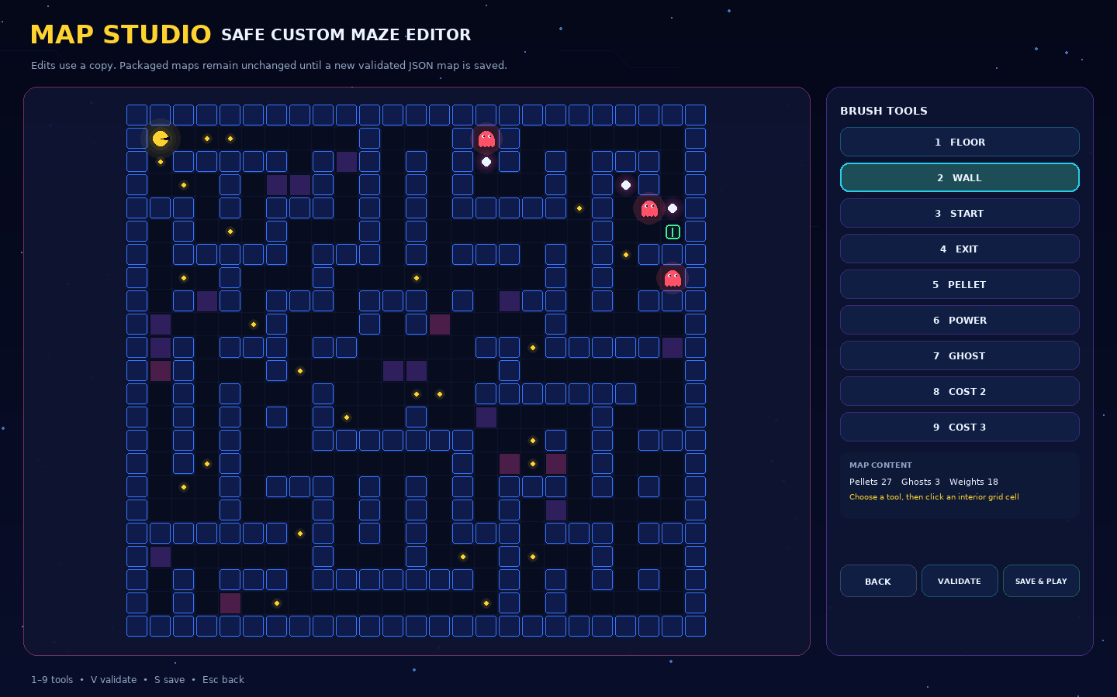
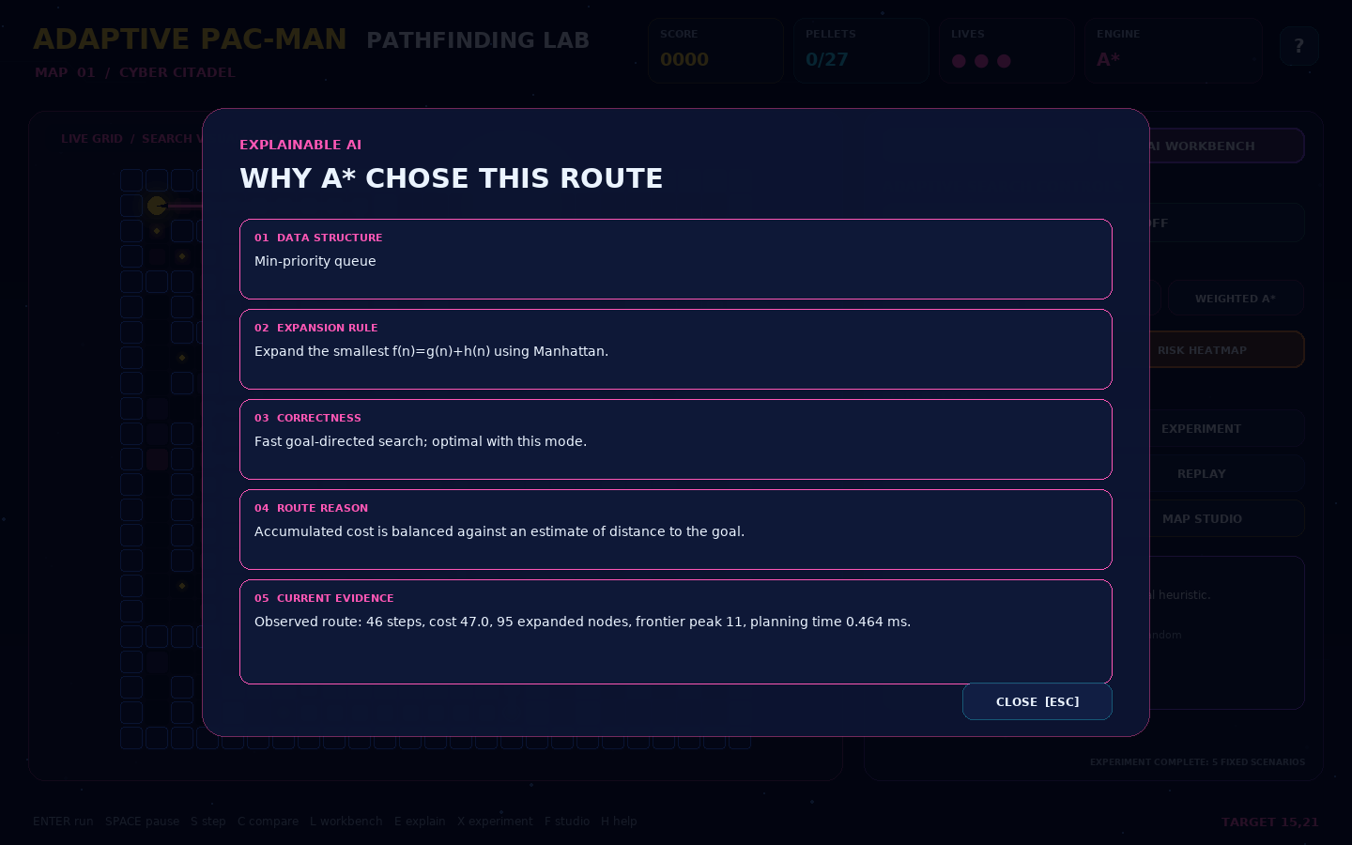
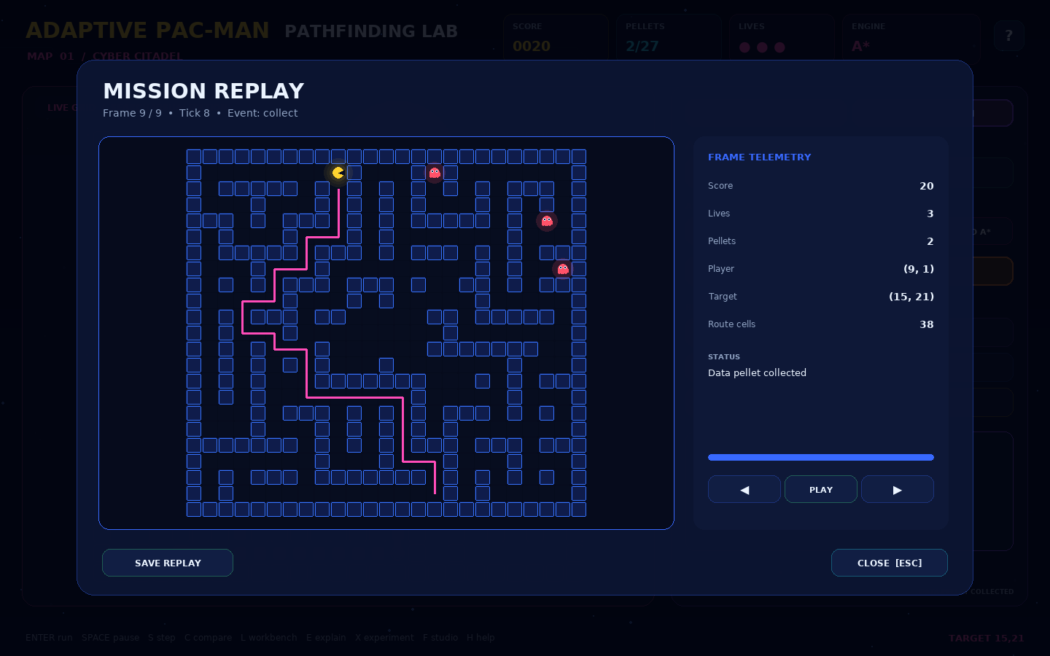
Create, explain, and replay
09
Features added to make the project demonstrable and reusable
MAP STUDIO
EXPLAIN THIS ROUTE
MISSION REPLAY
Paint walls, weighted terrain, start, exit, pellets, power items, and ghosts. Validation protects existing maps.
Shows the frontier, expansion rule, optimality guarantee, route rationale, and evidence from the current search.
Records bounded logical frames and exports portable JSON for review, debugging, and presentation evidence.
CREATE
UNDERSTAND
PROVE
your own scenario
Notes:
Demonstrate the expanded learning loop. A student can create a scenario, ask why a route was chosen, then preserve the mission as replay data.

Slide 10
Three-week implementation and ownership plan
10
Neutral role-based assignment
Week | Focus | Milestone | Evidence
1 | Search foundation and maps | All five solvers produce valid routes | Unit tests and baseline maze
2 | Game integration and UI | Playable mission with live replanning | Gameplay and comparison screen
3 | Advanced lab and validation | Map Studio, replay, reports, final QA | 19 tests, screenshots, CSV, PDF, JSON
Role ownership
INTEGRATION LEAD
SEARCH LEAD
INTERFACE LEAD
QUALITY LEAD
Architecture, final build, demo flow
Algorithms, heuristics, tests
Game UI, Map Studio, readability
Experiments, exports, docs, rehearsal
Shared familiarity rule: every contributor can explain one solver, the cost model, their module, and one verified result.
Notes:
Use role names instead of personal details. Explain the weekly milestones and the shared familiarity requirement so the whole team can answer basic viva questions.

Slide 11
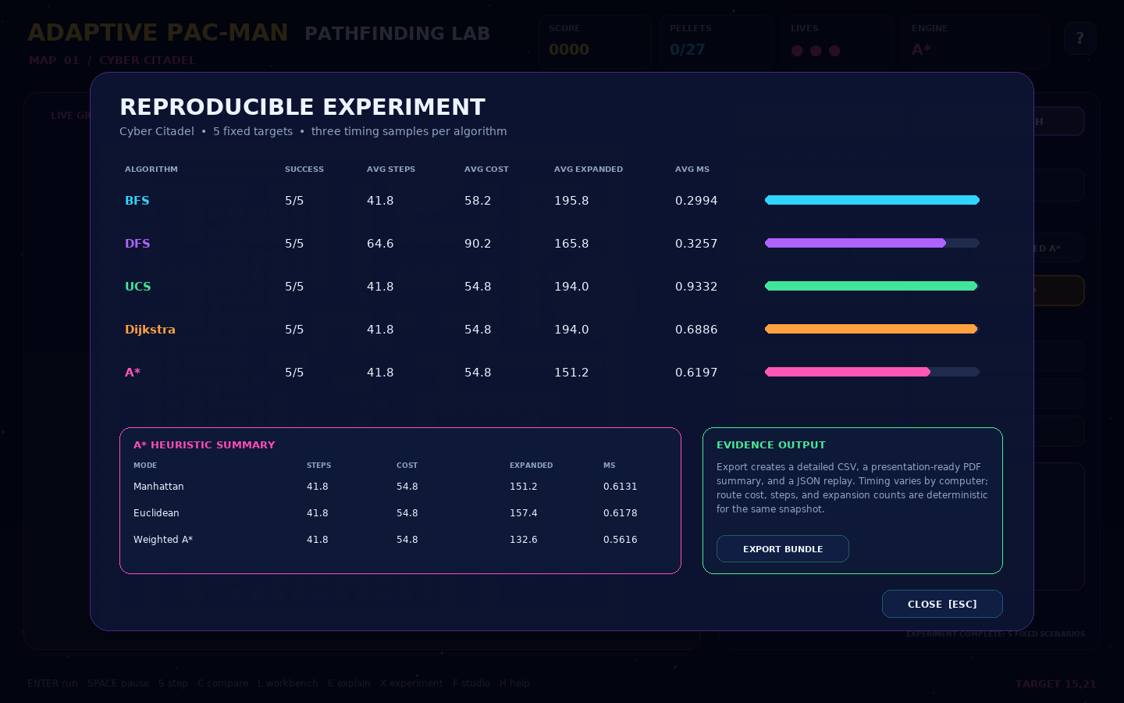
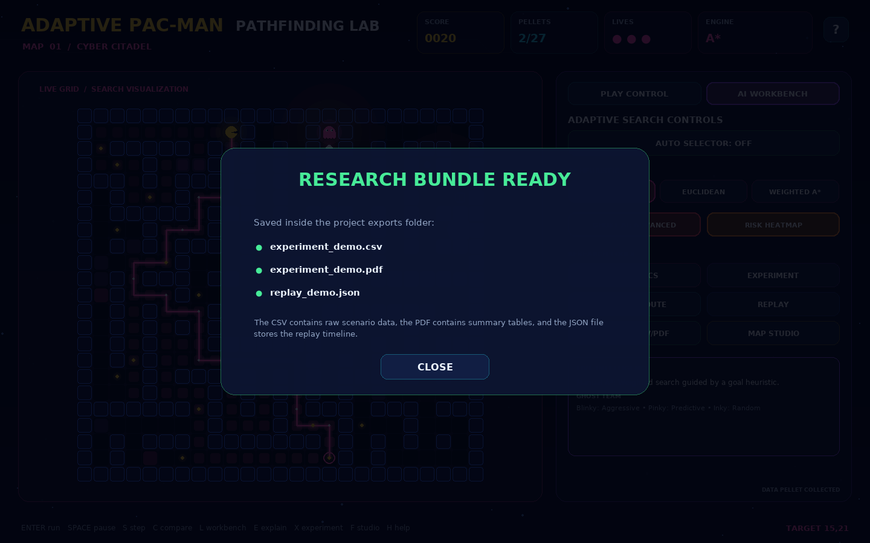
A complete game that produces its own evidence
11
Verified project outcome
19 / 19
6 MODES
automated tests pass
five solvers plus AUTO
CSV • PDF • JSON
experiment metrics, report, and mission replay
DELIVERY READY
Source, maps, tests, documentation, screenshots, sample exports, and this editable presentation are included in one clean archive.
Notes:
Close with evidence. The archive includes reproducible tests, a startup smoke check, ten QA screens, sample export files, and the editable source code. Avoid claiming Weighted A* is always optimal.

