Slide 1

Topic : Outcome Based Education Software : data visualization and analysis of CO-PO attainments
Ahsanullah University of Science and Technology
Department of Computer Science and Engineering
Course no : CSE4250
Course Title : Project & Thesis -I I

Slide 2
Supervisor : Mr. Tanveer Ahmed Belal
Assistant Professor
Department of CSE
Group No :4017
Submitted by :
Tanvir Ahmed Shiddiquee 17.02.04.007
Israt Jahan 17.02.04.107
Kazi Shabab Mahfuz 17.01.04.141
Tanvir Ahmed Siddiqi 16.01.04.069
MD. Rafiul Rabbi 15.02.04.092

Slide 3
CONTENTS
Introduction
Feature
ERD
DFD
Feasibility
Framework
Project Outcome
Difficulties
Future Work
Conclusion

Slide 4
Introduction :
The latest paradigm for education system.
Alternative of conventional education system.
Student centered approach.
Makes students more dynamic.
The way set expectation and achieve desired.

Slide 5
Introduction :
Course Outcomes (COs) : Course outcomes are the statements of what a student should know, understand and/or be able to demonstrate after completion of a course.
Program Outcomes (POs) : POs describe what students should know and be able to do at the end of the program.

Slide 6
Feature :
Program objective
Program Outcome
Performance indicators

Slide 7
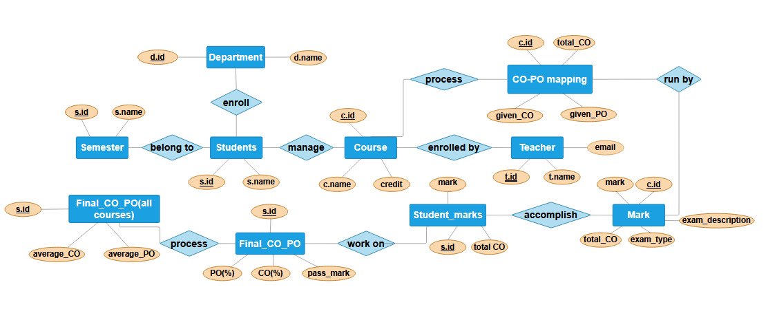
ERD:

Slide 8
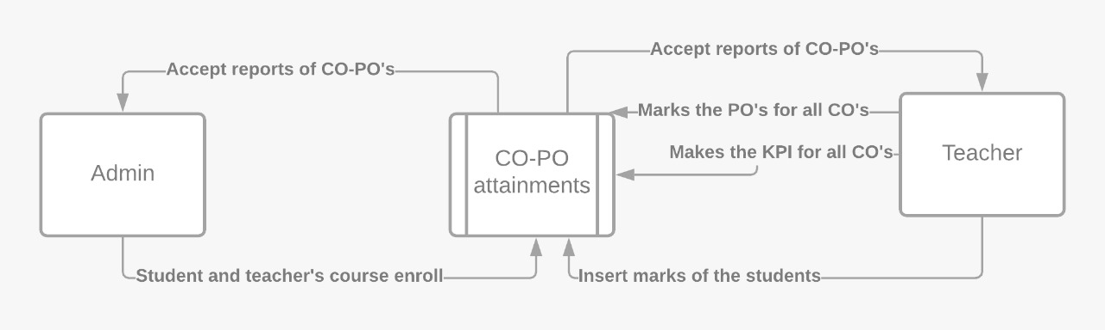
DFD:

Slide 9
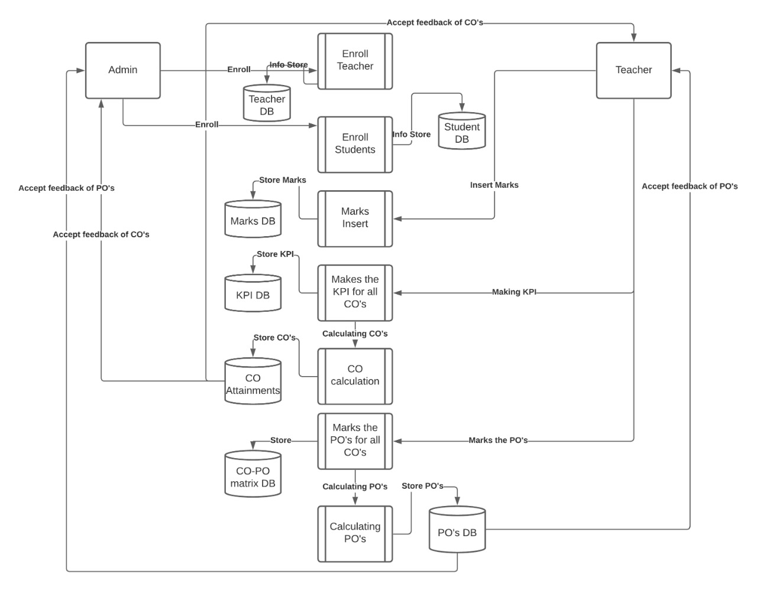
DFD:

Slide 10
Feasibility :
Technical Feasibility
Hardware & software resource
Technical skill
Operational Feasibility
Operational activities
Fulfill all the requirements
User friendly
Economic Feasibility
Maintenance cost
Legal Feasibility
Data protection
Copy rights
Scheduling Feasibility
Deadline

Slide 11
Framework :
Spring Framework, a open source Java platform. that provides infrastructure support for developing Java applications. One of the most popular Java Enterprise Edition (Java EE) frameworks, Spring helps developers create high performing applications

Slide 12
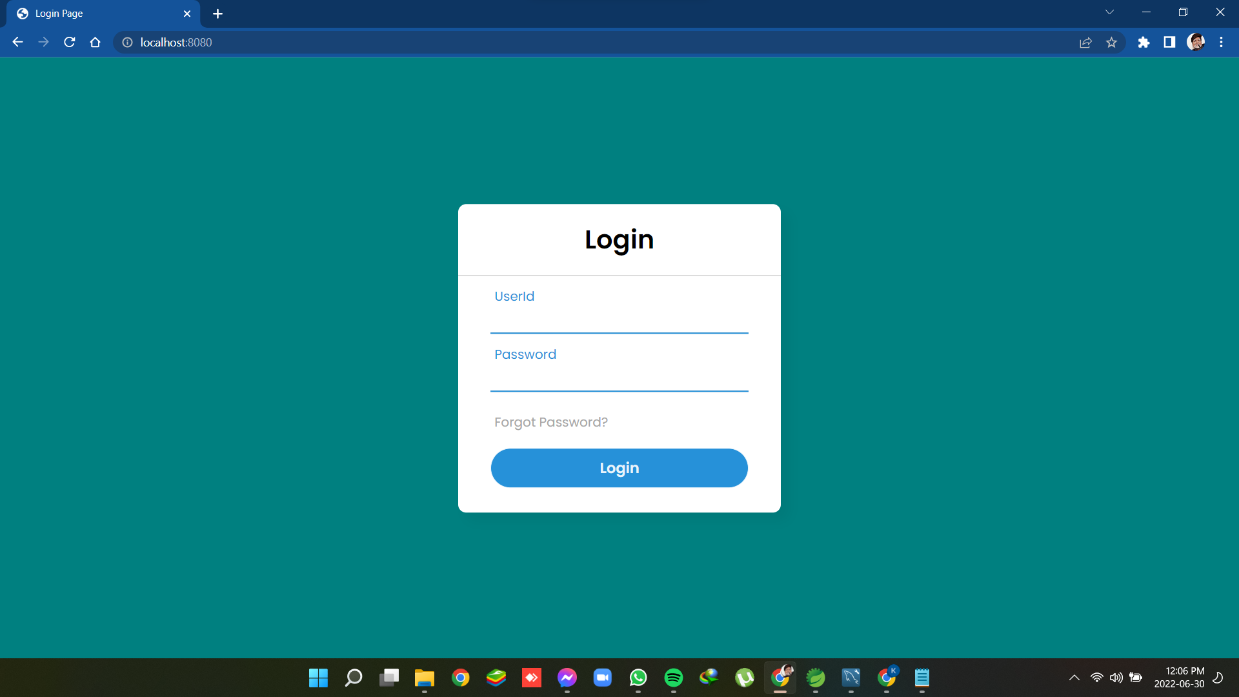
Project Outcome :

Slide 13
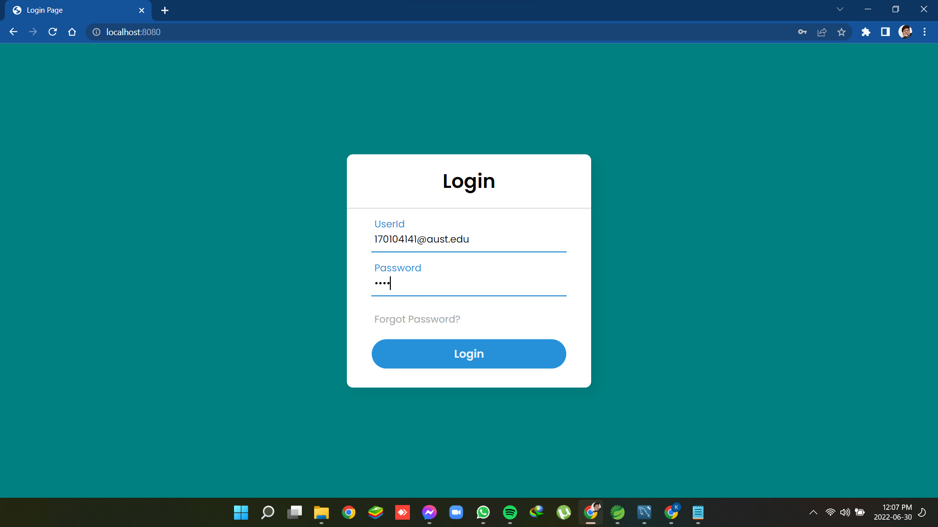
Project Outcome :

Slide 14
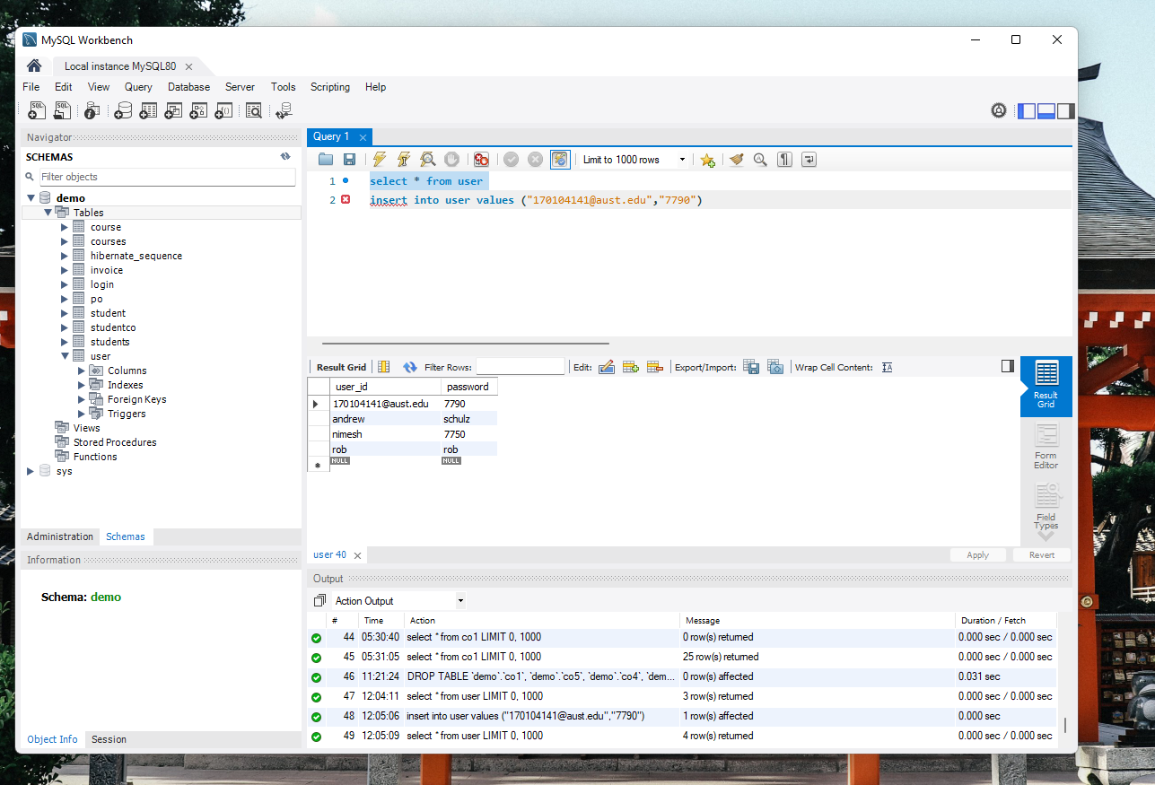
Project Outcome :

Slide 15
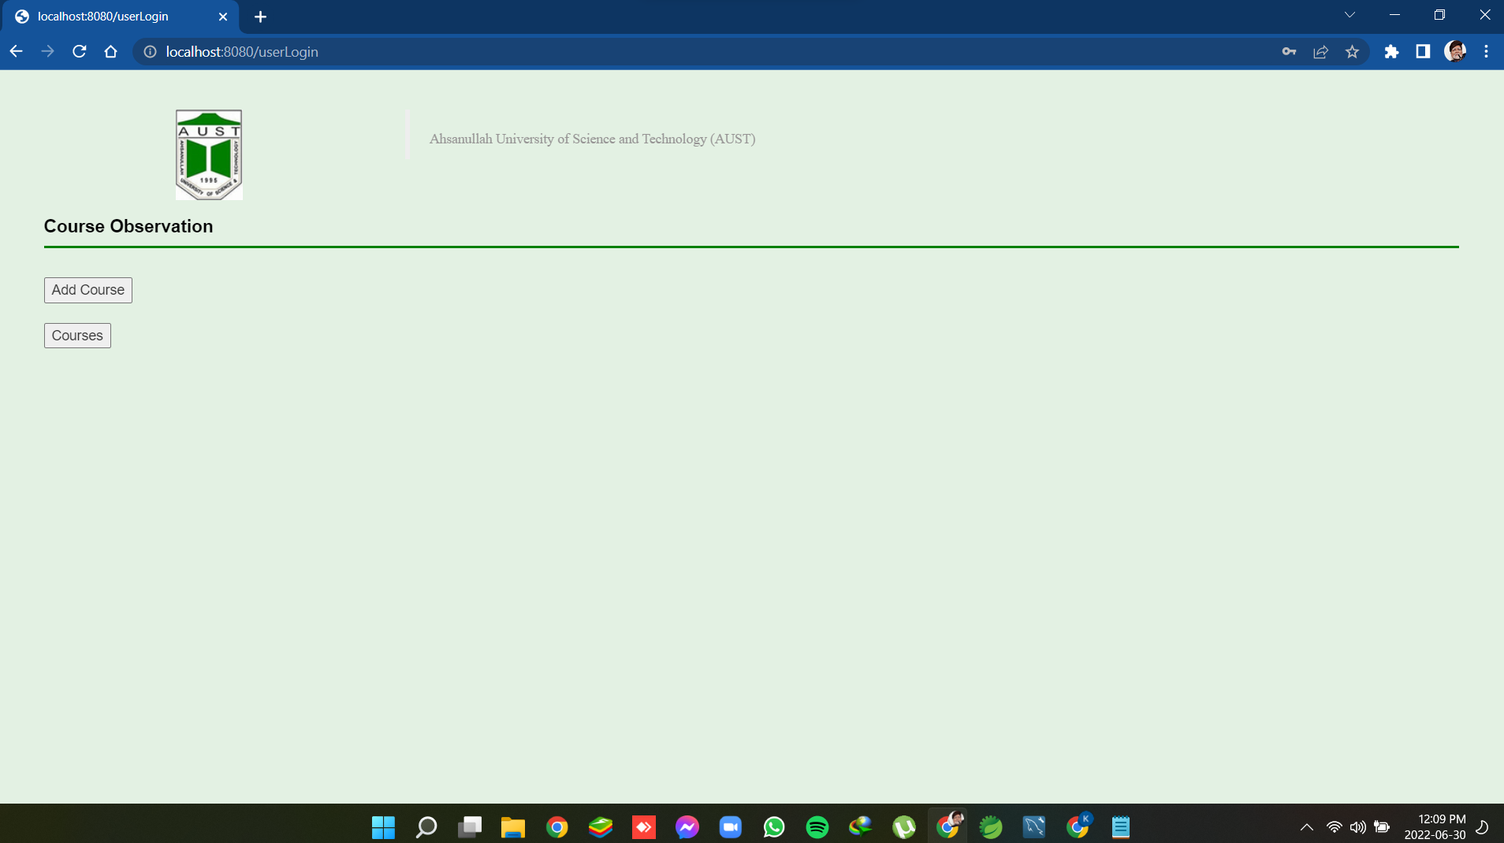
Project Outcome :

Slide 16
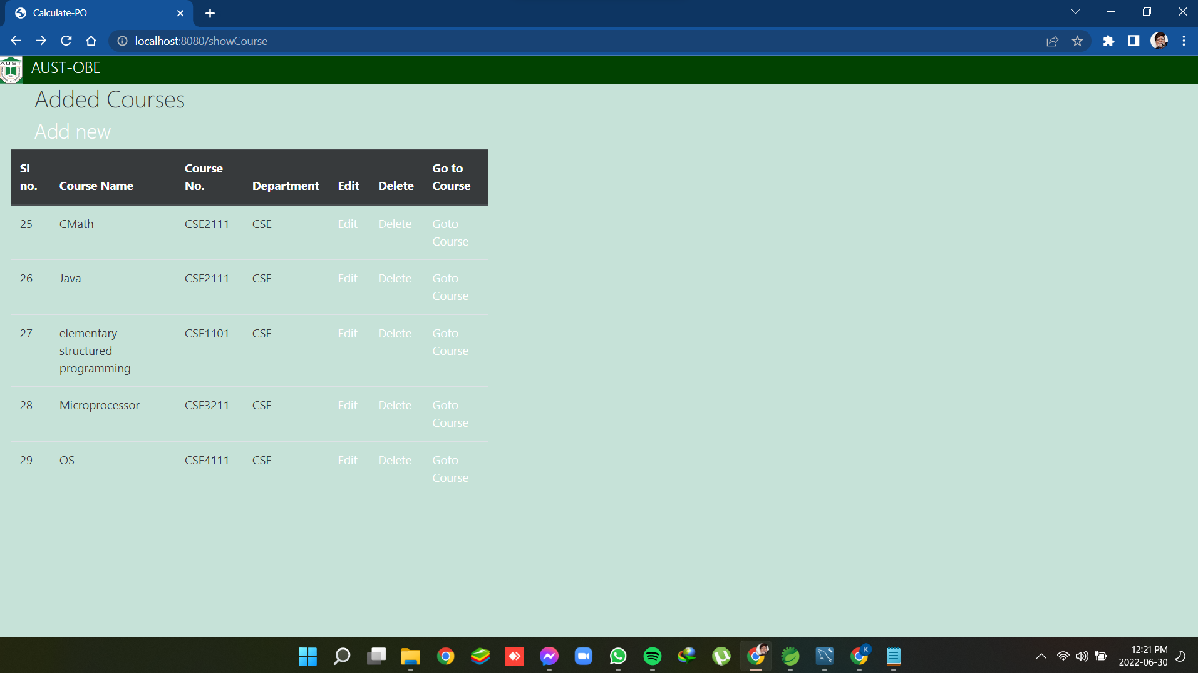
Project Outcome :

Slide 17
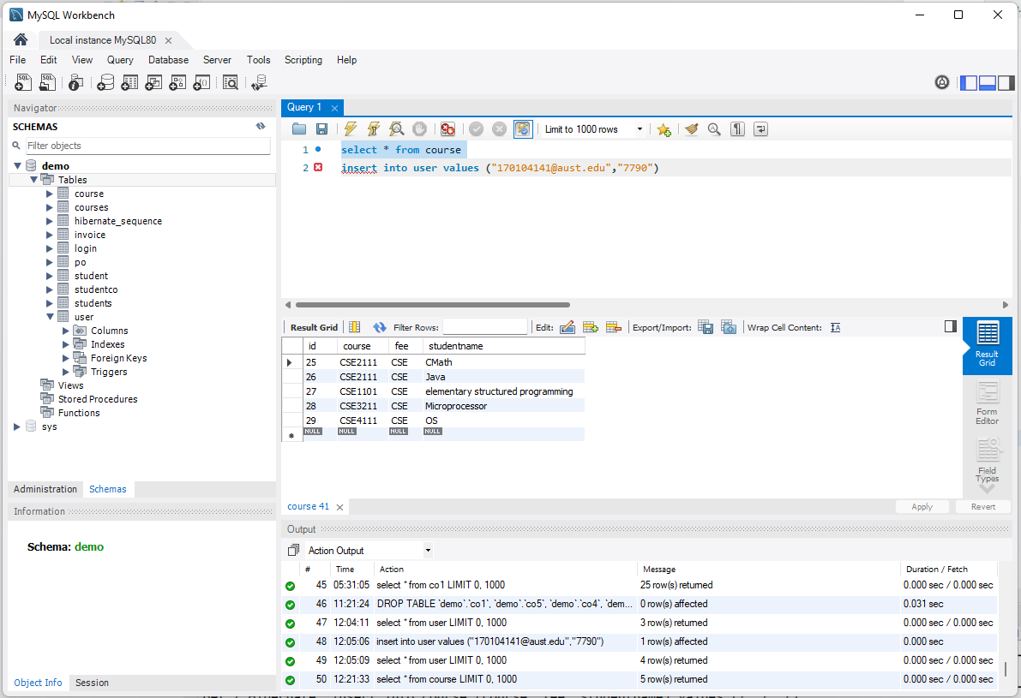
Project Outcome :

Slide 18
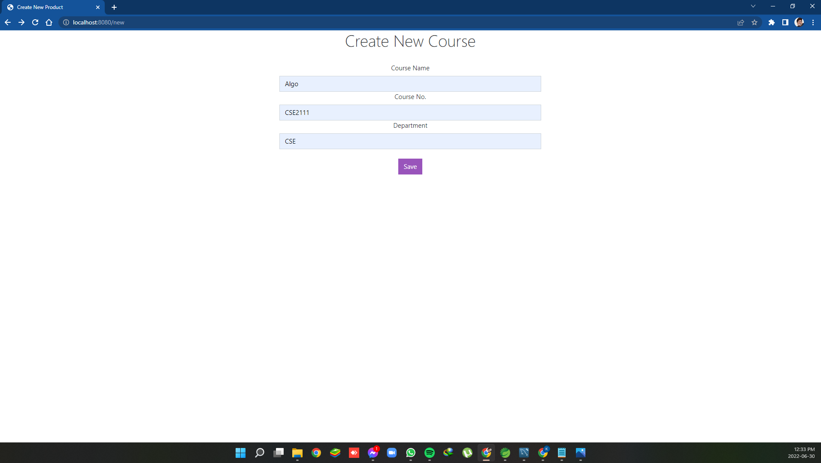
Project Outcome :

Slide 19
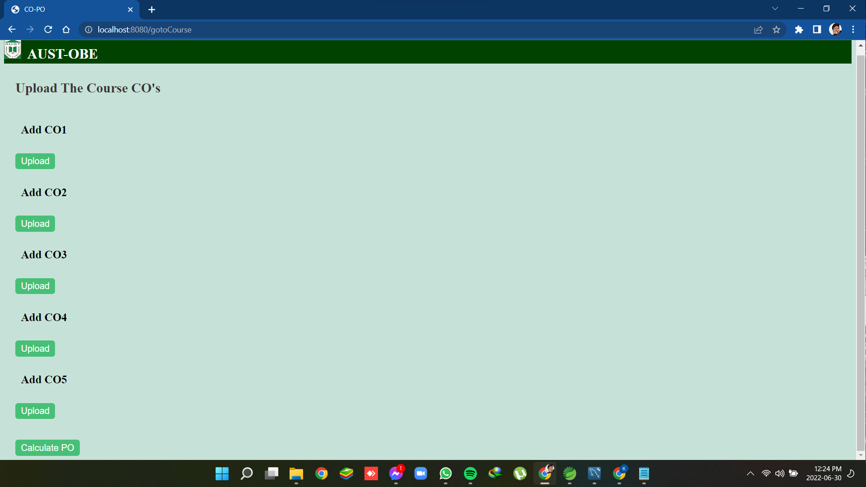
Project Outcome :

Slide 20
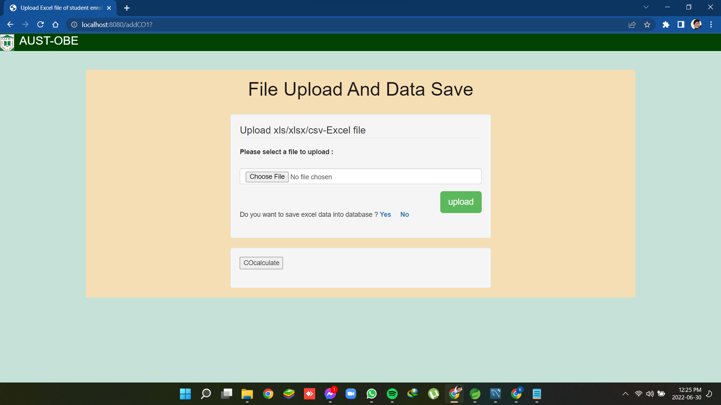
Project Outcome :

Slide 21
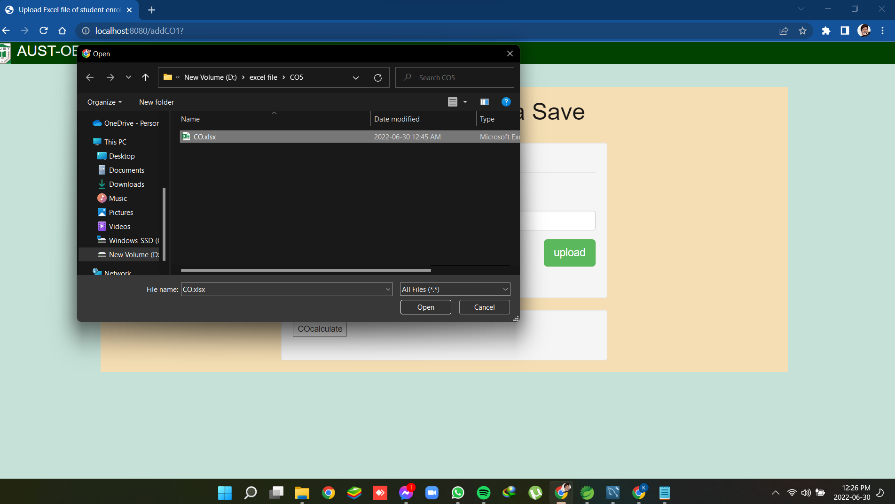
Project Outcome :

Slide 22
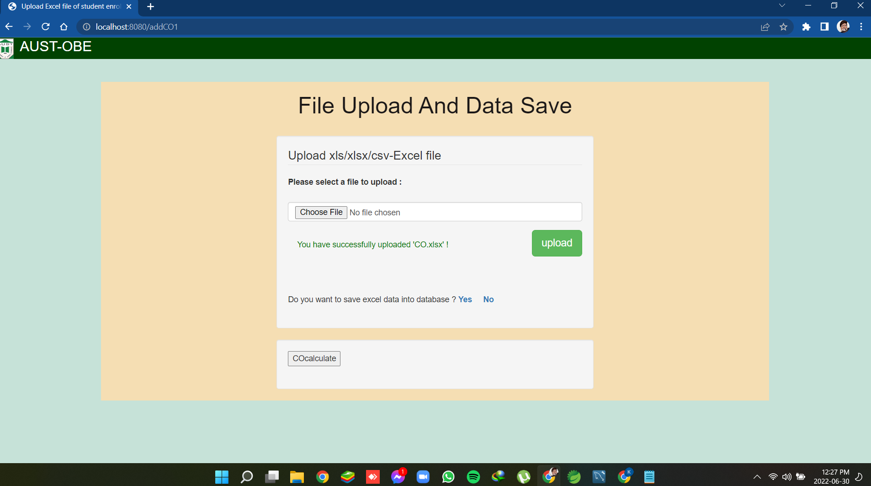
Project Outcome :

Slide 23
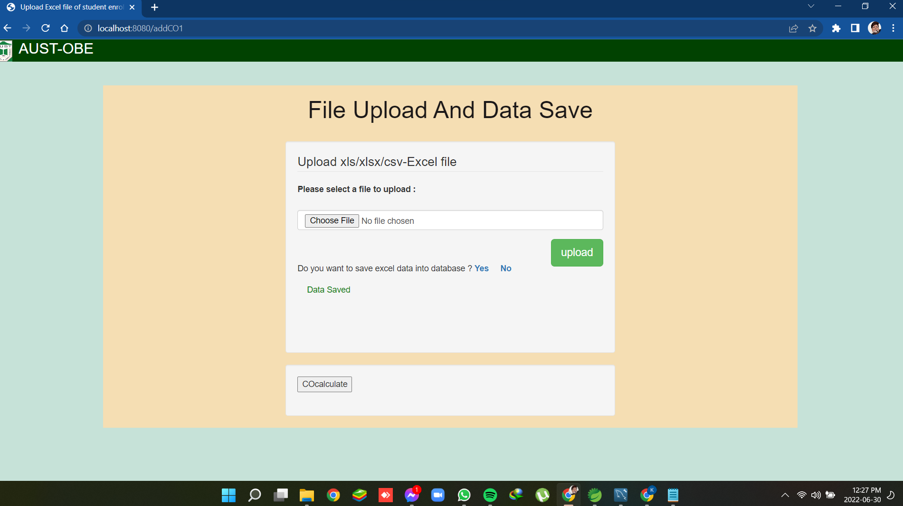
Project Outcome :

Slide 24
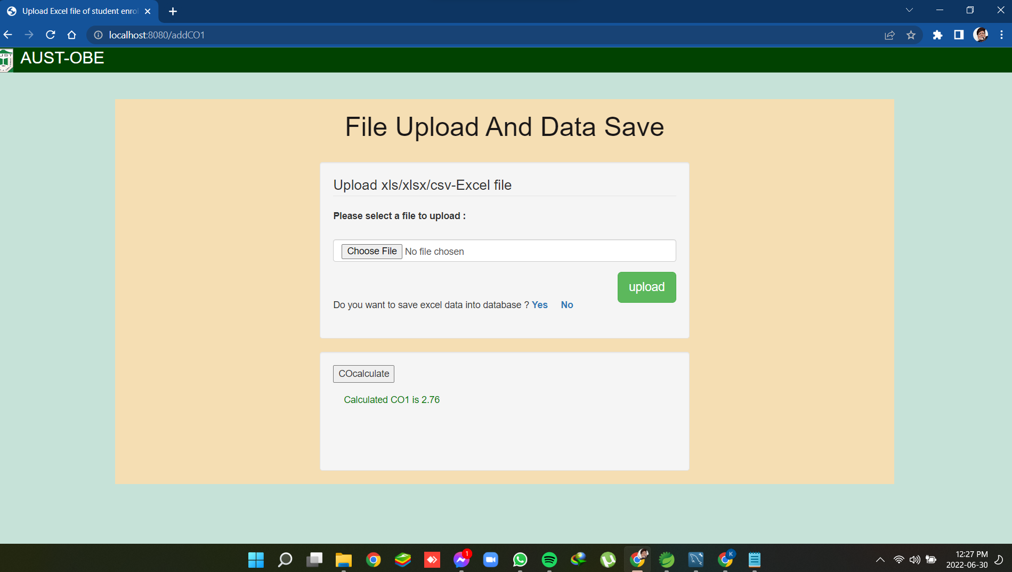
Project Outcome :

Slide 25
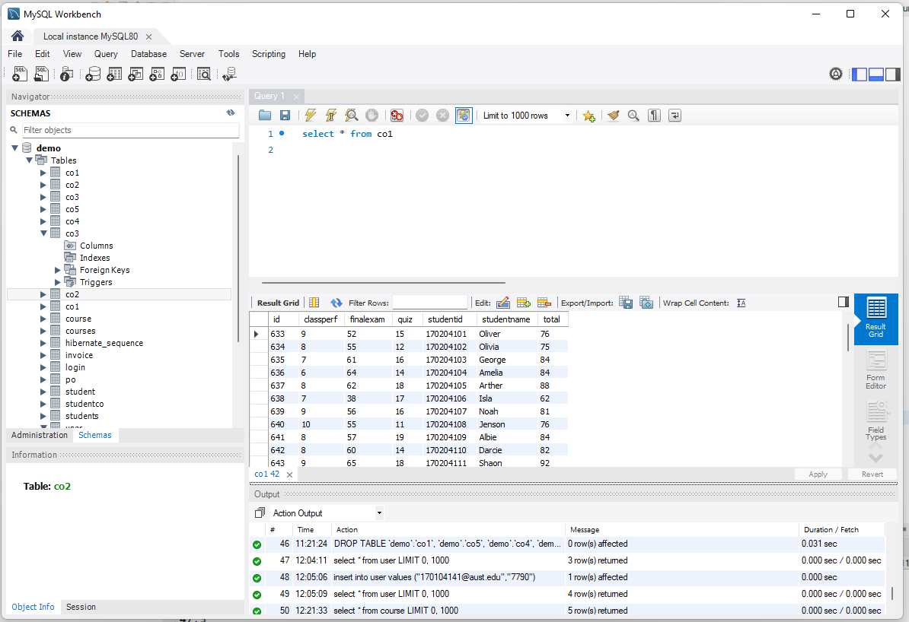
Project Outcome :

Slide 26
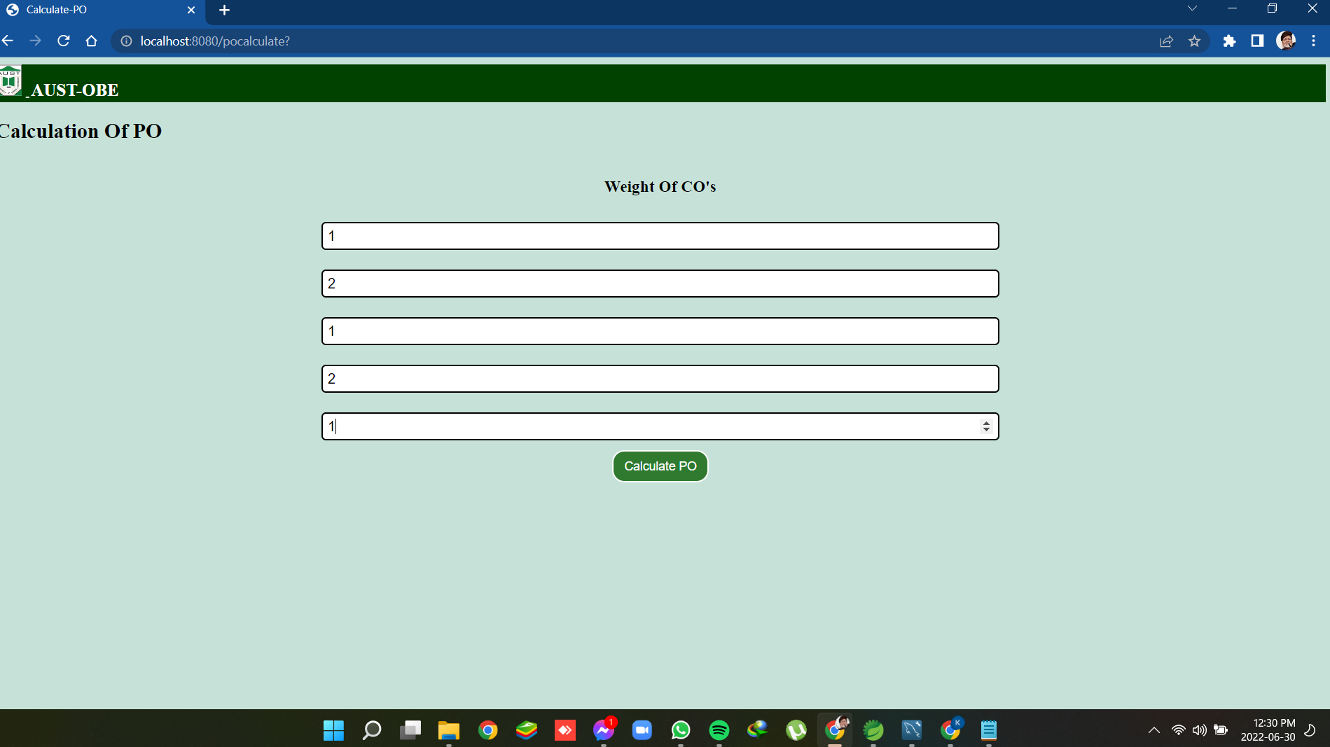
Project Outcome :

Slide 27
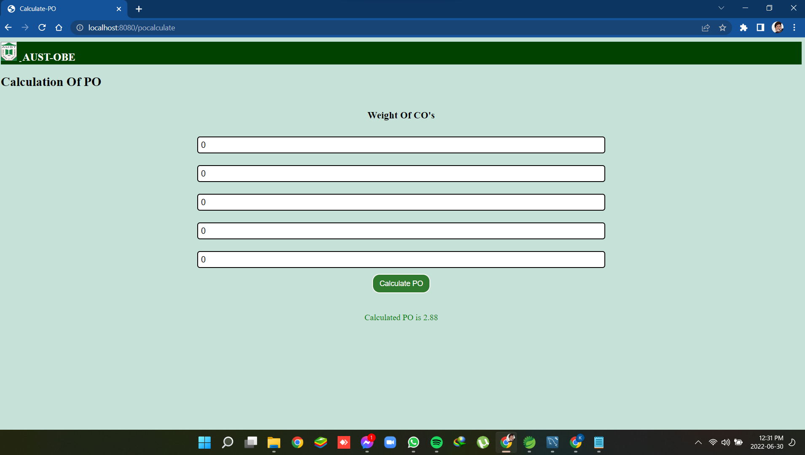
Project Outcome :

Slide 29
Difficulties :
Learning curve
Unknown interface
Deficiency of workshop

Slide 30
Future Work :
Program Educational Objectives (PEO) will be measured and calculated.
Program Specific Outcomes (PSO) will be measured and calculated.
Database which is used in this project will be distributed database.

Slide 31
Conclusion :
A reformative educational approach considering in planning, implementing and evaluating
Enable teachers to pre-define the educational goals for students
Maps throughout the learning sessions via continuous assessments
Provides the learner with the destination of educational journey before voyaging.

