Slide 1

NSU ClubHub
A comprehensive platform connecting students with campus clubs through seamless frontend experiences and robust backend infrastructure.
Notes:
1

Slide 2
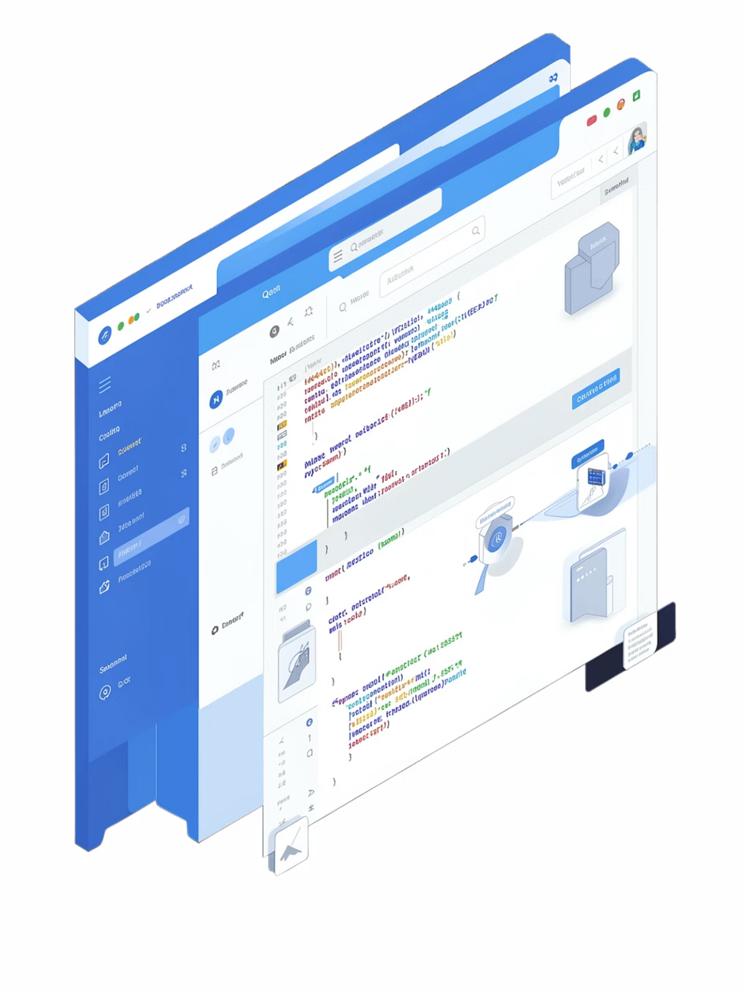




Frontend Architecture
Next.js 15
Modern React framework powering the user interface
Tailwind CSS
Fast, consistent styling with reusable components
Zustand
Global state management for user data
React Query
Server data fetching and intelligent caching
Notes:
2

Slide 3
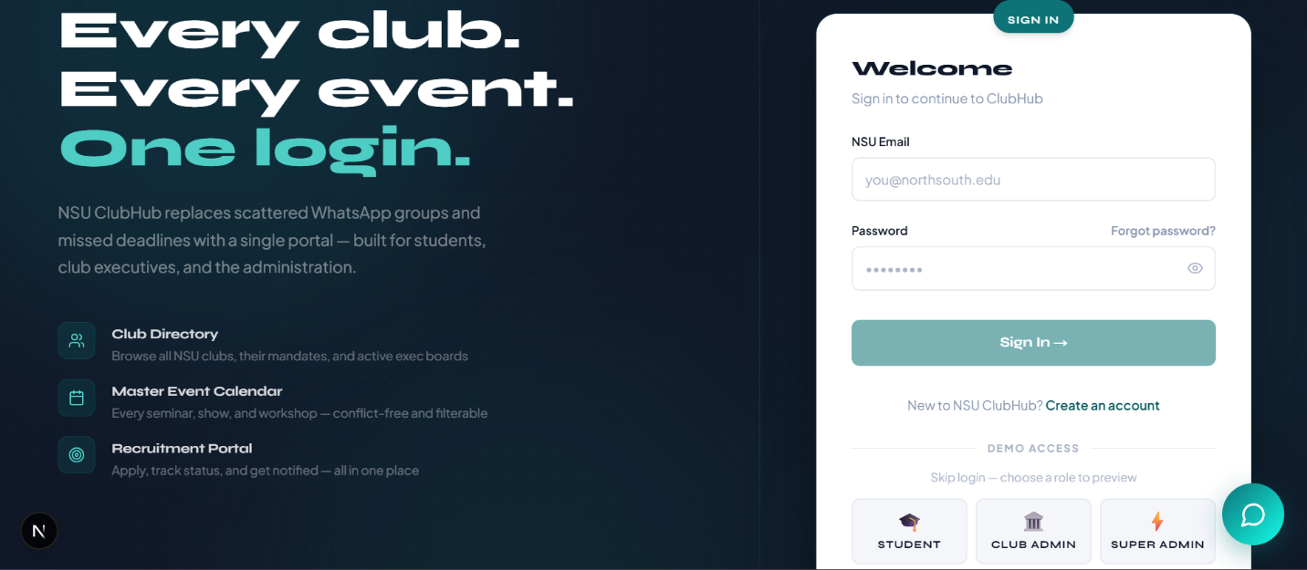

Slide 4
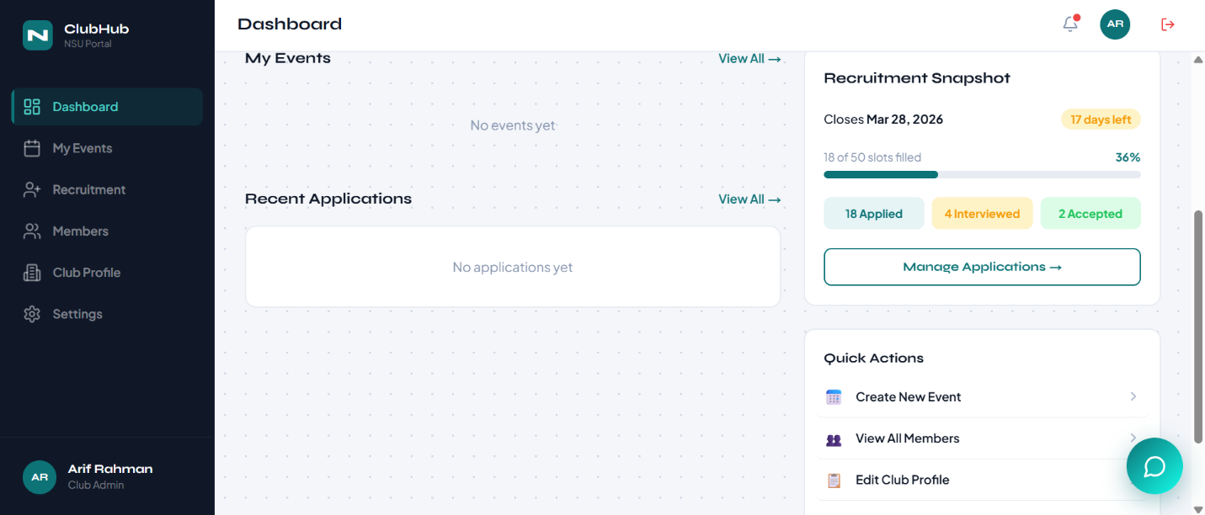
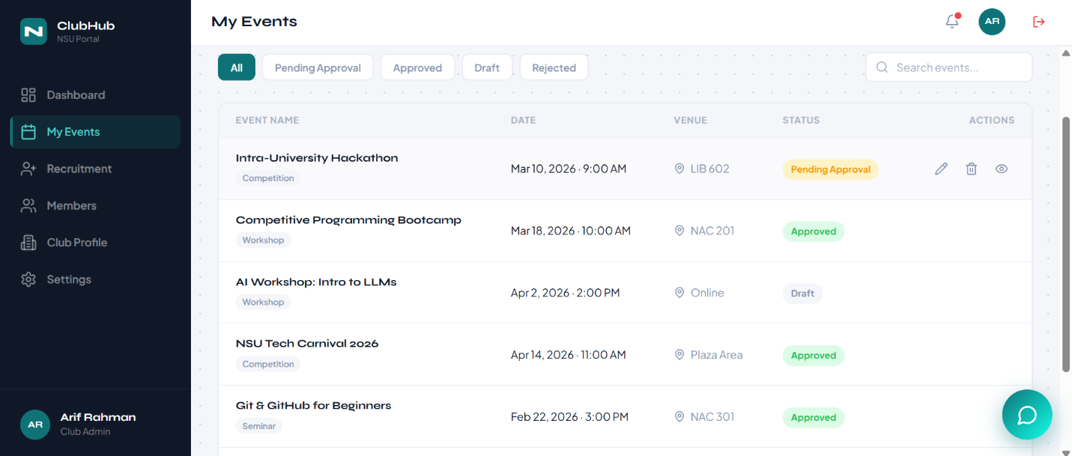

Slide 5
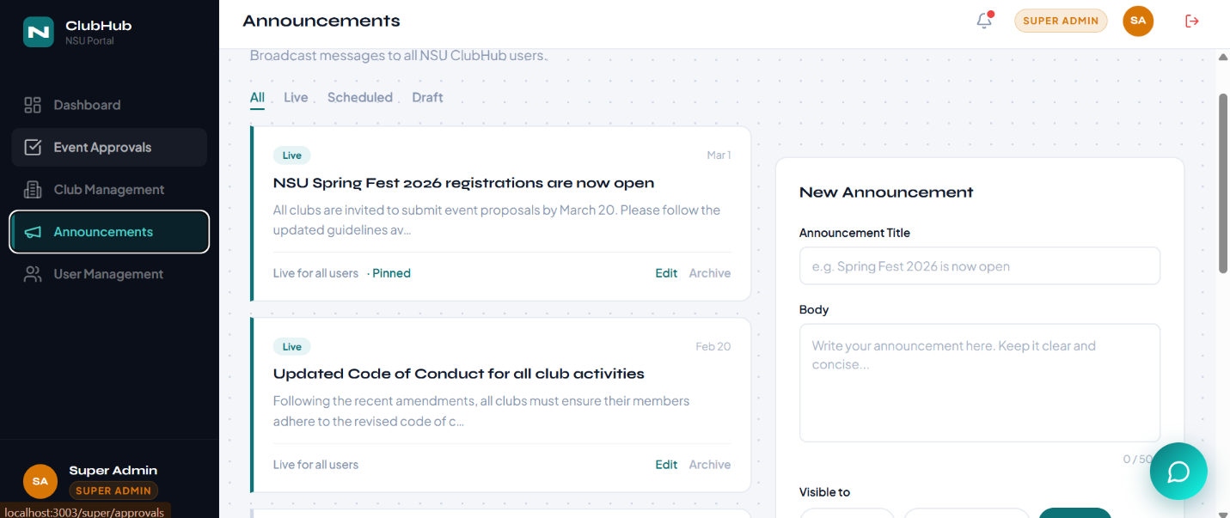

Slide 6
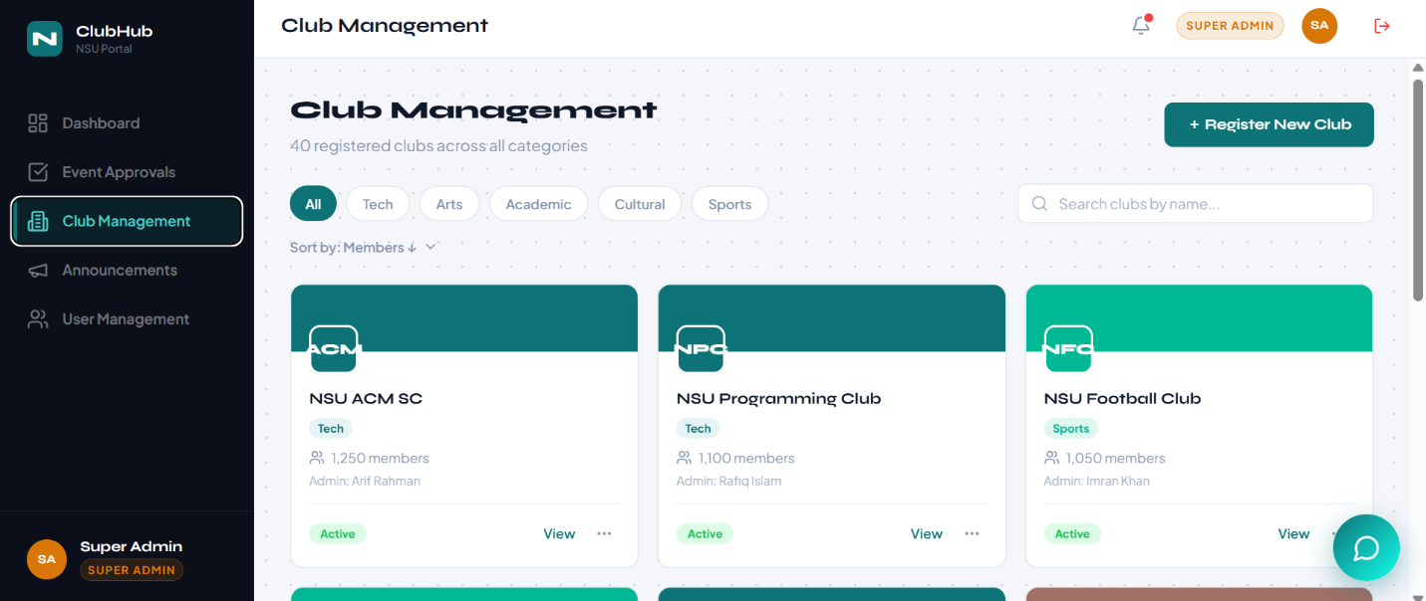

Slide 7
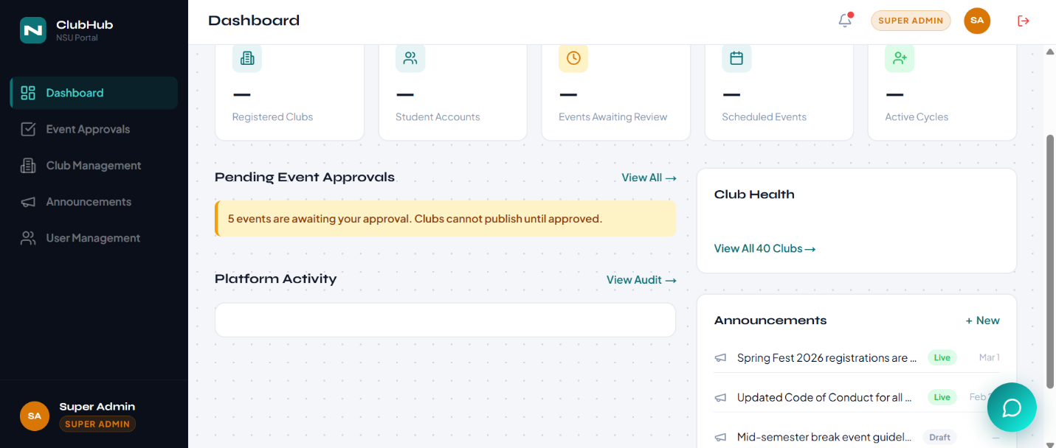

Slide 8
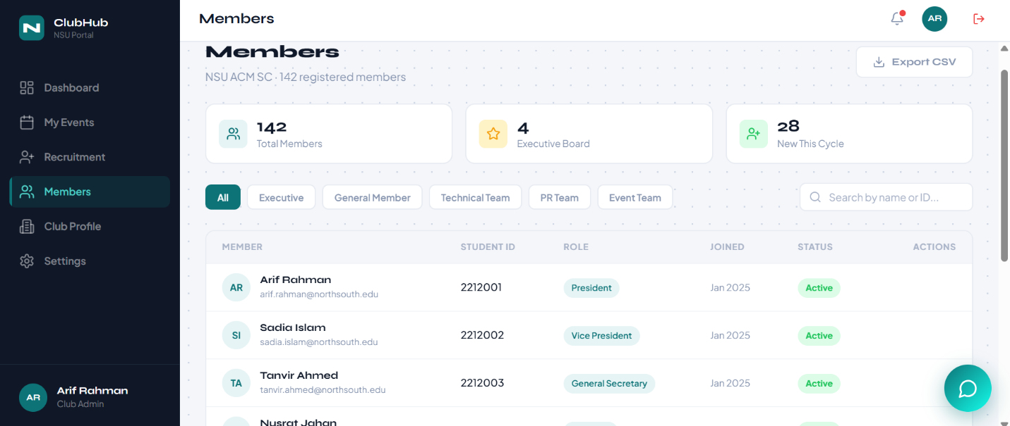

Slide 9
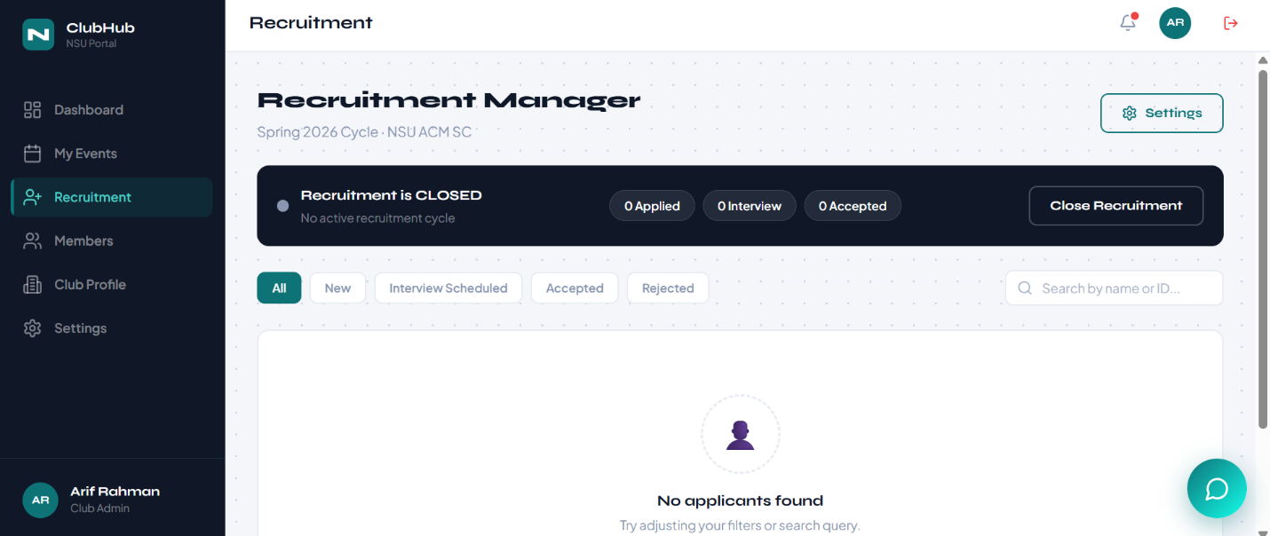

Slide 10


Slide 11


Slide 12
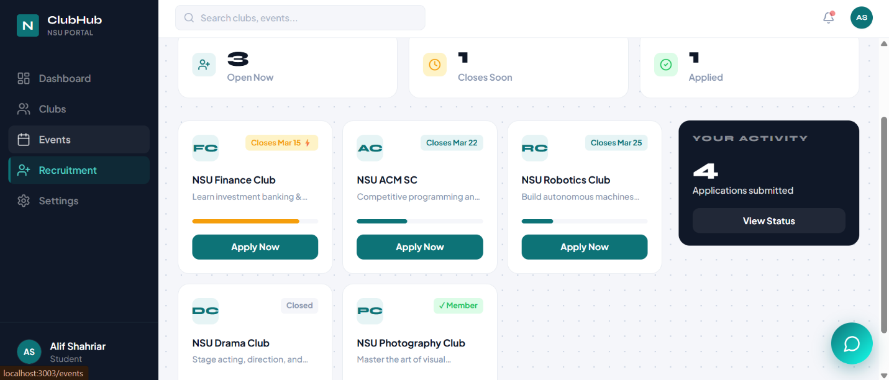

Slide 13
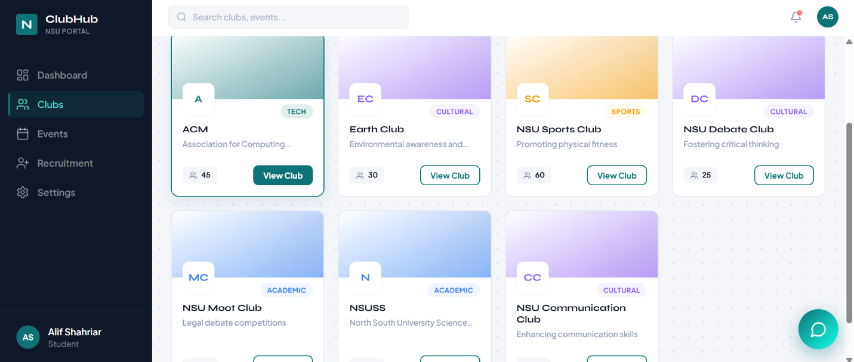

Slide 14
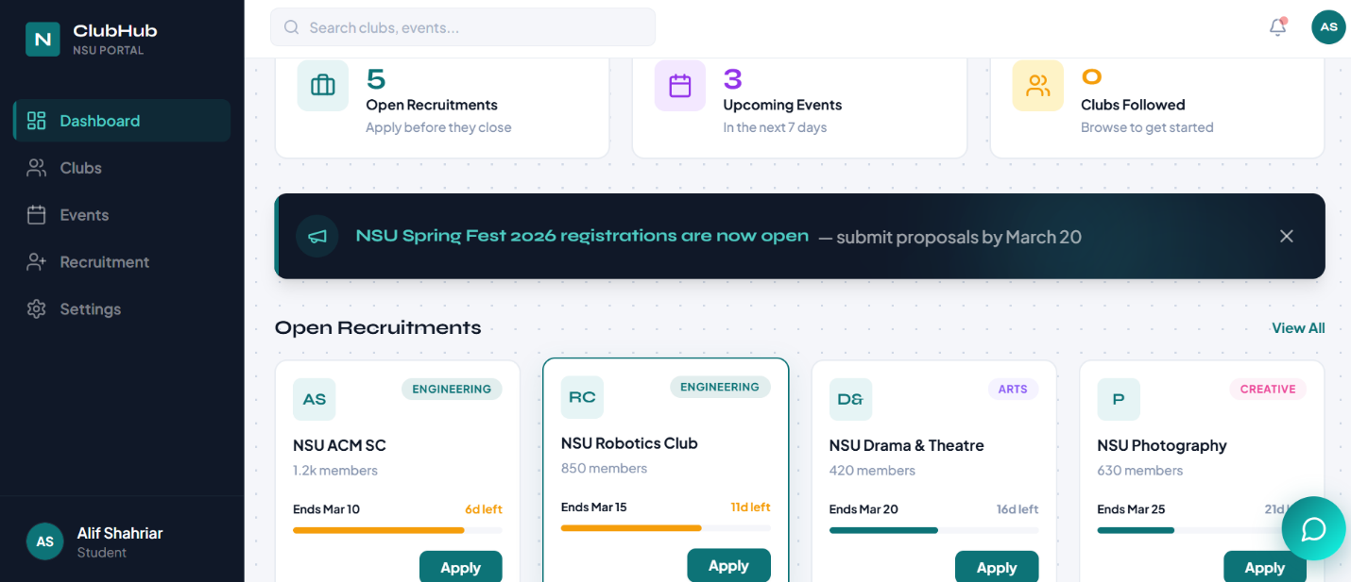

Slide 15
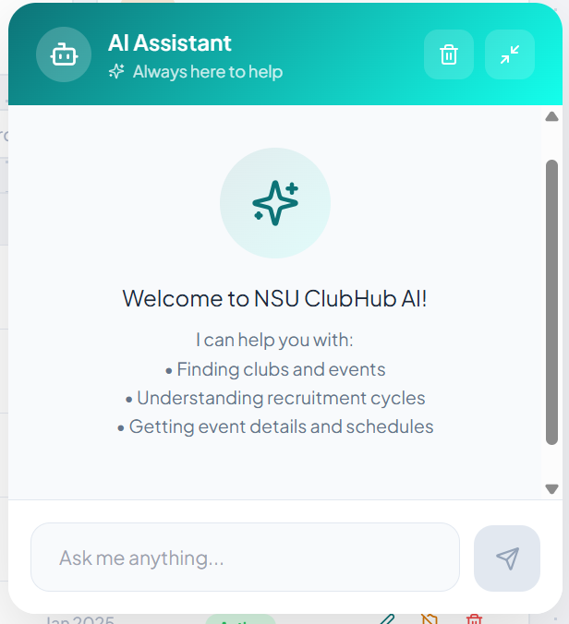

Slide 16




Backend Architecture
Routes
API endpoints definition
Controllers
Request handling logic
Services
Business logic processing
Built with Express.js and TypeScript, following RESTful API principles for scalable, organized communication between frontend and database.
Notes:
16

Slide 17

Middleware Pipeline
01
02
CORS
JSON Parser
Access permission control
Request data processing
03
04
Logger
Rate Limiter
System activity tracking
Abuse prevention
05
06
Authentication
Authorization
JWT verification
Role-based access checks
Centralized error handling ensures consistent responses throughout the request lifecycle.
Notes:
17

Slide 18



Role-Based Access Control
Student
Browse clubs, apply for recruitment, register for events
Club Admin
Manage club operations, approve events, handle applications
Super Admin
Full system control, user management, platform oversight
Strict permission enforcement prevents unauthorized access to sensitive operations.
Notes:
18

Slide 19
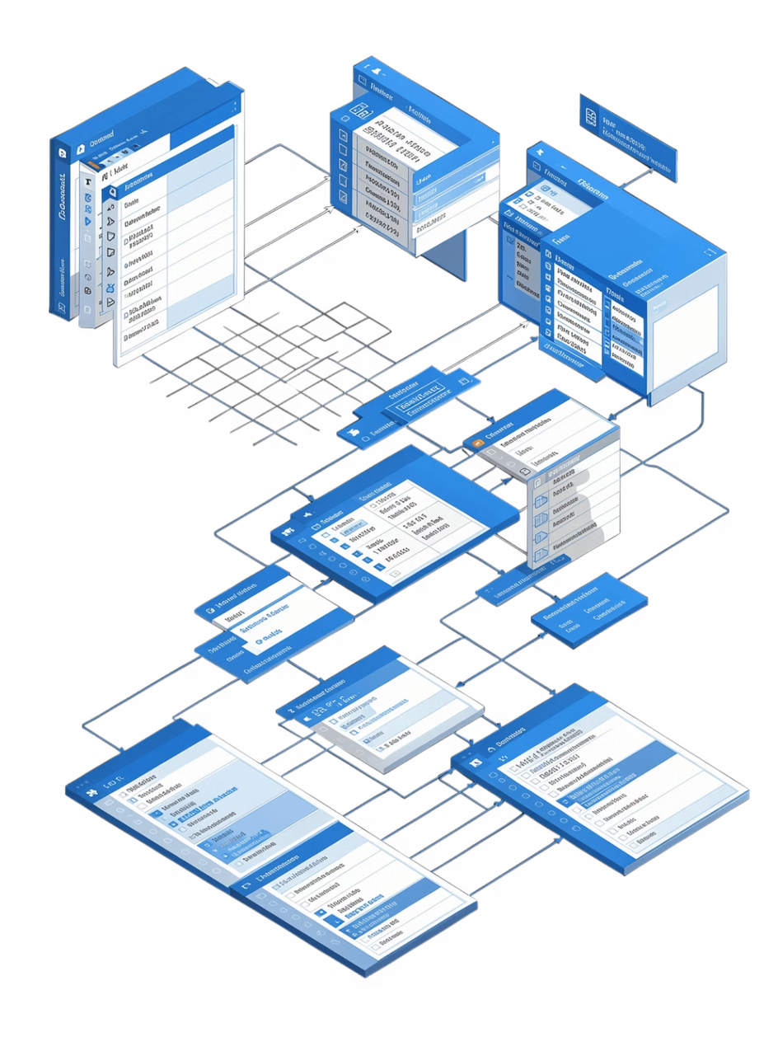
Service Layer & Data Management
Service Modules
Database Stack
UserService – User data and authentication
ClubService – Club operations and memberships
EventService – Event creation and registration
RecruitmentService – Application tracking
NotificationService – User updates
PostgreSQL for reliable data storage with Prisma ORM for type-safe queries.
Entities include users, clubs, events, QR tickets, applications, and audit logs.
Notes:
19

Slide 20






Core Features
QR Ticketing
Club Discovery
Unique QR codes with real-time validation and duplicate entry prevention
Search and filter functionality for finding relevant clubs
Event Management
Recruitment System
Admin-approved events with student registration system
Multi-stage applications with progress tracking and automated updates
Notifications
AI Assistant
Updates for events, recruitment status, and important announcements
Intelligent help system for navigation and information queries
Notes:
20

Slide 21
API Design
1
2
Authentication
Club Operations
Login, registration, JWT management
Create, update, search clubs
3
4
Event Management
Recruitment
Event creation, registration, QR tickets
Application forms, progress tracking
5
6
Notifications
AI Chat
Real-time updates and alerts
Intelligent assistant interface
Organized under /api/v1/ endpoints for version control and scalability.
Notes:
21

Slide 22

System Overview
Frontend Excellence
Backend Power
Fast, user-friendly interface with Next.js, Tailwind CSS, and optimized rendering
Secure, scalable architecture with Express.js, TypeScript, and PostgreSQL
Seamless Integration
Secure REST API communication with role-based access control
A production-ready platform combining speed, security, and scalability for campus club management.
Notes:
22

Slide 23
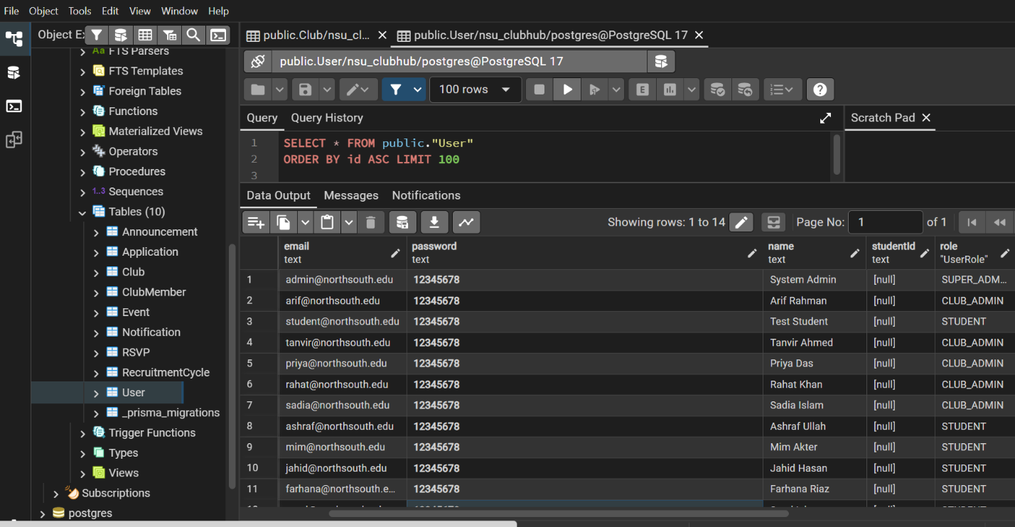

Slide 24
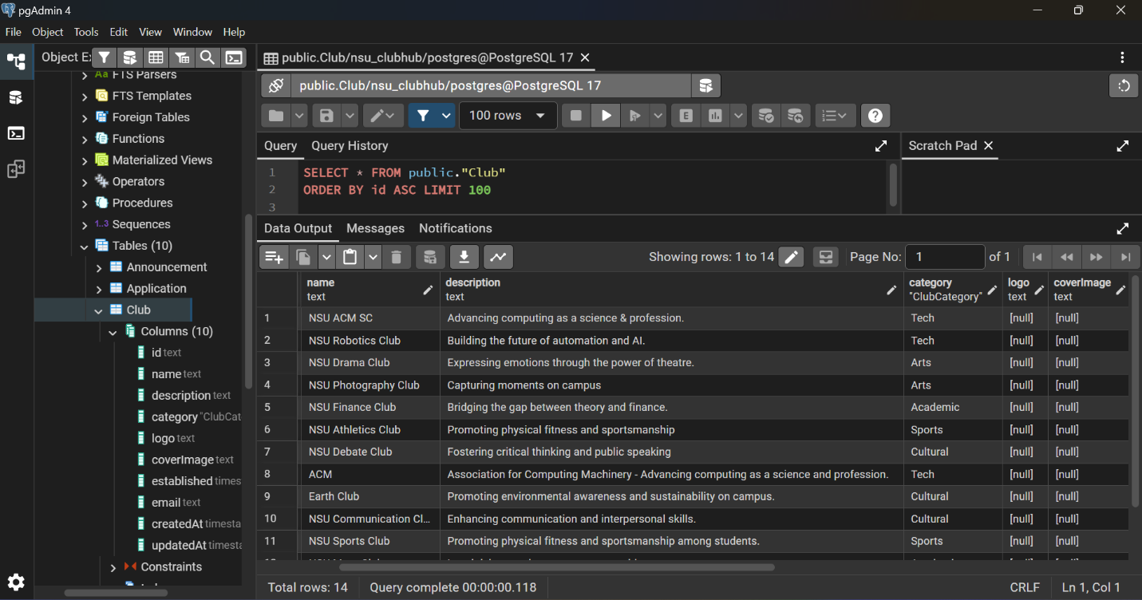

Slide 25
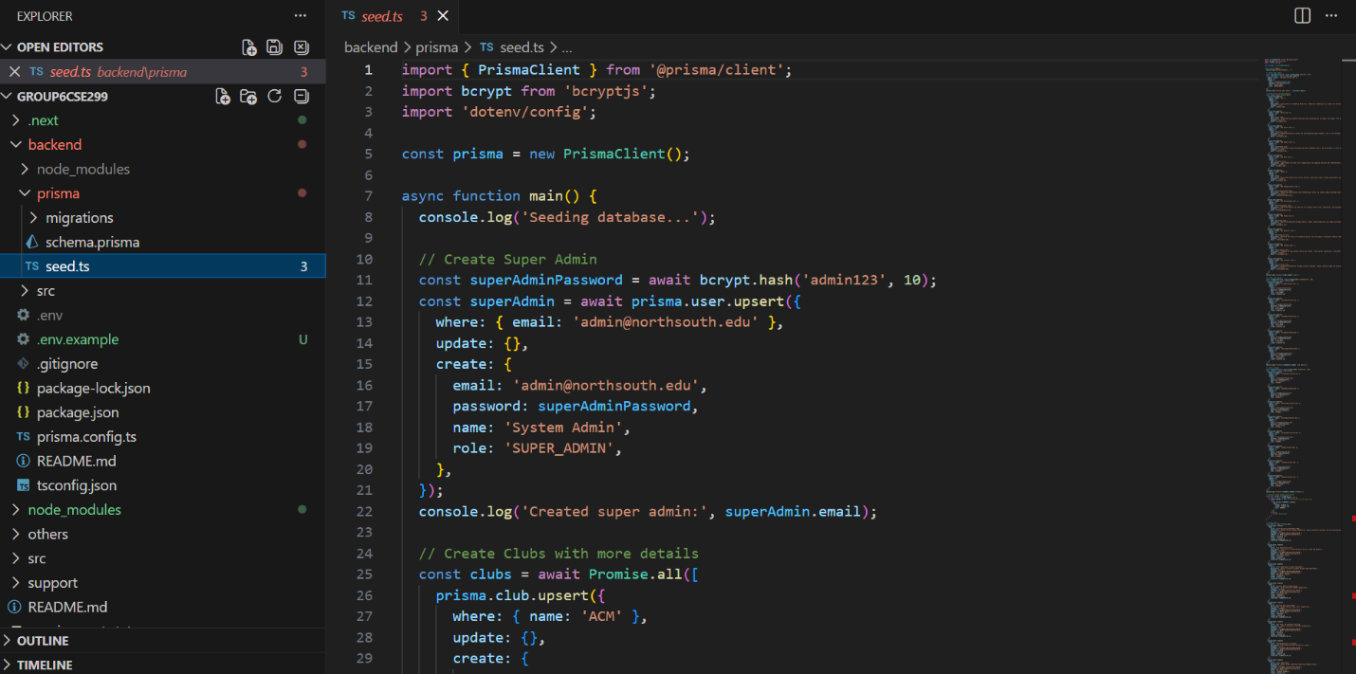

Slide 26
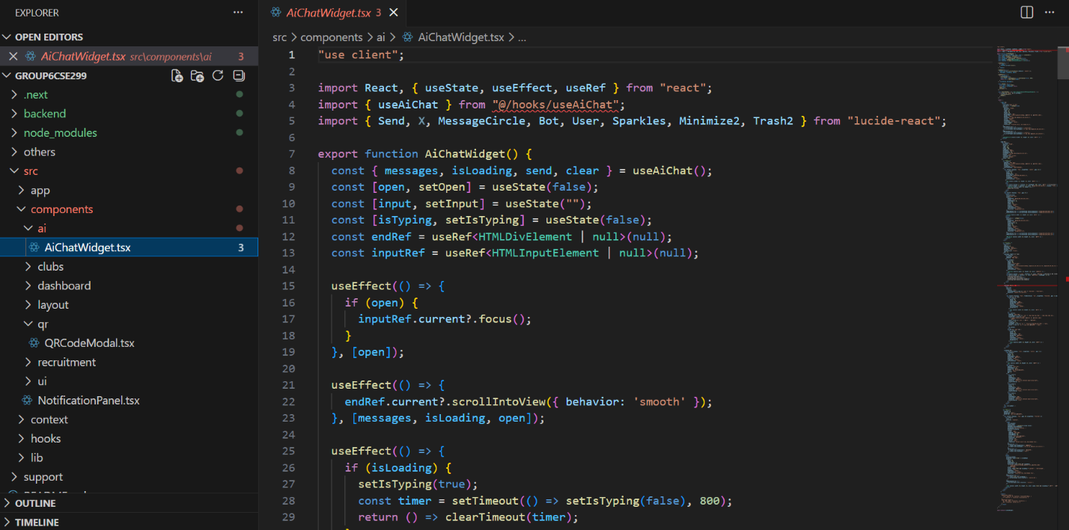

Slide 27
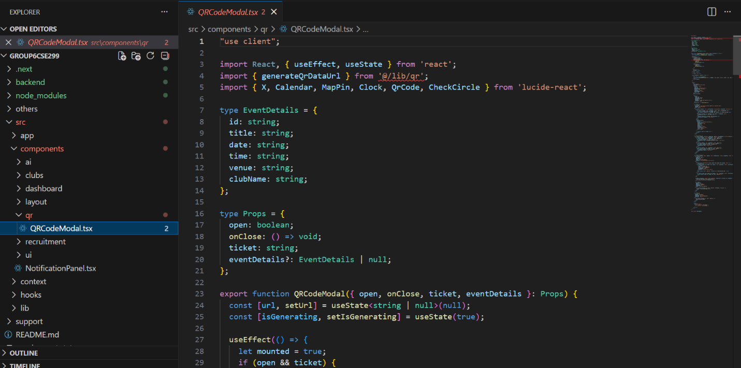

Slide 28
