Slide 1
NSU ClubHub
Centralized Club Management & Engagement Portal
North South University
Team Members:
M.A. Rahman Junaid
Shabab Alam Pean
Mohammad Safayet Hossain Alif
Syed Mohim Rahman Preo
Notes:
1

Slide 2
Project Overview
NSU ClubHub is a platform for managing university clubs.
It helps students and admins organize club activities easily.
The system includes club management, recruitment, events, and announcements.
Update 4 focuses on admin portals and login system improvements.
Notes:
2

Slide 3
Login Page Improvement
The login page was redesigned with a modern interface.
Added a demo role selector for testing.
Users can preview dashboards without entering credentials.
Available roles:
Student
Club Admin
Super Admin
Notes:
3

Slide 4
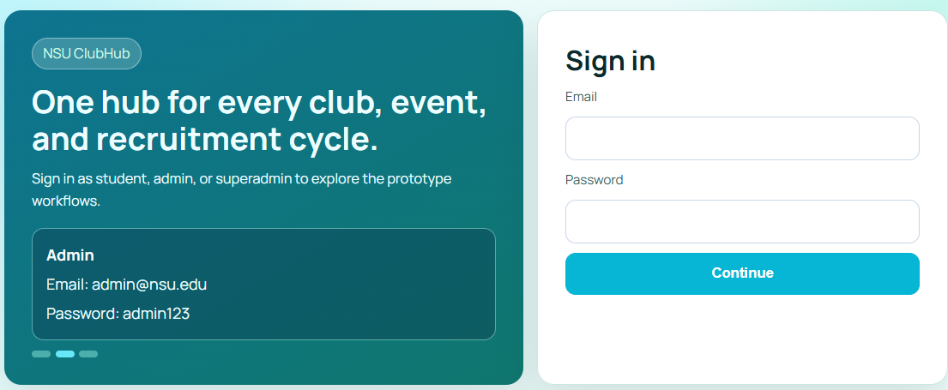

Slide 5
Club Admin Portal
The Club Admin portal now includes 8 modules:
Dashboard overview
Member management
Event creation and management
Recruitment post management
Application review system
Club analytics and statistics
Club announcements
Club profile settings
Notes:
4

Slide 6
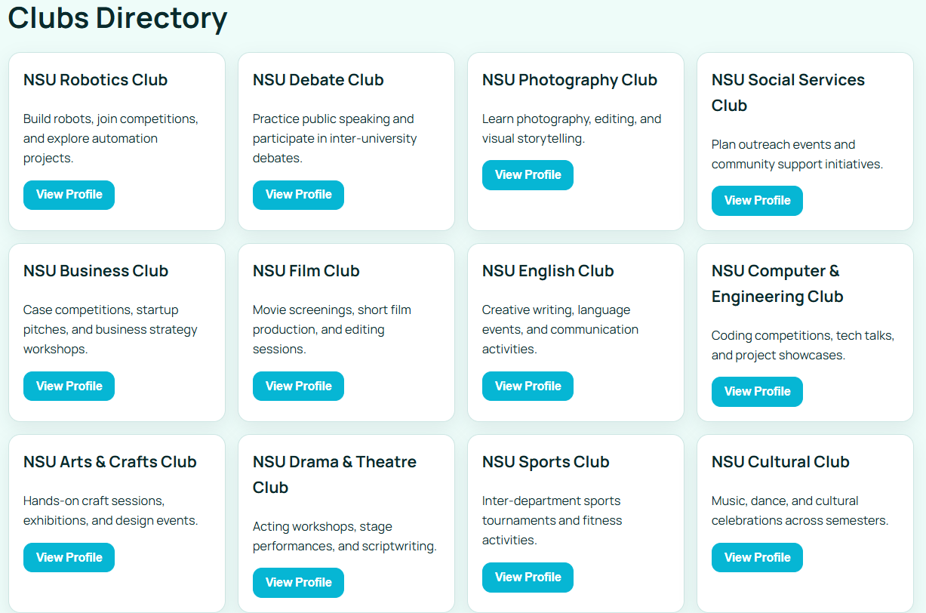
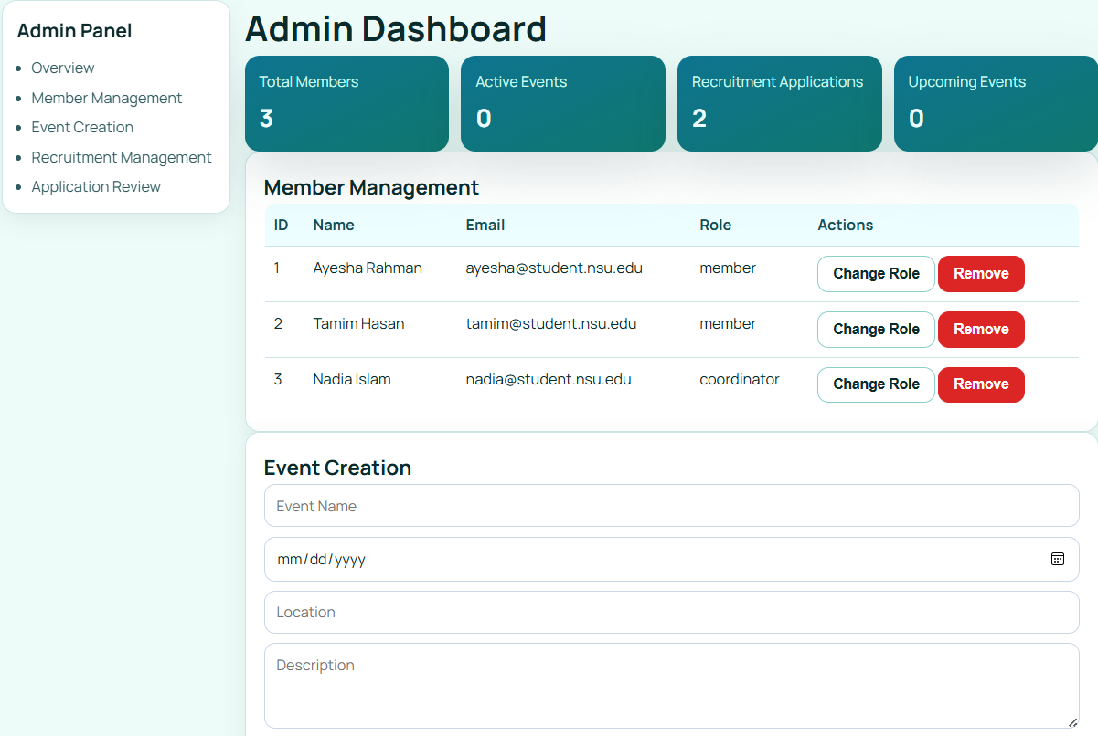
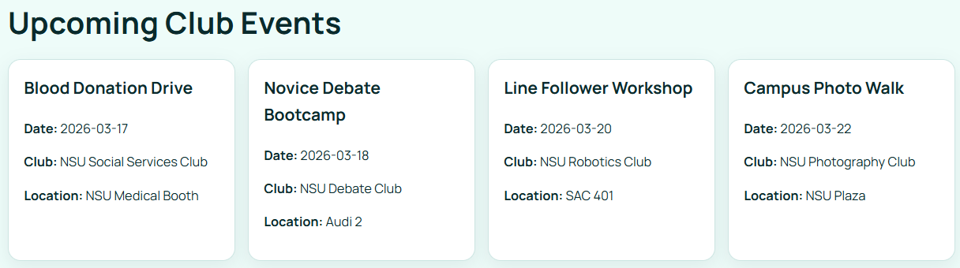

Slide 7
Super Admin Portal
Super Admin features include:
System-wide dashboard
Club registration approval
User account management
Platform analytics
Announcements for all users
This portal allows complete management of the platform.
Notes:
5

Slide 8
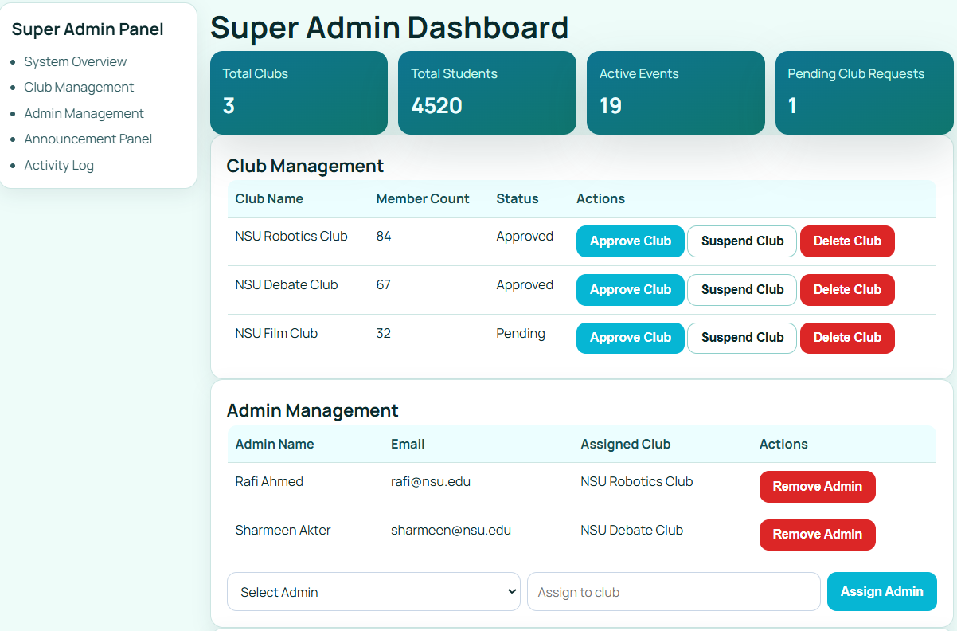
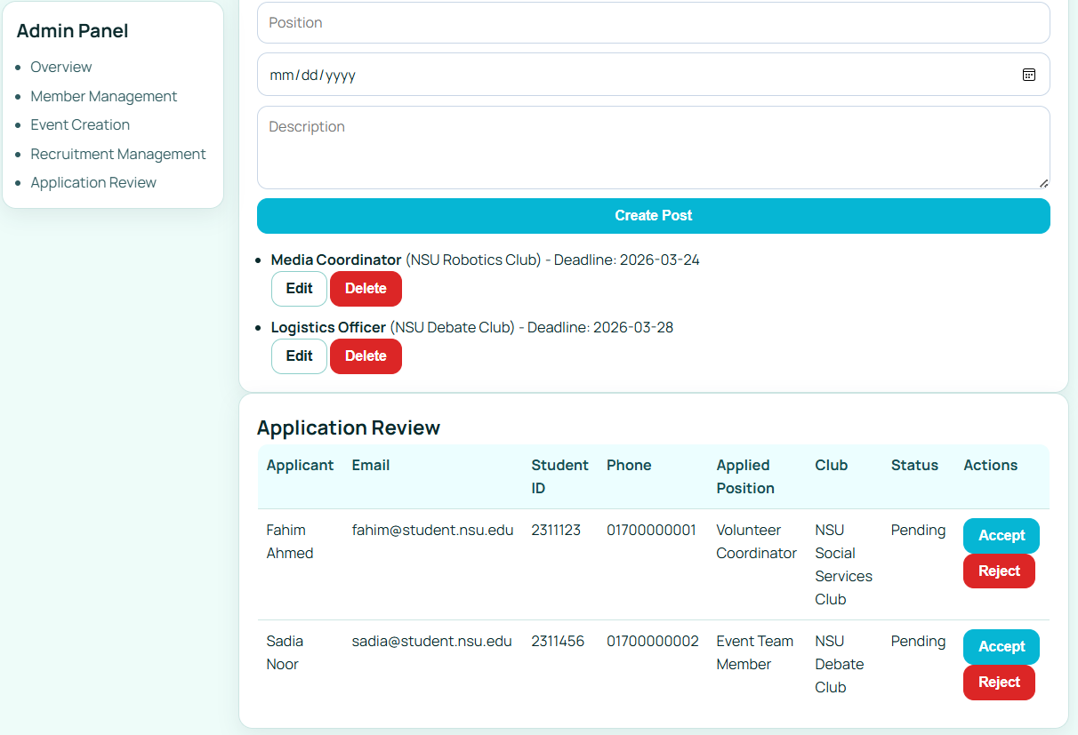

Slide 9




Progress from Update 3
Major improvements in Update 4:
Redesigned login page
Club Admin expanded from 1 module to 8 modules
Super Admin portal expanded to 5 modules
Demo system supports three user roles.
Notes:
6

Slide 10
Limitations & Future Work
Current Limitations:
System uses frontend mock data only
No permanent data storage yet
Notes:
7

