Slide 1


NSU ClubHub — Frontend Overview
This React website lets students log in, sign up, browse clubs and events, and access admin pages based on role. It's a demo frontend with dummy data and role-based views.
THEME: #97B8FFFF
REACT + VITE
Notes:
1

Slide 2
Main Pages & Routes
/
Login page — first screen for users.
/signup
Signup page with role selection.
/home
Home dashboard after login.
/clubs & /clubs/:id
Club list and club details pages.
/calendar
Event calendar using react-big-calendar + date-fns.
/recruitment
Recruitment information page.
/admin & /super
Club admin and super admin dashboards (role-gated).
Notes:
2

Slide 3
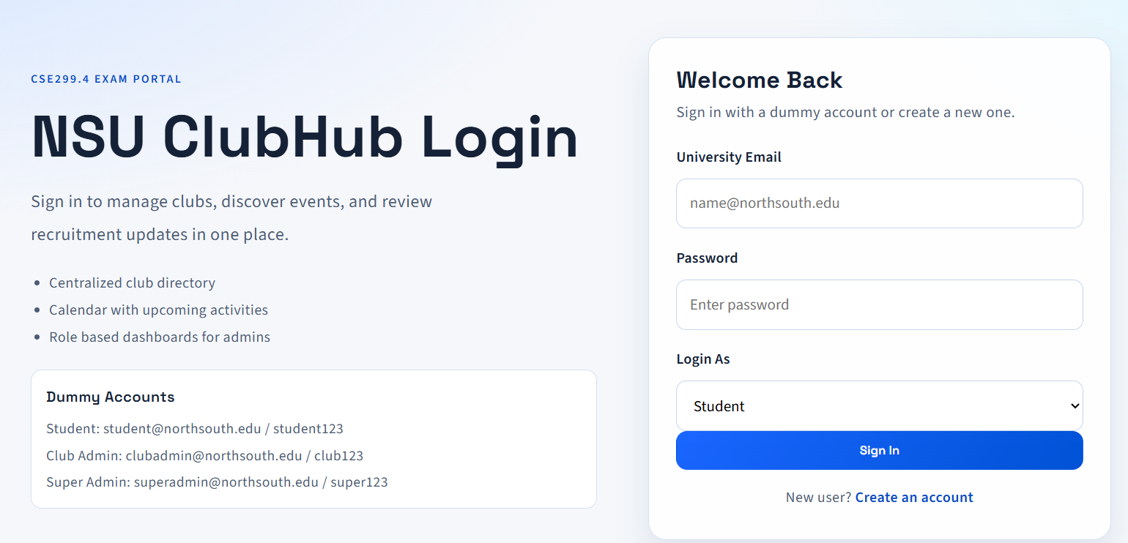
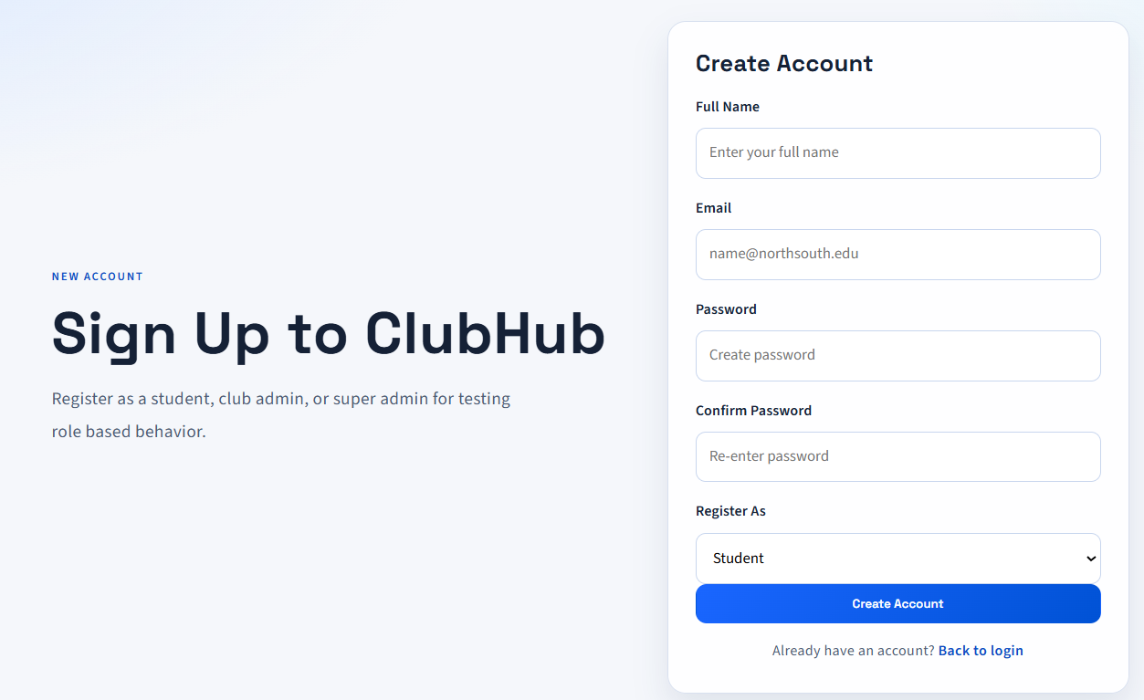
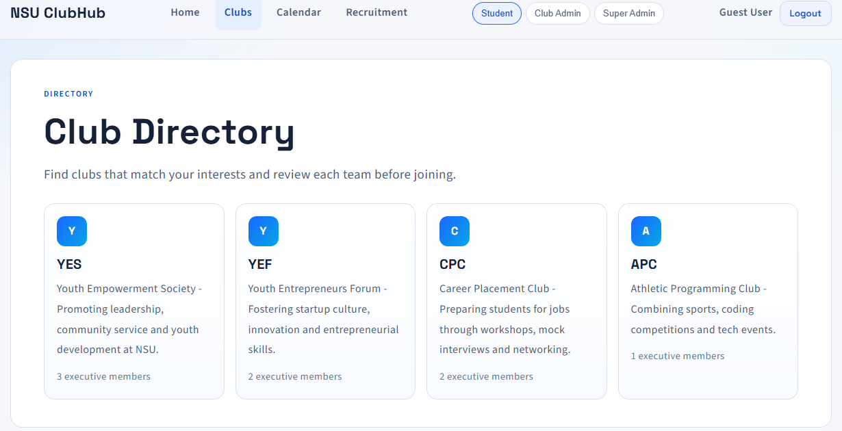
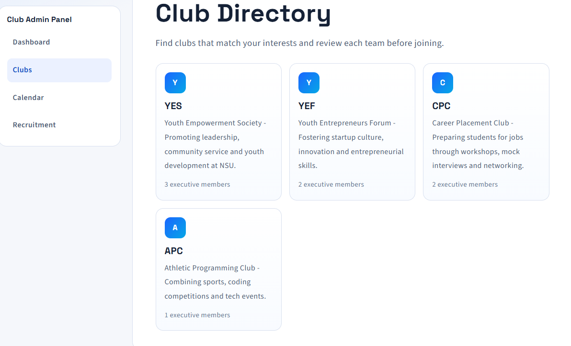

Slide 4



Roles & Login Details
student
Dummy Test Accounts
Standard student view — access clubs, calendar, recruitment.
student@northsouth.edu / student123
clubadmin@northsouth.edu / club123
superadmin@northsouth.edu / super123
club_admin
Accounts are stored in memory only — frontend demo, not a real DB.
Club admin sees /admin and admin sidebar features.
super_admin
Super admin sees /super with global overview.
Notes:
3

Slide 5
Authentication & Signup Flow
01
02
03
Signup
Login
Post-Auth
Name, email, password, confirm password, role selection. Checks: passwords match and email unique (frontend).
Email, password, role selection. Shows clear error messages for wrong info. Demo list of dummy accounts on the login page for testing.
Successful auth sets role state and routes user to /home. Logout clears user and returns to login.
Notes:
4

Slide 6
Key Components & Files
main.jsx
Application entry point.
App.jsx
Routes and main layout logic.
rolecontext.jsx
Auth, login/signup/logout, and role state management.
src/pages/* & src/components/*
Individual page files and reusable UI like header, footer, cards, sidebar.
mockclubs.jsx & mockevents.jsx
Dummy club and event data for pages and calendar.
index.css
Single style file for spacing, typography, and responsive layout.
Notes:
5

Slide 7
Pages — What Each Shows
Home
Calendar
Recruitment
Intro text + quick action buttons to clubs and calendar.
Monthly/weekly views with events (react-big-calendar).
Recruitment info and calls to join.
Clubs
Admin Dashboards
List of clubs from mock data.
Club admin: stats and tools. Super admin: global overview.
Club Profile
Full club details and exec members.
Notes:
6

Slide 8




Design Improvements
Readability
UI Polish
Bigger line spacing and larger important text for easier reading.
Cleaner titles, bigger inputs, improved padding, and modern card styles.
Responsive
Colors
Layouts adapted for mobile and desktop.
Theme colors applied—accent use of #97b8ffff, #7AF0FF, #120336, #0D0326 for emphasis.
Notes:
7

Slide 9
Status, Limits & How to Run
Current Status
Known Limits
Next Steps (simple)
npm run lint passes. npm run build passes. Run locally with npm run dev.
Frontend-only auth (not secure), data is in-memory and resets on refresh, no backend/database yet.
Add backend API, persistent DB, and secure authentication to move to production.
All text and facts match the original project details; language is simple and concise for easy sharing.
Notes:
8

