Slide 1

NSU ClubHub
UPDATE 2 — COMPLETE FRONTEND REDESIGN OF STUDENT DASHBOARD
Next.js 15 + React 19 + TypeScript · Group 6 · CSE 299 · North South University

Slide 2



PROJECT OVERVIEW
One Portal. Every Club. All in One Place.
What is NSU ClubHub?
Mock Data Scope
A university club management portal for North South University, built as a CSE 299 Junior Design project. Students can log in, browse clubs, track events, apply for recruitment, and manage their profile — all from a single, polished interface.
9 Clubs
7 Events
Tech, Arts, Academic, Sports, Cultural
Spanning March 2026
Current state: UI/UX prototype powered by hardcoded mock data. Backend integration is planned for the next update.
5 Roles
5 Alerts
4 application statuses tracked
Read / unread notification states

Slide 3






TECH STACK
Built on a Modern, Type-Safe Foundation
Next.js 15 + App Router
React 19 + TypeScript
File-based routing and server components for fast, scalable page architecture.
Type-safe component architecture eliminating runtime errors before they happen.
Tailwind CSS + shadcn/ui
Syne + Plus Jakarta Sans
Utility-first styling paired with accessible, headless Radix UI primitives.
Syne for bold display headings, Plus Jakarta Sans for clean, readable body text.
Planned (not yet implemented): Neon Postgres · Drizzle ORM · NextAuth v5 · Resend Email · Zod Validation

Slide 4


PAGES BUILT
6 Fully Redesigned Pages
Landing / Login
1
Split-layout hero, login form with role-redirect logic, animated background.
Dashboard
2
Stats row, dismissible announcements, open recruitments grid, mini calendar.
Club Directory
3
Real-time search, category filters, shimmer loading skeletons, 9-club card grid.
Club Profile
4
Hero banner, about section, exec board display, events tab, recruitment CTA.
Event Calendar
5
Month / Week / Agenda views, category filters, popover event details, 7 mock events.
Recruitment + Settings
6
4-step apply wizard, application tracker timeline, profile editing, password strength meter.

Slide 5
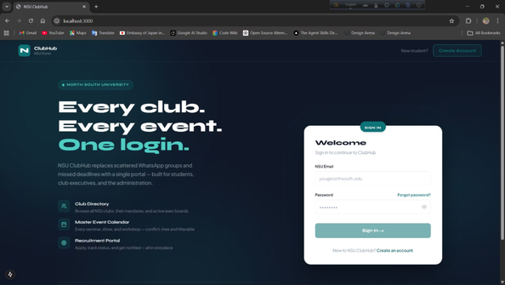
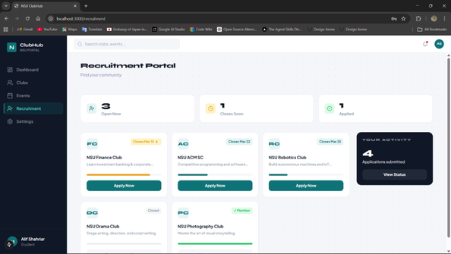
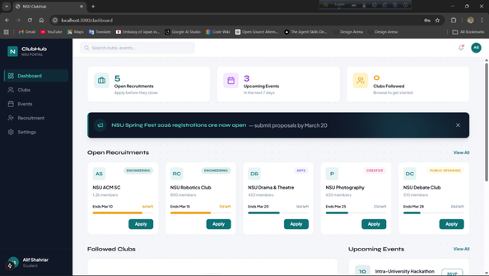
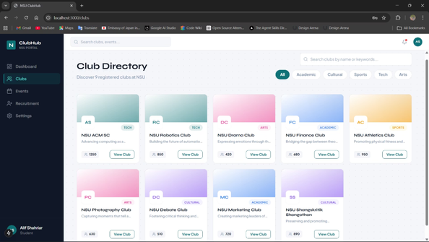
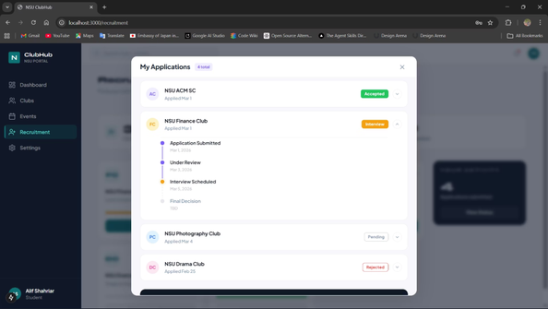
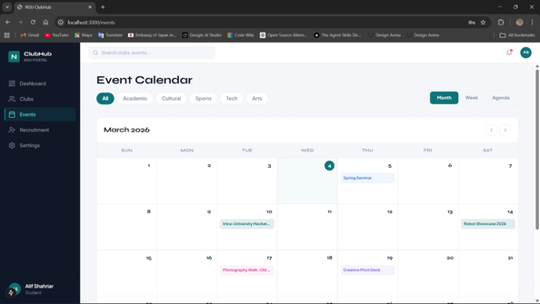
LIVE PRODUCT GALLERY
Project Showcase
Recruitment
Apply Modal
📸 Screenshots of the corresponding app page. Six pages total — Login, Dashboard, Club Directory, Event Calendar, Recruitment Portal, and apply modal

Slide 6
TECH STACK
Built on a Modern, Type-Safe Foundation
Next.js 15 + App Router
React 19 + TypeScript
File-based routing and server components for fast, scalable page architecture.
Type-safe component architecture eliminating runtime errors before they happen.
Tailwind CSS + shadcn/ui
Syne + Plus Jakarta Sans
Utility-first styling paired with accessible, headless Radix UI primitives.
Syne for bold display headings, Plus Jakarta Sans for clean, readable body text.
Planned (not yet implemented): Neon Postgres · Drizzle ORM · NextAuth v5 · Resend Email · Zod Validation

Slide 7



DESIGN SYSTEM
A Consistent Visual Language, Token to Token
Color Tokens
Typography System
■ #2DC7A0 Teal/Cyan — Primary CTAs, active nav, badges
Syne — Display & Headings
Plus Jakarta Sans — Body
■ #97B8FF Periwinkle — Secondary accents, icons
■ #0D0326 Deep Navy — Main page backgrounds
Bold, geometric. Used for hero titles, section headers, and nav branding.
Clean, humanist. Used for paragraphs, labels, form fields, and descriptions.
■ #120336 Dark Surface — Sidebar and card backgrounds
■ Amber — Urgent deadline badges
Consistent border-radius, spacing scale, and shadow tokens applied across every component for visual cohesion.
Status: Green (Accepted) · Orange (Interview) · Red (Rejected) · Gray (Pending)

Slide 8


PROGRESS TRACKER
What's New vs. Update 1
Feature
Update 1
Update 2
Framework
React + Vite
Next.js 15 App Router
Language
JavaScript
TypeScript
UI Library
Custom CSS
shadcn/ui + Tailwind
Design System
None
Full token system
Login Page
Basic form
Split hero layout
Dashboard
Plain cards
Stats + announcements + sidebar
Club Directory
Flat list
Search + filters + shimmer skeletons
Club Profile
Not present
Full hero + exec board + events
Apply Flow
Not present
4-step wizard with validation
Notifications
Not present
Sheet-based panel
Settings
Not present
Profile + password + notifications

Slide 9






ROADMAP
What's Next — Backend Integration
Database
Communication
Neon Postgres + Drizzle ORM for type-safe cloud data
Resend transactional emails for updates and alerts
Authentication
Validation
NextAuth v5 with NSU email and role-based access
Zod runtime validation for forms and APIs
The goal is to evolve NSU ClubHub from a polished UI prototype into a fully functional, production-ready platform for every student at North South University — with real authentication, live data, and automated notifications powering the experience.

