Slide 1
Identifying Emotions From Text
Presented BY:
Shabana R.P
Spurthi M.S
Eshamma K.G
Guided by:Dr. K.M Anil Kumar

Slide 2
Table of Contents
Aim
Objective
Existing Solution Method
Proposed Solution Method
Details of first Presentation
Current Progress

Slide 3
Aim
This project is aimed to design a prototype which classifies different levels of emotions and detects emotions from text using NLP and ML.

Slide 4
OBJECTIVE
To classify text as emotional or non emotional text.
To compare Natural Language processing and Machine Learning based application.
To develop a prototype for classifying and detection of emotions.

Slide 5
Existing solution Method
We can detect emotion by reading and analyzing the text statement or document.
In Existing solution method detection of emotions is limited to some short documents.
They detect emotions by classifying it into positive , negative and neutral
Emotion detection by emotional keyword.

Slide 6
Proposed solution Methods
We are trying to detect emotion from different sized documents.
Emotions are divided into 5 different types based on the Paul Ekman Theory
Happy
Sad
Angry
Fear
Disgust
Finding the accuracy of the Emotions.

Slide 7
Details of first presentation
Identification of emotional words from text
Classification of Emotion
Emotion Analysis using ML and NLTK

Slide 8
Current Progress
What are the emotions we are interested in?
How to collect the input dataset?
How to process and find the emotion?

Slide 9
Collecting dataset
In order to train the word2vec tool we are using a dataset from Google news corpus.
Further, we have an emotion based
Keyword dataset
Phrase dataset

Slide 10
KEYWORD EXTRACTION
Identify keywords that are the useful to the classifier from the input dataset.
Classify the extracted keywords into 5 basic emotion class
We have classified keyword dataset of size 1540 into 5 text files
Joy:553
Fear:195
Disgust:70
Anger:355
Sad:274

Slide 11
Word2vec tool
Converts given text data into vector representation.
Enables us to arrive at semantically similar words.
However, we need the words to be emotionally similar.

Slide 12
Word2vec tool
We need to consider semantically equal words with the constraint that they are emotionally equal too and update their weights respectively so that emotionally similar words are closer to each other.

Slide 13
Emotion classification
Consider 5 basic emotions
We have implemented 5 small baseline
Programs to identify emotion
Given any sentence/paragraph we will determine the 5 basic emotions through feature extraction

Slide 14
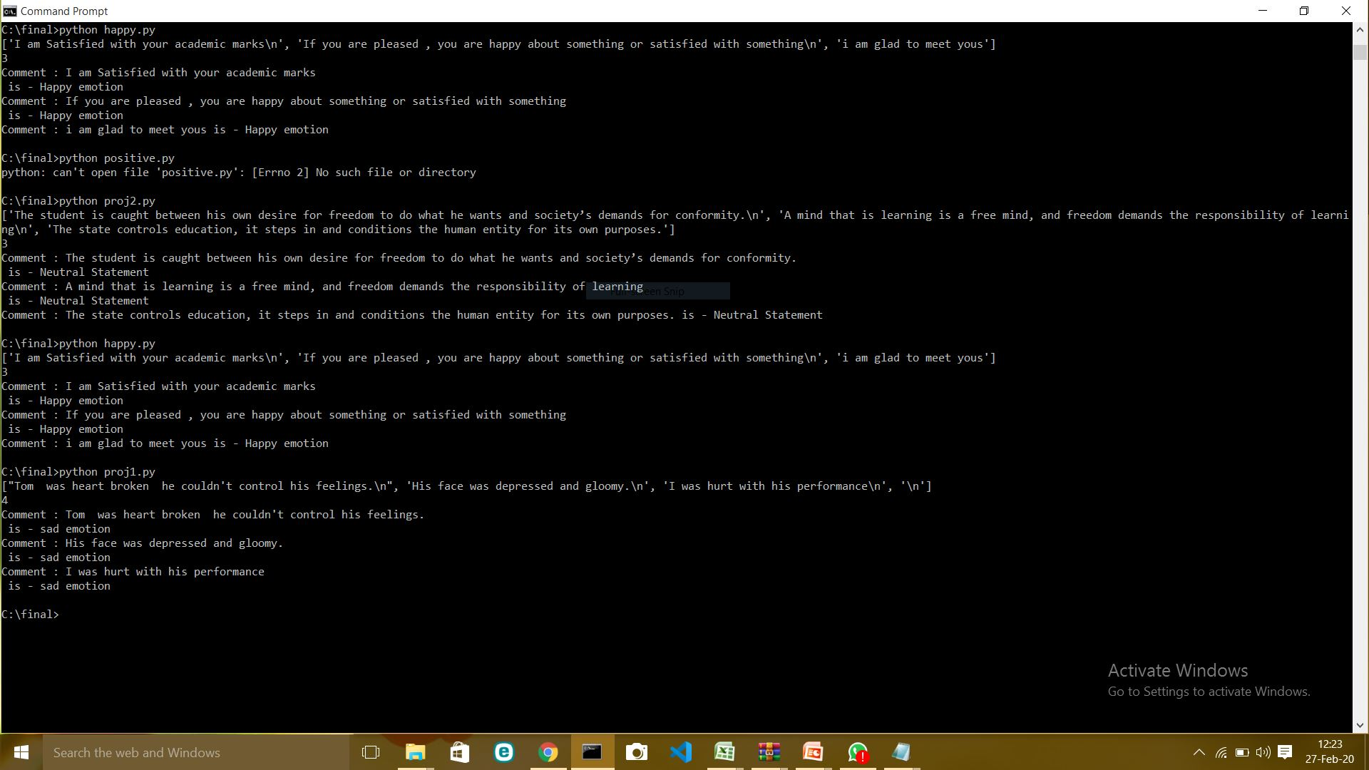

Slide 15
Thank You

