Slide 1
Status Presentation
FDS (FOOD DONATION SYSTEM)
Presented By
TEAM 11
Under the Guidance of
ASHA ALI
ASST. PROFESSOR
INFORMATION TECHNOLOGY
Team Members
20. FATHIMA NK
31. MUHAMMED ASHIK A
41. SHABANA K M
42. SHAMEEMUL HAQUE P

Slide 2
Problem Statement
To develop a web application for a food donation system.
Specific Objectives
Food Donation System is a web-based application that helps agencies or event management to provide food for orphanages or other organizations in an area.
This system also helps orphanages or organizations to get food by simply registering their information on the website after that they can collect food after receiving the notification from the site when the event has ended.
Our goal is to encourage the best use of wholesome unmarketable food. We can accomplish this through our partnerships with food companies, food charities, and other waste diverters with a focus on bridging the technology, communication, and infrastructure gap that results in large amounts of food waste.

Slide 3
Proposed Architecture
FRONTEND HTML,CSS
BACKEND
JAVASCRIPT,PHP
USER
DATABASE

Slide 4
Algorithms/Tools Used
Visual Studio Code: A streamlined code editor which supports development operations like debugging, task, running, and version control.
Database Server: It is an organized collection of data stored and accessed electronically.

Slide 5
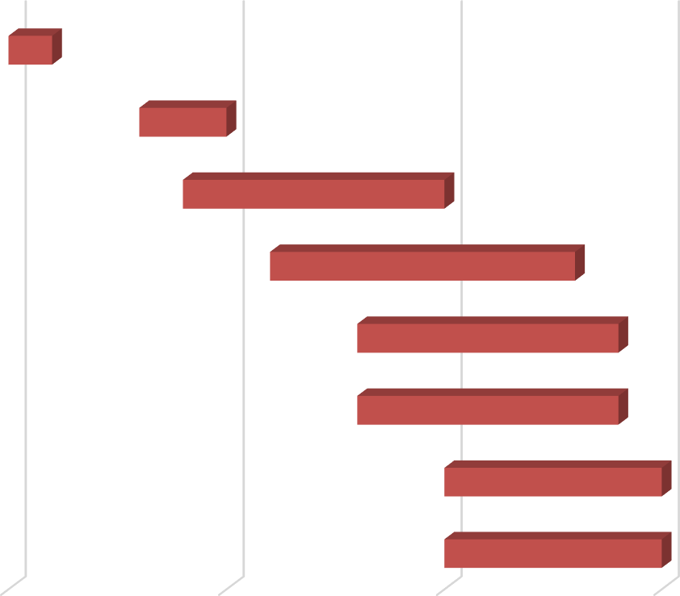
Implementation Plan
6/10/2022
6/15/2022
6/20/2022
7/06/2022
Project kick-off
Abstract Wireframe design Home page design Coll
organization page
Event management page
Database management
Final

Slide 6
Conclusion
Every year fifty thousand crore rupees of food are wasted in a world where millions of people do not have food to eat properly. Donating food to worthy people or organizations helps counter poverty and hunger and at the same time, we can reduce the wastage of food. FDS is a system that helps the organization to collects food from a variety of sources and then distributes the food to needy organizations such as orphanages.

Slide 7
References
YouTube
W3 School
Coursera

