Slide 1
Programming for AI
Fall 2026
Lecture-1
Introduction

Slide 2
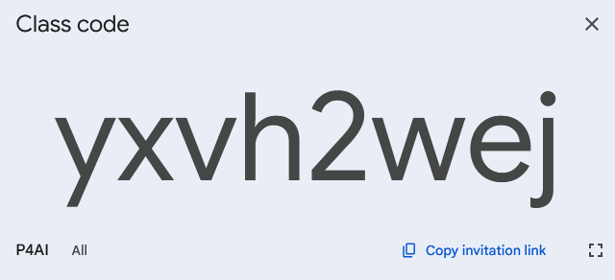
Programming for AI
Fall 2026
Instructions
Please join Google Classroom to get updates.
In case of any query, contact me on my email. (ishabansatti@gmail.com)
Office: New Computer Lab (Mon to Thu: 10 AM to 1 PM)
Google Classroom Code

Slide 3
Programming for AI
Fall 2026
Marks Breakup
Projects (30 = 3 X 10)
Mid Exam (30)
Final Exam (40)
Instructions
You should have a GitHub account to upload your project codes.
All projects will be followed by a relevant viva.
Mid and Final Exams will be scenario based and may be open book subjected to approval.

Slide 4
Programming for AI
Fall 2026
Projects Details
Projects
# | Project | Due | Marks
1 | ETL + EDA Pipeline Build an ETL pipeline that extracts data from an API, transforms/validates it with pandas and Pydantic, loads it to a database, and conduct a structured exploratory data analysis on the result. | Week 7 | 10
2 | scikit-learn ML Pipeline Build an end to end scikit-learn Pipeline combining preprocessing and a model, with cross-validated hyperparameter search, evaluated on a held-out test set. | Week 11 | 10
3 | PyTorch + MLflow Train and tune a PyTorch model (using Optuna) and track all experiments, parameters, metrics, and the final model with MLflow. | Week 15 | 10
Total |  |  | 30

Slide 5




Programming for AI
Fall 2026
Tools Required for this course
VS Code https://code.visualstudio.com/
Python https://www.python.org/downloads/
Docker https://www.docker.com/
GitHub Desktop https://github.com/
Google Colab https://colab.research.google.com/

Slide 6
Programming for AI
Fall 2026
01.
Why Python?
02.
Python’s Typing Paradigm
03.
Python Execution Engine and Interfaces
04.
Variables
05.
Input & Output
06.
Type Conversion
Agenda
07.
Arithmetic Operations

Slide 7
Programming for AI
Fall 2026
01.
Why Python?

Slide 8
Programming for AI
Fall 2026
Python
Default language for modern artificial intelligence and machine learning.
High-level, and readable syntax.
It acts as a thin, expressive wrapper around low-level performance engines written in C, and CUDA.
Libraries such as PyTorch, NumPy, and Hugging Face Transformers expose Python APIs.

Slide 9
Programming for AI
Fall 2026
Python
Enormous ecosystem: NumPy, pandas, PyTorch, TensorFlow, scikit-learn, Hugging Face.
Rapid prototyping: dynamic typing and a REPL-friendly design.
Community and education: the largest base of tutorials and courses.
Interoperability: Python glues together C/C++ kernels, GPU drivers, distributed systems, and web APIs with minimal friction.

Slide 10
Programming for AI
Fall 2026
02.
Typing Paradigms

Slide 11
Programming for AI
Fall 2026
Typing Paradigms
Every programming language can be classified along two independent axes.
    When types are checked: Static (at compile time) vs. Dynamic (at run time).
    How conversions between types are handled: Strong (no implicit coercion) vs. Weak (implicit coercion allowed).
Python sits in a specific, important quadrant: dynamically typed AND strongly typed.

Slide 12
Programming for AI
Fall 2026
Static Typed
Languages like C++, Java, and Rust require variable type to be declared and checked before the program runs.
The compiler determines memory layout and allocations ahead of time (AOT), based on those declared types.
Benefit: many type errors are caught early, before deployment, and the compiler can produce more optimized machine code.
Trade-off: more verbose code, and less flexibility to rapidly reshape data structures during experimentation.
Example: int x = 42; in C++ fixes x to the integer type for its entire lifetime.

Slide 13
Programming for AI
Fall 2026
Dynamic Typed
In Python, a variable name is simply a label. It is a reference bound to an object living somewhere in memory.
The type belongs to the OBJECT, not the variable name. A name can be re-bound to point to any type of object at any time.
Type checking happens dynamically, as each instruction executes.
This enables extremely fast prototyping: you can reshape a variable's role without touching a type declaration.
The cost: certain classes of bugs (e.g. calling a method that does not exist on the current object) are only caught when that exact line executes.

Slide 14
Programming for AI
Fall 2026
Weak Typed
Weakly typed languages automatically convert (coerce) values between incompatible types when an operation is attempted.
JavaScript example: '5' + 5 silently evaluates to the string '55'.
Convenient for quick scripting, but a frequent source of subtle bugs in large codebases.
A hidden coercion can propagate incorrect values silently.

Slide 15
Programming for AI
Fall 2026
Strong Typed
Python enforces type boundaries between fundamentally different types.
Attempting an operation between incompatible types (e.g. str + int) raises an explicit TypeError at run time rather than silently coercing.
This forces developers to be deliberate and explicitly convert types yourself, e.g. str(98) or int("98").
In AI code, this discipline prevents silent numerical corruption. Imagine a batch size accidentally becoming a string and no error being raised.

Slide 16
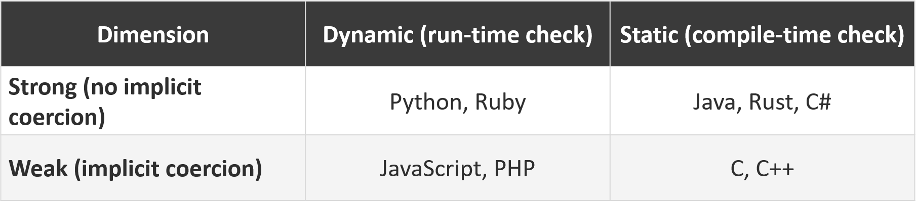
Programming for AI
Fall 2026
Typing Dimensions

Slide 17
Programming for AI
Fall 2026
Question:
What happens at run time when you execute "Score: " + 98 in Python versus in JavaScript? Explain the underlying mechanism.

Slide 18
Programming for AI
Fall 2026
What happens at run time when you execute "Score: " + 98 in Python versus in JavaScript? Explain the underlying mechanism.
Python raises a TypeError because it is strongly typed and will not automatically coerce an integer to a string during addition. JavaScript is weakly typed and performs implicit coercion, yielding the string "Score: 98".

Slide 19
Programming for AI
Fall 2026
Question:
Which statement accurately describes Python's typing system?
A
Statically and weakly typed
B
Dynamically and strongly typed
C
Dynamically and weakly typed
D
Statically and strongly typed
Answer: B Python checks types at run time (dynamic) and refuses implicit coercion between incompatible types (strong).

Slide 20
Programming for AI
Fall 2026
03.
Execution Engine and Interfaces

Slide 21
Programming for AI
Fall 2026
Execution Engine
Every Python program needs an execution engine to run.
CPython Interpreter: It reads source code, compiles it to bytecode, and executes that bytecode on a virtual machine.

Slide 22
Programming for AI
Fall 2026
CPython Interpreter
Parsing: It reads your .py source file and checks for syntax errors, converting the text into an Abstract Syntax Tree (AST).
2. Compiling to Bytecode: The compiler component of CPython translates the AST into a low-level, platform-independent instruction set called bytecode.
Caching (.pyc): To speed up future runs, CPython writes this bytecode to disk inside a __pycache__ directory as a .pyc file. If the source file hasn't changed on the next run, Python skips steps 1 and 2 entirely.
Virtual Machine Execution: The CPython Virtual Machine (PVM) loops through the bytecode instructions, evaluates them, and interacts with your system hardware to execute the program.

Slide 23
Programming for AI
Fall 2026
Interfaces
REPL (Read-Eval-Print Loop): an interactive shell that executes one statement at a time and immediately shows results.
Scripting: running a complete .py file from the command line, top to bottom, in one process.
Notebook environments (IPython, Jupyter): cell-based, interactive execution popular for AI experimentation.

Slide 24
Programming for AI
Fall 2026
Thank
You!

