Slide 1
Reinforcement Learning
Spring 2026
Lecture-1
An Introduction

Slide 2
Reinforcement Learning
Spring 2026
Instructions
Please join Google Classroom to get updates.
Attendance will be marked on Google Forms. You should have internet to mark the attendance.
In case of any query, you can contact me on my email.
ishabansatti@gmail.com
Please be punctual in class.

Slide 3
Reinforcement Learning
Spring 2026
Marks Breakup
Quizzes (25 = 5 X 5)
Assignments (5 = 1 X 5)
Mid Exam (30)
Final Exam (40)
Instructions
MCQs based quizzes on google forms.
You should have a GitHub account to upload your assignment codes.
All assignments will be followed by a relevant viva.

Slide 4
Reinforcement Learning
Spring 2026
01.
Learning by Interaction
02.
Reinforcement Learning (RL)
03.
Elements of RL
04.
Examples
Agenda
Difference from Supervised and Unsupervised Learning
05.

Slide 5
Reinforcement Learning
Spring 2026
Learning by Interaction
01.

Slide 6

Reinforcement Learning
Spring 2026
Learning by Interaction
No explicit teacher.
Direct interaction with the environment.
Learn cause and effect, and about what to do to achieve goals.
Examples: Infant movement, driving a car or holding a conversation.

Slide 7
Reinforcement Learning
Spring 2026
Reinforcement Learning (RL)
02.

Slide 8
Reinforcement Learning
Spring 2026
Reinforcement Learning
A computational approach to learn from interaction.
RL is learning
what to do i.e. how to map situations to actions
To maximize a numerical reward signal.
Two distinguishing features of RL
trial-and-error search
delayed reward

Slide 9
Reinforcement Learning
Spring 2026
03.
Elements of RL

Slide 10
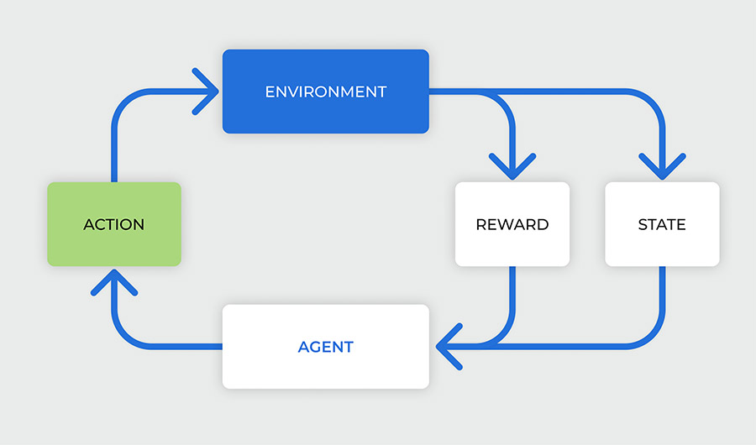
Reinforcement Learning
Spring 2026

Slide 11
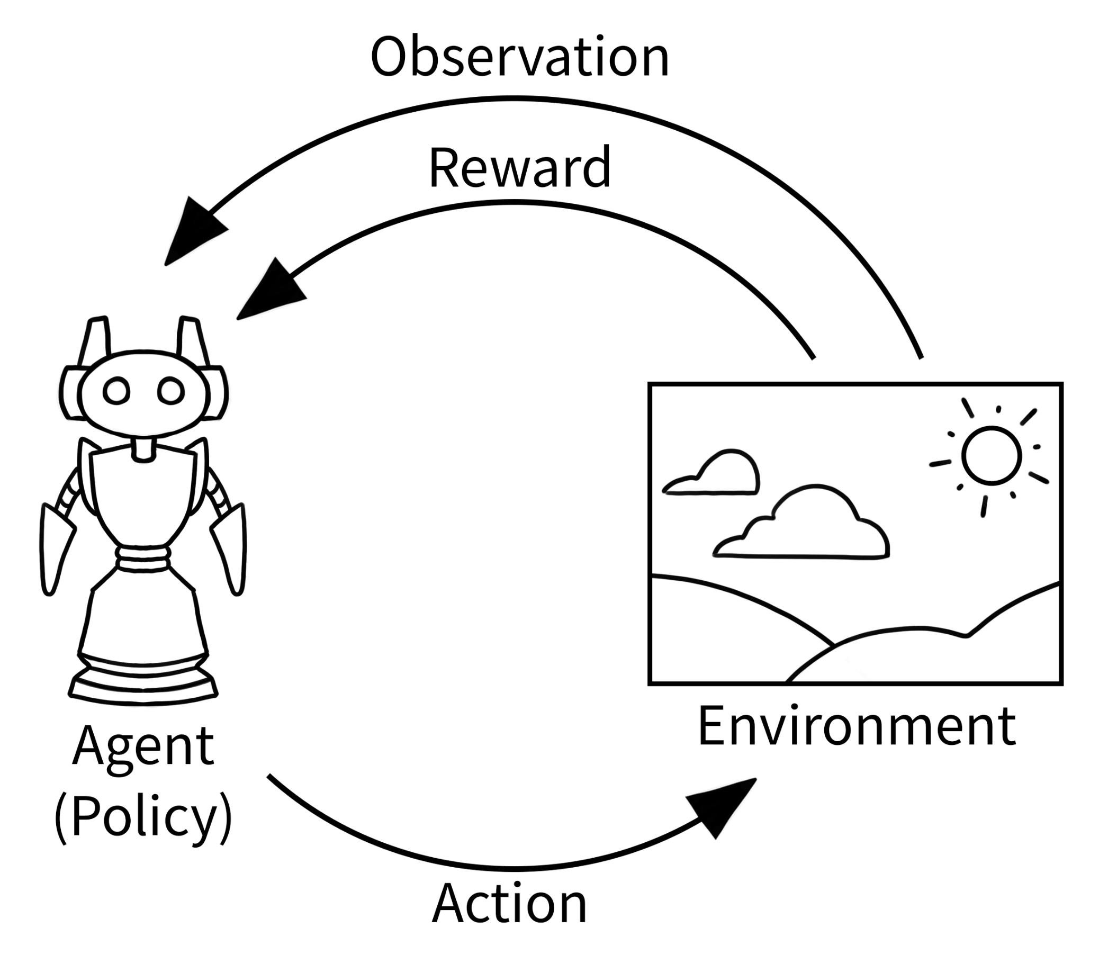
Reinforcement Learning
Spring 2026

Slide 12
Reinforcement Learning
Spring 2026
Agent and Environment
The environment is the world that the agent lives in and interacts with.
At every step of interaction, the agent sees a (possibly partial) observation of the state of the world and then decides on an action to take. The environment changes when the agent acts on it but may also change on its own.

Slide 13
Reinforcement Learning
Spring 2026
States and Observations
A state is a complete description of the state of the world. There is no information about the world which is hidden from the state. An observation is a partial description of a state, which may omit information.
The state of a robot might be represented by its joint angles and velocities.
When the agent is able to observe the complete state of the environment, the environment is fully observed. When the agent can only see a partial observation, we say that the environment is partially observed.

Slide 14
Reinforcement Learning
Spring 2026
State Space
The state space is the set of all possible states that the environment can be in.
A state is a complete description of the situation in the environment at a particular point in time.
For a robot on a grid, if the grid is 3x3, each cell on the grid can be a possible position of the robot. The state space would include all possible positions the robot can occupy, i.e., 9.

Slide 15

Reinforcement Learning
Spring 2026
Reward
A reward Rt is a scalar feedback signal
Indicates how well agent is doing at step t
The agent's job is to maximise cumulative reward

Slide 16


Reinforcement Learning
Spring 2026
Policy
A policy is the agent's behavior.
It is a map from state to action, e.g.
Deterministic policy:
Stochastic policy:

Slide 17
Reinforcement Learning
Spring 2026
Action Space
The action space defines all possible actions an agent can take within an environment.
The action space can be either discrete or continuous.
For example, in a game like chess, the action space is discrete—each move corresponds to a specific, countable option. In contrast, a self-driving car’s steering angle or acceleration might operate in a continuous action space, where actions are real-valued and infinite in possibility.

Slide 18
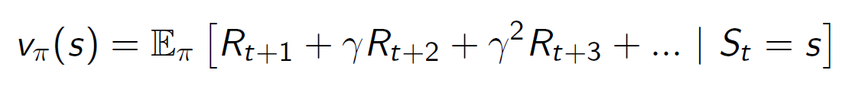
Reinforcement Learning
Spring 2026
Value Function
Value function is a prediction of future reward.
Used to evaluate the goodness/badness of states.
And therefore, to select between actions, e.g.

Slide 19
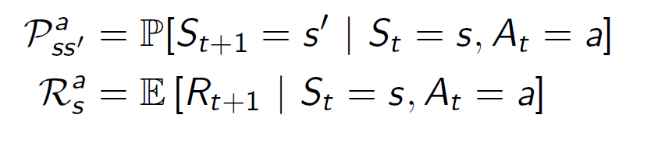
Reinforcement Learning
Spring 2026
Model
A model predicts what the environment will do next
P predicts the next state
R predicts the next (immediate) reward, e.g.

Slide 20
Reinforcement Learning
Spring 2026
04.
Examples

Slide 21
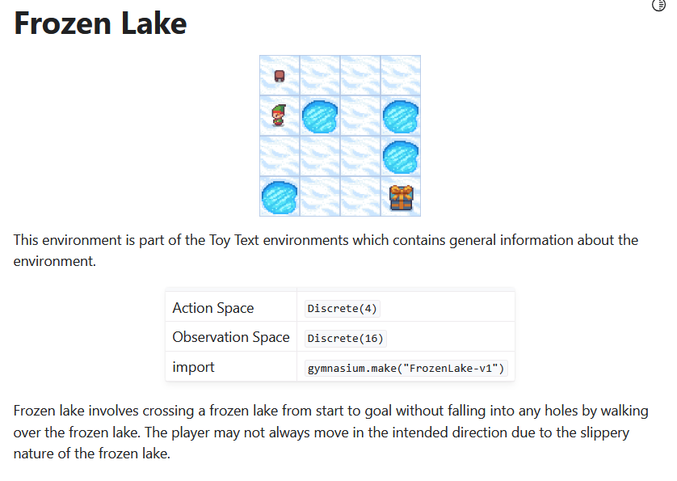
Reinforcement Learning
Spring 2026
Gymnasium Env.
https://gymnasium.farama.org/

Slide 22
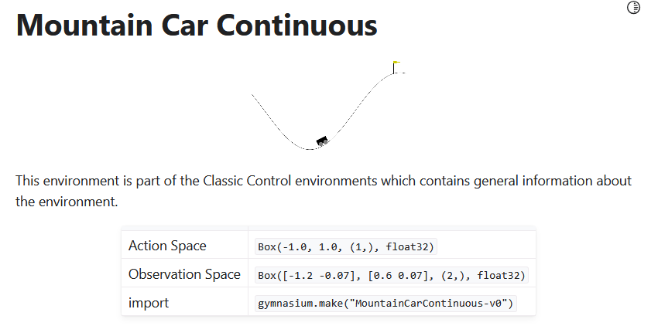
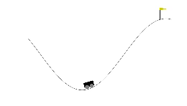
Reinforcement Learning
Spring 2026
Gymnasium Env.

Slide 23
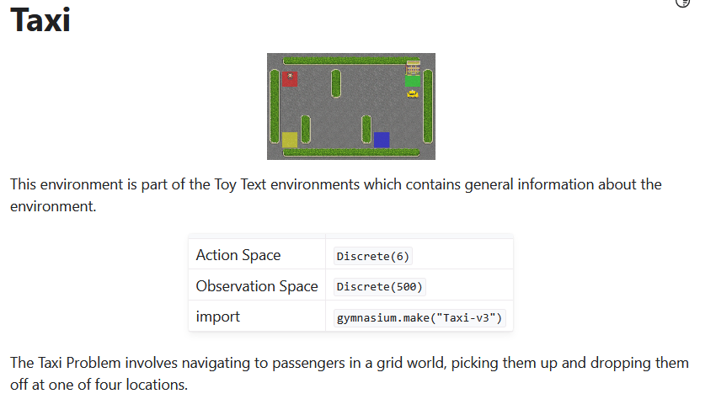
Reinforcement Learning
Spring 2026
Gymnasium Env.

Slide 24
Reinforcement Learning
Spring 2026
Bioreactor
Actions: Target temperatures and target stirring rates that are passed to lower-level control systems.
States: thermocouple and other sensory readings, perhaps filtered and delayed, plus symbolic inputs representing the ingredients.
Rewards: moment-by-moment measures of the rate at which the useful chemical is produced.

Slide 25
Reinforcement Learning
Spring 2026
Pick-and-Place Robot
Actions: the voltages applied to each motor at each joint.
States: latest readings of joint angles and velocities.
Rewards: The reward might be +1 for each object successfully picked up and placed. To encourage smooth movements, on each time step a small, negative reward can be given as a function of the moment-to-moment “jerkiness” of the motion

Slide 26
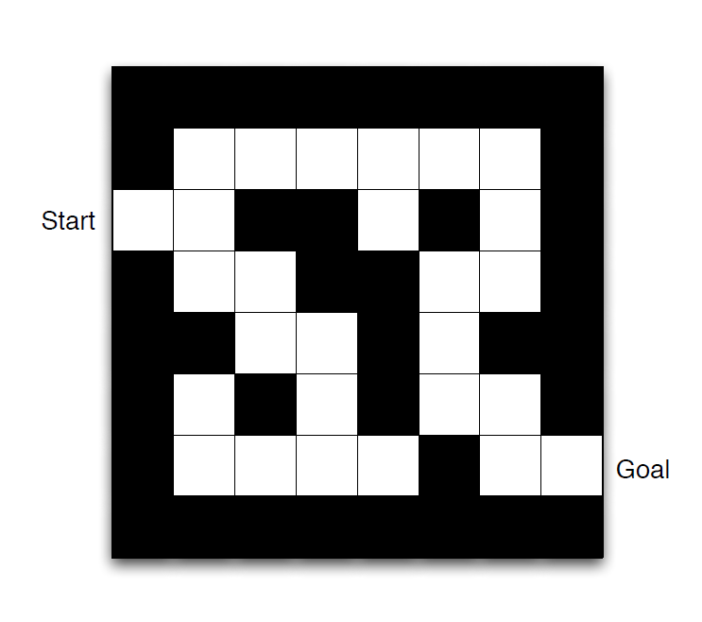
Reinforcement Learning
Spring 2026
A Maze

Slide 27
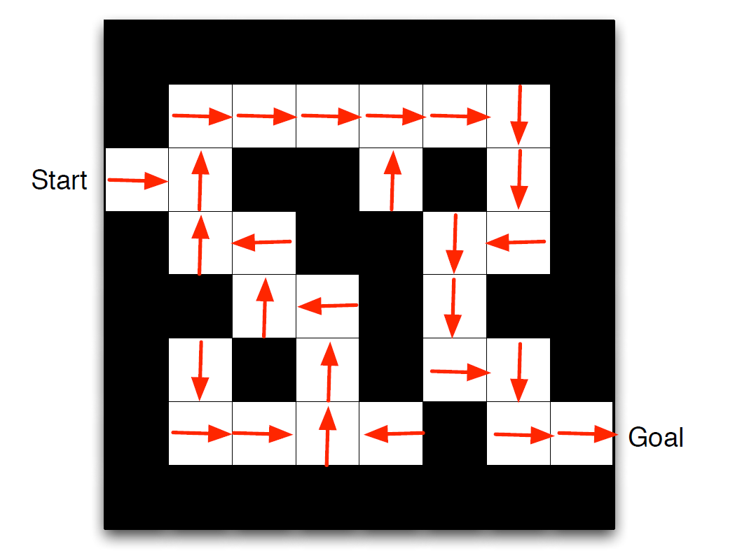
Reinforcement Learning
Spring 2026
A Maze

Slide 28
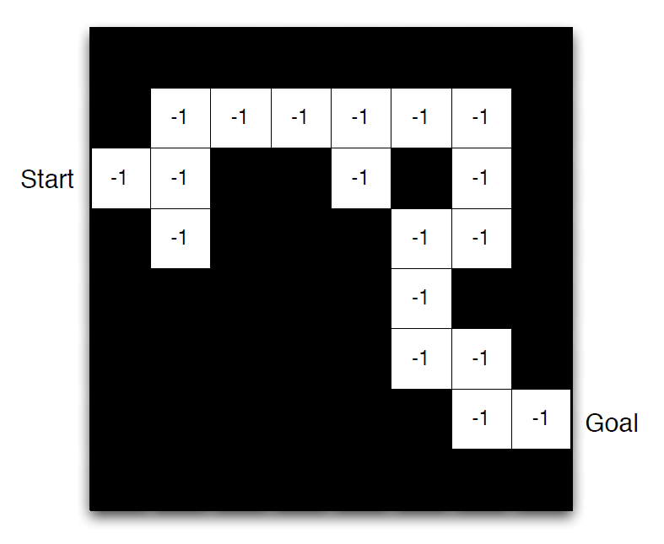
Reinforcement Learning
Spring 2026
A Maze

Slide 29
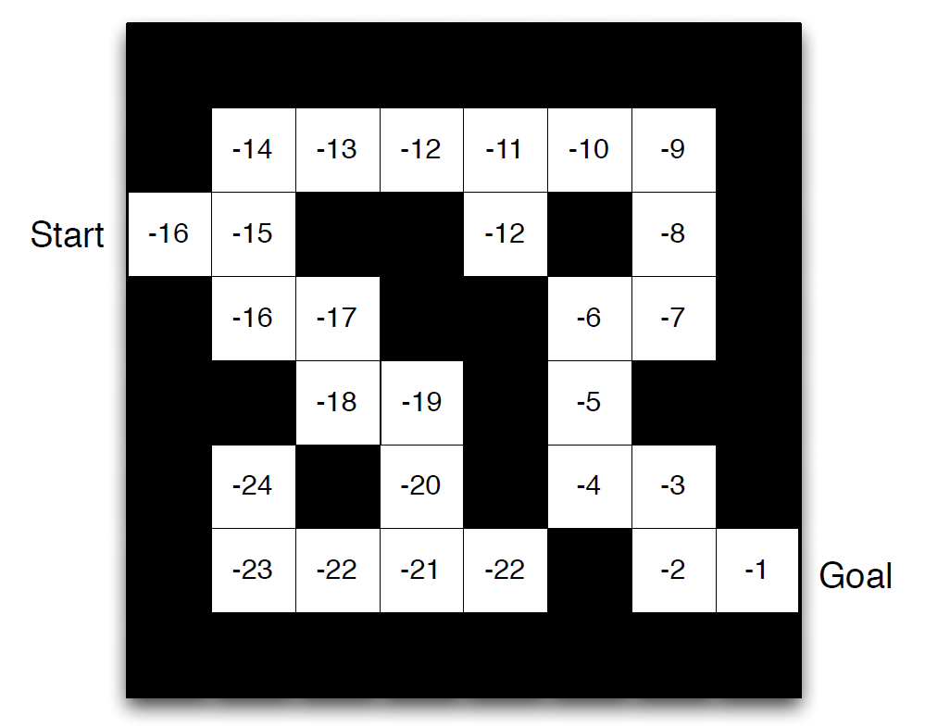
Reinforcement Learning
Spring 2026
A Maze

Slide 30
Reinforcement Learning
Spring 2026
Difference from Supervised and Unsupervised Learning
05.

Slide 31
Reinforcement Learning
Spring 2026
Supervised Learning
Supervised learning is learning from a training set of labeled.
Objective of SL is for the system to extrapolate, or generalize, its responses to act correctly in situations not present in the training set.
In interactive problems it is often impractical to obtain examples of desired behavior that are both correct and representative of all the situations in which the agent has to act.

Slide 32
Reinforcement Learning
Spring 2026
Unsupervised Learning
Unsupervised learning is typically about finding structure hidden in collections of unlabeled data.
Reinforcement learning as a kind of unsupervised learning because it does not rely on examples of correct behavior.
Reinforcement learning is trying to maximize a reward signal instead of trying to find hidden structure.

Slide 33

Presentation Name
Date 20XX
Thank
You!
18.

