Slide 1
KERAS-DEEP LEARNING API
Presented by:
Keerthana B 21C046
Shabari Prakash SV 21C085
Shaye Sree Nivashini SR 21C088

Slide 2
INTRODUCTION OF TOOL
Keras is an open-source deep learning library written in Python that provides a user-friendly interface for building and training neural networks.
It was developed with a focus on ease of use, flexibility, and modularity, making it a popular choice for both beginners and experienced machine learning practitioners.

Slide 3
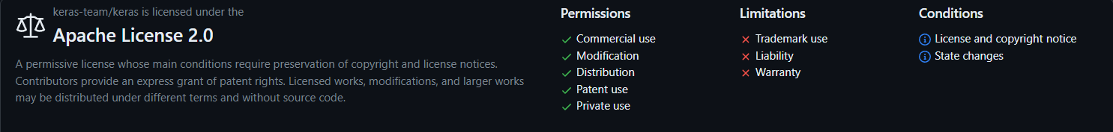
LICENSES OF THE TOOL

Slide 4
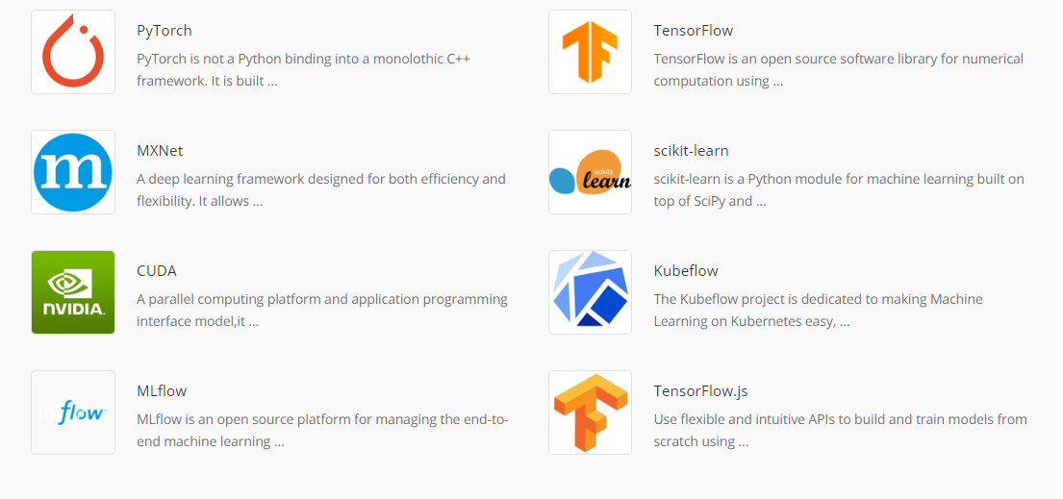
ALTERNATIVES FOR THE TOOL

Slide 5
ADVANTAGES OF USING THE TOOL
Ease of Use: Keras provides a user-friendly and intuitive API for designing and training neural networks.
Modularity: Keras follows a modular design approach, allowing you to create neural network models by stacking layers together.
Backend Agnostic: Keras is backend-agnostic, meaning it can run on top of multiple deep learning frameworks, such as TensorFlow, Theano, or CNTK.
Compatibility: Keras is compatible with Python 3 and seamlessly integrates with other popular Python libraries like NumPy, Pandas, and Matplotlib.
Transfer Learning: Keras makes it easy to perform transfer learning by leveraging pre-trained models and fine-tuning them for your specific tasks. This can save you a significant amount of training time and data.
Visualization Tools: Keras provides built-in tools for visualizing model architectures and monitoring training progress. Tools like TensorBoard integration make it easier to analyze and debug your models.
Versatility: Keras supports a wide range of deep learning tasks, including image classification, object detection, natural language processing, and more.

Slide 6
PROBLEM STATEMENT FOR PROJECT
Problem Description:
Many educational institutions and workplaces require an efficient and accurate system for tracking attendance. Traditional methods involving paper sign-in sheets or manual entry are prone to errors and time-consuming. To address these issues, we propose the development of an automated attendance system using facial detection technology.
Problem Statement:
Design and implement an Attendance System using Facial Detection to accurately record and manage attendance for students or employees in an educational institution or workplace.

Slide 7
INSTALLATION STEPS(IN LINUX)
sudo apt update
sudo apt install python3
sudo apt install python3-pip
pip3install tensorflow keras

Slide 8
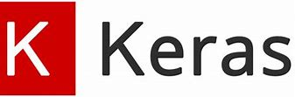


TECH STACK INVOLVED
FRONT END
BACKEND
(ON PROGRESS)

Slide 9
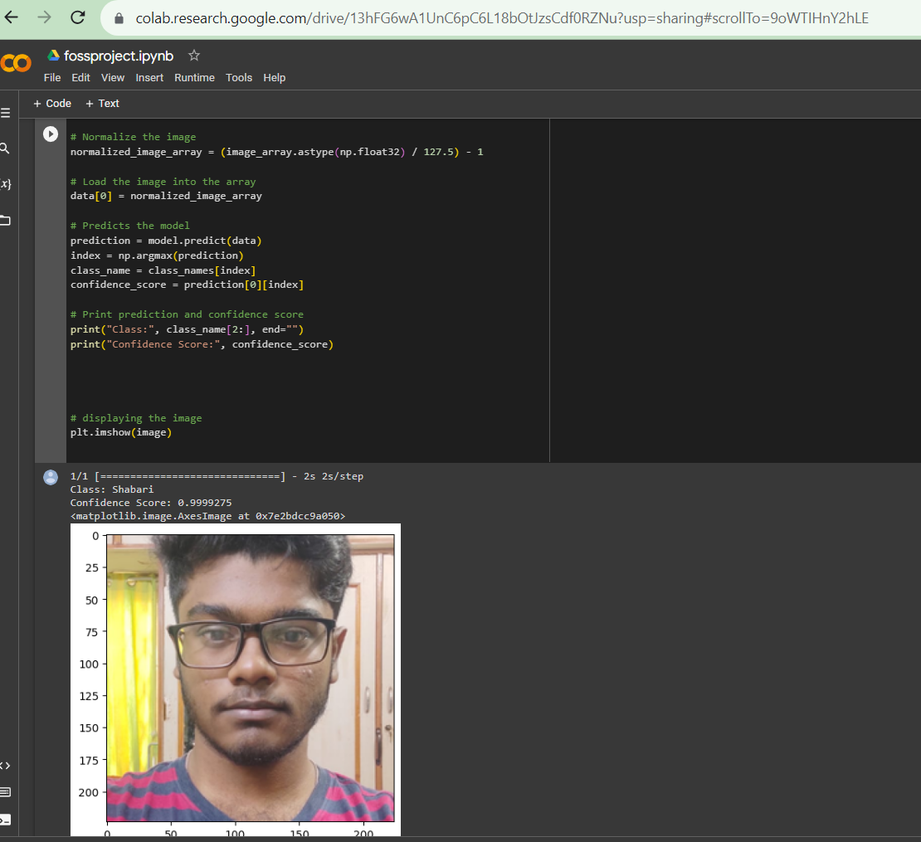
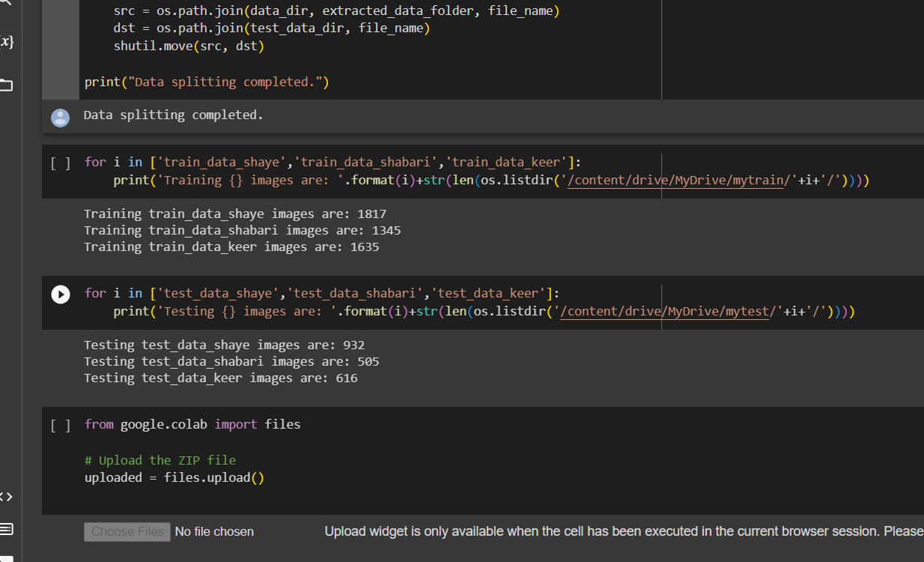
SCREENSHOTS

